Slide 1
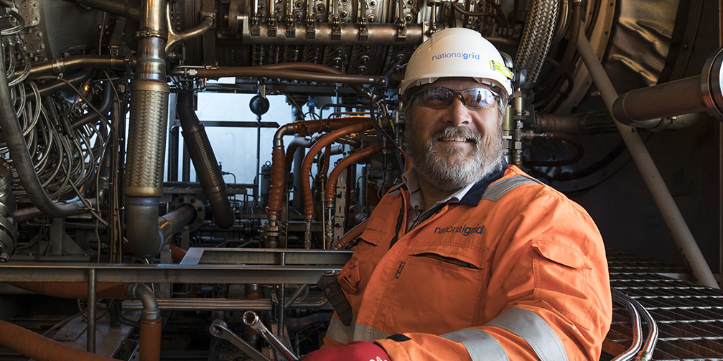
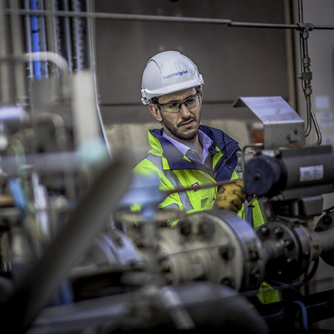

UNC Modification 0780S:
Amendment to Gas Quality NTS Entry Specification at the St Fergus SAGE System Entry Point
Workgroup Meeting 6th January 2022
Notes:
Further discussion with engineers since the December meeting about the potential impacts of a slug of high CO2 gas albeit in unlikely scenarios and engagement with the Proposer about how best to address those concerns

Slide 2
Potential NTS Impacts of Elevated CO₂ Content
  NTS Compressor Operability:
  Gas with a high CO₂ content results in a reduction in its CV
  If the rate of change in CV delivered to the NTS is significant, the operability of NTS compressors could be impacted
  Compressor Emissions Models:
  We use predictive emissions models to determine emissions from compressors on the NTS
  These models are set up based on the gas quality at the time, if gas quality on a day is materially different, the accuracy of these models could be impacted
Notes:
Operability
Could manifest as either trips or blow-outs of the units resulting in disruption to our ability to move the gas south and additional costs in callouts to restart the machines
Not possible to say definitively x MJ over y duration but when working with the proposer to identify what an elevated CO2 slug might mean in terms of CV change, the reduction in CV was a cause for some concern
Ultimately will only know when we run the gas through the units
Emissions
Concern is that lower CV fuel means lower flame temperature, less efficient combustion and the CO output increases
Potential consequence of continued repeat breaches to emissions levels detailed in the environmental permits could results in enforcement action from the Env Regulators

Slide 3
St Fergus Simplified Schematic
Incoming pipelines
SAGE
Shell
NSMP
NGG Terminal
Co-mingling of gases
Gas quality measurement
NTS feeders

Slide 4
Potential Flow Rates and CV Reduction
 | Ave flow 19/20 (mcmd) | Assumed flow over 1 hour period (mcm) | Assumed CV before CO₂ spike | Assumed CV during CO₂ spike
NSMP | 19.8 | 0.825 | 39* | 39*
SAGE | 15.35 | 0.640 | 41.56** | 40.07**
Shell | 18.14 | 0.756 | 39* | 39*
Flow weighted CV before CO₂ spike | 39.74
Flow weighted CV during CO₂ spike | 39.31
Indicative CV reduction in gas entering NTS at St Fergus | 0.43
* Illustrative CVs only
** Predicted SAGE CV, assuming an increase in CO₂ content from 2.5mol% to 6mol% and that Ancala take no other action in response to the CV reduction. In practice, Ancala may offset the CV reduction to some degree by changing the operation of the NGL extraction plant.
With average flows from all three St Fergus terminals and assuming constant CVs from NSMP and Shell, we do not expect a 0.43 MJ/m³ CV drop to cause any operational issues with NTS compressors.
If gas is flowing at St Fergus from the SAGE terminal only / if SAGE is the dominant flow, coincident with a CO₂ spike, the reduction in the CV of the gas exiting National Grid’s St Fergus terminal of 1.5 MJ/m³ could be sufficiently material to cause operational problems with NTS compressors further downstream.
Notes:
0.4 MJ = as we say in the WG report

Slide 5
Proposed Amendment to Solution
  Whilst we currently expect that a CV reduction from SAGE that would be sufficiently material to impact compressor operation is unlikely due to the co-mingling effect, we wish to include a provision to address this, should it occur
  We have engaged with the Proposer and agreed the following amendment to the Solution:
  “It is proposed that National Grid NTS shall be permitted to reduce the CO₂ limit at the St Fergus SAGE System Entry Point to a level between 4.0 mol% and 6.0 mol% with a 2 year notice period if:
    another UNC Modification(s) is raised that seeks to increase the CO₂ limit at another NTS System Entry Point that National Grid NTS would be unable to accommodate without incurring material cost; and/or
    in the reasonable opinion of National Grid NTS, the 6.0mol% CO₂ limit has had a material adverse impact on the operation of any NTS compressor and/or the determination of emissions from an NTS compressor”
Notes:
Balance – giving flexibility to Ancala but also protecting the network integrity to be able to transport gas for our other customers.
This text would require us to be able to show that it was the Ancala supply that had caused this, that it’s not a combination of factors including CVs from other terminals
If challenged – this is expectation of a slugs a few times a year – Ancala would have a contractual right to deliver up to 6% at any time over the next 5 years therefore we’re seeking this extra contractual protection

