Slide 1
Pastel Colour options

Slide 2
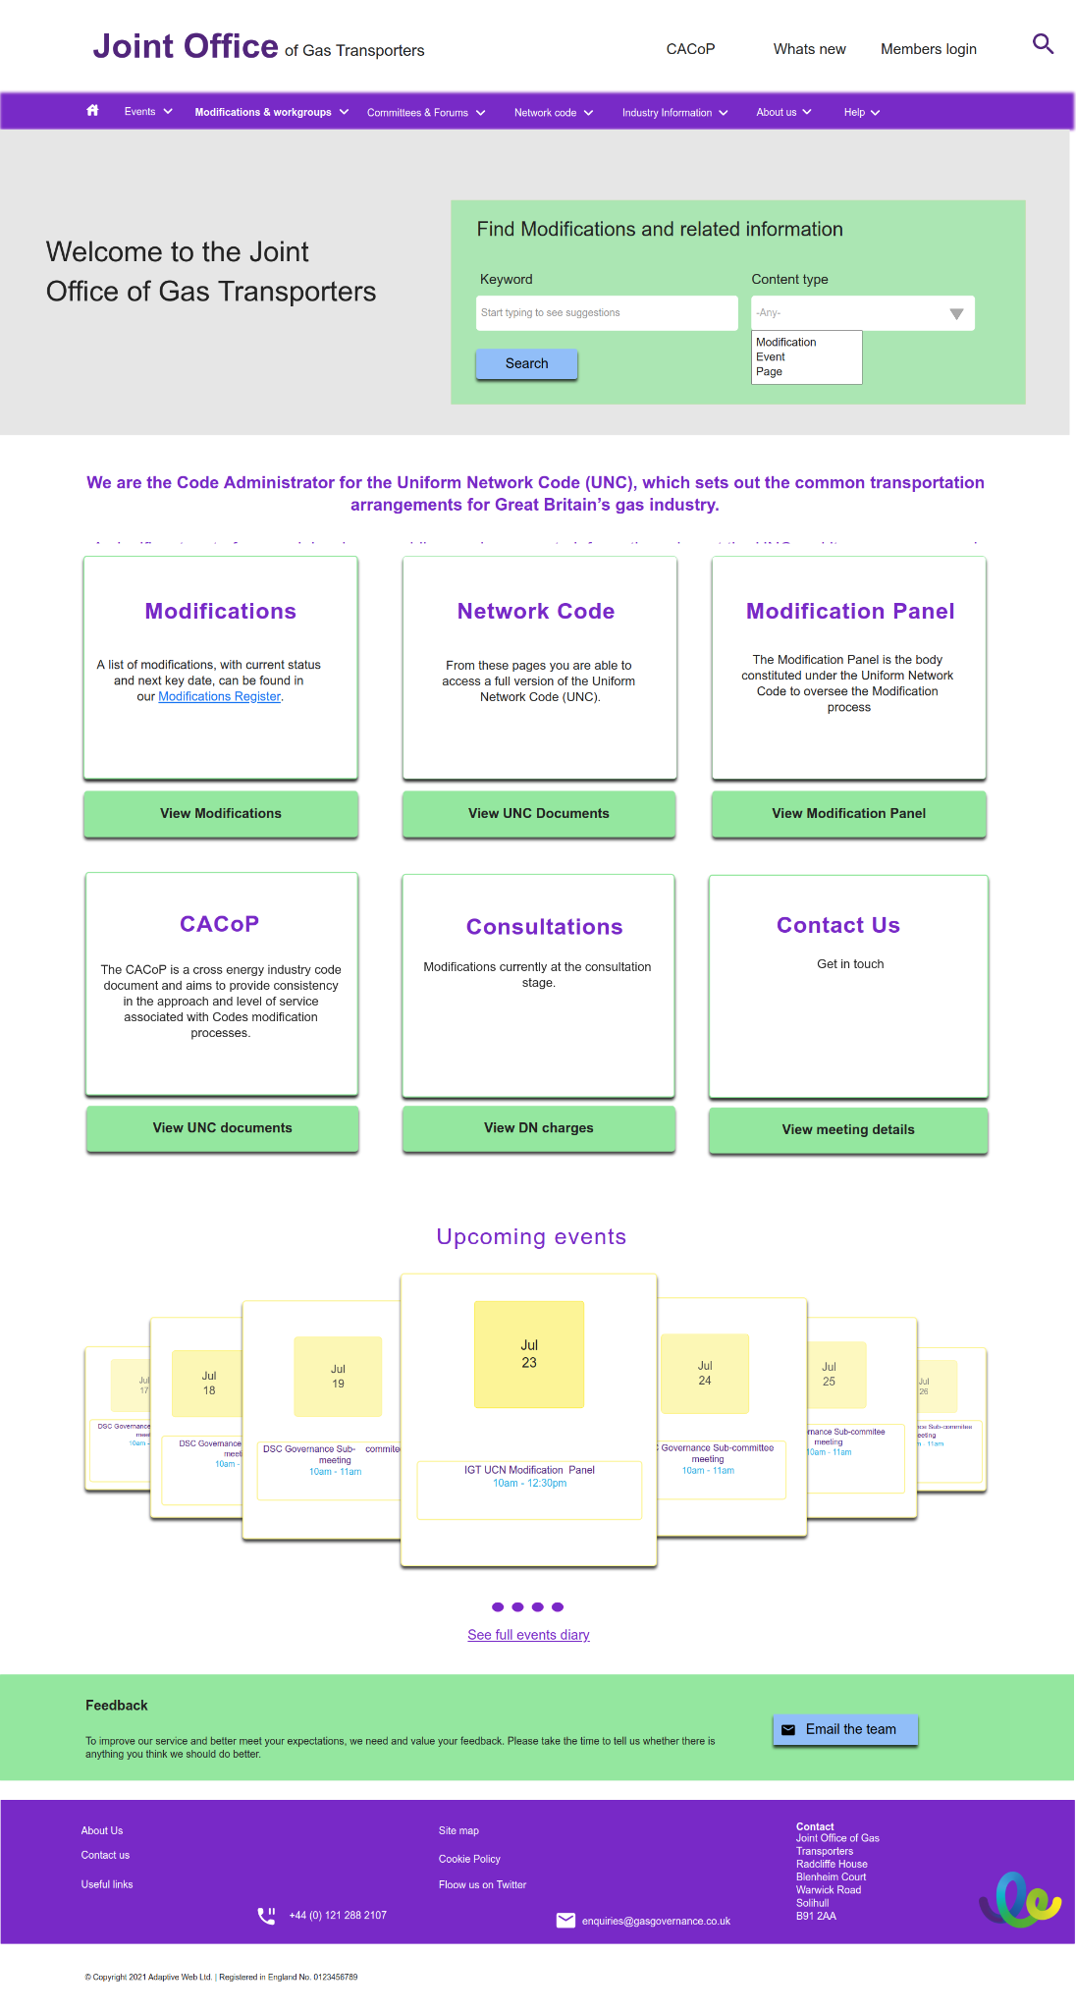
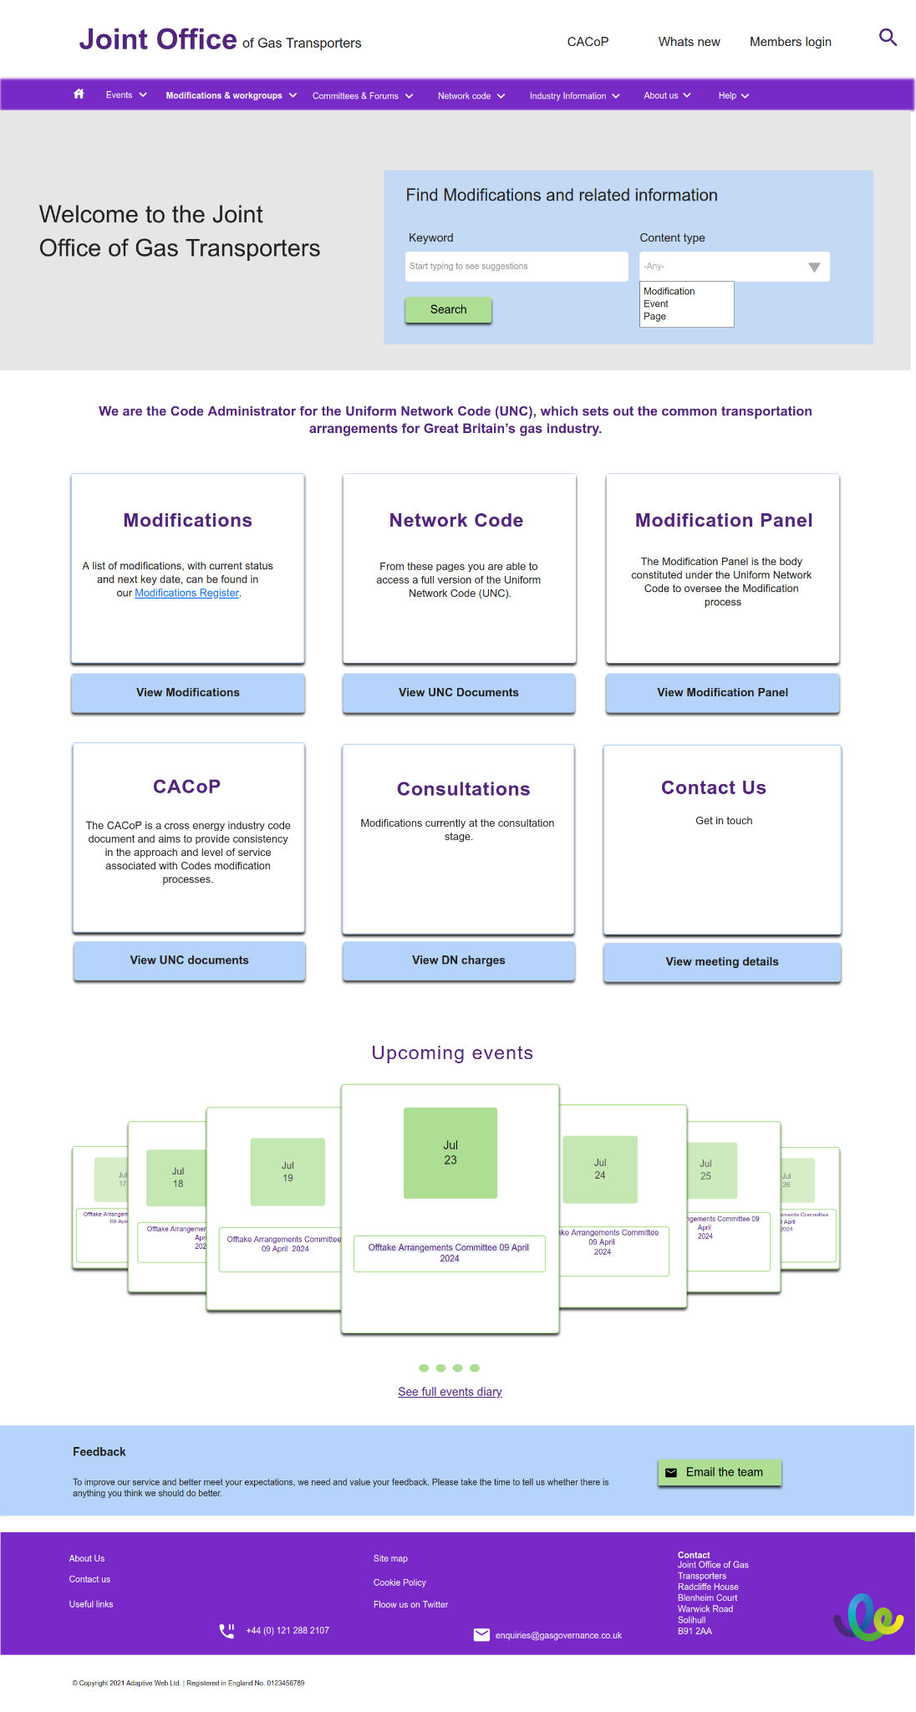
Current home page
Home page - option 1
Home page - option 2

Slide 3
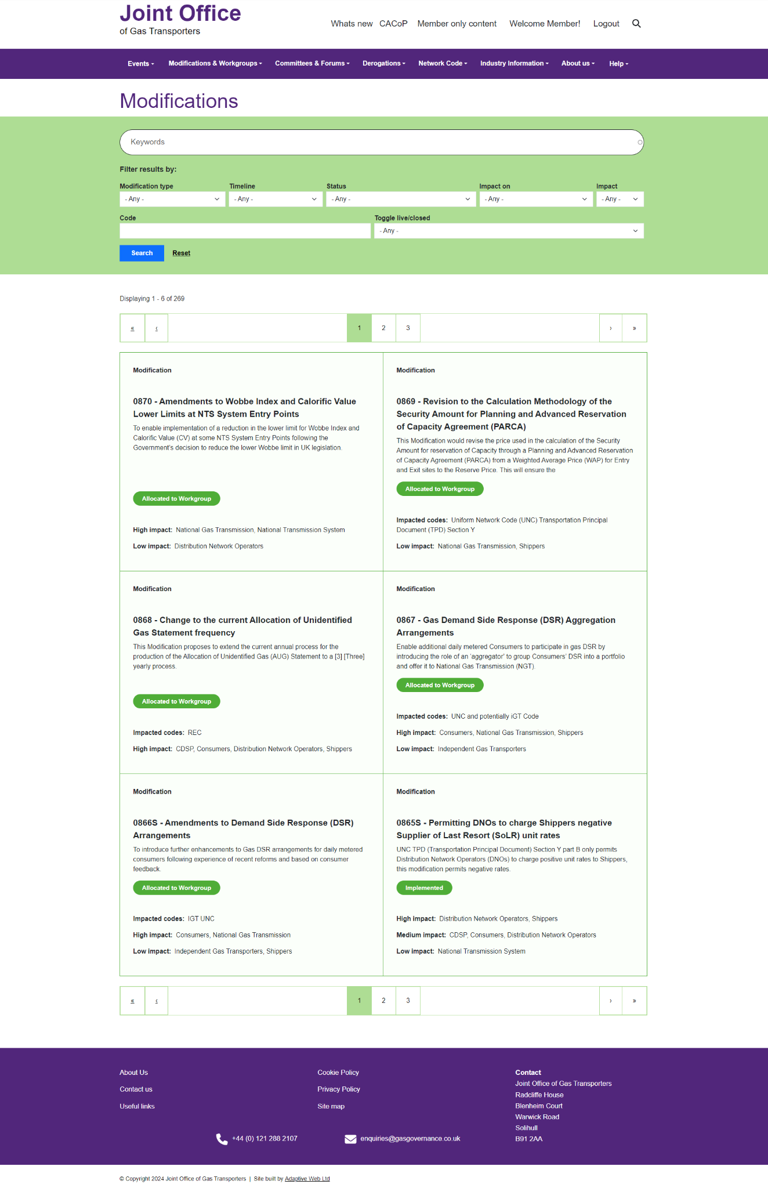
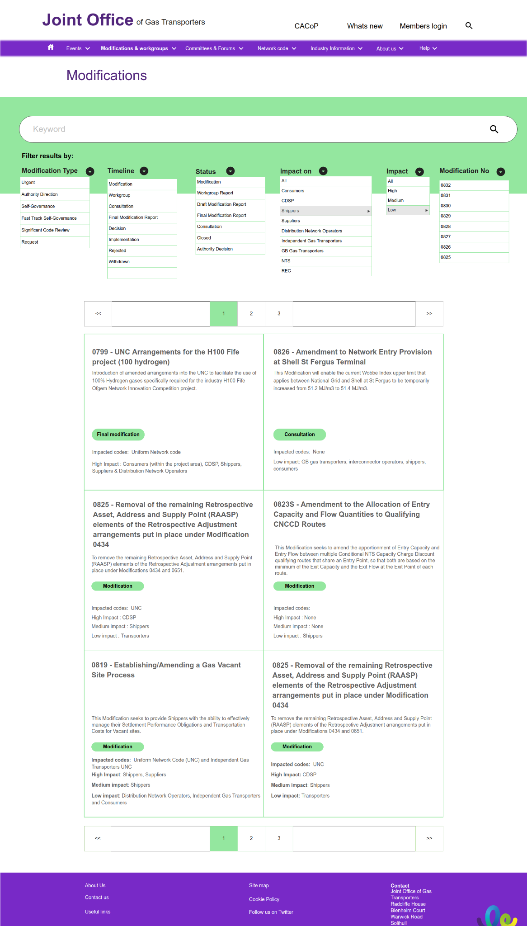
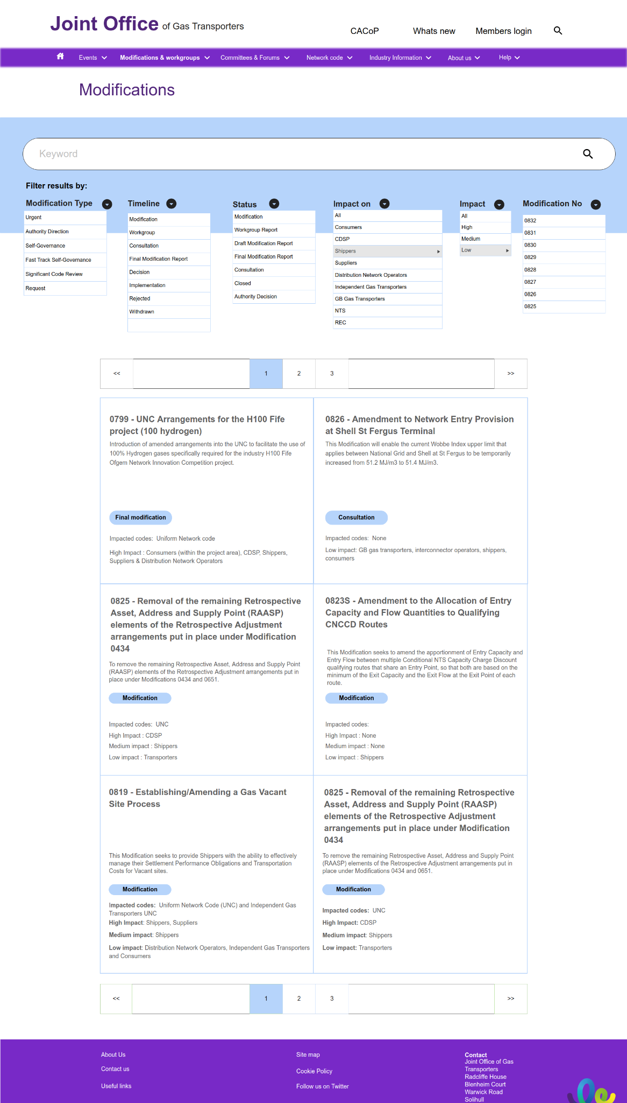
Modifications - current
Modifications - option 1
Modifications - option 2

Slide 4
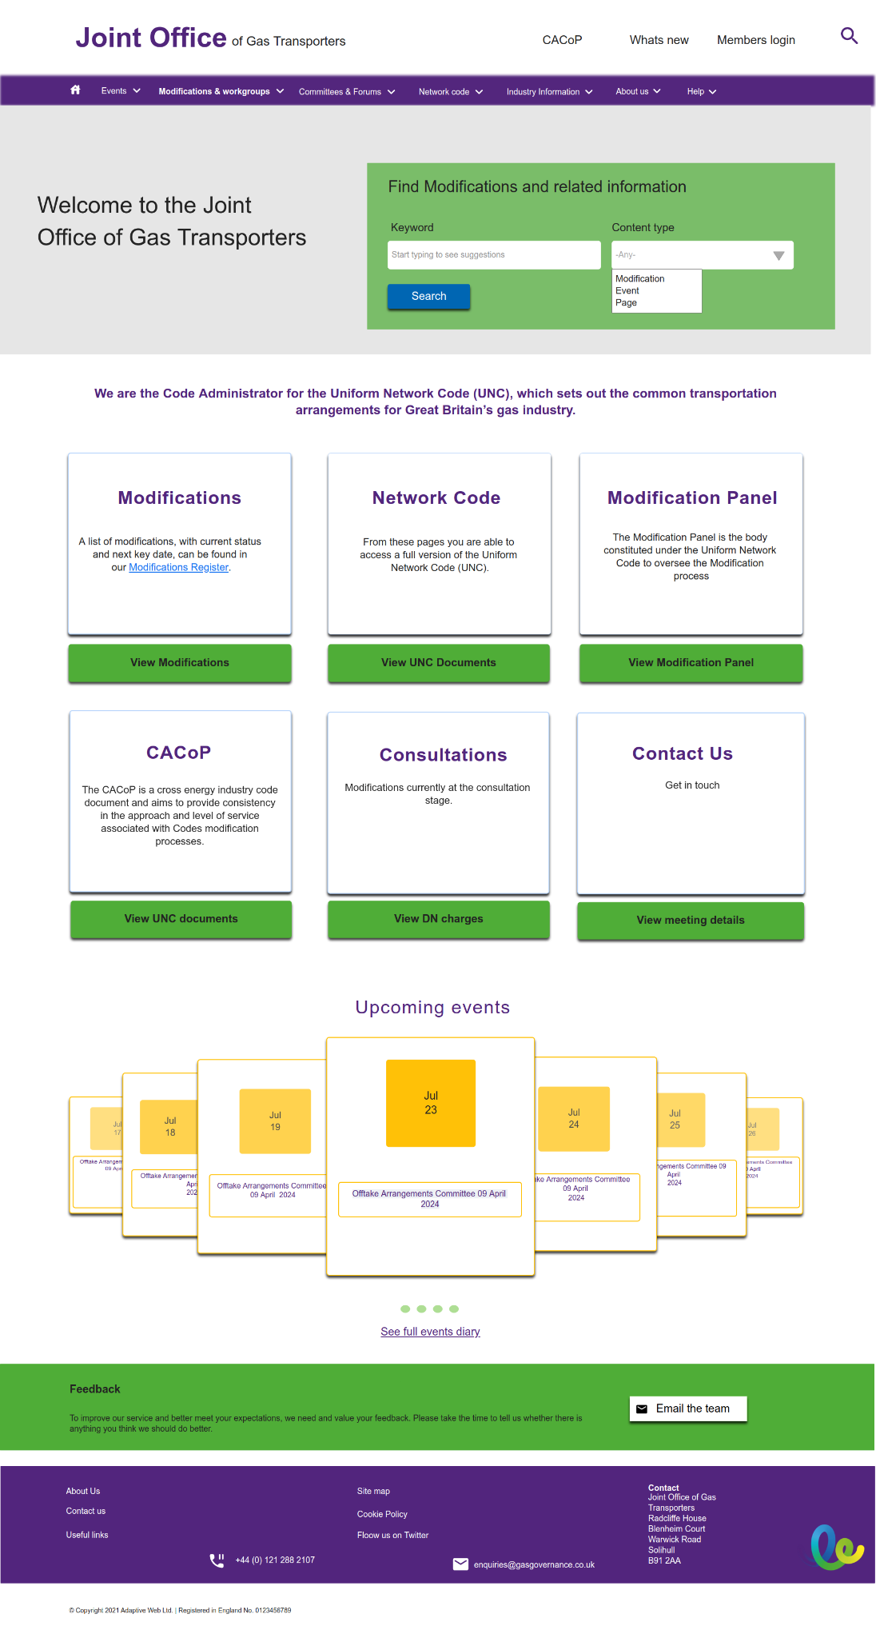
Option 3 - existing colours but with contracts issues addressed

