Slide 1
Amendment Invoice
XEC Update 12th November 2019
Dan Donovan

Slide 2
Summary Resolution Plan
Apr
May
Jun
Jul
Aug
Sept
Oct
Nov onwards
ASP / AML Mismatches
RCA activities
Operating within SLA
Exceptions
(LSPs)
Mobilise
Backlog Clearance
Operating within SLA
Exceptions
(SSPs)
Mobilise
Backlog Clearance
Operating within SLA
Exclusions
Mobilise
Backlog Clearance
Operating within SLA
Defects
Backlog Clearance
Operating within SLA
MI / Reporting
Deploy MI solution
Operating within SLA
Today

Slide 3
Supporting Information Mismatches
SLA
Mismatches are corrected ‘in cycle’ and associated defects are cleared in time for the second following cycle from detection. Correction of mismatches should be invisible to shippers. During transition to this any correction files issued are delivered within 3 business days of payment due date issue and meet communicated quality and format requirements on first delivery. There should be no unresolved causes to mismatches of more than 2 invoice cycles in age.
Target Date to operate within SLA
August 2019
Current SLA RAG Status (ASP only)
Green
RAG Justification
284 MPRNs out of the 310,321 LSPs that were billed incurred an ASP mismatch.. 100% of ASP and AML mismatch correction files issued to customers within SLA of PDD -3 days Testing of merged ASP and AML files underway.
 |  |  | ASP Mismatches |  | AML Mismatches
Billing Month | Billed Contracts | LSP Invoiced | Unique LSP MPRNs causing ASP mismatch | % of invoiced LSPs causing ASP mismatches | SSP Invoiced | Unique SSP MPRNs causing AML mismatch | % of invoiced SSP causing AML mismatches
Sep-18 | 8,444,158 | 227,514 | 413 | 0.18% | 8,216,644
Oct-18 | 8,523,582 | 244,986 | 241 | 0.10% | 8,278,596
Nov-18 | 9,243,302 | 290,019 | 534 | 0.18% | 8,953,283
Dec-18 | 8,375,975 | 378,856 | 1295 | 0.34% | 7,997,119
Jan-19 | 9,541,221 | 258,859 | 557 | 0.22% | 9,282,362
Feb-19 | 9,015,766 | 173,688 | 509 | 0.29% | 8,842,078
Mar-19 | 9,399,210 | 174,114 | 109 | 0.06% |  | 12,946
Apr-19 | 8,896,444 | 184,562 | 264 | 0.14% | 8,711,882 | 5,594 | 0.06%
May-19 | 9,648,261 | 168,267 | 118 | 0.07% | 9,479,994 | 7,493 | 0.08%
Jun-19 | 9,653,613 | 178,064 | 65 | 0.04% | 9,475,549 | 1,882,702 | 19.87%
Jul-19 | 9,895,118 | 180,536 | 92 | 0.05% | 9,714,582 | 250 | 0.0026%
Aug-19 | 9,977,884 | 230,802 | 254 | 0.11% | 9,747,082 | 208 | 0.0021%
Sep-19 | 11,133,817 | 310,321 | 284 | 0.09% | 10,823,496 | 2,701 | 0.02%
Mismatch instances remain relatively low however the number of MPRNs causing ASP mismatch has increased to 284 due to a manual error in technical exception resolution. Process reviewed and measures in place to prevent the error reoccurring.
Provision of a single ASP file, followed by a single AML file remains a delivery target for Nov-2019 Amendment invoice cycle.
100% AML offline correction files issued to customers ahead of payment due date
100 % of ASP offline correction files issued 3 days prior to PDD.

Slide 4
Exceptions
SLA
Known exceptions are corrected ‘in cycle’; new exceptions within the gift of Xoserve and its partners to correct are cleared in time for the second cycle from detection, as is any defect that caused the exception. Exception backlogs should be no more than 2 invoice cycles old.
Target Date to operate within SLA
August 2019
Current SLA RAG Status
Amber
RAG Justification
Exception backlog clearance continues to trend downwards. Despite reductions in backlog exceptions, the number of LSP and SSP reconciliations held off the AMS as a result of an exception remains high. Exceptions MI now shared with customers and analysis underway as to how best utilise this data for improved exception resolution.
What is an exception?
Business or Technical processing errors generated within our system, that cause reconciliations at individual sites, to be held back off the Amendment Invoice until resolved.
147,489 distinct MPRNs currently have unresolved exceptions within our systems (as of 7th Nov).
(Jun-19 = 166,903, Jul-19 = 241,115, Aug-19 = 442,074)
Customer MI outlining all reconciliations and their status (invoiced, in exception, in exclusion) has been shared with all customers.
Note for XEC: Team are analysing MI of age profile of withheld to ensure focus and RTG in place by end of November

Slide 5
Exclusions
SLA
Known exclusions are executed ‘in cycle’; new exclusions within the gift of Xoserve and its partners to correct are cleared in time for the second cycle from detection, as is the defect that caused the exclusion. Exclusion backlogs should be no more than 2 invoice cycles old. Correction of billed exclusions should be performed no later than 2 invoice cycles after detection.
Target Date to operate within SLA
July 2019
Current SLA RAG Status
RED
RAG Justification
c.20,000 distinct sites released from bill blocks over the last three months. Cataloguing of all scenario resolution steps to ensure accuracy remains a key focus Exclusions for a small number of unique contracts are missing the SLA
What is an exclusion?
Until permanent system fixes are deployed to address charge calculation errors, monthly profiling of new reconciliations received that relate to the scenario of the open defect is performed, with “bill blocks” applied to that MPRN to safeguard the accuracy of the amendment charge calculations by exclusion from the AMS.
8,503 distinct MPRNs for the September billing period currently have bill blocks placed upon them (as at 26/10/19)
(Jun-19 = 5,043, Jul-19 = 1,733, Aug-19 = 2,696*)
Customer MI outlining all reconciliations and their status (invoiced, in exception, in exclusion) has been shared with all customers
* Increase since August is due to a newly identified defect resulting in additional bill blocks being placed

Slide 6
Defects
SLA
Defects, including associated data fixes, within the gift of Xoserve and its partners to resolve should be cleared within 2 invoice cycles of being raised.
Target Date to operate within SLA
August 2019
Current SLA RAG Status
RED
RAG Justification
8 Amendment invoice impacting defects open as of 8th Nov-19. Defect 1333 to have a Change Request raised due to complexity and may require a design change 1 Defect did not meet the SLA: 1429 – additional scenarios added at a late stage of the defect process due to MOD700, then failed assurance twice 1 Defect will fail the November SLA: 1449 – Defect put on hold due to code clash with November Release Return to Green (RTG) plan in place for 15th Nov with forecast RTG in Jan 2020 for all Defects
8 ASP/AML related defects as of 8th Nov-19
(8 defects open at last month’s update)
Defects currently open awaiting fix deployment
Defect ID | Defect Title | Date Detected | Target Fix Date | SLA Resolution Date
1333 | DM REC financial mismatches in Amendment supporting file | 27/03/2019 | Requires CR | 31/08/2019
1429 | RGMA activity has performed both class 3 normal rec and Check to Check reconciliation. Should have triggered only Check to Check rec since DRE or AMR are registered. | 24/07/2019 | 15/11/2019 | 04/10/2019
1449 | RGMA activity received in a class 4 period post class change from class 2 to class 4 calculates incorrect volume. | 03/09/2019 | 06/12/2019 | 08/11/2019
1453 | SAP - ASP RCA May-19 | 11/09/2019 | 29/11/2019 | 06/12/2019
1458 | Issue with class 3 read upload process - Non-opening read is inserted between two reads through UBR process and next read has a TTZ of 1, volume is calculated incorrectly through UBR | 13/09/2019 | 06/12/2019 | 06/12/2019
1462 | SAP - differences between the total of the K90 lines in the ASP file and the K92 lines in the AML | 17/09/2019 | 22/11/2019 | 06/12/2019
1463 | Incorrect volume calculation for class 3 sites between class change date and first cyclic read received post class change to class 3 - Linked to Defect 1146 | 19/09/2019 | 22/11/2019 | 06/12/2019
1477 | Incorrect variance Energy created after NDM prime reconciliation and net off volume - energy being populated with 0 | 11/10/2019 | 13/12/2019 | 10/01/2020

Slide 7
MI / Reporting
SLA
All MPRN recs received are accounted for and valued; allocation across invoices, exceptions, exclusions and mismatches is shared at shipper level with individual shippers at the end of each invoice cycle Exceptions, Exclusions and mismatches are communicated within 2 business days following invoice receipt.
Target Date to operate within SLA
August 2019
Current SLA RAG Status
Green
RAG Justification
Reports shared with all customers and general and individual WebEx’s are ongoing
MI reports have now been shared with our customers
Ongoing WebEx’s are being held to discuss general questions our customers have with the reports.
Ongoing individual customer WebEx's to discuss what the MI means specifically to them

Slide 8
Summary Resolution One Pager
Mismatches | Exceptions | Exclusions | Defects | MI / Reporting
Mismatches are corrected ‘in cycle’ and associated defects are cleared in time for the second following cycle from detection. Correction of mismatches should be invisible to shippers. During transition to this any correction files issued are delivered within 3 business days of payment due date issue and meet communicated quality and format requirements on first delivery. There should be no unresolved causes to mismatches of more than 2 invoice cycles in age. | Known exceptions are corrected ‘in cycle’; new exceptions within the gift of Xoserve and its partners to correct are cleared in time for the second cycle from detection, as is any defect that caused the exception. Exception backlogs should be no more than 2 invoice cycles old. | Known exclusions are executed ‘in cycle’; new exclusions within the gift of Xoserve and its partners to correct are cleared in time for the second cycle from detection, as is the defect that caused the exclusion. Exclusion backlogs should be no more than 2 invoice cycles old. Correction of billed exclusions should be performed no later than 2 invoice cycles after detection. | Defects, including associated data fixes, within the gift of Xoserve and its partners to resolve should be cleared within 2 invoice cycles of being raised. | All MPRN recs received are accounted for and valued; allocation across invoices, exceptions, exclusions and mismatches is shared at shipper level with individual shippers at the end of each invoice cycle Exceptions, Exclusions and mismatches are communicated within 2 business days following invoice receipt.
Target Date to operate within SLA
September 2019 | August 2019 | July 2019 | August 2019 | August 2019
Current SLA RAG Status
Green | Amber | Red | Red | Green
RAG Justification
100% of ASP and AML correction files issued 3 days prior to PDD. Testing of merged ASP & AML files has commenced. Merged files scheduled to be available for Nov-19 billing period (issued 27th December). Merged file will be in line with ASP & AML file formats. Customer WebEx and individual customer calls scheduled to provide further details of merged files | Despite reductions in backlog exceptions, the number of LSP and SSP reconciliations held off the AMS as a result of an exception remains high. Glidepath for clearance of backlog and transition exceptions on track for Feb-20 (Glidepaths attached as an appendix) | c.20,000 distinct sites released from bill blocks over the last three months. Cataloguing all scenario resolution steps to ensure accuracy Increase since August is due to a newly identified defect resulting in additional bill blocks being placed | 8 Amendment invoice impacting defects open as of 8th Nov-19. Defect 1333 is now a CR due to complexity - may require a design change 1 Defect missed SLA: 1429 – additional scenarios added at a late stage due to MOD700, then failed assurance twice 1 Defect will fail the November SLA: 1449 – on hold due to code clash with November Release Return to Green (RTG) plan in place for 15th Nov with forecast RTG in Jan 2020 for all Defects | Reports now shared with all customers 2 business days after Amendment invoice issue date. Ongoing WebEx’s are being held to discuss general questions our customers have with the reports Ongoing individual customer WebEx's to discuss what the MI means specifically to them

Slide 9
Appendix
Back Log and Transition Exclusions and Exceptions

Slide 10
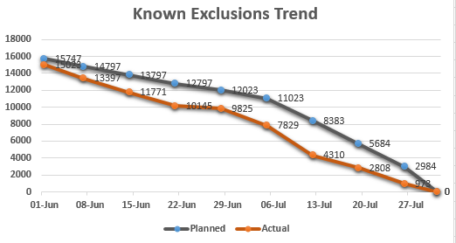
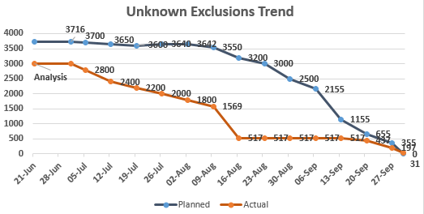
DO NOT MOVE THIS OR CHANGE THE SIZE
EXCLUSIONS - BACKLOG and TRANSITION – as at 1st Nov
Static
Improving
Declining
Urgent and decisive action required
Key
Monitor closely, some slippage
On track; no slippage or concerns
Overall Delivery Status |  | Current Workstream Health Metrics
Overall Status | Trend | Performance VS plan | Risk Profile | Resourcing | Readiness BAU | Benefits SLA contribution
Metrics
Summary :
Known Exclusions resolved by 31 July - 201
Unknown Exclusions – 3,685 out of 3,716 resolved, 31 Exclusions remaining. POC for scenario - 49 identified issue where incorrect variance energy is being calculated after NDM prime reconciliation. If correction is attempted for blocked MPRNs it will result in an AML-ASP mismatch and incorrect charge calculation. A defect has been raised to resolve the underlying issue.

Slide 11
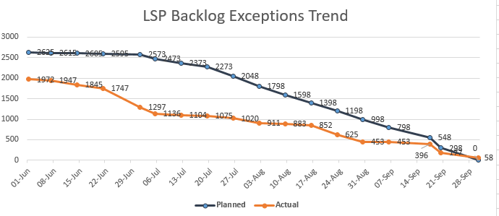
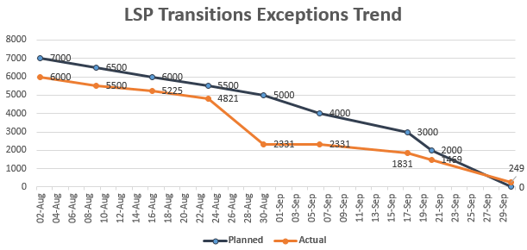
DO NOT MOVE THIS OR CHANGE THE SIZE
Static
Improving
Declining
Urgent and decisive action required
LSP EXCEPTIONS - BACKLOG AND TRANSITION – as at 1st Nov
Key
Monitor closely, some slippage
On track; no slippage or concerns
Overall Delivery Status |  | Current Workstream Health Metrics
Overall Status | Trend | Performance VS plan | Risk Profile | Resourcing | Readiness BAU | Benefits SLA contribution
Summary :
2,567 out of 2,625 Backlog exceptions resolved, 58 technical exceptions MPRNs remaining (additional 530 with a business dependency)
6,751 out of 7,000 Transition Exceptions resolved, 249 technical exceptions MPRNs remaining
Category of Exceptions with dependency on business are separately identified

Slide 12
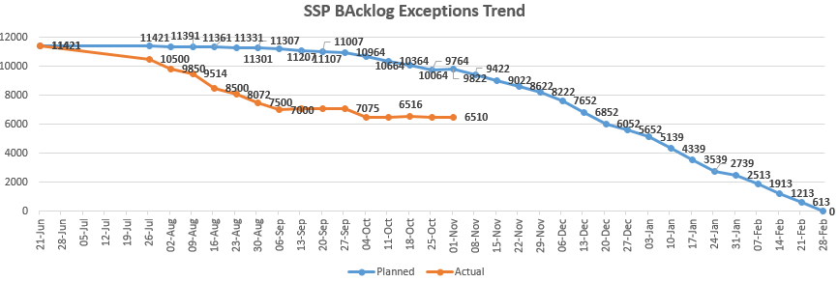
SSP Exceptions Backlog & Transition - SLA end Feb 2020 – as at 1st Nov
DO NOT MOVE THIS R CHANGE THE SIZE
Overall Delivery Status |  | Current Workstream Health Metrics
Overall Status | Trend | Performance VS plan | Risk Profile | Resourcing | Readiness BAU | Benefits SLA contribution
Rate of progress has slowed although still ahead of plan

