Slide 1
UIG Task Force Progress Report
Contract Management Committee 16/01/19

Slide 2
Background
Modification 0658: ‘CDSP to identify and develop improvements to LDZ settlement processes’ approved by Ofgem on 6th July 2018
Modification raised to authorise the CDSP to assign resources and incur costs related to a task force to investigate the causes and influencers of Unidentified Gas (UIG), with a target of reducing the volatility and scale of UIG and developing a robust predictive model for daily UIG for use by all parties.
BER for Change Reference Number XRN4695: ‘Investigating causes and contributors to levels and volatility of Unidentified Gas’ approved at ChMC on 11th July 2018
This Change Proposal added an additional service line into the DSC to enable Xoserve access to investigate, using resources and technology, causes and contributors to levels and volatility of Unidentified Gas. Xoserve is to provide monthly update reports and recommend proposals and subsequent changes or modifications for the industry.
The following slides provide:
Task force dashboard
POAP
Reporting on budget
Task force next steps

Slide 3
UIG Task Force: Dashboard
RAG
Time | G
Cost | G
Benefit | N/A
Overall RAG status:*
G
Progress since last month - key milestones | Workstream | Date | Status
Publication of Sprint 4 Executive Summary | IA & AA | 08/11 | C
Publication of Sprint 5 Executive Summary | IA & AA | 22/11 | C
Publication of Sprint 6 Executive Summary | IA & AA | 06/12 | C
Present documented Recommendations at ChMC December | IA & AA | 12/12 | C
Attend UIG working group | IA & AA | 07/12 | C
Priorities for next month – key milestones | Workstream | Date | Status
Publication of Findings & Recommendations ongoing | IA & AA | 07/12 | G
AUGE & PAFA – Task force present recommendations | IA & AA | 09/01/19 | G
Attend ChMC | IA & AA | 09/01/19 | G
Attend UIG working group | IA & AA | 18/01/19 | G
Run UIG Recommendation day under UIG work group banner | IA & AA | 28/01/19 | G

Slide 4
Plan on Page
C
Completed activity
Delivery team milestone
Advanced Analytics
DSC ChMC governance
I
 | September |  |  |  | October |  |  |  |  | November |  |  |  | December |  |  |  |  | January
 | 03/09 | 10/09 | 17/09 | 24/09 | 01/10 | 08/10 | 15/10 | 22/10 | 29/10 | 05/11 | 12/11 | 19/11 | 26/11 | 03/12 | 10/12 | 17/12 | 24/12 | 31/12 | 07/01 | 14/01 | 21/01 | 28/01
12/09 DSC ChMC
02/10 Extraordinary DSC ChMC
I
I
12/12 DSC ChMC
09/01 DSC ChMC
I
28/01 CUSTOMER RECOMMENDATION DAY
C
I
I
10/10 DSC ChMC
TBC Extraordinary DSC ChMC
07/11 DCS ChMC
I
I
03/09 Kick-off workshop with Vendor
27/08 Sprint 1 Exec Summary
12/10 Sprint 2 Exec Summary
C
C
C
C
C
25/10 Sprint 3 Exec Summary
Sprint 1
Sprint 2
08/11 Sprint 4 Exec Summary
22/11 Sprint 5 Exec Summary
05/12 Sprint 6 Exec Summary
Sprint 3
C
C
C
Sprint 4
Develop Findings template and Recommendation Packs
C
12/10 Publish Industry Data Tree
Sprint 5
Sprint 6
Investigation Analysis
Sprints 4-6 to continue at the same pace and follow directly after the initial sprints to maintain momentum and ensure existing team resources are fully utilised. A 14-day stand-down period applies at any time.
Develop and manage shipper action plans (linked to Investigation Log)
22/10 Action plan template developed
C
10/10 Agree appropriate forum for creation of shipper dashboards
Issue analysis and tracking (Investigation Tracker updated and published bi-weekly)

Slide 5
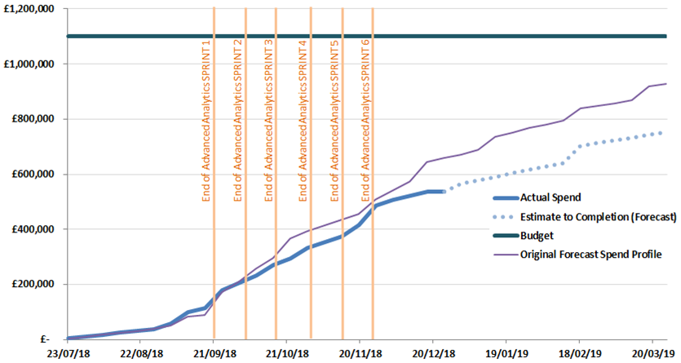
Overview Of Taskforce Funding

Slide 6
Taskforce Next Steps
28th January 2019 – Taskforce Recommendation Walkthrough/UIG Working Group
Taskforce present findings for each investigation line which has a set of options to support the reduction of UIG
Taskforce share Xoserve recommended options
Taskforce share their view of suggested priority per investigation line
Taskforce support customers with any questions
All Industry parties engage with discussion of options/suggest other options
Agree next steps per investigation line -
Which option(s) are being taken forward? (where agreement is reached)
Next set of actions required to move investigation line(s) forwards
Are there other options to be considered?
Who’s ownership/sponsorship
Which forum is it being taken to and when (if ready/appropriate)

