Slide 2
Background
MDD is currently managed within SPAA
A separate list is managed in UK Link system by Xoserve
There is a planned migration for the CDSP to maintain Market Participant Id MDD as part of Retail Energy Code (REC)
CDSP will be responsible for supplying:
Market Participant Identifiers
Maintaining the Shipper to Supplier Relationship Table
Maintaining the Transporter to Shipper Relationship Table
The first meeting of the Joint UNC / SPAA working group took place on 13th December
These obligations will be inserted into the UNC
Market Participant data responsibility is proposed to be inserted into UNC GT-D – CDSP and UK Link
Relationship management inserted into [TBC]

Slide 3
Preliminary Discussion points:
ElectraLink have conducted a review of the current process and highlighted some existing considerations
Xoserve has also conducted some very preliminary thinking
We are sharing some of the key points, in terms of thinking
Principles proposed:
Validation based on ‘fact based checks’ by CDSP
Removing barriers to entry
Simplifying the existing process
Making arrangements inclusive and fair, noting that certain Market Participants are not UNC Parties
Making the end to end process expedient
Making decision making robust and objective
Making provisions fit for future nature of industry

Slide 4
Preliminary Discussion points:
Currently individual MDD approvals are required by SPAA Change Board (CB).
The proposed plan is to use DSC Committee for MDD Market Participant governance.
Planned to use Change Pack process for representations from existing Market Participants for Add / Delete / Amend Participants requests
Challenge - how are all industry participants engaged?
Challenge – alignment to Electricity Releases?
Planned to define Guidance / Verification Criteria for Add Participants as these should be verifiable against data available – e.g. Licencing / Companies House
Challenge - how existing Market Participants can impact assess additions in a timely manner so as not to delay entry?
Currently only SPAA parties can raise MDD proposals
Planned that all parties controlled by MDD can raise requests (in some instances this might be a consequence of other processes (e.g. Shipper Accession to UNC)) using the existing templates
Currently CDSP may raise changes to SPAA MDD
Planned that this continues, and CDSP shall seek to demonstrate that impacted Market Participant has been consulted if possible

Slide 5
Preliminary Discussion points:
Currently unanimous agreement is necessary for MDD under SPAA
Proposing to use existing representation processes to obtain views and make views available to the DSC Committee
Currently a formal appeals process is provided for MDD under SPAA
Proposed to use standard DSC escalation to UNCC – it is not expected that this will be utilised, but DSC Committees are a sub group of UNCC

Slide 6
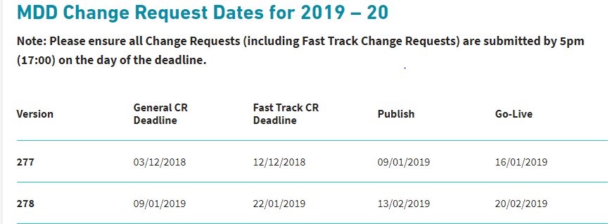
Views Requested:
For the Market Participant data, as this is proposed to go into UNC GT-D
DSC Committees provide the logical point for:
Oversight of the ‘fact based’ validation to be applied by the CDSP
‘Approval’ of the MDD Changes
Propose that the Contract Management Committee provides the logical point of approval
Please note - the Change Management Committee may highlight issues with existing systems – propose that there is an opportunity to comment
We need to assess the timelines but in principle:
Use the Change Management Change Pack (CP) to notify MDD proposals (it is likely that this will be issued on a different date from the current CP)
Provide any representation responses to Change Management Committee – particularly those that highlight technical issues
Seek ‘approval’ by Contract Management Committee (Please note this may be outside of the committee meeting)
Assess how this fits against electricity

Slide 7
Technical Requirements to consume MDD Market Participant Data – Under Consideration
What are the requirements by the industry for consuming the Market Participant Data
CDSP to CSS data provision is not explicitly defined
Frequency of issue? A regular release should be planned for amend / delete, but add participant may need to be more responsive.
Issue when changed? If so, format?
How are Users planning to consume this data?
Any format preferences?

