Slide 1
Shipper MI (Shipper Pack / PARR)– Update
2nd July 2019

Slide 2
Agenda
Update on the Shipper MI
Delivery Approach
Drop 1, Portfolio Data scope
Shipper Pack / PARR report Alignment
Approval of the approach by Change Management
Approval to change the Shipper Pack to align to the PARR report

Slide 3
Product Delivery & Structure - Agile Product Approach
An agile approach to product development is being piloted. Expected benefits include increased transparency, predictable delivery dates / costs, improved quality and focus on customer value. The term Pilot refers to how we are delivering (approach) rather than what we are delivering (What)..
This package has been selected based on an historical & current view of Customer Change, consultations with Customer Advocates, the requirements for Shipper Packs & PARR.
Build
Test
Develop
Analysis
Design
Build
Test
Build
Test
Shipper MI:
Portfolio
Shipper MI:
Shipper MI:
Pilot Drop 1:
(6 Weeks)
19th June –
31st July
Drop 2:
(6 Weeks)
7th August – 18th Sept
Drop 3:
(6 Weeks)
25th Sept – 6th Nov
Design
Develop
Design
Develop
Analysis
Product Backlog
Analysis
Product Backlog
Product Backlog
Product Backlog
Product Backlog
Product Backlog
Product Backlog
Product Backlog
Product Backlog
Product Backlog
Timelines for drop 2 & 3 are indicative
Future drops scope has not yet been defined
Customer Change
Report Review
Technical Capability
Agile Product Governance Framework Development
RAG depicts certainty of drop content

Slide 4
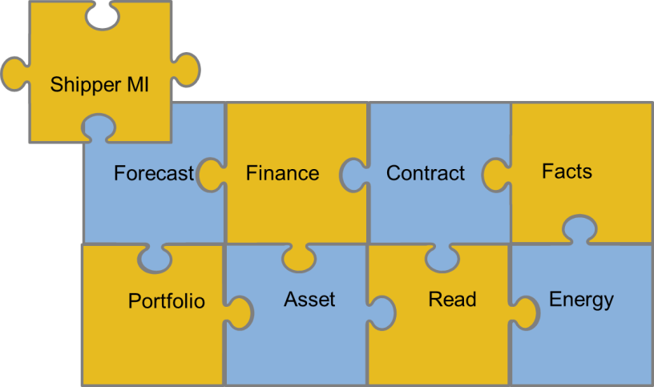
Product Delivery & Structure - Shipper MI – Portfolio Data Package (Pilot)
Portfolio - Data Package
What do we deliver:
An online portal for Shippers to access Portfolio data
Pre-defined set of dashboards
Establishes a framework for future agile deliveries (completion in Drop 2)
Delivers 29% of Xoserve data into the Data Discovery Platform (DDP)
Shippers Can:
Access MPRN Portfolio Data via an online portal
Gain insight from predefined dashboards to support in meeting industry obligations including:
Meter Status
Meter Point Status
No Reads (Class 4)
Blank MAM’s
Dead report
Portfolio AQ / SOQ
Portfolio count
Portfolio data availability increased from monthly to daily
Track portfolio performance via trend analysis of GT/IGT, Network, Class, etc.
Approach:
Shipper MI is an Agile pilot, drop 1 timelines will not move but scope may change
Anything not delivered will go back into the product backlog and considered for future releases

Slide 5
Existing Shipper Pack / PARR report alignment
Reflects 21st data
Shipper Pack table
PARR table
PARR report
Shipper Pack
Shipper Pack
Enduring data model
PARR report
Shipper Pack
As is
Tactical
Enduring solution
Shipper Pack table
PARR table
PARR topics & alignment
Shipper Pack topics
PARR report
Reflects 12th data
Currently the existing Shipper Pack and PARR are not aligned e.g. split by class / reflecting different dates etc.
Next Steps:
Approval of the approach at Change Management - July 2019
Approval from Change Management to align the reports – July 2019
Align the run times to 12th of the month
Topics which are in both reports will be aligned and pulled from one data source (please refer to the appendix for more details)
Include PARR topics into the existing Shipper Pack (consistency)
Drop 2 scope to be confirmed once Drop 1 pilot has been delivered

Slide 6
APPENDIX: Shipper Pack / PARR report alignment detail
PARR Topic | Shipper Performance Pack Topic | Shipper Pack report changes
No Meter Recorded in Supply Point (SP) register | Confirmed No Asset | Align this topic from the PARR table & split by class
No Meter Recorded in SP and dataflow | NA | Include PARR topic within the Shipper Pack & split by class
No Read for 1,2,3 or 4 | No Reads | Align the topic from the PARR table and show actual count.
Standard Correction Factors | Potentially Incorrect Correction Factors | PARR topic replaces Shipper Pack topic
Estimated & Check Reads | NA | Include PARR topic within the Shipper Pack (split by class)
Shipper Transfer Read Performance | NA | Include PARR topic within the Shipper Pack (split by class)
Read Performance | NA | Include PARR topic within the Shipper Pack (split by class)
Meter Read Validity Monitoring | NA | Include PARR topic within the Shipper Pack
AQ Correction by Reason Code | NA | Include PARR topic within the Shipper Pack
Replaced Meter Reads | NA | Include PARR topic within the Shipper Pack
**Topics marked in red can be supported with low level information for Shippers**

