Slide 1
KVI Relationship Management December 2019 for CoMC 15th January 2020
Dionne Thompson

Slide 2
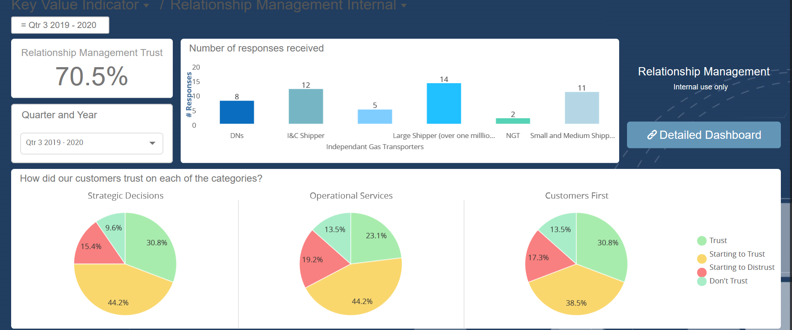
KVI Relationship Management - December 2019
75.0%
67.3%
69.2%
Down from:
90% Sept 19
88.9% Dec 18
Down from:
85% Sept 19
83.3% Dec 18
Down from:
85% Sept 19
83.3% Dec 18

Slide 3
12 Month View of KVI Relationship Results - All Customer Segments
December 2018*
March 2019*
June 2019
September 2019
December 2019
Overall Trust
85.2%
80.7%
84.8%
86.7%
70.5%
Strategic
88.9%
86.0%
81.9%
90%
75.0%
Operational
83.3%
70.0%
84.9%
85%
67.3%
Customer First
83.3%
86.0%
87.9%
85%
69.2%
Responses
18
50
33
20
52
Negative
Customer Change: customer understanding / engagement levels
Query resolution: time taken to resolve
Positive
Positive people behaviours
Relationship engagement
Service Improvements
Negative
Operational Issues: AQ/Invoicing/Transportation rates
Systems: CMS
Access to process guides/SME’s
Customer Change: customer understanding
Query resolution: Not kept informed/ time taken to resolve/ resolution quality
Positive
Positive people behaviours
Relationship engagement
Service Improvements
Negative
Systems: CMS / DES / Class 3 Migration
Query resolution: Not kept informed/ time taken to resolve/ resolution quality
Operational Issues: AQ/Invoicing
Change: Customer understanding /engagement levels
Access to process guides/SME’s
Positive
Positive people behaviours
Relationship engagement
Service Improvements
Customer Change Engagement
Negative
Customer change: evidencing cost of change
Comms: email volumes
Operational issues: lack of RCA/ AQ defects
Quality of reporting
Positive
Positive people behaviours
Relationship engagement
MOD700 Recommendations
Greater customer understanding
Negative
Quality of operational delivery
Management of defect fixes and understanding of customer impact
Recent incidents with no proactive engagement
Change governance process mistrust
Lack of ownership of issues and no lessons learnt
Lack of customer understanding and knowledge of services customers provide
Positive
Positive people behaviours
Relationship engagement
Training events
Sentiment - main themes

