Slide 1
Golden Principles of Customer Contact
Dionne Thompson
February 2020

Slide 2
Summary
Purpose
To help Xoserve people provide a quality customer experience; through a guide on how to manage incoming customer contacts
Outcomes
Improve customer experience - from process centric to customer centric
A structured view of what good looks like
Consistent customer contact approach across Xoserve
Timelines
Golden Principle Launch - week commencing 17th February
Embedding Golden Principles throughout Xoserve - Q1 2020/2021
Measures
Operational MI (resolution timeframes & quality of resolution)
Customer KVI Surveys

Slide 3
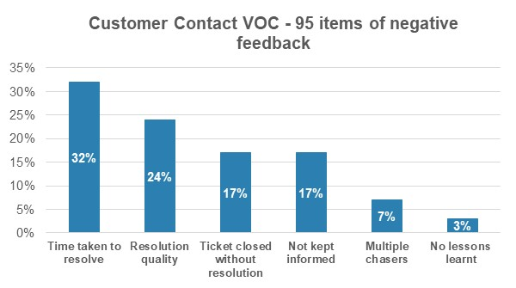
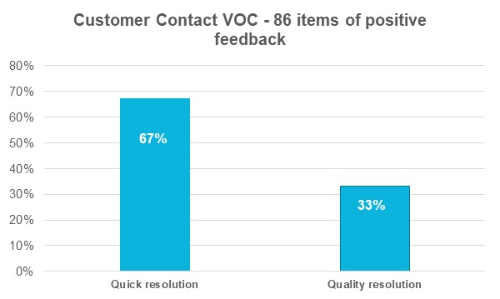
Voice Of Customer (VOC) captured over 12 months
VOC Sources:
Customer Service KVI
Relationship Management KVI
Change Management KVI
Service Desk Plus
Customer Engagement Meetings
Customer Verbatim
Customer Verbatim:
Didn't receive a response which meant I had to chase it before I received anything and even then it was quite a poor response.
Only one of my two questions had been answered
Very pleased with the response provided, especially considering multiple further questions/queries were raised above and beyond the original ticket query
Very detailed, prompt and efficient response
Took way too long to respond
Did not address the query and forwarded it on to a different team that did not contact.
I was given the correct information and the team has given me the proper support
Extremely quick reply and clarification received

Slide 4
