Slide 1
Amendment Invoice Update

Slide 2
Summary
133 unique MPRNs with mismatch affecting 13 customers
File merge activities ensured that mismatch data for the 133 MPRNs was included in the online ASP files to the relevant customers
AML files were delivered earlier following improvements to the file generation process.
Cataloguing of Exception resolution process steps significantly behind schedule. Plan was originally to be completed by end of Dec-19. Revised plan has a completion date of end of Feb-20
Defect resolution and deployment has been affected by re-prioritisation and focus on AQ issues and test environment availability issues causing bottle necks through-out the process. RTG forecast to be mid March

Slide 3
Summary Resolution Plan
Apr
May
Jun
Jul
Aug
Sept
Oct
Nov onwards
ASP / AML Mismatches
RCA activities
Operating within SLA
Exceptions (LSPs)
Mobilise
Backlog Clearance
Operating within SLA
Exceptions (SSPs)
Mobilise
Backlog Clearance
Operating within SLA
Exclusions
Mobilise
Backlog Clearance
Operating within SLA
Defects
Backlog Clearance
Operating within SLA
MI / Reporting
Deploy MI solution
Operating within SLA

Slide 4
Supporting Information Mismatches
SLA
Mismatches are corrected ‘in cycle’ and associated defects are cleared in time for the second following cycle from detection. Correction of mismatches should be invisible to shippers. During transition to this any correction files issued are delivered within 3 business days of payment due date issue and meet communicated quality and format requirements on first delivery. There should be no unresolved causes to mismatches of more than 2 invoice cycles in age.
Target Date to operate within SLA
August 2019
Current SLA RAG Status
Green
RAG Justification
113 MPRNs out of the 227,508 LSPs (0.06%) that were billed incurred an ASP mismatch. File merge activities ensured mismatch data was included in the online ASP file. AML process improvements ensured delivery of all customer files either on or before SLA (PPD minus 3 days)
 |  |  | ASP Mismatches |  | AML Mismatches
Billing Month | Billed Contracts | LSP Invoiced | Unique LSP MPRNs causing ASP mismatch | % of invoiced LSPs causing ASP mismatches | SSP Invoiced | Unique SSP MPRNs causing AML mismatch | % of invoiced SSP causing AML mismatches
Sep-18 | 8,444,158 | 227,514 | 413 | 0.18% | 8,216,644
Oct-18 | 8,523,582 | 244,986 | 241 | 0.10% | 8,278,596
Nov-18 | 9,243,302 | 290,019 | 534 | 0.18% | 8,953,283
Dec-18 | 8,375,975 | 378,856 | 1295 | 0.34% | 7,997,119
Jan-19 | 9,541,221 | 258,859 | 557 | 0.22% | 9,282,362
Feb-19 | 9,015,766 | 173,688 | 509 | 0.29% | 8,842,078
Mar-19 | 9,399,210 | 174,114 | 109 | 0.06% |  | 12,946
Apr-19 | 8,896,444 | 184,562 | 264 | 0.14% | 8,711,882 | 5,594 | 0.06%
May-19 | 9,648,261 | 168,267 | 118 | 0.07% | 9,479,994 | 7,493 | 0.08%
Jun-19 | 9,653,613 | 178,064 | 65 | 0.04% | 9,475,549 | 1,882,702 | 19.87%
Jul-19 | 9,895,118 | 180,536 | 92 | 0.05% | 9,714,582 | 250 | 0.00%
Aug-19 | 9,977,884 | 230,802 | 254 | 0.11% | 9,747,082 | 208 | 0.00%
Sep-19 | 11,133,817 | 310,321 | 284 | 0.09% | 10,823,496 | 2,701 | 0.02%
Oct-19 | 11,067,074 | 252,181 | 855 | 0.34% | 10,814,893 | 9,235 | 0.09%
Nov-19 | 10,746,544 | 235,402 | 110 | 0.05% | 10,511,142 | 585 | 0.01%
Dec-19 | 9,907,903 | 227,508 | 133 | 0.06% | 9,680,395 | 2019 | 0.02%
133 unique MPRNs with ASP mismatch but file merge activities ensured mismatch data was included in ASP file issue on the invoice issue date (27th Jan)
AML files were delivered earlier following improvements to the file generation process
100 % of ASP and AML files delivered on or before SLA date.

Slide 5
Exceptions
SLA
Known exceptions are corrected ‘in cycle’; new exceptions within the gift of Xoserve and its partners to correct are cleared in time for the second cycle from detection, as is any defect that caused the exception. Exception backlogs should be no more than 2 invoice cycles old.
Target Date to operate within SLA
August 2019
Current SLA RAG Status
AMBER
RAG Justification
All workable exceptions classified as Backlog and Transition exceptions have now been cleared. A number of exceptions BAU (raised between 1st August and current date) continue to miss the 2 month SLA Cataloguing of Exception resolution steps planned to be completed by end of Feb-20. This should improve the exception resolution process.
What is an exception?
Business or Technical processing errors generated within our system, that cause reconciliations at individual sites, to be held back off the Amendment Invoice until resolved.
161,024 distinct MPRNs currently have unresolved exceptions within our systems (as of 3rd Feb).
(Sep-19 =147,489, Oct-19 = 179,165, Nov-19 =124,152)
Customer MI outlining all reconciliations and their status (invoiced, in exception, in exclusion) has been shared with all customers.

Slide 6
Exclusions
SLA
Known exclusions are executed ‘in cycle’; new exclusions within the gift of Xoserve and its partners to correct are cleared in time for the second cycle from detection, as is the defect that caused the exclusion. Exclusion backlogs should be no more than 2 invoice cycles old. Correction of billed exclusions should be performed no later than 2 invoice cycles after detection.
Target Date to operate within SLA
July 2019
Current SLA RAG Status
GREEN
RAG Justification
Cataloguing of all scenario resolution steps to ensure accuracy remains a key focus
What is an exclusion?
Until permanent system fixes are deployed to address charge calculation errors, monthly profiling of new reconciliations received that relate to the scenario of the open defect is performed, with “bill blocks” applied to that MPRN to safeguard the accuracy of the amendment charge calculations by exclusion from the AMS.
2,104 distinct MPRNs for the December billing period currently have bill blocks placed upon them (as at 4th February). Bill blocks are placed on MPRNs where there are known issues that will result in incorrect charges being calculated.
(Sep-19 = 8,503, Oct-19 = 1,245, Nov-19 = 247)
Customer MI outlining all reconciliations and their status (invoiced, in exception, in exclusion) has been shared with all customers

Slide 7
Defects
SLA
Defects, including associated data fixes, within the gift of Xoserve and its partners to resolve should be cleared within 2 invoice cycles of being raised.
Target Date to operate within SLA
August 2019
Current SLA RAG Status
RED
RAG Justification
8 Amendment invoice impacting defects open as of 5th Feb-20. 2 Defects did not meet the January SLA: 1477 – Defect previously on hold due to November release. Delays in testing due to data. Testing was moved to pre-production environment to mitigate however UAT Team are still having issues and 3 further issues have been identified (New defects to be raised for the additional issues found) 1486 – Defect had to have the fix re-worked after UAT had been completed. Fix was reworked however UAT has not progressed as it is believed that this may need to be incorporated into the TTZ CR which has been raised. Discussions are underway on how to progress as it is linked to the CR around TTZ.
8 open ASP/AML related defects as of 5th February 2020
(9 defects open at last month’s update)
Defect ID | Defect Title | Date Detected | Target Fix Date | SLA Resolution Date
1333 | DM REC financial mismatches in Amendment supporting file | 27/03/2019 | TBC | 31/08/2019
1458 | Issue with class 3 read upload process - Non-opening read is inserted between two reads through UBR process and next read has a TTZ of 1, volume is calculated incorrectly through UBR process | 13/09/2019 | TBC | 06/12/2019
1477 | Incorrect variance Energy created after NDM prime reconciliation and net off volume and energy getting populated with 0 | 11/10/2019 | TBC | 10/01/2020
1486 | Incorrect volume calculated by NDM estimation process when RGMA is received between D+6 to D+10, if the new read is going round the clock | 23/10/2019 | TBC | 10/01/2020
1513 | MR15 exception not created when the variance volume was negative but total volumes was positive and vice versa | 17/12/2019 | 21/02/2020 | 06/03/2020
1520 | Incorrect Volume in SAP due to multiple check read processing on same day in incorrect sequence | 07/01/2020 | 28/02/2020 | 06/03/2020
1522 | ASP Merged File & Prime Meters | 09/01/2020 | 06/03/2020 | 06/03/2020
1526 | Incorrect volume sent to CMS from retrieve adjustment details service for class 4 sites | 10/01/2020 | 06/03/2020 | 03/04/2020
61159 | Class change from 4 to 1 not updating total check to check volume and energy against MRD | 24/01/2020 | 27/03/2020 | 03/04/2020

Slide 8
MI / Reporting
SLA
All MPRN recs received are accounted for and valued; allocation across invoices, exceptions, exclusions and mismatches is shared at shipper level with individual shippers at the end of each invoice cycle Exceptions, Exclusions and mismatches are communicated within 2 business days following invoice receipt.
Target Date to operate within SLA
August 2019
Current SLA RAG Status
Green
RAG Justification
Reports shared with all customers and general and individual WebEx’s are ongoing
MI reports continue to be shared with our customers 2 business days after Amendment invoice issue date.
Ongoing WebEx’s are being held to discuss general questions our customers have with the reports.
Ongoing individual customer WebEx's to discuss what the MI means specifically to them.

Slide 9
Summary Resolution One Pager
Mismatches | Exceptions | Exclusions | Defects | MI / Reporting
Mismatches are corrected ‘in cycle’ and associated defects are cleared in time for the second following cycle from detection. Correction of mismatches should be invisible to shippers. During transition to this any correction files issued are delivered within 3 business days of payment due date issue and meet communicated quality and format requirements on first delivery. There should be no unresolved causes to mismatches of more than 2 invoice cycles in age. | Known exceptions are corrected ‘in cycle’; new exceptions within the gift of Xoserve and its partners to correct are cleared in time for the second cycle from detection, as is any defect that caused the exception. Exception backlogs should be no more than 2 invoice cycles old. | Known exclusions are executed ‘in cycle’; new exclusions within the gift of Xoserve and its partners to correct are cleared in time for the second cycle from detection, as is the defect that caused the exclusion. Exclusion backlogs should be no more than 2 invoice cycles old. Correction of billed exclusions should be performed no later than 2 invoice cycles after detection. | Defects, including associated data fixes, within the gift of Xoserve and its partners to resolve should be cleared within 2 invoice cycles of being raised. | All MPRN recs received are accounted for and valued; allocation across invoices, exceptions, exclusions and mismatches is shared at shipper level with individual shippers at the end of each invoice cycle Exceptions, Exclusions and mismatches are communicated within 2 business days following invoice receipt.
Target Date to operate within SLA
September 2019 | August 2019 | July 2019 | August 2019 | August 2019
Current SLA RAG Status
GREEN | AMBER | GREEN | RED | GREEN
RAG Justification
133 MPRNs with ASP mismatch ASP file merge activities ensured the mismatch data for the 133 affected MPRNs were included in the ASP online file. This was the 1st month where no ASP correction/offline files were required to be issued to customers Improvements to the AML file generation ensured all AML files were delivered on or before the SLA date (PPD minus 3 days). | All workable exceptions classified as Backlog and Transition exceptions have now been cleared. A number of exceptions BAU (raised between 1st August and current date) continue to miss the 2 month SLA Cataloguing of Exception resolution steps planned to be completed by end of Feb-20. This should improve the exception resolution process. | c.25,000 distinct sites released from bill blocks over the last six months. | 8 Amendment invoice impacting defects open as of 5th Feb-20. 2 Defects did not meet the January SLA: 1477 – Defect previously on hold due to November release. Delays in testing due to data. 1486 – Defect had to have the fix re-worked after UAT had been completed. Fix was reworked however UAT has not progressed. | Reports shared with all customers 2 business days after Amendment invoice issue date. Ongoing WebEx’s are being held to discuss general questions our customers have with the reports Ongoing individual customer WebEx's to discuss what the MI means specifically to them

Slide 10
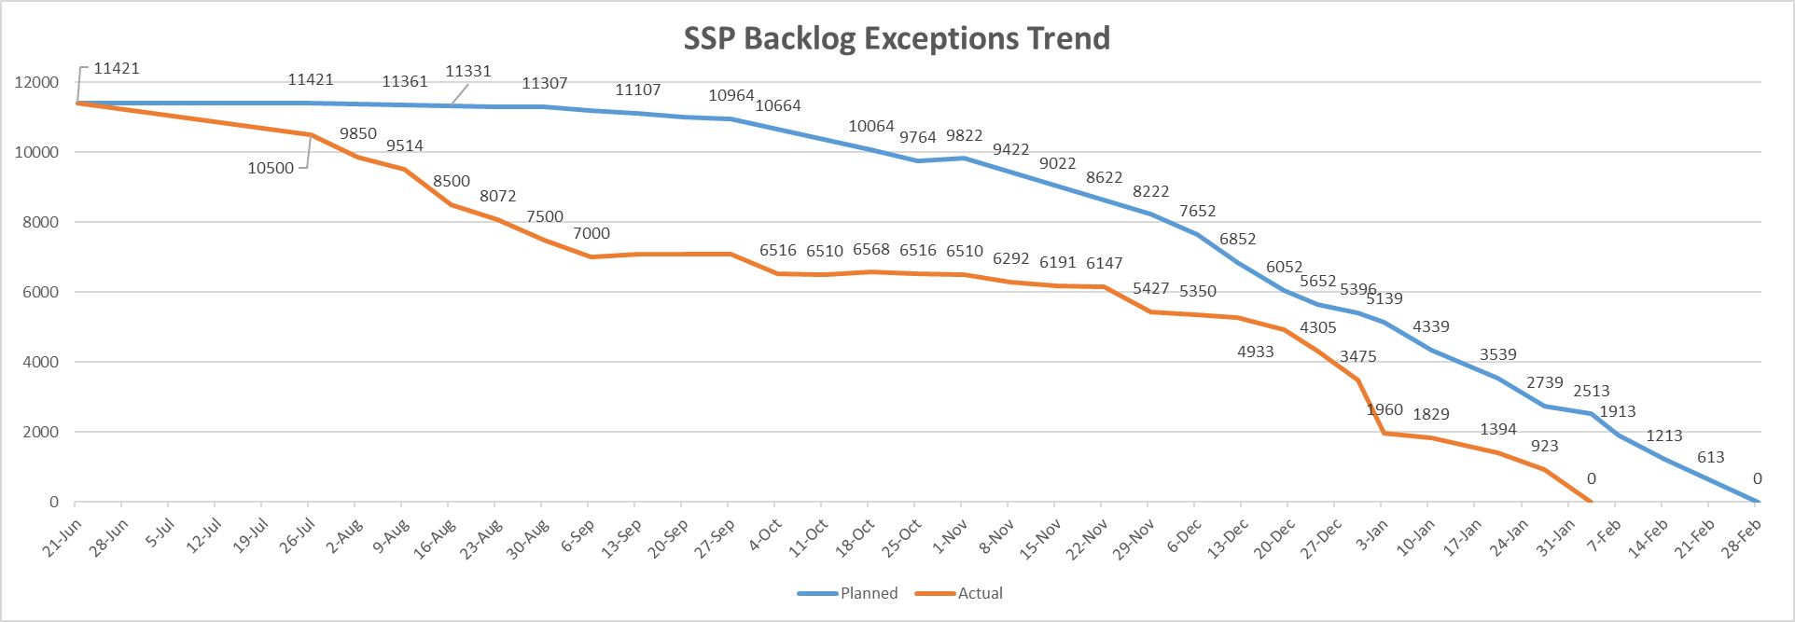
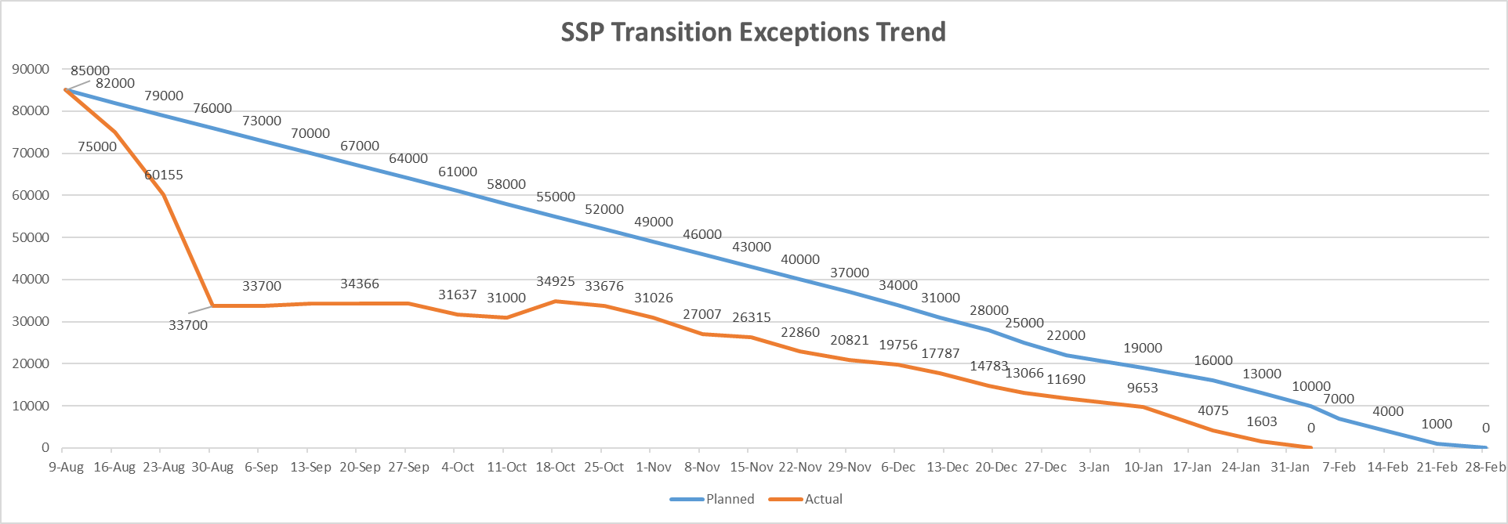
SSP Exceptions Backlog & Transitions - SLA FEB 2020

