Slide 1
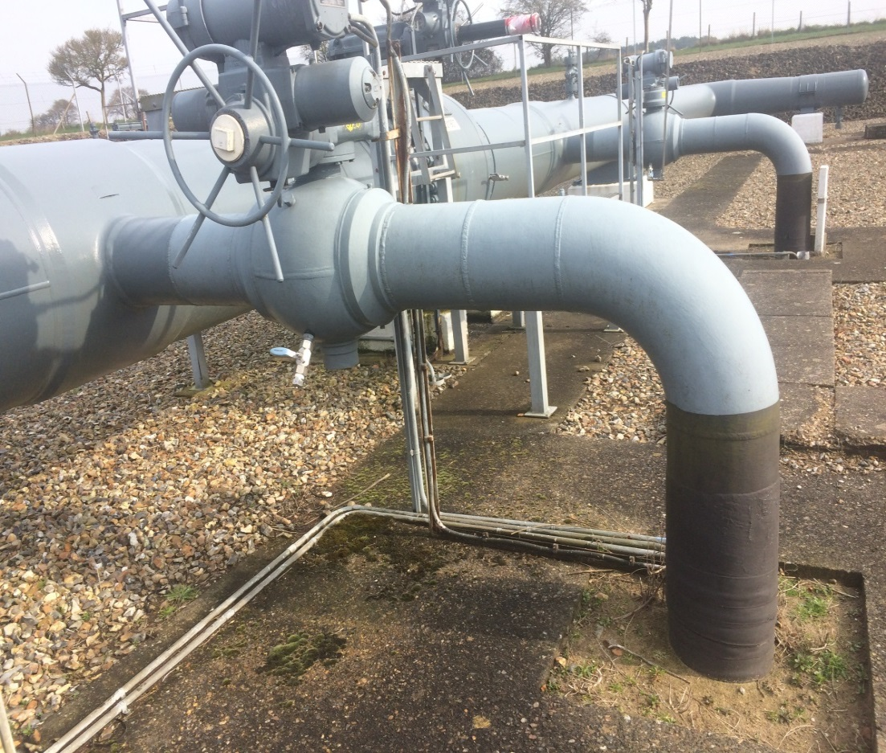
OAD Revisions to the SA Amendment Process
Darren Dunkley
July 2022

Slide 2
SA Amendment Process Overview
The current arrangements in OAD for updating Supplemental Agreements are unchanged since the framework was implemented back in 2005.
Through the review group 0646r it has been agreed that the existing arrangements do need to be updated. A summary of the key issues are:
OAD states the upstream party is responsible for processing any SA amendments;
The process does not cater for tri-party sites;
The process is very transactional and does not allow sufficient time for operators to review amendments made by another operator;
The process does not cater for certain commercial circumstances where the SA requires agreement prior to the assets become operational;
Arrangements are hard-wired into OAD making process revisions burdensome.

Slide 3
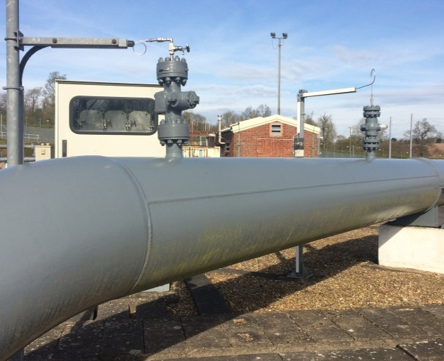
SA Amendment Process Business Rules
Before 0646r was closed, the operators agreed the principles for the necessary process revisions.
These were:
any party can initiate the update process and draft proposed changes;
any amendments provided must have updated the relevant current version of the supplemental agreement and track changes must have been applied;
for tri-partite sites, the initiating or amending party shall assess the impact on the services party and will seek approval for any modifications to the site services and site services assets;
The process revisions will apply for all site types (including shared sites);
The receiving party or parties may require further additional information from the amending party to support to acceptance of the revised supplemental. This is covered by OAD Section N3.3;
The revised process is to be agreed as a new Subsidiary Document.

Slide 4
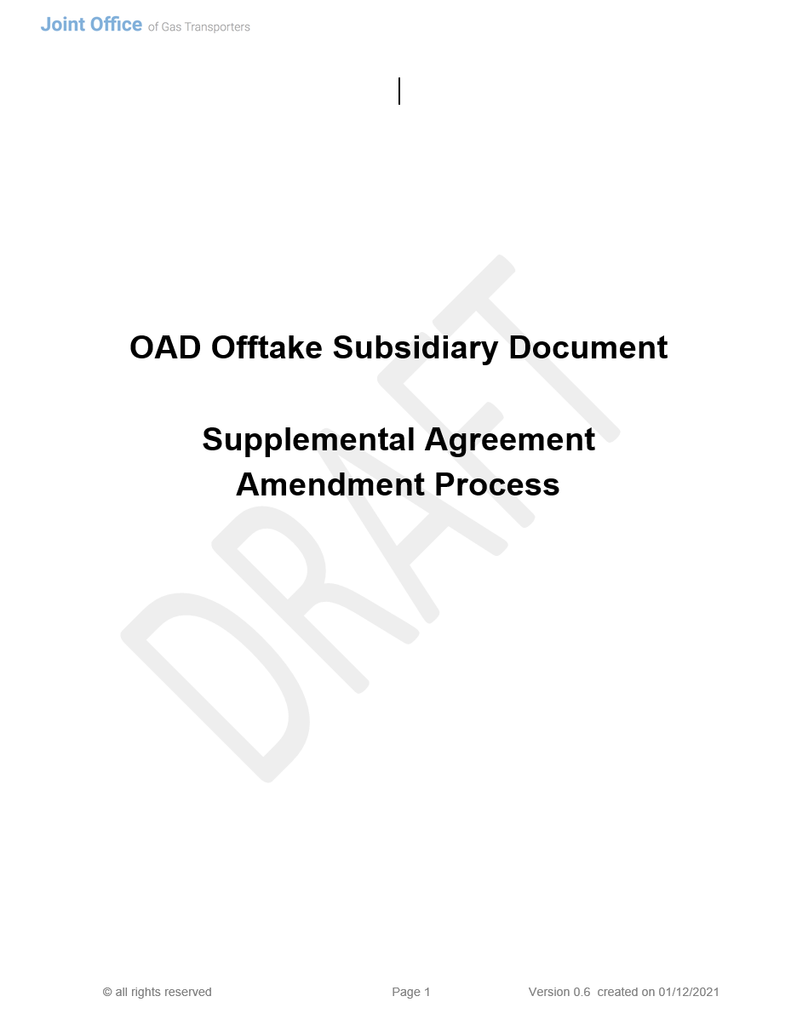
SA Amendment Process Current Status
The current drafting status is:
Proposal Document produced covering the principles for the necessary amendments - Proposal for Updating Supplemental Agreements v0.5.docx.
OAD Subsidiary Document has been produced. This includes:
The standard template has been used for developing Subsidiary document;
A two phase process approach covering ‘draft’ and ‘execution’ requirements;
Scope and Principles requirements refined to include the agreement reached for Metering Upgrades or amendments;
Procedural steps drafted.
Latest version is UNC OAD Subsidiary Document (Supplemental Agreement Update Process) v0.6.xdoc
The subsidiary document needs to be provisionally agreed so the next step of reviewing the legal text can commence.

Slide 5
SA Amendment Process Next Steps
As some time has elapsed since the closure of 0646r, operators are asked to re-review the drafted Subsidiary Document.
Considerations then need to take place concerning the approach for amending and providing the respective legal text.
The key amendments are anticipated as:
Overhaul of Section N3.3.1 with replacement text to ‘hook in’ new Subsidiary Document.
A new requirement is needed to terminate previous versions that have been superseded by a newly executed version (Section A, B or N?)
Minor amendments to Section N10 (Shared Sites) to also link to new Subsidiary Document.
Re-review Subsidiary Document
Agree Subsidiary Document
Agree Legal Text Approach
Produce MOD documentation
Deliver Legal Text / MOD Proposal

Slide 6
Feedback Dialogue, questions or concerns

