Slide 1
DSC Credit Committee Operational Update May 2022 Quarterly Meeting

Slide 2
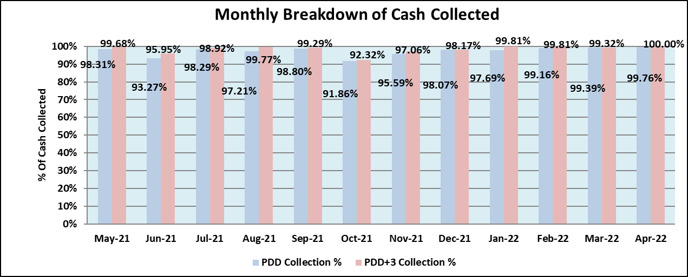
DSC Credit Committee Scorecard – Quarterly Meeting May 2022
Subject Areas | Areas to cover | Quarterly RAG
 | Percentage of Cash Collected by Payment Due Date Percentage of Cash Collected by Payment Due Date +3 | Dip in collection performance in February attributed to non-payment of DSC invoices from a group of users however settled at payment due date +3.
Cash Collection

Slide 3
Cash Collection
Month | Invoices Due for Collection | Payment Due Date | Payment Due Date +3
February | £9,212,083.67 | £9,134,851.91 | £9,194,157.72
March | £9,215,131.97 | £9,113,679.33 | £9,152,493.14
April | £9,186,755.12 | £9,164,291.41 | £9,186,558.62

Slide 4
Failure to Pay Notices Issued
Month | Failure to Pay Notices Issued | Value
February | 14 | £67,503.05
March | 9 | £54,967.62
April | 10 | £23,193.61

Slide 5
DSC Credit Committee Scorecard – Quarterly Meeting May 2022
Subject Areas | Areas to cover | Quarterly RAG
 | Invoicing Issues Late Paid Interest | No invoicing issues reported during this quarter. Total of in Late Paid Interest charges invoiced in February, March and April £4,846.67
Invoicing
 | Escalations to Committee | No escalations to committee during the last quarter.
Escalations
 | Focus Areas for next quarter Modifications Updates | Continue early engagement with customers leading up to payment due date. Increase communications with administrators in pursuit of debt left from failed users.
Outlook

Slide 6
Securities - Published Credit Ratings
Total Customers Supported with Credit Rating | Total Value of Credit Rating | Number of May Invoices | Value of May Invoices
361 – (91%) | £401,945,316.00 | 111 | £6,290,657.03
£1 - £500 |  |  |  |  | £5,800 - £10,000
Number of Customers | Total Security Cover | May Invoices | Value |  | Number of Customers | Total Security Cover | May Invoices | Value
42 | £7,950.00 | 5 | £310.90 |  | 6 | £53,800.00 | 4 | £468.49
£500 - £1,000 |  |  |  |  | £10,251 - £50,000
Number of Customers | Total Security Cover | May Invoices | Value |  | Number of Customers | Total Security Cover | May Invoices | Value
26 | £25,000.00 | 9 | £3,215.84 |  | 27 | £802,800.00 | 9 | £165,325.23
£1,250 - £5,000 |  |  |  |  | £70,000 - £10,000,000
Number of Customers | Total Security Cover | May Invoices | Value |  | Number of Customers | Total Security Cover | May Invoices | Value
39 | £107,200.00 | 10 | £24,384.19 |  | 221 | £400,948,566.00 | 74 | £6,096,952.38
A
Snapshot for May 2022
Action – 0201 – Positions monitored daily to mitigate any risk.

Slide 7
Securities - Other
Type of Security | Number of Customers | Percentage | Financial Value
Prepayment customers | 27 | 7% | Payment is made before service is provided
Secured with a Letter of Credit or Parent Company Guarantee | 8 | 1% | £230,591.00
Immediate Payment Terms | 1 | 1% | May invoice value £35,782.80.

