Slide 1
Request to use Close Brothers for Letter of Credit
Energy Balancing Credit Committee (“EBCC”) meeting Wednesday 25 May 2022 Provision of Letter of Credit by Close Brothers Limited
Our customer, is a gas and electricity supplier in the GB market. They provide National Grid with various balancing and frequency services via the Balancing Mechanism and other tendered ancillary services.
In order to provide these energy balancing activities, they are required to lodge adequate security with Xoserve Limited (“Xoserve”). We understand that the security is currently provided by way of a cash deposit.
Our customer have asked that Close Brothers Limited (“Close Brothers”) provide Xoserve with a Letter of Credit as an alternative to posting cash as collateral.
We have set out below Rule 2.2a of the Energy Balancing Credit Rules dated 11 October 2021 (the “Rules”) which comments on the conditions that should be met for a financial institution to provide a Letter of Credit:
Our interpretation of the Rules is that there is a requirement for a financial institution to have a long term credit rating from Moody’s of “not less than A3”. If the financial institution does not have a rating from Moody’s, the EBCC would consider the alternative “or such equivalent rating by Standard and Poor’s”. In summary, whilst there appears to be a preference for a credit rating from Moody’s there is no requirement in the Rules for the financial institution to have ratings from both Moody’s and S&P – if that were the case it might be that the “or” would be replaced with “and”.
Close Brothers have a Moody’s rating of Aa3 which we consider i) satisfies the requirements under 2.2a of the Rules and, ii) should enable Close Brothers to provide a Letter of Credit to our customer.
Whilst we appreciate that Xoserve’s current practice is to have ratings from both Moody’s and S&P, we do not think this is strictly in line with the Rules. Separately, Close Brothers have a credit rating from another ratings agency, Fitch which is A-, and we consider a credible alternative to S&P if there was a desire for two ratings.
We provide letters of credit to a number of customers and have not encountered any difficulties in relation to our credit worthiness. The standard approach is for a financial institution to have two ratings with only much larger institutions having three. Moody’s is the key player in the financial institution market (as the Rules appear to support) with Fitch also having a strong record in the sector.
We would be grateful if the Committee could consider our request outlined above. Should any further information be of assistance, we would be happy to make this available. In the meantime, we thank you the Committee for the opportunity to raise this matter at the meeting on 25 May 2022. .

Slide 2
Energy Balancing Committee Operational Update
May 2022 Quarterly Meeting

Slide 3
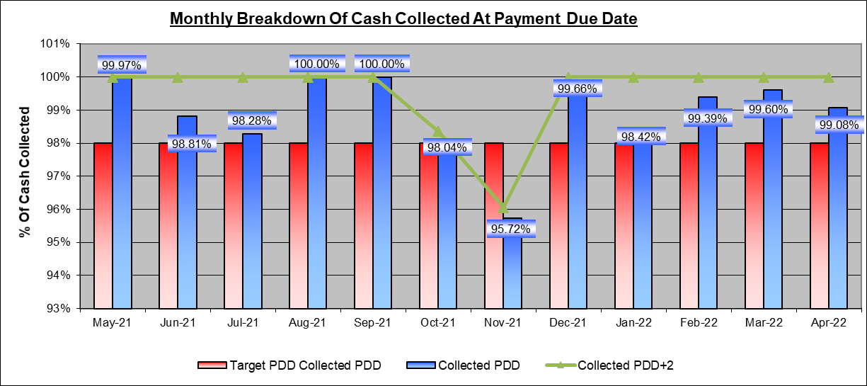
Energy Balancing Credit Committee Scorecard – Quarterly Meeting May 2022
Subject Areas | Areas to cover | Quarterly RAG
 | 98% average rolling 12 month period of Cash Collected by Payment Due Date 100% of Cash Collected by Payment Due Date +2 | Cash Collection targets achieved by Payment Due Date and Payment Due Date + Failure to Pay Notices Issued – 7 in February, 6 in March and 12 in April.
Cash Collection

Slide 4
Debit Invoice Values

Slide 5
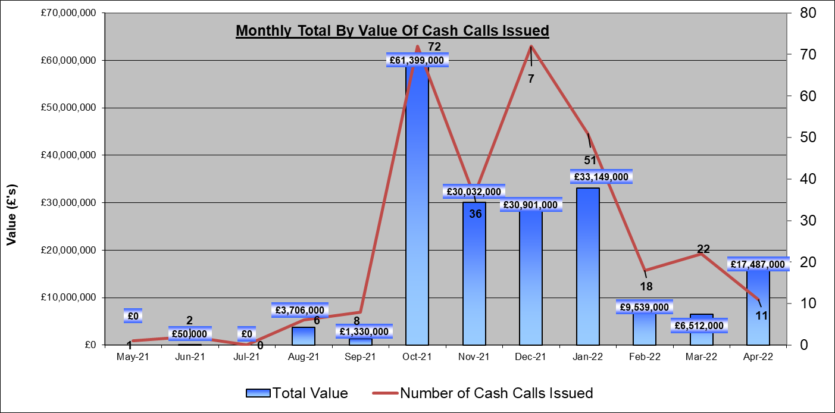
Energy Balancing Credit Committee Scorecard – Quarterly Meeting May 2022
Subject Areas | Areas to cover | Quarterly RAG
 | Security Renewals completed within month Further Security Requests Cash Calls Alerts Credit Agency Update | All securities renewed ahead of expiry. 0 bank downgrades or credit agency alerts requiring action. 18 Cash Calls issued February, 22 March and 11 in April.
Security

Slide 6
Energy Balancing Credit Committee Scorecard – Quarterly Meeting May 2022
Subject Areas | Areas to cover | Quarterly RAG
 | Invoicing Issues Late Paid Interest | Financial value for late paid charges accrued between February March and April nets to £1,884.12. To be issued in January 2023. No issues with invoicing recorded.
Invoicing
 | Focus Areas for next quarter Team Initiatives | Continuing to monitor financial institutions providing security and individual organisations through credit agencies. Continued engagement with customers to identify any issues at an early stage with no indications given. Continuing early communications with invoicing teams to obtain invoice data earlier to forecast any potential cash calls. Direct Debit implementation for Energy invoices.
Outlook

Slide 7
Energy Balancing Adjustments – May 2022 Update
National Grid have sent through a high volume of revised allocations for a number of Unique Sites resulting in a large energy difference.
Users Affected | Billing Month | Energy Difference (Kwh)
32 | Various | 468,908,920

Slide 8
Update Security Review
Review Users who have onboarded in the last 12 months and share a view of their securities.
- Review the 3 days non-deliverability.
- Carry out a more formal review of Users credit limit monthly and formally write to them asking them to increase their security.
- Look at tying the following into the EBCC rules:
review and formally request for security increase,
security assessment form.
the time period to resubmit new security long before termination.

Slide 9
EBCC Credit Rules Updates
Agreed in March 2022 to increase headroom for all banks currently used for Letter of Credits.
Update made in draft copy of rules.
Following review of current security process and also challenge to wording in current rules may need further changes.
Plan walk through of all updates with EBCC.

