Slide 1
Change Management Committee
7th September 2022

Slide 2
Section 2: DSC Change Budget & Horizon Planning

Slide 3
General Change Budget BP22 YTD

Slide 4
Forecasted Year End Spend (BP22)
The graph below illustrates the current forecast for financial year-end utilisation of the General Change investment budget (BP22) – this is subject to change should ChMC approve further change delivery
Committed spend has increased since last month by £0.8m - £0.1m adjusted following approvals in Aug-ChMC and £0.7m for illustrative / forecasting purposes (embedded spreadsheet provides XRN-level detail)
Change budget can be found here

Slide 5
General Change Budget BP23

Slide 6
Guiding Principles
General Change (formerly called ‘UNC Change’) is an investment budget that iteratively funds UNC, REC and DSC Changes, once approved for delivery in ChMC
Investment funds are only utilised from design phase onwards (via approval of EQRs) and also cover build/test/implement/PIS phases (via approval of BER) for major release or standalone change delivery
Regulation-driven change (UNC, REC) is prioritised as per DSC Change Management procedures 46768906.01 (gasgovernance.co.uk)
Unutilised funds rebated at end of financial year

Slide 7
How does this relate to previous investments?
The purpose and size of the investment has remained relatively static over the last three BPs as the graph below shows. The proposed budget in BP23 is £3.5m
Previous BPs included investment associated with Decarbonisation and Minor Release. From BP22 Decarbonisation was communicated as its own investment and Minor Release moved into Operate. Only elements that have been consistently applied across the period depicted in the graph below have been included for comparison)

Slide 8
Breakdown per element / constituency
The shape of the investment has evolved. As with BP22, there is a continued need to ring-fence funds to cover the following items:
Cost splits the same as in BP20 and BP21:
PAC funding split |  | 58.4% | 35.5% | 6.1% | 0%
All other categories funding split |  | 57.7% | 34.8% | 5.4% | 2%

Slide 9
Plan v investment
The graph below depicts how maximum utilisation of the budget could be committed through the course of the BP:

Slide 10
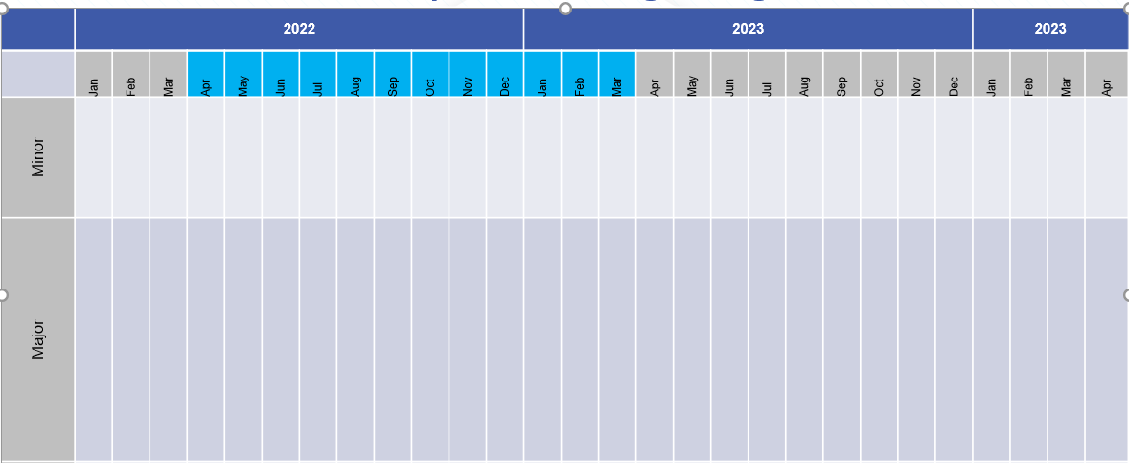
Release bandwidth & impacts to budget BP23
2023
2024
2025
2023
2024
2025
Standalone*
MiR 12
XRN
XRN
XRN
XRN
XRN
Costs for release or individual changes are considered committed upon approval of EQR/BER
Major release costs based on average cost of previous releases (£0.8m)
F23
Build/Test / Imp
PIS
Build/Test
PIS
J23
Build/Test /Imp
PIS
Major Release
F23
Build/Test
PIS
N23
Build/Test/Imp
PIS
J23
Build/Test
PIS
F24
Build/Test/Imp
PIS
Build/Test
N23
PIS
J24
Build/Test/Imp
PIS
Design
N24
Build/Test /Imp
PIS
Develop
Key
Activity
BP23 Delivery Budget Impact
Design
Design
Design
Development
Develop
No £ Impact to BP23
BP22 Delivery Budget Impact
* Standalone for illustration only

Slide 11
Timeline for next steps
BP23 Principles and approach doc published for customer consultation
2nd draft presented to ChMC incorporating feedback from customers
Discussion with constituency groups
New budget goes live
BP consultation iterative draft process
Jun-22
Jul-22
Aug-22
Sep-22
Jan-23
Apr-23
BP approval
Initial draft of General Change Budget presented to ChMC for feedback / discussion
Final draft presented to ChMC for recommendation into BP23
Key
Wider BP events
GC Budget Specific events

Slide 12
Change Pipeline

Slide 13
Change Delivery Pipeline August 22 – December 23
July 22
November 22
February 23
June 23
November 23
CSSC Go-Live
No Major Release
February 23 – Major Release
XRN4900, XRN4978, XRN4990, XRN4989, XRN4992, XRN5298
June 23 – Major Release
XRN5091, XRN5186, XRN5482
XRN5231
November 23 – Major Release
XRN4713
XRN5379
XRN5515
XRN5236
XRN5143
XRN5316
XRN5469
XRN5472
Delivery Key
= Firm Implementation Date – Funding Approved by ChMC and / or Non-Negotiable Industry Implementation Date in place
= Indicative Implementation Date – Changes are scoped for delivery – Funding and Implementation Date not yet approved by ChMC

Slide 14
Change Pipeline - Delivery Plan July 2022 – February 2023
XRN | Change Title | Proposer | Benefit / Impact | Funding | HLSO Max Cost | Target Implementation Date | Release Type | Firm / Indicative
5515 | HyDeploy Close Down | NGN | Shipper DN | DN DeCarb | N/A | 18th July 2022 | Standalone | Firm
5316 | Rejecting Pre LIS Replacement Reads | Xoserve | Shipper | N/A | N/A | September 22 | Standalone | Indicative
5469 | Increase Frequency of FSG Payments | Cadent | DN | DN | £63.3k | 3rd October 22 | Standalone | Firm
5231 | FWACV Service | SGN | DN NG | DN NG | £1.198m | 1st September 22 | Standalone | Firm
4713 | Actual read following estimated transfer read calculating AQ of 1 | Npower | Shipper | Shipper | £7k | October 2022 | Standalone | Indicative
5236 | Reporting Valid Confirmed Theft of Gas in central systems (Modification 0734) | Gazprom | Shipper | Shipper | Tbc | Oct / Nov 22 | CMS Rebuild Release 1 | Firm
4900 | Biomethane/Propane Reduction | SGN | Shipper DNO | DN Decarb | N/A | 25th February 23 | Major | Firm
4978 | Notification of Rolling AQ Value (following Transfer of Ownership between M-5 and M) | British Gas | Shipper | Shipper | £90.6k | 25th February 23 | Major | Firm
4990 | Transfer of Sites with Low Read Submission Performance from Class 2 and 3 into Class 4 (MOD0664) | SSE | Shipper | Shipper | £232k | 25th February 23 | Major | Firm
4989 | Residual AMT activities | CDSP | Shipper | Shipper | N/A | 25th February 23 | Major | Firm
4992 | XRN4992 - Modification 0687 Clarification of Supplier of Last Resort (SoLR) Cost Recovery Process | Total | Shipper DNO | Shipper DNO | £108.7k | 25th February 23 | Major | Firm
5298 | H100 Fife Project – Hydrogen Network Trial | SGN | Shipper DN | DN Decarb | N/A | 25th February 23 | Major | Firm
Slide produced 25th August 2022

Slide 15
Change Pipeline – Delivery Plan April 2023 – June 2023
XRN | Change Title | Proposer | Benefit / Impact | Funding | HLSO Max Cost | Target Implementation Date | Release Type | Firm / Indicative
5379 | Class 1 Read Service Procurement Exercise - MOD0710 (DM Sampling) | Xoserve | Shipper DN | Shipper | £150k | 1st April 23 | Standalone | Firm
5143 | Transfer of NDM sampling obligations from Cadent, WWU, and NGN to the CDSP | Cadent | DN | DN WWU, Cadent, NGN only | N/A | 1st April 23 | Standalone | Firm
5472 | Creation of a UK Link API to consume daily weather data for Demand Estimation | CDSP | Shipper DN | Shipper DN | Tbc | 1st April 23 | Standalone | Firm
5091 | Deferral of creation of Class change reads at transfer of ownership | EDF | Shipper | Shipper | £200k | June 23 | Major | Indicative
5186 | MOD0701 - Aligning Capacity booking under the UNC and arrangements set out in relevant NEXAs | NGN | Shipper DN | Shipper DN | £200k | June 23 | Major | Indicative
5482 | Replacement of reads associated to a meter asset technical details change or update (RGMA) | Scottish Power | Shipper | Shipper | Tbc | June 23 | Major | Indicative
Slide produced 25th August 2022

Slide 16
Change Backlog Details
XRN | Change Title | Proposer | Benefit / Impact | Funding | HLSO Max Cost | Target Implementation Date | Release Type | Firm / Indicative
4914 | Mod0651 – Retrospective Data Update Provisions | Cadent | Shipper | Tbc | £1.8m – £2.4m | Tbc | Major | N/A
5144 | Enabling Re-assignment of Supplier Short Codes to Implement Supplier of Last Resort Directions | Xoserve | Shipper DN IGT | Tbc | Tbc | Tbc | Tbc | N/A
5187 | MOD0696 - Addressing inequities between Capacity booking under the UNC and arrangements set out in relevant NExAs | Gazprom | Shipper DN | Shipper DN | Tbc | Tbc | Tbc | N/A
5286 | Clarification Change to the AQ amendment process to be applied retrospectively (MO0746) | CDSP | Shipper DN | Shipper | Tbc | Tbc | Tbc | N/A
5345 | Deferral of creation of Class change reads for DM to NDM and NDM to DM sites at Transfer | CDSP | Xoserve | Shipper | Tbc | Tbc | Tbc | N/A
5453 | GSOS 2, 3 & 13 Payment Automation | SGN | Shipper DN | DN | Tbc | Tbc | Tbc | N/A
5454 | SoLR Reporting Suite | EDF | Shipper | Shipper | Tbc | Tbc | Tbc | N/A
5471 | DSC Core Customer Access to Data | CDSP | Shipper DN IGT | IGT Shipper DN | Tbc | Tbc | Tbc | N/A
5473 | Meter Asset Details Proactive Management Service | CDSP | Shipper | Shipper | Tbc | Tbc | Tbc | N/A
5517 | Hydrogen Checker Website | Cadent | Shipper DN | DN | Tbc | Tbc | Tbc | N/A
Slide produced 25th August 2022

Slide 17
Change Backlog Details - Continued
XRN | Change Title | Proposer | Benefit / Impact | Funding | HLSO Max Cost | Target Implementation Date | Release Type | Firm / Indicative
5529 | UNC Derogation Process – Mod 0800 | NGN | DN IGT Shipper NGT | DN Decarb | Tbc | Tbc | Tbc | N/A
5531 | Hydrogen Village Trial | SGN | DN IGT Shipper NGT | DN Decarb | Tbc | Tbc | Tbc | N/A
5532 | Hydrogen Town Trial | WWU | DN IGT Shipper NGT | DN Decarb | Tbc | Tbc | Tbc | N/A
5535 | Processing of CSS Switch Requests Received in ‘Time Period 5’ | Xoserve | DN IGT Shipper NGT | Shipper | Tbc | Tbc | Tbc | N/A
5541 | Amendments to the UIG Additional National Data Reporting | Scottish Power | Shipper | Shipper | Tbc | Tbc | Tbc | N/A
5545 | Hydrogen Trial Visualisation Dashboard | Northern Gas | DN IGT NGT Shipper | DN Decarb | Tbc | Tbc | Tbc | N/A
5546 | Resolution of Address Interactions between DCC and CDSP | Xoserve | DN IGT Shipper | Shipper | Tbc | Tbc | Tbc | N/A
5547 | Updating the Comprehensive Invoice Master List and INV template | Eon | Shipper DN | Shipper | Tbc | February 2023 | Tbc | Indicative
Slide produced 25th August 2022

Slide 18
Section 3: Capture

Slide 19
New Change Proposals
New Change Proposals - For Approval
XRN5554 - Allocation of Unidentified Gas Expert (AUGE) Management – Independent Review
XRN5555 - Amend existing Large Load Site Reporting
New Change Proposals – For Information
XRN5556 - CMS rebuild parent XRN
XRN5556a - First release of new CMS

Slide 20
XRN5554 - Allocation of Unidentified Gas Expert (AUGE) Management – Independent Review
Customer Class | Voting Party?
Shipper | X
Distribution Network Operators (DNOs)
National Grid Transmission
IGT’s
Change Description
This Change Proposal has been raised to appoint a party to provide an independent assessment of the AUGE’s compliance with: It’s contractual obligations The terms of the AUG Framework document All relevant UNC obligations Please see the Change Proposal for a full description of the Change.
DSC Service Area: | TBC
Link to Change Proposal | Link to CP
Change Type | Non - Regulatory
Priority Score | Medium
Sponsor Representative | Xoserve

Slide 21
XRN5555 - Amend existing Large Load Site Reporting
Customer Class | Voting Party?
Shipper
Distribution Network Operators (DNOs) | X
National Grid Transmission
IGT’s
Change Description
Some of the sites within this data have multiple meters but the data is currently provided as an aggregated demand. The result of this is before we can use it we have to investigate each site to better understand the actual demand split or make an ‘informed decision’ on what the demand is for the individual MPRN’s and this can add weeks to the process as well as add risk as we may make an error. SGN are looking at the existing Large Load Reporting, and it has been identified within the current reports that some sites have multiple meters however the report is provided is an aggregated demand. Please see the Change Proposal for a full description of the Change.
DSC Service Area: | TBC
Link to Change Proposal | Link to CP
Change Type | Non - Regulatory
Priority Score | Medium
Sponsor Representative | SGN

Slide 22
XRN5556 - CMS rebuild parent XRN
Customer Class | Voting Party?
Shipper | X
Distribution Network Operators (DNOs) | X
National Grid Transmission | X
IGT’s | X
Change Description
The current CMS system will be rebuilt (the scope being the same contact codes as current CMS with the addition of a new contact code for Supplier theft (SUT). The new solution will take into account customer pain points and reduce customer effort where possible. The system solution will be built, funded and owned by Correla and charged to Xoserve through subscription charges, therefore eliminating the need for DSC customers to source up front investment funding
DSC Service Area: | TBC
Link to Change Proposal | Link to CP
Change Type | Non - Regulatory
Priority Score | Medium
Sponsor Representative | Correla

Slide 23
XRN5556a - First release of new CMS
Customer Class | Voting Party?
Shipper | X
Distribution Network Operators (DNOs) | X
National Grid Transmission
IGT’s | X
Change Description
This XRN covers the first release of two contact codes (Shipper MNC - found meters, and SUT - Supplier raised theft). MNC's have historically been managed off line and this release will allow customers to raise MNC's through a standard on line portal, reducing customer effort and increasing transparency. SUT is a new contact type, arising from Mod 0734 whereby theft cases are submitted to the CDSP and then managed through the resolution, resulting in debit adjustments to the relevant Shipper/Supplier and credits to UIG
DSC Service Area: | TBC
Link to Change Proposal | Link to CP
Change Type | Non - Regulatory
Priority Score | Medium
Sponsor Representative | Correla

Slide 24
section 4. Design & Delivery

Slide 25
Design Change Pack – For Information Only
Change Pack Title | Change Pack Ref | Funding | Release
XRN5298 - H100 Fife Project Phase 1 | 3078.1 - MT - PO | Decarb | February 23
XRN5186 - Modification 0701 - Interim Process | 3078.3 - MT - PO | Interim Process – N/A | Adhoc
Notice of Non-Business Days Non-Supply Point System Business Days Notice Industry Dates - 2023 | 3078.4 - MT - PO | N/A | N/A
These Change Packs went out for Information only - No Comments received
Change Pack Title | Change Pack Ref | Funding | Release
XRN5200 - Shipper Pack Transition to Data Discovery Platform | 3078.2 - MT - PO | N/A | Adhoc
This Change Packs went out for Information and requested information – 1 representation received along with individual responses as requested
Organisation | Comments
Centrica | Can you please provide each DSC contract manager with a list of recipients of each shipper pack report. We can then ensure they have DDP access.

Slide 26
Standalone Change Documents for Approval (BER, CCR, EQR)
BER for XRN5554 - Allocation of Unidentified Gas Expert (AUGE) Management – Independent Review
- Voting: Shipper
CCR for XRN5515 - HyDeploy Closedown
- Voting: Shipper, DNO

Slide 27
UK Link June 23 Major Release Scope Approval

Slide 28
Proposed Scope
Release | UK Link June 23 Major Release
Implementation Date | 23rd / 24th June 2023 (no REC changes in scope so proposing weekend go live)
Contingency Implementation Date | 30th June / 1st July 2023
BER Approval being sought from ChMC | 9th November 2022 subject to prior approval of scope
XRN | Title | Proposer | Benefitting | Funded by | HLSO Est. | Points | Design Change Pack Approved
5091 | Deferral of creation of Class change reads at transfer of ownership | EDF | Shipper | Service Area 4 | £350k | 21 | Yes (July 22)
5186 | MOD0701 - Aligning Capacity booking under the UNC and arrangements set out in relevant NEXAs | NGN | Shipper DNO | Service Area 3 | £200k | 13 | Yes (July 22)
5482 | Replacement of reads associated to a meter asset technical details change or update (RGMA) | Scottish Power | Shipper | Service Area 4 | £350K | 21 | No
 |  |  |  | Total | £900K | 55
Decision: | Required from the committee on proposed scope above
Note: | Capacity is available in the release for changes materialising post Go Live and PIS for CSSC. Any such changes or other additional scope requirements will be change controlled into the BER at an appropriate time and through consultation with and approval by ChMC.

Slide 29
XRN5236 - Reporting valid confirmed Theft of Gas into Central Systems (Mod0734)
ChMC September 2022

Slide 30
Background
UNC Modification 0734 was approved by UNC Panel in February and is currently awaiting implementation. The intent of this Modification is to introduce a new process to help ensure that valid confirmed theft data (claims), received from Suppliers via the Retail Energy Code Company (RECCo), are appropriately reported into central systems.
The workflow process for the Supplier theft reported contacts (SUT) is being built into the new CMS replacement and has been absorbed into the subscription costs, resulting in no additional funding required by customers for the technical part of the solution. It is also one of the first processes to be delivered through the new solution in order to implement the Modification as soon as practically possible.
Based on the expected complexity and increased volumes of SUT contacts, we believe additional resource is required to support the new theft process. The following slides provide detail and options for a way forward for the next 6 months following implementation of Mod0734.
Modification 0734 significantly changes the current Shipper theft process.
The new process is more complex and assumes drastically higher volumes of theft cases requiring processing.
Based on RECCo (and previously SPAA) data, expected volumes are around 1000 theft contacts per month compared to the current 260 theft contacts per month.

Slide 31
What is required from ChMC
Discuss the different options for managing the new Supplier Theft (SUT) process to be introduced via Modification 0734.
Provide approval on the chosen option following which a BER will be created for formal approval.
CDSP to seek formal approval of the BER (for the chosen option) in October’s ChMC meeting.

Slide 32
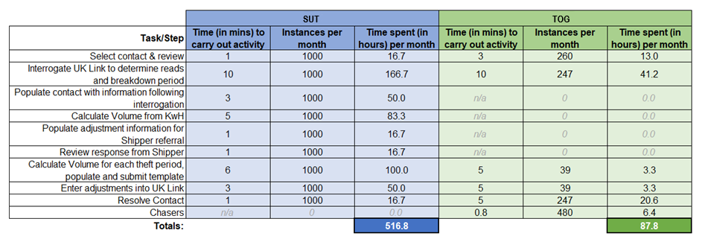
Low Level Task Comparison
The below table shows each task carried out in the resolution of theft contacts and how the numbers compare between current and new process

Slide 33
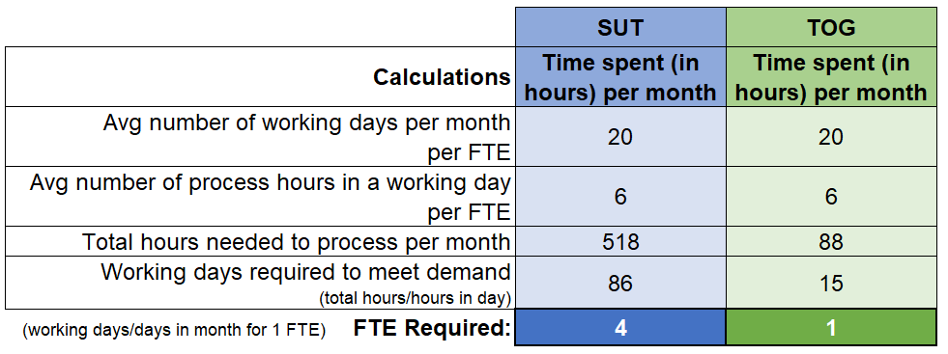
Full Time Equivalent (FTE) Comparison
The table shows the calculation and FTE requirements for managing theft contacts, and the comparison between the current and new process.
As highlighted above, the current theft process (TOG) has 1 FTE, however the new theft process, introduced under Modification 0734 (SUT), based on the indicative figures, will require 4 FTE.

Slide 34
Option 1 - Use Current Resource
Additional Information
Option 1
Use Current Resource
It would be accepted that a large backlog of contacts would be expected to build up and be ongoing if assumptions on volumes are correct (1000 contacts per month).
Existing resource utilised with no incremental resource.
No immediate impact to DSC change budget.
Potential backlog of SUT contacts delaying theft charges to relevant suppliers and opposite credits to UIG would be expected.
We would expect BP23 would need to include assumed resources following review period (6 months).
No Performance Indicators for 6 months, review findings to be taken to ChMC in April 23.
BP22 DSC Change Budget
£0
Utilise the current 1 x FTE working on TOG contacts, to be transferred to SUT contacts moving forwards. No increase in resources.
BP23 Ongoing Uplift
£0
Funding Party
N/A

Slide 35
Option 2 - Increase Resource by 2 FTE
Additional Information
Option 2
Increment by 2 FTE
This would result in £37k of Change Budget (6 months x 2 FTE) required and ongoing costs of £74k with backlogs growing and enduring if assumptions are correct
2 additional FTE and 1 existing FTE
Still expected to result in ongoing and increasing backlog of SUT contacts, delaying theft charges to relevant suppliers and opposite credits to UIG.
Reduced backlog build up when compared to Option 1, meaning charges invoiced to relevant parties will happen more quickly.
No Performance Indicators for 6 months, review findings to be taken to ChMC in April 23.
BP22 DSC Change Budget
£37,000
Recruit 2 x FTE to work with the existing resource who would transfer from TOG contacts to SUT contacts moving forwards.
BP23 Ongoing Uplift
£74,000
Funding Party
100% Shipper - Service Area 1

Slide 36
Option 3 - Increment by 3 FTE
Additional Information
Option 3
Increment by 3 FTE
Contacts will be cleared with adjustments being processed to the relevant parties in a timely manner, expected no backlogs if assumptions are correct.
3 additional FTE’s.
6 months funding from ChMC (DSC Change Budget).
Enduring funding from BP23 onwards.
Resources recruited at point of implementation.
No backlogs expected to build up.
Timely invoicing to relevant parties.
Review findings to be taken to ChMC in April 23.
BP22 DSC Change Budget
£56,000
Based on analysis undertaken, recruit 3 FTE to manage expected number of SUT contacts per month.
BP23 Ongoing Uplift
£111,000
Funding Party
100% Shipper - Service Area 1

Slide 37
Options Summary
Option 1
Use Current Resource
Option 2
Increment by 2 FTE
Option 3
Increment by 3 FTE
No increase in FTE resources
--------------
No charge to DSC Change (BP22) and no increase in BP23
--------------
Potential risk of high SUT backlog and delay to invoicing.
Increase in FTE resources by 2
--------------
£34k charge to DSC Change (BP22) and £74k increase moving forwards (BP23)
--------------
Potential risk of SUT backlog and delay to invoicing.
Increase in FTE resources by 3
--------------
£56k charge to DSC Change (BP22) and £111k increase moving forwards (BP23)
--------------
Expected no SUT backlog, timely invoice.

Slide 38
Recommendation
Option 1
Use Current Resource
Option 2
Increment by 2 FTE
Option 3
Increment by 3 FTE
No increase in FTE resources
--------------
No charge to DSC Change (BP22) and no increase in BP23
--------------
Potential risk of high SUT backlog and delay to invoicing.
Increase in FTE resources by 2
--------------
£34k charge to DSC Change (BP22) and £74k increase moving forwards (BP23)
--------------
Potential risk of SUT backlog and delay to invoicing.
Increase in FTE resources by 3
--------------
£56k charge to DSC Change (BP22) and £111k increase moving forwards (BP23)
--------------
Expected no SUT backlog, timely invoice.

Slide 39
February 23 Release Update

Slide 40
XRN5533 – February 23 Major Release - Status Update
 | Overall Project RAG Status
 | Schedule | Risks and Issues |  | Cost
RAG Status
Status Justification
Schedule | Overall release is tracking on target; Green, BER has been approved in eChMC on 29/07. Currently in delivery start up / initiation phase, with build phase commenced on 01/08 Progress update: UK Link build in progress, delivery on track to complete by 30/09 DDP build for XRN4990 to commence 12/09 System Testing preparation to commence 12/09 On track to complete delivery start-up/initiation on 23/09 XRN4900 DSG Meeting in September to discuss the change to the treatment of updating estimated CVs internally This will be followed by a revised Detailed Design Change Pack issued for information only in October No impacts to delivery timelines or cost No impacts to customer processes Decision in September ChMC: None
Risks and Issues | XRN5298: There is a risk that UNC Modification 0799 will not be approved, leading to build activities halted and possibly design to be revisited. Mitigation: ChMC approved the change to progress delivery at risk; with the assumption that the MOD will be approved.
Cost | Forecast to complete delivery against approved BER
Scope | XRN4900 - Biomethane/Propane Reduction XRN4978 - Shipper - Notification of Rolling AQ Value XRN4989B - Residual AMT activities XRN4990 - MOD0664 – Transfer of Sites with Low Read Submission Performance from Class 2 and 3 into Class 4 XRN4992B - MOD0687 - Clarification of Supplier of Last Resort (SoLR) Cost Recovery Process - Inner for replacement reads and read insertions​ XRN5298 - H100 Fife Project – Hydrogen Network Trial
Complete
On Track
At Risk
Overdue
Slide updated on 24th August 2023

Slide 41
December 21 - April 22 Changes in Design Update

Slide 42
Dec 21 - April 22 Changes in Design – Shipper Status Update
XRN Title | Target Detailed Design Date | Risk & Issues / RAG | Cost RAG | Key Messaging
XRN4978 - Notification of Rolling AQ Value (following Transfer of Ownership between M-5 and M) |  |  |  | Change Pack approved at ChMC on 11/05/22
XRN4990 - Transfer of Sites with Low Read Submission Performance from Class 2 and 3 into Class 4 (MOD 0664) |  |  |  | Change Pack approved at ChMC on 08/06/22
XRN4992B - MOD 0797 Creation of New Charge to Recover Last resort Supply Payments |  | Issue ID 67431: There is a issue that Modification 0809S has been raised to include IGT Supply Points into SoLR charging Action: Inclusion of IGT sites in the change for Feb23 release is being assessed |  | Change Pack approved at ChMC on 08/06/22
XRN5091 - Deferral of creation of Class change reads at transfer of ownership |  |  |  | Change Pack approved at ChMC on 13/07/22
XRN5186 – MOD 0701 - Aligning Capacity booking under the UNC and arrangements set out in relevant NEXAs |  |  |  | Change Pack approved at ChMC on 13/07/22
Slide updated on 21st August 2022
Notes:
u

Slide 43
Dec 21 - April 22 Changes in Design – DN Status Update
XRN Title | Target Detailed Design Date | Risk & Issues / RAG | Cost RAG | Key Messaging
XRN4900 - Biomethane/Propane Reduction |  |  |  | Change Pack approved at ChMC on 08/06/22
XRN5186 – MOD 0701 - Aligning Capacity booking under the UNC and arrangements set out in relevant NEXAs |  |  |  | Change Pack approved at ChMC on 13/07/22
XRN5298 - MOD 0799 - H100 Fife Project – Hydrogen Network Trial |  | Issue ID 67645: The detailed design Change Pack has not be approved as MOD 0799 is still outstanding​ Action: Accept Issue. Decision was taken at ChMC in July to include into delivery for Feb23 release |  | Change Pack baselined for delivery in Feb23 release in July ChMC Approval of Change Pack expected in September ChMC following approval of MOD 0799
Slide updated on 21st August 2022

Slide 44
XRN5231 Provision of a FWACV Service Update

Slide 45
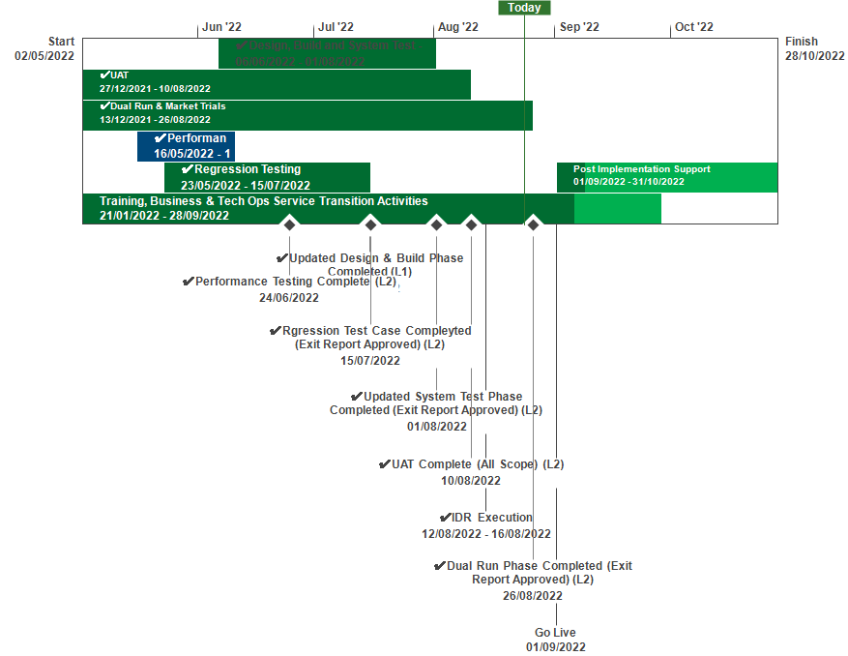
XRN5231 Flow Weighted Average CV
September 2022 ChMC Dashboard |  | Overall Project RAG Status
 |  | Schedule | Risks and Issues |  | Cost
RAG Status
Status Justification
Schedule | Overall RAG status is tracking at Amber on basis a revised Go Live date of 1st September 2022 has been agreed, though remains Amber due to lack of contingency within plan and the heavy dependency on NG to deliver all required data ahead of Go-Live. Revised Go Live date set for 1st September with contingency date of 14th September Dual Run/ Market Trials has been complete An Issue was identified as part of Market Trials, interim solution has been agreed and enduring solution identified Implementation Dress Rehearsal (IDR) execution for UKLink and Gemini aspects of FWACV have been successful Internal Testing phases progressed to plan. UAT, Performance Testing all completed Data Migration and Go-live activities are on track, to complete 31st August Internal Business Readiness activities continue to progress to plan Next Steps: Complete Go-live on 1st September Commence Post Implementation Support phase 1st September | Overall RAG status is tracking at Purple as project is now in re-planning phase due to the position that we will not be able to implement by 1st April 22. The project has continued with its planned activities alongside the replan. To support the re-plan activity the project is conducting a Gap Analysis exercise on the defined requirements to ensure we have a baselined position for Day 1 Implementation. An Impact Assessment will then be conducted against the change variations to support the re-plan activity UAT execution and assurance is in progress, revised completion date to be confirmed as part of re-plan Dual Run Preparation continues with Connectivity Testing and Master Data Readiness. Resolution of the Master Data Issue is a significant step forward to support Dual Run Testing and Data Migration approach for cutover Re-planning to be completed post completion of Gap Analysis activity with the intention to agree revised plan in March and present updated BER for approval at April ChMC Next Steps: Finalise Gap Analysis exercise with DNs and National Grid to agree Day 1 Must Have requirements & any decisions in order to meet a proposed Go Live date (Mid June 22) Define full re-plan based on Gap Analysis Impact Assessment and Business Readiness requirements Target to issue revised BER from replan for approval at the April 22 ChMC Risk of FWACV Imp to CSSC is in assessment, this is deemed low risk as there is no code conflict
Risks and Issues | There is an issue identified during Market Trails were DN’s are unable to process all AO files, this is impacting each DN differently and may impact the planned implementation date. 23/08 update: Cadent & SGN are able to process all AO files, the remaining DN’s are able to process most but not all and a report will be run and sent accordingly as an agreed workaround. | The dependencies for NG to provide Master data and DNs connectivity details for Dual Run/MT have not been provided as per the plan defined in the approach leading to a delay to this phase of testing Update: A plan was defined to mitigate this issue through validating and cross-checking data with National Grid and Distribution Networks (DNs). Plan is nearing completion with final checks now being completed by DNs. Issue to be closed once Data loaded to testing environment The Project is not able to meet its planned Implementation Date of 1st April due to delays to the start of Dual Run, volume of parallel activity required prior to the planned implementation and identification of gaps in the As Is and To Be processes that could lead to further changes to approved solution Update: The project is carrying out a re-plan activity with the priority being to complete Analysis on approved scope/processes to confirm Day 1 must have requirements. The plan and activities has been agreed with Xoserve, NG and DNs on 22/02 and the activities are tracking to plan
Cost | Forecasting costs within approved spend | Forecast costs tracking to approved BER costs at present. Revised plan options will require a full cost assessment to be completed on the replan position for Day 1
Scope | XRN5231 Flow Weighted Average (CV) Gemini consequential change parts A & B - A - PRCMS validation/processing & Part B - LDZ Stock Change and Embedded LDZ Unique Sites | XRN5231 Flow Weighted Average (CV) Gemini consequential change part A - PRCMS validation/processing Gemini consequential change part B - LDZ Stock Change and Embedded LDZ Unique Sites

Slide 46
NG TRANSMISSION CHANGE HORIZON PLAN 0 - 2 YEARS AUG 2022 – JUL 2024
AUGUST 2022

Slide 47
NG TRANSMISSION CHANGE HORIZON PLAN 0-2 YEARS AUG 2022 – JUL 2024
Programmes & Projects 2022-2024 |  |  |  | 2022 |  |  |  |  | 2023/24
 |  |  |  | Aug | Sep | Oct | Nov | Dec | Jan | Feb | Mar | Apr | May | Jun | Jul
MAJOR RELEASES | Regulatory / Customer Requested Change | PM Emma Catton | XRN5455 Autumn Release
MAJOR RELEASES | Regulatory / Customer Requested Change | PM Matthew Rider | XRN5393 Gemini Spring 22 Release
 | UK Link Consequential Changes | PM Karl Davidson | XRN5231 Flow Weighted Average CV FWACV
 | Gemini Sustain | PM Emma Catton | Gemini Change Programme Sustain
Deployment
18th Sept
Ofgem Decision
23rd Dec
Design to PIS –Apr 22 to Nov 22
Functionality Parameterised
Closedown
in Progress
KEY RISK & % = Certainty of Scope
 | Approved on Track
 | Approved
 | Approval at Risk
 | Change Completion Report
 | External User Activity
Deployment
1st Sep
Design to PIS - Nov 21 to Nov 22
KEY – Project Status
On Track
Complete
Potential Risk to Plan
Plan at Risk
Closedown
in Progress
Gemini Change Programme Sustain – Important Info Closedown date subject to change due to Change Variation received from National Grid. New date to be reported from next month, once agreed
Notes:
XRN5393 – Gemini Spring 22 Release - RFC
CHG0033706 - Go Live 25/02 - UNC785 - Aggregate Bacton Exit Points - Part A (Operational)
CHG0033667 - Contingency 27/02 - UNC785 - Aggregate Bacton Exit Points - Part A (Operational)
CHG0033668 - Go Live 03/04 - UNC785 - Aggregate Bacton Exit Points - Part B (Charging Theory)
CHG0033767 - Contingency 10/04 - UNC785 - Aggregate Bacton Exit Points - Part B (Charging Theory
XRN5231 - Flow Weighted Average - RFC
CHG0033749 – Go Live 30/06 - Flow weighted Average CV Calculation
XRN5368.2 - Single Sign on Experience - RFC
CHG0033809 – Go Live 29/05 - SSO/MFA /SSPR
CHG0033828 – Contingency 12/06 - SSO/MFA /SSPR - Placeholder
XRN5368.3 - API Enhancements - RFC
CHG0033766 Go Live 10/04 - Azure APIM API’s over the internet - TBC
XRN5368.1 - Control M and Batch Processing - RFC
CHG0033808 Go Live 01/03 - Deletion & Housekeeping
CHG0033810 Go Live 15/03 - Deletion & Housekeeping
XRN5368.5 - Site Minder Upgrade - RFC
CHG0033777 - Siteminder upgrade - Prod change 1
CHG0033778 - Siteminder upgrade - Prod change 2 - Log4j re-fix.

Slide 48
DDP September CHMC update

Slide 50
Roadmap
PRODUCT DEVELOPMENT AND ROLLOUT
2022
2023
2024
04
05
06
07
08
09
10
11
12
01
02
03
04
05
06
07
08
09
10
11
12
01
02
03
ACTIVITY
Release 1 – Shipper Pack
Change freeze
Release 2 – Golden Bullet forecast
Release 3 – Golden Bullet invoice & IGT data quality analysis
Release 4 – XRN4990
Release 5 – XRN4990
Release 6 – tbc
REC / Golden Bullet data modelling
KEY
On track
Issue – (Requires escalation/support)
Ti
At risk - (Risk is being managed)
Complete
Milestone

Slide 51
Data Discovery Platform | Release 2
Goal: Enable Distribution Network Users to access a financial forecasting report (part of the golden bullet), to understand variances between formula year AQ / SOQ and rolling AQ / SOQ to understand the impact this has on revenue.
User Stories: As a DN I want a view of my Formula year AQ/ SOQ and Rolling AQ / SOQ simulation data grouped by: LDZ, Exit Zone, Shipper Short, EUC, Code, Charge Type, Charge Rate, Asset Type, AQ Band and Class As a DN I want total FY AQ / SOQ and Rolling AQ / SOQ displayed in kwh and as a percentage, and the difference between the two As a DN I want total charges by Rolling and Formula Year AQ / SOQ totals and difference As a DN I want the number of MPRNs grouped by charge type between Formula year AQ / SOQ and Rolling AQ /SOQ (by kwh and percentage difference) so I can see how many MPRNs fall into each group and the difference between FY and Rolling for each charge type in both kwh and percent age and split by LDZ, Exit Zone, Class, AQ band, Shipper Short Code and Asset Type Charge types: ZCA, 891, CCA, CFI, ECN, C04 As a DN I want a trend view between Formula Year and Rolling AQ and SOQ with the total charge position for both Stretch element: As a DN I want the number of MPRNs grouped by % difference between FY AQ and rolling AQ and between FY SOQ and Rolling SOQ As a DN I want the number of MPRNs grouped by kwh difference between FY AQ and Rolling AQ and FY SOQ and rolling SOQ so I can see how many MPRNs fall into each group As a DN I want to see the total number of MPRNs that have had a rate change within the last month, and have these split by reason for the rate change (Shipper change, Class change, other) so I can understand how rate changes are affecting my revenues

Slide 52
Data Discovery Platform | Release 3
Goals: Complete model to enable the aggregated invoice element of the Golden Bullet Report Enable more elements of the Shipper pack to be self served
User Stories: Build the data model to enable the DN aggregated invoice element of the golden bullet to be delivered via DDP including A new monthly report that consolidates all the detail information shown in : BOPRI SCH606 Geninf shows the cash invoices values on aswell that we have received Summarises it separately by EUC and also by Load Band It is also to be used to generate the December ""snapshot"" position and a forward forecast of new charging years monthly invoices so we would like to know in December what the new invoice values will be the following April - so forward forecast what the new capacity values will be inclusive of the new load factors and latest snapshot AQ use this report to populate the results Note: December snapshot: Capacity charges are established based on the December AQ / SOQ for the following financial year As a Shipper I want to be able to report on Dead meters via a monthly snapshot and see a trend over 12 months, so that the dead report in the Shipper pack can be retired As a Shipper I want my read performance for class 3 sites to be displayed as 'MET' when I have achieved 90% of reads accepted so that I can monitor my read performance Analysis of the below user story; As a Shipper I want an industry view of read rejection reasons so that I can compare my performance with industry Read rejections by reason code (numbers). Existing report need enhancing to give; Read rejections by reason code percentage value for a Shipper needs to be added to current dashboard Industry average number of read rejections (number and percentage) needs adding Performance enhancement to give a greater user experience of the large volumes Stretch targets: As a Shipper I want to see a list of sites in my portfolio containing plot addresses so that I can assess and update the address details correctly & in a timely manner. As a Shipper I want the WAR Bands dashboard to be moved out of UIG area of DDP and added to the Reads area of DDP so that it sits more logically from a business process perspective

Slide 53
Data Discovery Platform | Inflight Sprint (part of release 3)
Goals: Build the golden bullet invoice report
User Stories: Build the dashboards to enable the DN aggregated invoice element of the golden bullet to be delivered via DDP including A new monthly report that consolidates all the detail information shown in : BOPRI SCH606 Geninf shows the cash invoices values on as well that we have received Summarises it separately by EUC and also by Load Band It is also to be used to generate the December ""snapshot"" position and a forward forecast of new charging years monthly invoices so we would like to know in December what the new invoice values will be the following April - so forward forecast what the new capacity values will be inclusive of the new load factors and latest snapshot AQ use this report to populate the results Note: December snapshot: Capacity charges are established based on the December AQ / SOQ for the following financial year Performance optimisation for read dashboards Stretch Target: Must read enhancement to align BAU enhancement to DDP Industry view of number of MPRN associated to MRF (part of Shipper Pack XRN 5200)

Slide 54
Section 5: Non-DSC Change Budget Impacting Programmes

Slide 55
CSSC Programme Update
September 2022

Slide 56
Programme Health – RAG
Overall Programme Status | Previous | Current | The programme is reflective of a Green Status The Programme continues to be in a healthy state and we have seen resolutions to a number of the issues we called out last month, however we have identified and resolved one further issue which I have referred to below.
Programme Plan | Previous | Current
Risk Profile | Previous | Current
Resources | Previous | Current
Executive Summary |  |  |  | Upcoming Activities & Milestones (Next Month)
Irregularities with File Sequence Numbers for the new CSS files (BRR, TMC & ASN file types) – we are continuing to provide information to AMT to enable them to identify a fix. AMT are currently testing a fix, we are still pending a deployment date for the fix to be issued to us. Files unable to be processed/issued due to ‘special characters’ with the file – Issue has been fixed Users experiencing issues with accessing Portal – Ticket volumes under 50 due to the many drop in sessions that have been hosted over the past two to three weeks. Individual comms have been issued in response to every ticket raised Missing Secured Active Messages (SAM’s) – Fix has been implemented by Landmark which we are actively tracking. We have not received any missing SAM’s post the fix but we have been experiencing late SAM’s which we have raised with DCC. We continue to communicate with DCC in relation to the next steps for brining the systems into sync and how the missing SAM’s will be issued to us for processing into UK Link. Class 3 & 4 reads not being estimated at transfer – A comm has been issued to confirm from CSS Go Live, estimates have not been calculated for these sites. A fix has been identified, is currently in testing with a date of Friday 2nd September for implementation. Further comms will be issued to confirm progress |  |  |  | Continued Business change activities which includes new operating model Continued Post Implementation Support Activities Movement for adoption of the Programme into BAU remains a focus area for adoption as soon as possible
e

Slide 57
September ChMC CMS Rebuild Update

Slide 58
Progress to Date
MNC will be delivered as a soft launch to the Customer Focus Group attendees at the beginning of October [target 10th October] where Users can ensure all is working as expected and then it will be rolled out to all customers on [19th October]. SUT will be implemented a few days later [26th October]. Change packs have/will be published to ensure all customers are aware and can impact assess any changes. Transition arrangements will be agreed and have been / will be communicated as we move contacts from old CMS to new CMS.
A new parent XRN has been raised as per ChMC in August; XRN 5556. This replaces the previous XRN5343 that was for analysis only. Each release will have its own XRN so that customers can track progress on the Change Page, for Release 1 XRN556.a has been raised
The CMS Rebuild webpage (https://www.xoserve.com/products-services/data-products/contact-management-service-cms/cms-rebuild-product/ ) contains the link to register for future Customer Focus Groups which are captured below, please note the agenda for the Focus Groups will be issued 7 days prior to the session:
The September Customer Focus Group, will focus on the launch details and the new DUP process which we are targeting to deliver in early December. The high level roadmap can be seen on the next slide, please note that this could change based on Industry priorities and complexities.
Further updates will be provided in October ChMC.
Date | Time Start | Time end
09/09/2022 | 10:00 | 12:00
14/10/2022 | 10:00 | 12:00
08/11/2022 | 10:00 | 12:00
09/12/2022 | 10:00 | 12:00
10/01/2023 | 10:00 | 12:00
07/02/2023 | 10:00 | 12:00
07/03/2023 | 10:00 | 12:00

Slide 59
Product Delivery Roadmap
XRN 5556.a
Supplier Theft of Gas (SUT)
Meter Number Creation (MNC)
Isolations
(ISO)
Dead to Live
(DTL)
Address Amendments (ADD/ UNC)
New MPRN Creation
(FOM)
Request for Adjustment (RFA)
Daily Metered Query (DMQ)
Consumption Dispute Query (CDQ)
Theft of Gas
(TOG)–
Network Raised
Must Reads
(MUR)
Manage Unregistered Sites
(MUS)
Gas Safety Regulation
(GSR)
Main Release Content
Duplicate MPRNs (DUP)
Set to Extinct
Swapped Address
(SWA)
Release content
DUP Enhancements
Enhancements to MNC Process including Network raised
Generic Enhancements
SUT Enhancements
Additional Enhancements alongside release
Generic to desk workflows – AGG, PSI, PSR
Generic to desk workflows –GIC
Generic to desk workflows – FLE
Now
Next
Later
A little Later
Current assumed delivery roadmap as of September 2022
KEY
New Process

Slide 60
Section 6: AnY Other Business

Slide 61
September 2022 - ChMC Mod0651 Retrospective Data Update Provisions Recap of Solution and Proposed Next Steps

Slide 62
Purpose of ChMC Update
Confirm the current position of XRN4914 – Mod0651 Retrospective Data Update Provisions
ReCap on Mod0651 compliant Solution Option – including key features and customer considerations
Propose the next steps

Slide 63
Current Position of XRN4914 – Mod0651 Retrospective Data Update Provisions
Following a consultation exercise in summer 2021, it was agreed that a whilst CSSC and related gas industry changes were a priority, a Mod0651 compliant solution should be progressed at the earliest available opportunity
Delivery of Central Switching Service Consequential Programme in July 2022 has enabled key resource that are required to progress a Retrospective Data Update solution forward
In order to progress the compliant solution into detailed requirements definition and solution design a project team will need to be mobilised
Approval of this Detailed Design phase project mobilisation will be required from ChMC
Costs and timescales for Detailed Design are yet to be shared with DSC Customers due to the dependencies on key resources and priority industry programme delivery

Slide 64
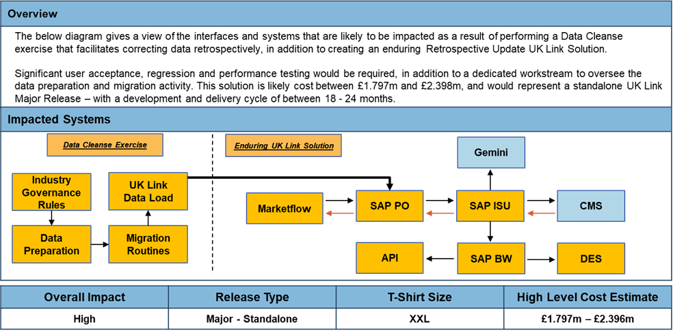
Mod0651 – Solution Recap

Slide 65
Proposed Next Steps
Xoserve are looking to provide clarity to customers on future Change Pipeline and scope of changes being progressed and delivered over the coming 18-24months
Plan to issue an EQR to ChMC in October for Approval – this will request funding to commence Detailed Design phase
Noted that a Shipper organisation at August Distribution Workgroup has discussed their intention to present a UNC Modification which proposes to prevent Mod0651 from being implemented
Should this Modification be raised, ChMC will be asked to confirm if Detailed Design should progress in parallel to UNC development or whether we await a Modification Decision

Slide 66
Appendix

Slide 67
Portfolio POAP

