Slide 1
Change Management Committee
13th July 2022

Slide 2
Section 2: DSC Change Budget & Horizon Planning

Slide 3
General Change Budget BP23

Slide 4
Guiding Principles
General Change (formerly called ‘UNC Change’) is an investment budget that iteratively funds UNC, REC and DSC Changes, once approved for delivery in ChMC
Investment funds are only utilised from design phase onwards (via approval of EQRs) and also cover build/test/implement/PIS phases (via approval of BER) for major release or standalone change delivery
Regulation-driven change (UNC, REC) is prioritised as per DSC Change Management procedures 46768906.01 (gasgovernance.co.uk)
Unutilised funds rebated at end of financial year

Slide 5
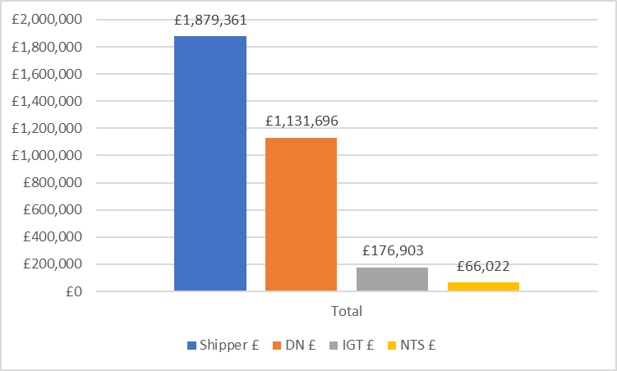
Proposed Budget
Proposed total budget is the same size as in BP22
Calculation based on major release bandwidth, historic trends / costs and a provision for REC change development above and beyond ‘BAU’ levels of regulatory change post CSSC implementation

Slide 6
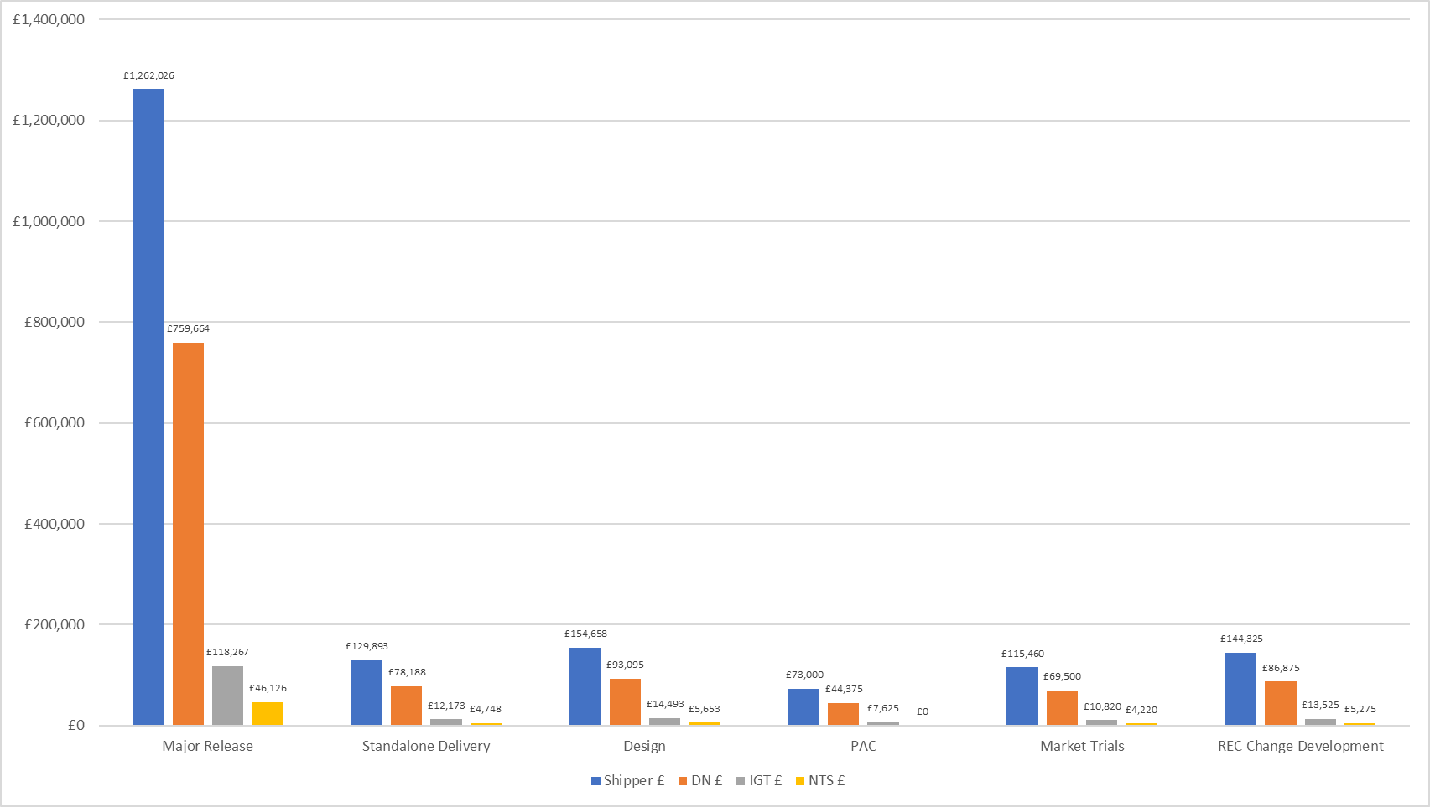
Breakdown
Same as previous years, except with the introduction of ring-fenced ‘Design’ pot for transparency and to support ‘factory model’ of design activity
Cost splits the same as in BP20 and BP21:
PAC funding split |  | 58.4% | 35.5% | 6.1% | 0%
All other categories funding split |  | 57.7% | 34.8% | 5.4% | 2%

Slide 7
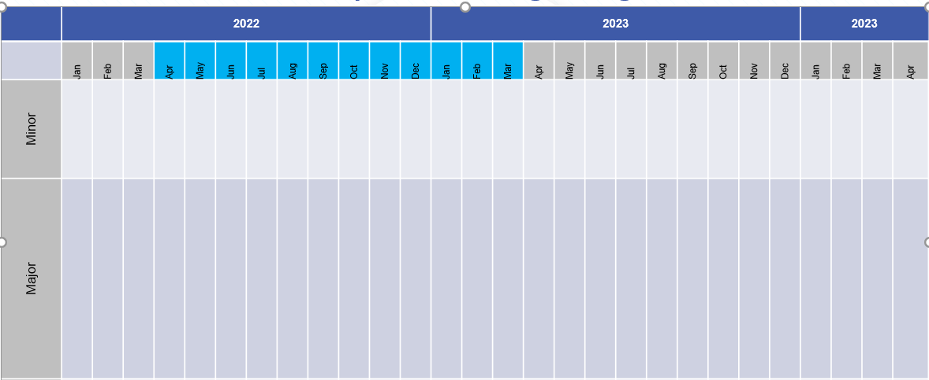
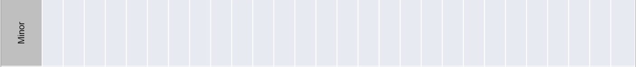
Release bandwidth & impacts to budget BP23
2023
2024
2025
2023
2024
2025
Standalone*
MiR 12
XRN
XRN
XRN
XRN
XRN
Costs for release or individual changes are considered committed upon approval of EQR/BER
Major release costs based on average cost of previous releases (£0.8m)
F23
Build/Test / Imp
PIS
Build/Test
PIS
J23
Build/Test /Imp
PIS
Major Release
F23
Build/Test
PIS
N23
Build/Test/Imp
PIS
J23
Build/Test
PIS
F24
Build/Test/Imp
PIS
Build/Test
N23
PIS
J24
Build/Test/Imp
PIS
Design
N24
Build/Test /Imp
PIS
Develop
Key
Activity
BP23 Delivery Budget Impact
Design
Design
Design
Development
Develop
No £ Impact to BP23
BP22 Delivery Budget Impact
* Standalone for illustration only

Slide 8


Design approach
We have optimised the CDSP design process, so it’s a more efficient process for customers that leads to smarter release planning outcomes

Slide 9
Timeline for next steps
BP23 Principles and approach doc published for customer consultation
2nd draft presented to ChMC incorporating feedback from customers
Discussion with constituency groups
New budget goes live
BP consultation iterative draft process
Jun-22
Jul-22
Aug-22
Sep-22
Jan-23
Apr-23
BP approval
Initial draft of General Change Budget presented to ChMC for feedback / discussion
Final draft presented to ChMC for recommendation into BP23
Key
Wider BP events
GC Budget Specific events

Slide 10
General Change Budget BP22 YTD (July 2022)

Slide 11
Budget v Committed Spend BP22
The Change Budget can be found here

Slide 12
Change Pipeline

Slide 13
Change Delivery Pipeline
July 22 – December 23
July 22
November 22
February 23
June 23
November 23
CSSC Go-Live
No Major Release
February 23 – Major Release
June 23 – Major Release
XRN5231 – FWACV
November 23 – Major Release
XRN5379
XRN5515
XRN5236 – CMS Release1
XRN5143
XRN5316
XRN5469
XRN5472
Key Activities
- - - - = Indicative Implementation Date
= Major Release scope to be endorsed and approved by ChMC

Slide 14
Change Pipeline - Delivery Plan
July 2022 – February 2023
XRN | Change Title | Proposer | Benefit / Impact | Funding | HLSO Max Cost | Target Implementation Date | Release Type | Firm / Indicative
5515 | HyDeploy Close Down | NGN | Shipper DN | DN DeCarb | N/A | July 2022 | Standalone | Firm
5316 | Rejecting Pre LIS Replacement Reads | Xoserve | Shipper | N/A | N/A | August 22 | Standalone | Indicative
5469 | Increase Frequency of FSG Payments | Cadent | DN | DN | £60K | September 22 | Standalone | Firm
5231 | FWACV Service | SGN | DN NG | DN NG | *£936K | 1st September 22 | Standalone | Firm
5236 | Reporting Valid Confirmed Theft of Gas in central systems (Modification 0734) | GazProm | Shipper | Shipper | N/A | Oct / Nov 22 | CMS Rebuild Release 1 | Firm
4900 | Biomethane/Propane Reduction | SGN | Shipper DNO | DN Decarb | N/A | February 23 | Major | Firm
4978 | Notification of Rolling AQ Value (following Transfer of Ownership between M-5 and M) | British Gas | Shipper | Shipper | £150k | February 23 | Major | Firm
4990 | Transfer of Sites with Low Read Submission Performance from Class 2 and 3 into Class 4 (MOD0664) | SSE | Shipper | Shipper | £150k | February 23 | Major | Firm
4989 | Residual AMT activities | CDSP | Shipper | Shipper | £10k | February 23 | Major | Firm
4992 | XRN4992 - Modification 0687 Clarification of Supplier of Last Resort (SoLR) Cost Recovery Process | Total | Shipper DNO | Shipper DNO | £150k | February 23 | Major | Firm
5298 | H100 Fife Project – Hydrogen Network Trial | SGN | Shipper DN | DN Decarb | N/A | February 23 | Major | Firm
Slide produced 1st July 2022

Slide 15
Change Pipeline – Delivery Plan
April 2023 – June 2023
XRN | Change Title | Proposer | Benefit / Impact | Funding | HLSO Max Cost | Target Implementation Date | Release Type | Firm / Indicative
5379 | Class 1 Read Service Procurement Exercise - MOD0710 (DM Sampling) | Xoserve | Shipper DN | Shipper | Tbc | 1st April 23 | Standalone | Firm
5143 | Transfer of NDM sampling obligations from Cadent, WWU, and NGN to the CDSP | Cadent | DN | DN WWU, Cadent, NGN only | Tbc | 1st April 23 | Standalone | Firm
5472 | Creation of a UK Link API to consume daily weather data for Demand Estimation | CDSP | Shipper DN | Shipper DN | Tbc | 1st April 23 | Standalone | Firm
5091 | Deferral of creation of Class change reads at transfer of ownership | EDF | Shipper | Shipper | 350,000 | June 23 | Major | Indicative
5186 | MOD0701 - Aligning Capacity booking under the UNC and arrangements set out in relevant NEXAs | NGN | Shipper DN | Shipper DN | 200,000 | June 23 | Major | Indicative
5482 | Replacement of reads associated to a meter asset technical details change or update (RGMA) | Scottish Power | Shipper | Shipper | Tbc | June 23 | Major | Indicative

Slide 16
Change Backlog Details
XRN | Change Title | Proposer | Benefit / Impact | Funding | HLSO Max Cost | Target Implementation Date | Release Type | Firm / Indicative
4713 | Actual read following estimated transfer read calculating AQ of 1 | Npower | Shipper | Shipper | £7k | Tbc | Standalone | N/A
4914 | Mod0651 – Retrospective Data Update Provisions | Cadent | Shipper | Tbc | £1.8m – £2.4m | Tbc | Major | N/A
5144 | Enabling Re-assignment of Supplier Short Codes to Implement Supplier of Last Resort Directions | Xoserve | Shipper DN IGT | Tbc | Tbc | Tbc | Tbc | N/A
5187 | MOD0696 - Addressing inequities between Capacity booking under the UNC and arrangements set out in relevant NExAs | Gazprom | Shipper DN | Shipper DN | Tbc | Tbc | Tbc | N/A
5286 | Clarification Change to the AQ amendment process to be applied retrospectively (MO0746) | CDSP | Shipper DN | Shipper | Tbc | Tbc | Tbc | N/A
5345 | Deferral of creation of Class change reads for DM to NDM and NDM to DM sites at Transfer | CDSP | Xoserve | Shipper | Tbc | Tbc | Tbc | N/A
5453 | GSOS 2, 3 & 13 Payment Automation | SGN | Shipper DN | DN | Tbc | Tbc | Tbc | N/A
5454 | SoLR Reporting Suite | EDF | Shipper | Shipper | Tbc | Tbc | Tbc | N/A
5471 | DSC Core Customer Access to Data | CDSP | Shipper DN IGT | IGT Shipper DN | Tbc | Tbc | Tbc | N/A
5473 | Meter Asset Details Proactive Management Service | CDSP | Shipper | Shipper | Tbc | Tbc | Tbc | N/A
5517 | Hydrogen Checker Website | Cadent | Shipper DN | DN | Tbc | Tbc | Tbc | N/A

Slide 17
UK Link February 23 Major Release
Scope Approval

Slide 18
Proposed Scope
Release | UK Link February 23 Major Release
Implementation Date | 24th / 25th February 2023 (no REC changes in scope so proposing weekend go live)
Contingency Implementation Date | 3rd / 4th March 2023
BER Approval being sought from ChMC | 20th July 2022 (see below)
XRN | Title | Proposer | Benefitting | Funded by | HLSO Est. | Points | Design Change Pack Approved
4900 | Biomethane/Propane Reduction | SGN | Shipper DNO | Decarb (DNO) | £300k | 21 | Yes
4978 | Notification of Rolling AQ Value (following Transfer of Ownership between M-5 and M) | British Gas | Shipper | Shipper | £150k | 8 | Yes
4990 | Transfer of Sites with Low Read Submission Performance from Class 2 and 3 into Class 4 (MOD0664) | SSE | Shipper | Shipper | £150k | 8 | Yes
4989b | Residual AMT activities | CDSP | Shipper | Shipper | £10k | 3 | n/a
4992b | XRN4992 - Modification 0687 Clarification of Supplier of Last Resort (SoLR) Cost Recovery Process | Total | Shipper DNO | Shipper DNO | £150k | 13 | Yes
5298 | H100 Fife Project – Hydrogen Network Trial | SGN | Shipper, GT DNO, IGT | Decarb (DNO) | £300k | 21 | MOD not approved – work at risk against current Change Pack
 |  |  |  | Total | £1,060k | 74
Decision: | Required from the committee on proposed scope above
Agreement: | Being sought for an eChMC to be arranged on 22nd July to approve the BER
Note: | Any additional scope requirements will be change controlled into the BER

Slide 19
Section 3: Capture

Slide 20
New Change Proposals
New Change Proposals - For Approval
XRN5529 - UNC Derogation process – MOD 0800
XRN5531 - Hydrogen Village Trial
XRN5532 - Hydrogen Town Trial
XRN5535 - Processing of CSS Switch Requests Received in ‘Time Period 5’

Slide 21
XRN5529 - UNC Derogation process – MOD 0800
Customer Class | Voting Party?
Shipper | X
Distribution Network Operators (DNOs) | X
National Grid Transmission | X
IGT’s | X
Change Description
UNC Modification 0800 seeks to introduce the concept of degradation of UNC code and the governance process as which this is submitted, assured and approved/rejected. The CDSP would need a process set up in which to receive, process and handle these degradation requests.
DSC Service Area: | TBC
Link to Change Proposal | Link to CP
Change Type | Regulatory
Priority Score | High
Sponsor Representative | Northern Gas

Slide 22
XRN5531 - Hydrogen Village Trial
Customer Class | Voting Party?
Shipper | X
Distribution Network Operators (DNOs) | X
National Grid Transmission | X
IGT’s | X
Change Description
CDSP to undertake an assessment establishing the potential impacts and DSC process changes to facilitate the consumption of a Hydrogen CV and that a settlement and billing process is in place for the affected Trial areas utilising Hydrogen. The processes designed as part of this Hydrogen Village Trial will need to be replicable for the next phase of Hydrogen development, so cannot be designed specifically for this trial alone. Items for Xoserve to consider but not be limited to: Transporter, Shipper and Supplier Licences Gas Act Gas (Calculation of Thermal Energy) Regulations UNC & IGTUNC REC Settlement Energy tracking and Billing systems and processes IGT Networks Metering Calorific Value LPG Networks Some of the impacted items identified by this Change Proposal may not be required for the Hydrogen Village Trial but may be applicable to later trials. Xoserve will also be required to lead/support DNs with Industry communications ensuring that all Industry parties are aware of the projects, impacts, and the change requirements.
DSC Service Area: | TBC
Link to Change Proposal | Link to CP
Change Type | Non-Regulatory
Priority Score | Medium
Sponsor Representative | SGN

Slide 23
XRN5532 - Hydrogen Town Trial
Customer Class | Voting Party?
Shipper | X
Distribution Network Operators (DNOs) | X
National Grid Transmission | X
IGT’s | X
Change Description
CDSP to undertake an assessment establishing the potential impacts and DSC process changes to facilitate the consumption of a Hydrogen CV and that a settlement and billing process is in place for the affected Town areas utilising Hydrogen. The processes designed as part of the Hydrogen Village Trial will need to be replicable for the next phase of Hydrogen development, so Hydrogen Town design needs to be considered at the same time as Hydrogen Village – ensuring that long term roll out of Hydrogen design is considered. Items for Xoserve to consider but not be limited to: Transporter, Shipper and Supplier Licences Gas Act Gas (Calculation of Thermal Energy) Regulations UNC & IGTUNC REC Settlement Energy tracking and Billing systems and processes IGT Networks Metering Calorific Value LPG Networks Some of the impacted items identified by this Change Proposal may not be required for the Hydrogen Village Trial but may be applicable to Town so understanding the full design requirements is crucial to develop robust requirements for Hydrogen Town and beyond. Xoserve will also be required to lead/support DNs with Industry communications ensuring that all Industry parties are aware of the projects, impacts, and the change requirements.
DSC Service Area: | TBC
Link to Change Proposal | Link to CP
Change Type | Non-Regulatory
Priority Score | Medium
Sponsor Representative | Wales and West Utilities

Slide 24
XRN5535 - Processing of CSS Switch Requests Received in ‘Time Period 5’
Customer Class | Voting Party?
Shipper | X
Distribution Network Operators (DNOs) | X
National Grid Transmission | X
IGT’s | X
Change Description
The circumstances where the GRDA receives messages after 02:59:59 should be exceptionally rare – i.e. systems have failed in normal operation; the resilience built into the system to maintain contiguous service have failed such that they cannot be restored within the 1 hour RTO; Target DR Recovery has been missed AND Maximum DR Recovery has also been missed. Since this change is required in such rare circumstances this change needs to identify a solution that is cost effective to implement so that these Registrations can be recorded in UK Link systems. The analysis needs to engage stakeholders to determine the risk / impact of the solution to all industry participants. This change should focus on short term options for implementation. It is not proposed to initiate a large investment given the extremely low likelihood of this scenario occurring.
DSC Service Area: | Service Area 3 - Manage updates to customer portfolio
Link to Change Proposal | Link to CP
Change Type | Regulatory
Priority Score | High
Sponsor Representative | Xoserve

Slide 25
Solution Review
XRN5469 Increasing the Frequency of FSG Payments
Solution Review Consultation Summary
Change Pack Ref | HLSO Cost | Funding | Preferred Option | Voting | Proposed Delivery | Link to CP | Representation Summary
 |  |  |  |  |  |  | Approve | Defer | Reject
3050.4 - RT - PO | 60K | Service Area 10 – Invoicing Customers - Reapportioned 100% DNO | 1 | Shipper, DNO | September 22 | CP | 2
Org | Status | Comments
Cadent | Approve | We are supportive of the solution which will allow all DNs to submit Failure to Supply Gas payments more frequently (daily) This will support swifter payments to customers, hopefully leading to greater levels of customer satisfaction.
Wales and West Utilities | Approve | We support the proposed, single, solution. We agree with the proposer that increasing the frequency of the Failure to Supply Gas payment process is necessary given the shorter timescales DNs have to make the payments.

Slide 26
section 4. Design & Delivery

Slide 27
Design Change Pack
For Approval:
XRN5091 Deferral of creation of Class change reads at transfer of ownership
XRN5186 Modification 0701: Aligning Capacity booking under the UNC and arrangements set out in relevant NExAs
XRN5316 Rejecting a replacement read with a pre-Line in the Sand (LIS) read date Pack
XRN5515 Hydeploy close down

Slide 28
XRN5091 - Deferral of creation of Class change reads at transfer of ownership
Detailed Design Consultation Summary
Change Pack Ref | Funding | Voting | Release | Link to CP | Representation Summary
 |  |  |  |  | Approve | Defer | Reject
3050.1 - RT - PO | Service Area 4 - Meter Read/Asset processing – Reapportioned 100% Shipper | Shipper | June 23 | CP | 1
Organisation | Status | Comments
Gazprom | Approve | No Comments

Slide 29
XRN5186 Modification 0701: Aligning Capacity booking under the UNC and arrangements set out in relevant NExAs
Detailed Design Consultation Summary
Change Pack Ref | Funding | Voting | Release | Link to CP | Representation Summary
 |  |  |  |  | Approve | Defer | Reject
3050.2 - RT - PO | Service Area 3 - Manage updates to customer portfolio - Reapportioned 50% Shipper, 50% DNO | Shipper, DNO | June 23 | CP | 1
Organisation | Status | Comments
Wales and West Utilities | Approve | No Comments

Slide 30
XRN5316 Rejecting a replacement read with a pre-Line in the Sand (LIS) read date Pack
Detailed Design Consultation Summary
Change Pack Ref | Funding | Voting | Release | Link to CP | Representation Summary
 |  |  |  |  | Approve | Defer | Reject
3050.3 - RT - PO | MTB | Shipper | August 22 | CP | 1
Organisation | Status | Comments
Gazprom | Approve | No Comments

Slide 31
XRN5515 Hydeploy close down
Detailed Design Consultation Summary
Change Pack Ref | Funding | Voting | Release | Link to CP | Representation Summary
 |  |  |  |  | Approve | Defer | Reject
3057 - MH - PO | Decarb Investment | Shipper, DNO | July 22 | CP
Organisation | Status | Comments
 |  | No Representation received

Slide 32
Standalone Change Documents for Approval (BER, CCR, EQR)
BER for XRN5469 - Increase Frequency of FSG Payments
Voting: DNO

Slide 33
XRN5231 Provision of a FWACV Service Update

Slide 34
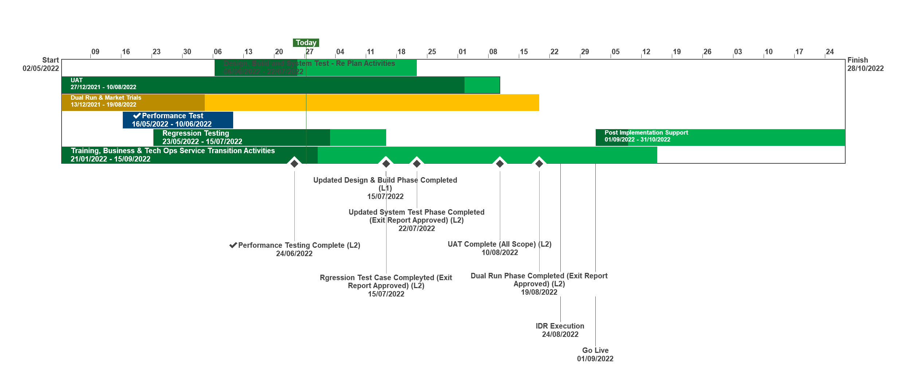
XRN5231 Flow Weighted Average CV
July 22 ChMC Dashboard |  | Overall Project RAG Status
 |  | Schedule | Risks and Issues |  | Cost
RAG Status
Status Justification
Schedule | Overall RAG status is tracking at Amber on basis a revised Go Live date of 1st September 2022 has been agreed, though Dual Run and Market Trials is currently behind plan due to a delay in full connectivity for all DNs. Progress to be closely monitored and decision made in early July, via project checkpoint on whether to progress into full E2E testing for all external parties. Cost set to Red, pending approval of revised BER A revised Go Live date of 1st September has been agreed with a contingency date of 14th September Dual Run/ Market Trials testing continues with all DNs connected. Due to a delay in full connectivity for all parties this phase is currently behind plan. Checkpoint arranged for 4th July on whether to commence full E2E testing to planned timescales A revised Change Pack, with Lowest CV requirement included was presented to project Focus Group on 21st June. To be formally approved in July following Focus Group Sign Off Revised BER to be approved in July following definition of revised plan and agreement on new Go Live date Internal testing phases are progressing to plan. Additional UAT scenarios (for Lowest CV requirement) to be executed and assured in 2nd week of July. Performance Testing and Regression Testing completed to plan. Data Migration (for Cutover), Transition and Cutover approach drafted and under internal review. To be reviewed with Focus Group in the first half of July Go No Go (GONG) criteria has been drafted and will be shared and agreed with Focus Group members in July Internal Business Readiness activities continue to progress to plan Next Steps: Gain approval of revised BER Finalise Data Migration, Cutover and Transition Approach Finalise GONG criteria Progress Dual Run/ Market Trails testing phase, working to completion by end of July Draft and agree detailed Implementation Plan | Overall RAG status is tracking at Purple as project is now in re-planning phase due to the position that we will not be able to implement by 1st April 22. The project has continued with its planned activities alongside the replan. To support the re-plan activity the project is conducting a Gap Analysis exercise on the defined requirements to ensure we have a baselined position for Day 1 Implementation. An Impact Assessment will then be conducted against the change variations to support the re-plan activity UAT execution and assurance is in progress, revised completion date to be confirmed as part of re-plan Dual Run Preparation continues with Connectivity Testing and Master Data Readiness. Resolution of the Master Data Issue is a significant step forward to support Dual Run Testing and Data Migration approach for cutover Re-planning to be completed post completion of Gap Analysis activity with the intention to agree revised plan in March and present updated BER for approval at April ChMC Next Steps: Finalise Gap Analysis exercise with DNs and National Grid to agree Day 1 Must Have requirements & any decisions in order to meet a proposed Go Live date (Mid June 22) Define full re-plan based on Gap Analysis Impact Assessment and Business Readiness requirements Target to issue revised BER from replan for approval at the April 22 ChMC Risk of FWACV Imp to CSSC is in assessment, this is deemed low risk as there is no code conflict
Risks and Issues | The DR/MT phase of testing will need to be signed off by all DNs but Cadent have not completed their connectivity testing activities, so they are unable to participate. The original connectivity date was January 22. There is a planned checkpoint on 04/07/22 where all DNS and Xoserve will decide whether final month of fully automated testing can start and therefore whether revised timelines can be met. Update 27/06:Cadent are now connected but need to catch up DR activities before MT start on 04/07. Issue to be monitored There is a risk that changes to the approved scope and requirements will be identified through the deliver plan – Update 27/06: 2nd replan in progress following the Lowest CV requirement change for revised plan to be baselined. Risk to be monitored through Dual Run and Market Trial There is a risk that changes to the baselined scope and requirements will increase the costs of the new FWACV service in extending the project and manual process being identified – Update: Revised costs finalized and approval to be sought in revised BER | The dependencies for NG to provide Master data and DNs connectivity details for Dual Run/MT have not been provided as per the plan defined in the approach leading to a delay to this phase of testing Update: A plan was defined to mitigate this issue through validating and cross-checking data with National Grid and Distribution Networks (DNs). Plan is nearing completion with final checks now being completed by DNs. Issue to be closed once Data loaded to testing environment The Project is not able to meet its planned Implementation Date of 1st April due to delays to the start of Dual Run, volume of parallel activity required prior to the planned implementation and identification of gaps in the As Is and To Be processes that could lead to further changes to approved solution Update: The project is carrying out a re-plan activity with the priority being to complete Analysis on approved scope/processes to confirm Day 1 must have requirements. The plan and activities has been agreed with Xoserve, NG and DNs on 22/02 and the activities are tracking to plan
Cost | Revised costs to be presented in an updated BER for review & approval by DNs and National Grid | Forecast costs tracking to approved BER costs at present. Revised plan options will require a full cost assessment to be completed on the replan position for Day 1
Scope | XRN5231 Flow Weighted Average (CV) Gemini consequential change parts A & B - A - PRCMS validation/processing & Part B - LDZ Stock Change and Embedded LDZ Unique Sites | XRN5231 Flow Weighted Average (CV) Gemini consequential change part A - PRCMS validation/processing Gemini consequential change part B - LDZ Stock Change and Embedded LDZ Unique Sites

Slide 35
BER for XRN5231 Provision of a FWACV Service
Voting: DNO, NTS
This will be a late paper

Slide 36
November 2021 Major Release

Slide 37
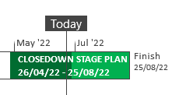
XRN5289 – November 21 Major Release - Status Update
 | Overall Project RAG Status
 | Schedule | Risks and Issues |  | Cost
RAG Status
Status Justification
Schedule | XRN4992a: Post Implementation Support completed on 26/05 Fix successfully deployed on 27/05 for issue identified with the level of aggregation in the RTB invoice XRN5188b: Post Implementation Support completed on 26/05 MAP ID data interim load completed on 25/05 Closedown in progress for all November 21 in scope changes Decision in July ChMC: Approval of Nov 21 Change Completion Report (CCR) |  | XRN5289
Risks and Issues | None
Cost | Forecast to complete delivery against approved BER
Scope | In Scope - XRN4941 - MOD0692 - Auto updates to meter read frequency In scope - XRN5007 - Enhancement to reconciliation process where prevailing volume is zero​ In Scope - XRN5072 - Application and derivation of TTZ indicator and calculation of volume and energy – all classes​ In Scope - XRN5142 - New allowable values for DCC Service Flag in DXI File from DCC​ In Scope - XRN5180 - Inner tolerance validation for replacement reads and read insertions​ In Scope - XRN4780C – Inclusion of Meter Asset Provider Identity (MAP Id) in the UK Link system (CSS Consequential Change) In Scope - XRN4992a - Modification 0687 Clarification of Supplier of Last Resort (SoLR) Cost Recovery Process In Scope - XRN5188b - Interim Data Loads of MAP Id into UK Link Descoped - XRN5091 - Deferral of creation of Class change reads at transfer of ownership​ Descoped - XRN5186 MOD0701 – Aligning capacity booking under the UNC and arrangements set out in relevant NExAs​ Descoped - XRN5187 MOD0696 – Addressing inequalities between capacity booking under the UNC and arrangements set out in the relevant NExAs
Complete
On Track
At Risk
Overdue
Not Baselined
Slide updated on 27th June 2022

Slide 38
CCR for November 2021 Major Release
- Voting: Shipper, DNO, IGT

Slide 39
December 21 - April 22 Changes in Design Update

Slide 40
Dec 21 - April 22 Changes in Design – Shipper Status Update
XRN Title | Target Detailed Design Date | Risk & Issues / RAG | Cost RAG | Key Messaging
XRN4978 - Notification of Rolling AQ Value (following Transfer of Ownership between M-5 and M) |  |  |  | Change Pack approved at ChMC on 11/05/22
XRN4990 - Transfer of Sites with Low Read Submission Performance from Class 2 and 3 into Class 4 (MOD0664) |  |  |  | Change Pack approved at ChMC on 08/06/22
XRN4992B - Modification 0687 Clarification of Supplier of Last Resort (SoLR) Cost Recovery Process |  | Issue ID 67431: There is a issue that a MOD has been raised to include IGT sites into SoLR charging Action: Submit Change request to impact assess the inclusion of iGT sites and incorporating the change in Feb23 release |  | Change Pack approved at ChMC on 08/06/22
XRN5091 - Deferral of creation of Class change reads at transfer of ownership | June 2022 – Consultation​ ​July 2022 - Approval |  |  | Change Pack submitted on 13/06/22 Seeking approval at ChMC on 13/07/22
XRN5186 - MOD0701 - Aligning Capacity booking under the UNC and arrangements set out in relevant NEXAs | June 2022 – Consultation July 2022 - Approval |  |  | Change Pack submitted on 13/06/22 Seeking approval at ChMC on 13/07/22
Slide updated on 27th June 2022
Notes:
u

Slide 41
Dec 21 - April 22 Changes in Design – DN Status Update
XRN Title | Target Detailed Design Date | Risk & Issues / RAG | Cost RAG | Key Messaging
XRN4900 - Biomethane/Propane Reduction |  |  |  | Change Pack approved at ChMC on 08/06/22
XRN5186 - MOD0701 - Aligning Capacity booking under the UNC and arrangements set out in relevant NEXAs | June 2022 – Consultation July 2022 - Approval |  |  | Change Pack submitted on 13/06/22 Seeking approval at ChMC on 13/07/22
XRN5298 - H100 Fife Project – Hydrogen Network Trial | June 2022 - Approval | Issue ID 67645: The detailed design Change Pack has not be approved as MOD0799 is still outstanding​ Action: Accept Issue. Decision will be taken at ChMC in July as to whether this will be approved and taken into delivery for Feb23 release |  | Change Pack deferred at ChMC on 08/06/22 as UNC MOD0799 is still under consultation Seeking approval at ChMC on 13/07/22
Slide updated on 27th June 2022

Slide 42
DDP Update

Slide 43
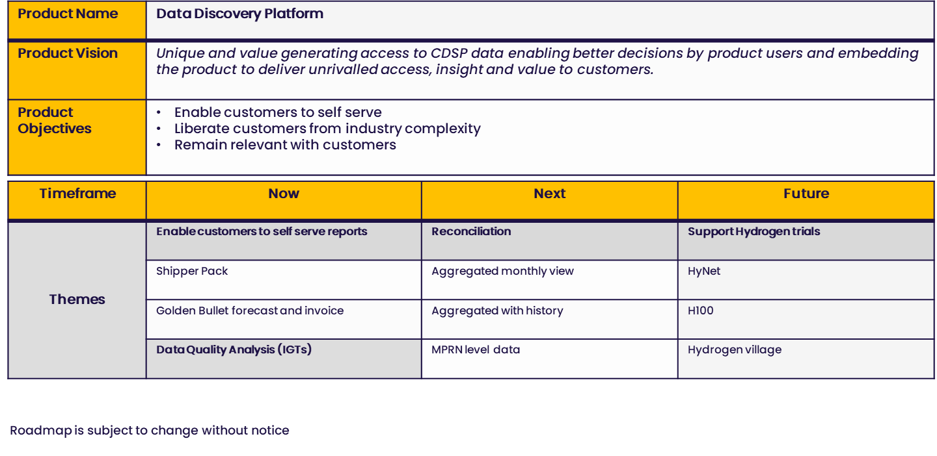

Slide 44
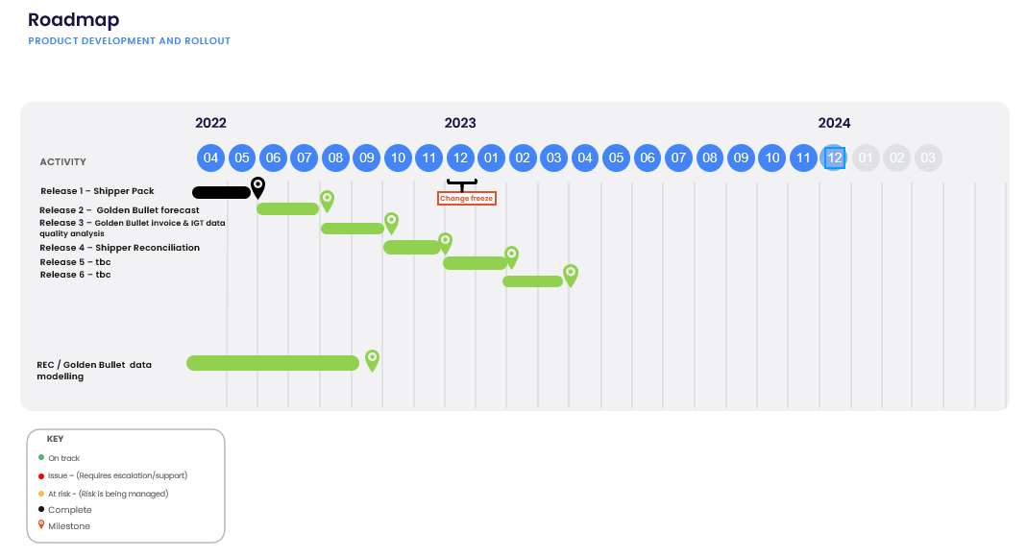

Slide 45
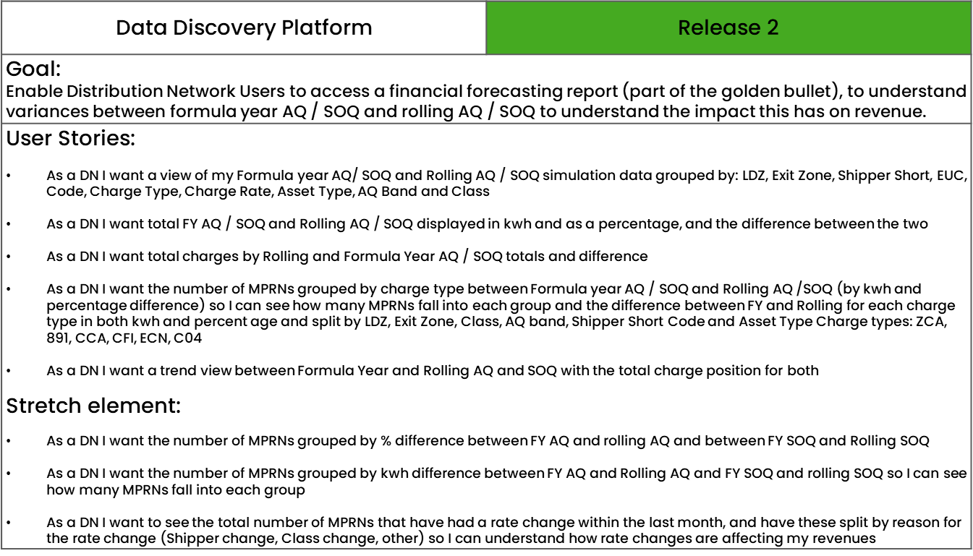

Slide 46
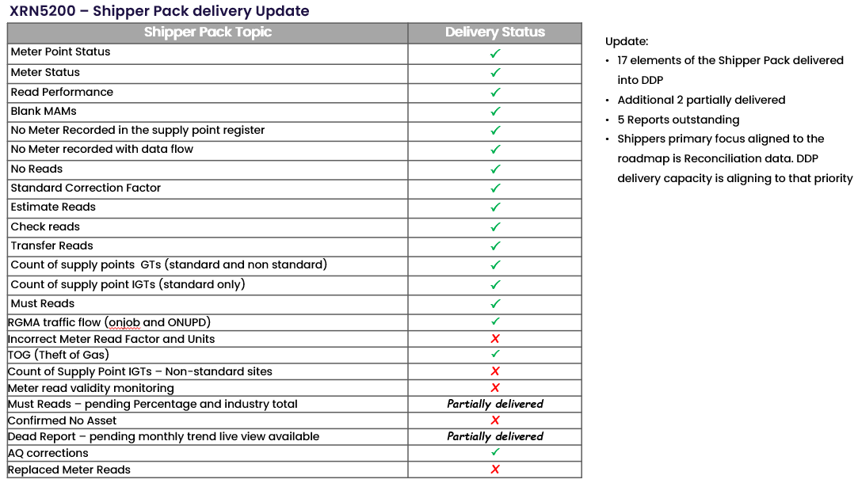

Slide 47
NG TRANSMISSION CHANGE HORIZON PLAN
0 - 2 YEARS JUNE 2022 – MAY 2024
JULY 2022

Slide 48
NG TRANSMISSION CHANGE HORIZON PLAN 0-2 YEARS JUNE 2022 – MAY 2024
Programmes & Projects 2022-2024 |  |  |  | 2022 |  |  |  |  |  |  | 2023
 |  |  |  | Jun | July | Aug | Sept | Oct | Nov | Dec | Jan | Feb | Mar | Apr | May
 | Regulatory / Customer Requested Change | PM Emma Catton | XRN5455 Autumn Release
MAJOR RELEASES | Regulatory / Customer Requested Change | PM Matthew Rider | XRN5393 Gemini Spring 22 Release
 | UK Link Consequential Changes | PM Karl Davidson | XRN5231 Flow Weighted Average CV FWACV
 | Gemini Change Programme Sustain | PM Emma Catton | XRN5368.2 Single Sign on Experience
 |  |  | XRN5368.3 API Enhancements
 |  |  | XRN5368.5 Site Minder Upgrade
Design to PIS –Apr 22 to Nov 22
Complete
GO Live
1st Sep
Design to PIS - Nov 21 to Nov 22
KEY RISK & % = Certainty of Scope
 | Approved on Track
 | Approved
 | Approval at Risk
 | Change Completion Report
 | External User Activity
Complete
Complete
KEY – Project Status
On Track
Complete
Potential Risk to Plan
Plan at Risk
Complete
Notes:
XRN5393 – Gemini Spring 22 Release - RFC
CHG0033706 - Go Live 25/02 - UNC785 - Aggregate Bacton Exit Points - Part A (Operational)
CHG0033667 - Contingency 27/02 - UNC785 - Aggregate Bacton Exit Points - Part A (Operational)
CHG0033668 - Go Live 03/04 - UNC785 - Aggregate Bacton Exit Points - Part B (Charging Theory)
CHG0033767 - Contingency 10/04 - UNC785 - Aggregate Bacton Exit Points - Part B (Charging Theory
XRN5231 - Flow Weighted Average - RFC
CHG0033749 – Go Live 30/06 - Flow weighted Average CV Calculation
XRN5368.2 - Single Sign on Experience - RFC
CHG0033809 – Go Live 29/05 - SSO/MFA /SSPR
CHG0033828 – Contingency 12/06 - SSO/MFA /SSPR - Placeholder
XRN5368.3 - API Enhancements - RFC
CHG0033766 Go Live 10/04 - Azure APIM API’s over the internet - TBC
XRN5368.1 - Control M and Batch Processing - RFC
CHG0033808 Go Live 01/03 - Deletion & Housekeeping
CHG0033810 Go Live 15/03 - Deletion & Housekeeping
XRN5368.5 - Site Minder Upgrade - RFC
CHG0033777 - Siteminder upgrade - Prod change 1
CHG0033778 - Siteminder upgrade - Prod change 2 - Log4j re-fix.

Slide 49
Section 5: Non-DSC Change Budget Impacting Programmes

Slide 50

CSSC Programme Dashboard
July 2022

Slide 51
Programme Health – RAG
Overall Programme Status | Previous | Current | The programme is reflective of a Green Status with all activities tracking to plan A Go decision for the Switching Programme implementation was approved at Delivery Group on the 30th June
Programme Plan | Previous | Current
Risk Profile | Previous | Current
Resources | Previous | Current
Executive Summary |  |  |  | Upcoming Activities & Milestones (Next Month)
Transition Stage 2 Activities continue to plan. This phase ends on ***** Transition Stage 3 Activities continue to track to plan. Key documentation has been reviewed and signed off by all key stakeholders in readiness for governance and Go/No Go activities. Our internal Go/No Go is planned and is on track for a Go decision All cutover activities are tracking to plan with all resource, governance and processes in place for the cutover weekend PIS PIS approach has been signed off with parties all clear and roles and activities for this period. All activities are tracking to plan for both readiness and support. War room is set up with appropriate model and processes in place. Bridge and processes are in place with the central switching team in readiness for Day 1 Business Change Tracking to plan with internal governance and criteria in place and approved in readiness for Go/No Go decision. Awareness and knowledge transfer will be completed for Go-Live |  |  |  | Transition Stage 2 continued monitoring Refinement of Transition Stage 3 Activities Continue OAT and PT Testing Continued Business change activities which includes new operating model Continued Post Implementation Support Activities
e

Slide 52
ChMC CMS Rebuild
July Update

Slide 53
Progress to Date
The CMS Rebuild Team have now completed the Meter Number Creation Process (MNC) and have commenced building the new Supplier Theft of Gas (SUT).
After the User Story sizing exercise to estimate the scale of Release 1 the number of processes remains at two. We had previously advised that we were investigating if Address Amendments (ADD) could be included. However, due to the complexities of the process it would not be able to be delivered in time for Release 1. A good proportion of the generic functionality has been developed in order to build MNC and SUT and therefore we are anticipating that we can release additional processes more quickly in a number of releases to ensure customers receive the benefit of the new CMS as soon as possible. Release 1.1 will follow shortly after Release 1 containing the Duplicates (DUP) process.
Release 1 is still targeted to be released in October / November 2022. The delivery date will be communicated out by the end of July.
We are launching Alpha Trials in July to the Customer Focus Group attendees. This will provide those attendees access to a sandbox environment which they can navigate through the processes as they are being developed. Alpha Trials will enable us to obtain real-time feedback from customers on the solution, showcase Agile delivery and generate familarisation. This will assist with the Beta Trials (External UAT) rollout which we are currently scheduling for September 2022. Additional information can be found on the following slide, this will also be discussed in detail at the Customer Focus Group on 06 July 2022.
The CMS Rebuild webpage (https://www.xoserve.com/products-services/data-products/contact-management-service-cms/cms-rebuild-product/ ) contains the link to register for future Customer Focus Groups which are captured below, please note the agenda for the Focus Groups will be issued 7 days prior to the session:
Further updates will be provided in August ChMC.
Date | Time Start | Time end
09/08/2022 | 10:00 | 12:00
09/09/2022 | 10:00 | 12:00
14/10/2022 | 10:00 | 12:00
08/11/2022 | 10:00 | 12:00
09/12/2022 | 10:00 | 12:00
10/01/2023 | 10:00 | 12:00
07/02/2023 | 10:00 | 12:00
07/03/2023 | 10:00 | 12:00

Slide 54
Alpha Trials – Customer Focus Group
The CMS Rebuild Customer Focus Group (CFG) contains attendees from 21 Organisations (below), who will be invited to partake in Alpha Trials.
  DNs – 15 individual attendees
  IGTs – 12 individual attendees
  Large Shippers – 12 individual attendees
  I&C Shippers - 13 individual attendees
  Small and Medium Shippers – 4 Individual attendees
Key benefits of Alpha Trials
  Confirmation from a target customer group that the system is working as expected
  Obtain early feedback on User Interface and Customer Journey
  Obtain early insight into user behaviour
  Generates familiarisation with the software for customers
  Produces considerations for the Beta (External UAT) phase
Proposed Timeline
July
August
September
Activities
CFG
Alpha Trials
Beta (External UAT)

Slide 55
Move To Cloud Update
Verbal Update presented by Emma Lyndon

Slide 56
Section 6: AnY Other Business

Slide 57
New Format for ROM requests

Slide 58
Appendix

Slide 59
Outages
Outages
Change Request Number | Impacted System | Outage Duration |  |  |  |  | Committee Notified Date
 |  | Start Date | Start Time | End Date | End Time | Brief Description
XRN 5301 | UKLink Portal | 02/07/2022 | 09:00 | 04/07/2022 | 07:00 | As part of the UK Link move to Cloud Programme, an extended outage will be required to complete implementation and cutover activities for the new DES & Portal screens. These systems will be unavailable for use from 2nd July 09:00 to 4th July 07:00 | 09/02/2022
CHG0033709 | Gemini | 18/06/2022 | 03:15 | 18/06/2022 | 07:30 | Gemini Disaster Recovery Test 2022 This is an annual activity to confirm Gemini services can be migrated to a secondary data centre location should there be a catastrophic failure within the primary data centre. During this phase of the test Gemini services will failover from the primary site to the secondary site. The activity starts within the scheduled maintenance window and the system will operate normally during times where there is no outage. | 13/04/2022
CHG0033709 | Gemini | 19/06/2022 | 03:00 | 19/06/2022 | 07:30 | Gemini Disaster Recovery Test 2022 During this phase of the test Gemini services will failback from the secondary site to the primary site. Again the activity starts within the scheduled maintenance window and the system will operate normally during times where there is no outage. | 13/04/2022
CHG0033562 | CMS | 30/07/2022 | 00:00 | 30/07/2022 | 07:00 | CMS Disaster Recovery Test 2022 This is an annual activity to confirm CMS (Contact Management Service) services can be migrated to a secondary data centre location should there be a catastrophic failure within the primary data centre. During this phase of the test CMS services will failover from the primary site to the secondary site. NOTE: This activity will run during the normal CMS maintenance window so no extended outage is expected however if we experience issues when the system is released there may be an extended outage until 11:00 as we revert the system back | 08/06/2022 Dates amended
CHG0033562 | CMS | 31/07/2022 | 00:00 | 31/07/2022 | 07:00 | CMS Disaster Recovery Test 2022 During this phase of the test CMS services will failback from the secondary site to the primary site. NOTE: This activity will run during the normal CMS maintenance window so no extended outage is expected however if we experience issues when the system is released there may be an extended outage until 11:00 as we revert the system back | 08/06/2022 Dates amended

Slide 60
Portfolio POAP

Slide 61
CSSC Programme Dashboard
July 2022

Slide 62
Programme Health – RAG
Overall Programme Status | Previous | Current | The programme is reflective of a Green Status with all activities tracking to plan A Go decision for the Switching Programme implementation was approved at Delivery Group on the 30th June
Programme Plan | Previous | Current
Risk Profile | Previous | Current
Resources | Previous | Current
Executive Summary |  |  |  | Upcoming Activities & Milestones (Next Month)
Transition Stage 2 Activities continue to plan. This phase ends on ***** Transition Stage 3 Activities continue to track to plan. Key documentation has been reviewed and signed off by all key stakeholders in readiness for governance and Go/No Go activities. Our internal Go/No Go is planned and is on track for a Go decision All cutover activities are tracking to plan with all resource, governance and processes in place for the cutover weekend PIS PIS approach has been signed off with parties all clear and roles and activities for this period. All activities are tracking to plan for both readiness and support. War room is set up with appropriate model and processes in place. Bridge and processes are in place with the central switching team in readiness for Day 1 Business Change Tracking to plan with internal governance and criteria in place and approved in readiness for Go/No Go decision. Awareness and knowledge transfer will be completed for Go-Live |  |  |  | Transition Stage 2 continued monitoring Refinement of Transition Stage 3 Activities Continue OAT and PT Testing Continued Business change activities which includes new operating model Continued Post Implementation Support Activities
e

Slide 63
Workstream Updates
RAG Previous month | RAG Current months | Work stream | SUMMARY
 |  | Transition | Overall Transition RAG is Green No significant risks Key critical activities are on-track or planned in the case of stage 3 implementation planning All key resource and processes are in place for the cutover weekend of the 16th and 17th July
 |  | Testing | The overall RAG is Green SME assurance activities continue for regression packs and CR’s Concluding the last remainder of CR code testing including final regression tests. All on track No critical risks being held MI and reporting in place in readiness for governance and Go-No/Go approvals
 |  | Non-Functional Test (Performance, operational acceptance testing and operational testing) | The overall RAG is Amber tracking to Green Amber status due to 3 P2 defects with AMT. Issues found following issues with AMT regression code. These defects have been fixed and we are deploying into environment and will run regression tests Dependency on IPT testing has been resolved OAT testing continues and is on track Minor elements will be moved to a work off plan following senior stakeholder agreement

Slide 64
Workstream Updates
RAG previous month | RAG current month | Work stream | SUMMARY
 |  | CSSC – UK Link | The overall RAG is Green All change requests still on track for delivery CR0196 Reconciliation Report – TS and System testing documentations issued for review to Tech Ops and testing workstream. CR252 Schema Changes and Go-live Configuration. CR issued for approval, planning and preparatory activities in progress. Production deployment planned for 04/06 New exceptions SLA’s agreed as part of the business change activities
 |  | CSSC – API | The overall RAG IS Green All build activities complete Customer portal activities on track Onboarding activities planned for next week for API’s Cutover planning and resource in place in readiness for cutover weekend MI and reporting in place in readiness for governance and Go-No/Go approvals

Slide 65
Workstream Updates
RAG previous month | RAG current months | Work stream | SUMMARY
 |  | Service Management | The overall RAG is Green Processes in place New processes and knowledge transfer in situ and due to complete prior to Go Live for primary processes Knowledge transfer will continue during PIS period with support teams working alongside Programme teams
 |  | Early life support | The overall RAG is Green PIS readiness ongoing Knowledge transfer has commenced in readiness for transfer to support target model WAR room in place including processes, resource and out of hours rotas TOM tracking to plan
 |  | Environments | The overall RAG is Green Post Go Live environment confirmation has been provided to the Central Programme following mandatory request
 |  | Batch | The overall RAG is Green – all on track for Go-Live Allbeen raised and completed

Slide 66
Workstream Updates
RAG previous month | RAG Current month | Work stream | SUMMARY
 |  | Business Change | The overall RAG is Green Prioritised areas of work are planned and in progress as per the change impact assessment For the unhappy path we are pending the update from the Industry Workshop to understand cut off times for messages Raised questions with DCC and the SI in respect of customer queries, pending a definitive answer on how a customer raises a query and if a set of FAQ’s is being raised and published by the Programme Continue to work through internal business awareness sessions with the whole organisation via a set of dedicated topics. Each topic is recorded A further external CSSC training day has taken place
 |  | Gemini | The overall RAG is Green All activities are tracking to plan

Slide 67
Key Programme Risks
RTC | RAG | Workstream | Description | Mitigation Strategy | Latest Update | Resolution Date
64002 |  | Programme | There is a risk that ongoing pipeline of customer driven and regulatory change within the industry could impact the CSSC and wider Switching Programme delivery because of technical conflict with the design of other changes and demand on resources across Xoserve and the customer teams involved in Switching Programme delivery leading to additional regression testing activity, CRs raised to modify solutions already developed and tested by the programme, delays to the overall Switching Programme, and therefore unplanned costs for Xoserve. | 1. Discuss the potential for change moratoria with Ofgem that could restrict the volume of change being made and in particular mitigate some of this risk in relation to coding impacts 2. Investigate the availability of and if necessary invest in tooling to support more enhanced branching and merging in terms of development to mitigate the technical impact of any non-CSSC changes. 3. Work with the SI to monitor for any potential impact on programme resources, including customer resources, that may result from change initiatives running in parallel with critical path Switching Programme phases. | Continues to be monitored | 31/10/22
67421 |  | Transition | There is a risk that Xoserve activities are delayed during actual transition or contingency is lost because CSS do not deliver the required dependency as per the planned dates leading to xoserve activities needing to be replanned and contingency reduced or potentially all transition activities needing to be replanned | Raise with SI transition group | Continue to monitor throughout transition | 18/07/22
64513 |  | Data | There is a risk that data cleansing requirements may not be met because Xoserve are not responsible for the data in UK Link, and can't compel shippers / GTs / iGTs to correct their data leading to incorrect data at the point of go live. | Communicate requirements through DSG and track progress | Probability has reduced however there is no monitoring of the cleansing so risk remains open but minimal. | 18/07/22
67839 |  | Business Change | There is a risk that not all customers will have migrated to new APIs that have changed as part of the programme ahead of go live because of a lack of understanding of the need to do this and the consequences of not doing this leading to a loss of relevant switching service API activities that the user has access to today. | 1. Send information pack to affected parties with key dates 2. CAM outreach to users 3. Simplify forms that users need to complete to sign up 4. Send comms to customers via RECco. | 34/40 responses received. Still chasing the remaining customers. The risk remains that some customer will lose access to GES, however the impact is mitigated by the audit trail we have of attempts to contact them. | 18/07/22
67959 |  | Programme | There is a risk that the GES contract between RECCo and Xoserve cannot be agreed because of the draft MSC terms provided by RECCo misaligning with the terms of the DSC that binds Xoserve, leading to services being provided without a contract and at risk, or in the non- provision of the Gas Enquiry Service unless funded directly by DSC Customers. | Xoserve proposed draft terms based on previously agreed industry terms (DSC) Continued discussions between both parties Escalation to Xoserve and RECCo CEOs Discuss further with CoMC | Contract negotiations between Xoserve and RECCo are progressing, and are nearing completion. | 17/07/22

Slide 68
Key Programme Risks
RTC | RAG | Workstream | Description | Mitigation Strategy | Latest Update | Resolution Date
66906 |  | Programme | There is a risk that UK Link may become out of sync because CSS may send secure active messages later than expected (circa 5:35pm) because of any upstream delays from CSS leading to a data mismatches between UK Link and CSS and more importantly Gemini and settlement issues which are incredibly difficult to correct. | Xoserve have raised CR-D129 to mitigate this risk. Discussions ongoing with programme stakeholders | Conversations with Xoserve/DCC continue. REC conversations in relation to CRD-129 being planned in. Industry discussions to be held w/c 27/6 | 01/07/22
66599 |  | Programme | There is a risk that the Transition phase of the Switching Programme may be adversely impacted as a result of SoLR activities consuming the focus and efforts of Business and Operational teams who had been planned to be focused on Switching Programme Transition activities leading to a potential impact to Transitional activities as planned currently (March 2022) | Liaise with Switching Programme stakeholders to agree mitigations | Continues to be monitored | 18/07/22
66908 |  | Programme | There is a risk that the industry has not defined and agreed joint processes should key central components such as CSS go down during key times in the day (e.g. Gate Closure) because CSS BC/DR processes have been approved without addressing the queries and caveats called out during the consultation process leading to the possibility that should a DR event occur, downstream impacts are not understand or mitigated | This will be raised with REC and Ofgem | This has been escalated as part of the Xoserve Readiness assesment | 30/09/22
64171 |  | Transition and Cutover | There is a risk that the SoLR process might kick off during the transition period because of a supplier going out of business at that time leading to Landmark needing to cater to additional volumes and also the potential for additional requirements for PUIs to undertake to ensure Transition timelines are maintained | Raise the risk with Ofgem and SI to understand what non-functional considerations have been applied to enable Landmark to manage the increased volumes Raise with the SI to include a transition test scenario if relevant to mitigate this possibility | Continues to be monitored | 18/07/22
65122 |  | Transition and Cutover | There is risk that additional Transitional changes could change scope of Transition because more changes are identified as Transition planning continues at the Central programme level leading to changes to the Transition plan and Xoserve planned activities. | Xoserve are actively involved in all programme work groups to monitor and mitigate this risk. | Continue to monitor, low exposure at this point | 15/07/22

Slide 69
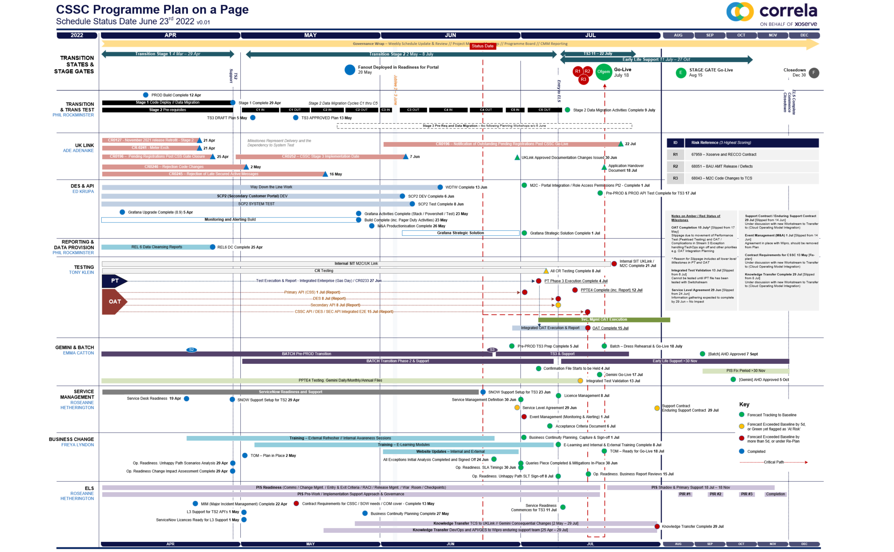

Slide 70
Switching Programme CR Position – CRs impacting Xoserve
CR Name | CR Ref | High Level Cost IA Cost | Date Raised | Status
Programme Plan Re-Baseline | CR-D002 | £0.00 | 07/11/2019 | Approved - Complete
Updates to the CSS Physical Interface Design (PhID). | CR-D008 | £17,250.00 | 22/01/2020 | Approved - Internal CR Created
CSS_Exception_Handling_Strategy_v0.2 | CR-D014 | £0.00 | 26/02/2020 | Approved - Internal CR Created
Provide_CSS_RegistrationID_to_PUI_and_LPs | CR-D016 | £12,643.00 | 07/08/2020 | Approved - Internal CR Created
Licence Exempt Network Customer Identifier – ABACUS Data Model update | CR-E51 | £0.00 | 29/10/2019 | Approved - Complete
Amendments to the DMS artefact suite | CR-D019 | £6,500.00 | 16/03/2020 | Approved - Internal CR Created
Migration of Terminated Gas RMPS | CR-D022 | £0.00 | 10/06/2020 | Approved - Internal CR Created
Amendments to the NC-0079 for REL (Retail Energy Location) Data Migration and Reconciliation | CR-D024 | £20,000.00 | 06/07/2020 | Approved - Internal CR Created
DMS - PHID Alignment Parties | CR-D026 | £0.00 | 06/07/2020 | Approved - Internal CR Created
Request For a New or Upgraded DMT Environment | CR-D027 | £256,009.00 | 07/08/2020 | Approved - Internal CR Created
Enable TLS connection pooling for all directly connected parties to CSS] | CR-D028 | £2,500.00 | 13/07/2020 | Approved - Internal CR Created
Message Header Format for PKI Certificate Identification] | CR-D029 | £2,500.00 | 13/07/2020 | Approved - Internal CR Created
SIT Functional Test Re Plan Enabling Parallel Testing | CR-D030 | £56,000.00 | 20/07/2020 | Approved - Internal CR Created
DM_Validation Catalogue_Shipper_Effective_Date_Change_ | CR-D032 | £0.00 | 03/08/2020 | Approved - Internal CR Created
Compression During Data Migration | CR-D034 | £500.00 | 09/09/2020 | Approved - Internal CR Created
Uplift to the CSS Interface Specifications | CR-D038 | £70,000.00 | 07/10/2020 | Approved - Internal CR Created
Uplift to Business Data Validation Rules | CR-D039 | £20,000.00 | 25/09/2020 | Approved - Internal CR Created
Programme Plan Re-Baseline | CR-D042 | £14,913,000.00 | 28/09/2020 | Approved - Internal CR Created
Changes to Support Energy Company Data | CR-D059 | £37,500.00 | 03/08/2021 | Approved - Internal CR Created
Amendment of Data Migration Solution to Protect Programme Timescales - Removal of Transition Stage 1 Delta files | CR-D062 | £83,490.00 | 25/02/2021 | Approved - Internal CR Created
Change to Management of In-Flight Switches Approach | CR-D071 | £0.00 | 15/03/2021 | Approved - Internal CR Created
Increase Cadence of Data cuts | CR-D080 | £24,600.00 | 10/05/2021 | Approved - Internal CR Created
Amendment to Assumptions as a result of analysis undertaken during CP1 v0.4] | CR-D083 | £0.00 | 24/05/2021 | Approved - Complete
TT Remediation & Paper-Based Testing Workshop | CR-D095 | £10,000.00 | 23/08/2021 | Approved - Complete
Changes to DB4 document; “E2E Transition Plan – Implementation Approach’ to remove the requirement to expose the REL | CR-D105 | £0.00 | 31/08/2021 | Approved - Internal CR Created
Additional Regression Testing cycles | CR-D113 | £20,000.00 | 19/11/2021 | Approved - Internal CR Created
Amendments to NCD-0008 Data Cleansing Catalogue v1.5 to reflect new updated data cleansing requirements following DA310 analysis of industry data cleansing progress | CR-D115 | £0.00 | 25/10/2021 | Approved - Internal CR Created
Uplifting the CSS Interface Specification Design document from v8.5 to v8.7 and the CSS Business Data Validation Rules document from v1.2 to v1.3 | CR-D134 | £15,680.00 | 10/03/2022 | Approved - Internal CR Created
Additional explanatory notes added to Switching Supplier of Last Resort Service Design document | CR-D141 | £15,680.00 | 20/05/2022 | Pending IA

Slide 71
Switching Programme CR Position – CRs impacting Xoserve
CR Name | CR Ref | High Level Cost IA Cost | Date Raised | Status
Programme Plan Re-Baseline | CR-D002 | £0.00 | 07/11/2019 | Approved - Complete
Updates to the CSS Physical Interface Design (PhID). | CR-D008 | £17,250.00 | 22/01/2020 | Approved - Internal CR Created
CSS_Exception_Handling_Strategy_v0.2 | CR-D014 | £0.00 | 26/02/2020 | Approved - Internal CR Created
Provide_CSS_RegistrationID_to_PUI_and_LPs | CR-D016 | £12,643.00 | 07/08/2020 | Approved - Internal CR Created
Licence Exempt Network Customer Identifier – ABACUS Data Model update | CR-E51 | £0.00 | 29/10/2019 | Approved - Complete
Amendments to the DMS artefact suite | CR-D019 | £6,500.00 | 16/03/2020 | Approved - Internal CR Created
Migration of Terminated Gas RMPS | CR-D022 | £0.00 | 10/06/2020 | Approved - Internal CR Created
Amendments to the NC-0079 for REL (Retail Energy Location) Data Migration and Reconciliation | CR-D024 | £20,000.00 | 06/07/2020 | Approved - Internal CR Created
DMS - PHID Alignment Parties | CR-D026 | £0.00 | 06/07/2020 | Approved - Internal CR Created
Request For a New or Upgraded DMT Environment | CR-D027 | £256,009.00 | 07/08/2020 | Approved - Internal CR Created
Enable TLS connection pooling for all directly connected parties to CSS] | CR-D028 | £2,500.00 | 13/07/2020 | Approved - Internal CR Created
Message Header Format for PKI Certificate Identification] | CR-D029 | £2,500.00 | 13/07/2020 | Approved - Internal CR Created
SIT Functional Test Re Plan Enabling Parallel Testing | CR-D030 | £56,000.00 | 20/07/2020 | Approved - Internal CR Created
DM_Validation Catalogue_Shipper_Effective_Date_Change_ | CR-D032 | £0.00 | 03/08/2020 | Approved - Internal CR Created
Compression During Data Migration | CR-D034 | £500.00 | 09/09/2020 | Approved - Internal CR Created
Uplift to the CSS Interface Specifications | CR-D038 | £70,000.00 | 07/10/2020 | Approved - Internal CR Created
Uplift to Business Data Validation Rules | CR-D039 | £20,000.00 | 25/09/2020 | Approved - Internal CR Created
Programme Plan Re-Baseline | CR-D042 | £14,913,000.00 | 28/09/2020 | Approved - Internal CR Created
Changes to Support Energy Company Data | CR-D059 | £37,500.00 | 03/08/2021 | Approved - Internal CR Created
Amendment of Data Migration Solution to Protect Programme Timescales - Removal of Transition Stage 1 Delta files | CR-D062 | £83,490.00 | 25/02/2021 | Approved - Internal CR Created
Change to Management of In-Flight Switches Approach | CR-D071 | £0.00 | 15/03/2021 | Approved - Internal CR Created
Increase Cadence of Data cuts | CR-D080 | £24,600.00 | 10/05/2021 | Approved - Internal CR Created
Amendment to Assumptions as a result of analysis undertaken during CP1 v0.4] | CR-D083 | £0.00 | 24/05/2021 | Approved - Complete
TT Remediation & Paper-Based Testing Workshop | CR-D095 | £10,000.00 | 23/08/2021 | Approved - Complete
Changes to DB4 document; “E2E Transition Plan – Implementation Approach’ to remove the requirement to expose the REL | CR-D105 | £0.00 | 31/08/2021 | Approved - Internal CR Created
Additional Regression Testing cycles | CR-D113 | £20,000.00 | 19/11/2021 | Approved - Internal CR Created
Amendments to NCD-0008 Data Cleansing Catalogue v1.5 to reflect new updated data cleansing requirements following DA310 analysis of industry data cleansing progress | CR-D115 | £0.00 | 25/10/2021 | Approved - Internal CR Created
Uplifting the CSS Interface Specification Design document from v8.5 to v8.7 and the CSS Business Data Validation Rules document from v1.2 to v1.3 | CR-D134 | £15,680.00 | 10/03/2022 | Approved - Internal CR Created
Additional explanatory notes added to Switching Supplier of Last Resort Service Design document | CR-D141 | £15,680.00 | 20/05/2022 | Pending IA

Slide 72
Switching Programme CR Position – CRs not impacting Xoserve
CR Name | CR Ref | Date Raised | Status
Non_Mandatory_MPAS_Metered_Indicator_v0.4 | CR-D001 | 27/01/2020 | Complete - No Xoserve Impact
REC Manager Procurement Timelines | CR-D003 | 02/12/2019 | Complete - No Xoserve Impact
MPAS Related MPAN Disconnection | CR-D004 |  | Withdrawn
Introduction of Validation Message to Logical Mode | CR-D005 | 25/11/2019 | Withdrawn
Modification of Related MPAN Cleanse Checkpoint Milestones | CR-D006 | 27/11/2019 | Complete - No Xoserve Impact
ABACUS Corrections and Re-alignments | CR-D007 | 04/12/2019 | Complete - No Xoserve Impact
ECOES REL API Webmethod | CR-D009 | 17/12/2019 | Complete - No Xoserve Impact
CSSIA Uplift to Implement IG Recommendations | CR-D010 | 17/12/2019 | Complete - No Xoserve Impact
Update 3 E2Es to align to CSSIA | CR-D011 | 10/06/2020 | Complete - No Xoserve Impact
CSS_Physical_Interface_Design_Updates_mpxn_v0.2 | CR-D012 | 30/01/2020 | Complete - No Xoserve Impact
Messaging_Requirements_Revisions_REC_Code_Manager_and_CSS_v0.1 Clean | CR-D013 | 28/01/2020 | Complete - No Xoserve Impact
Amendment_of_Xoserve_Consequential_Change_Milestone_Delivery_Dates_v0.2[DRAFT] | CR-D015 | 26/02/2020 | Withdrawn
CSS_Handling_of_MPAS_Business_Dates_v0.2[DRAFT] | CR-D017 | 20/07/2020 | Complete - No Xoserve Impact
Confirmation_Responses_to_Outbound_Synchronisations_v0.2[DRAFT] | CR-D018 | 02/03/2020 | Withdrawn
Regulatory Workstream – Programme Milestones Refresh | CR-D020 | 16/03/2020 | Withdrawn
Remove MPAS Interface | CR-D021 | 29/04/2020 | Withdrawn
DSP_Specific_ SIT_ Functional_Exit_Criteria | CR-D023 | 29/05/2020 | Complete - No Xoserve Impact
Changes to support enhanced Solar arrangements | CR-D025 |  | Withdrawn
CSS Role-based access control (RBAC) | CR-D031 | 24/07/2020 | Withdrawn
A Quality Analysis Activity of the Data being used for the DMT Non-Functional Test Phase​​ | CR-D033 |  | Withdrawn
CSS Change from UTC to Local Time | CR-D035 | 22/09/2020 | Complete - No Xoserve Impact
Xoserve CR for DES AI Removal | CR-D036 | 24/09/2020 | Complete - No Xoserve Impact
Provide_CSS_RegistrationID_to_LPs | CR-D037 | 06/10/2020 | Complete - No Xoserve Impact
UEPT Tranche Regulatory Change | CR-D040 | N/A | Complete - No Xoserve Impact
NCT-0073 Functional Script Master Changes | CR-D041 | 25/09/2020 | Complete - No Xoserve Impact
Update to the End to End Testing Plan | CR-D043 | 05/10/2020 | Complete - No Xoserve Impact
Request For a New DMT Environment for DMT Live Rehearsal | CR-D044 | 23/10/2020 | Complete - No Xoserve Impact
NC-0079 Adding Post Load Integrity Check Document | CR-D045 | 09/11/2020 | Complete - No Xoserve Impact
Uplift to the Code of Connection | CR-0046 | 09/11/2020 | Complete - No Xoserve Impact
Correctional Changes to MAD Log v2.0 & POAP v2.0 | CR-D047 | 13/11/2020 | Complete - No Xoserve Impact
Changes to Data Milestones in MAD Log v2.0 & POAP v2.0 | CR-D048 | 09/11/2020 | Complete - No Xoserve Impact
Consequential Changes to Testing Milestones in MAD Log | CR-D049 | 13/11/2020 | Withdrawn
CSS Environments for Faster Switching Enduring Service | CR-D050 |  | Withdrawn
Changes to Data Validation Rules | CR-D051 | 30/11/2020 | Complete - No Xoserve Impact

Slide 73
Switching Programme CR Position – CRs not impacting Xoserve
CR Name | CR Ref | Date Raised | Status
Additional and Further Correctional Changes to MAD Log v2.0 | CR-D052 | 05/12/2020 | Complete - No Xoserve Impact
Additional Onward Dependencies for MAD Log | CR-D053 | 18/12/2020 | Complete - No Xoserve Impact
Changing from GetOrganised to Landmark SFTP for SI receiving files | CR-D054 | 18/12/2020 | Complete - No Xoserve Impact
Amendments to the Data Cleansing Catalogue | CR-D055 | 18/12/2020 | Complete - No Xoserve Impact
MAD Log Changes for UIT Environment Verification | CR-D057 | 25/01/2021 | Complete - No Xoserve Impact
Discontinuance of Xoserve Consequential Change Market Trials | CR-D058 | 25/01/2021 | Complete - No Xoserve Impact
Uplift to SMS CoCo | CR-D063 | 29/01/2021 | Complete - No Xoserve Impact
Changes to SIT Functional Test Scenarios | CR-D064 | 29/01/2021 | Complete - No Xoserve Impact
Uplift to the Code of Connection | CR-D065 | 29/01/2021 | Complete - No Xoserve Impact
In-Flight Reg ID Dissemination | CR-D066 |  | Withdrawn
Uplift to the CSS Business Data Validation Rules Doc | CR-D067 | 19/03/2021 | Complete - No Xoserve Impact
Uplift to the CSS Interface Specification | CR-D068 | 15/03/2021 | Complete - No Xoserve Impact
REL Dissemination to iDNO and DNO | CR-D069 | 15/03/2021 | Complete - No Xoserve Impact
Removal of UEPT Stage 1 Data Allocation and Verification for Tranche 3 and 4 Participants and delivery acceleration of Stage 2 Data Allocation | CR-D070 | 05/03/2021 | Complete - No Xoserve Impact
Re-align Switching Programme Response SLAs with Xoserve response SLAs | CR-D072 | 07/05/2021 | Complete - No Xoserve Impact
Changes to MAD Log v2.2 to rectify incorrect milestone descriptions | CR-D074 | 29/03/2021 | Complete - No Xoserve Impact
Update Service Management Baseline Requirement | CR-D076 | 20/04/2021 | Complete - No Xoserve Impact
Amend the Transition Testing Milestones TR210 & TR220 for PUI Production Data Cuts v0.4 | CR-D078 | 14/05/2021 | Complete - No Xoserve Impact
Removal of SMS005 from UEPT Test Scenarios v0.2 | CR-D081 | 14/05/2021 | Complete - No Xoserve Impact
Engagement for Early E2E Testing v0.2 | CR-D082 | 14/05/2021 | Withdrawn
Change to Transition Stage 3 File-Based Migration Sequencing v0.2 | CR-D084 | 26/05/2021 | Complete - No Xoserve Impact
Request for an additional Data Reconciliation Activity at the end of DMT Live Rehearsal Cycle 2 v0.2 | CR-D086 | 01/06/2021 | Withdrawn
Update to UIT E2E Plan and Artefacts to incorporate the additional scope identified on the outcome of REL Gap Analysis v0.7 | CR-D087 | 17/06/2021 | Complete - No Xoserve Impact
Elevation of L2-TR070 (Transition Stage 1 Start) to a L1 milestone | CR-D088 | 04/06/2021 | Complete - No Xoserve Impact
NC-0107 Master Handover Pack Purpose Change | CR-D089 | 04/06/2021 | Complete - No Xoserve Impact
REC Code Manager Market Intelligence Reporting | CR-D090 | 11/06/2021 | Complete - No Xoserve Impact
Removal of Transition Test Artefacts | CR-D091 | 24/06/2021 | Complete - No Xoserve Impact
Feasibility study on potential to update Domestic Premises Indicator (DPI) electricity flags to reflect license status during transition stages, 1, 2 & 3 | CR-D093 | 28/06/2021 | Complete - No Xoserve Impact
Changes to Operational Testing | CR-D094 | 28/06/2021 | Complete - No Xoserve Impact
Changes to milestone date for L3-TE720 | CR-D096 | 29/07/2021 | Complete - No Xoserve Impact
Continuation of support for UEPT | CR-D098 | 03/08/2021 | Withdrawn
Further consquential changes to DB4 and related artefacts following CR-D071 v0.2 | CR-D100 | 06/08/2021 | Complete - No Xoserve Impact
CSS Stage 1 ECOES Interface Specification Uplift to v2.0 | CR-D102 | 17/08/2021 | Complete - No Xoserve Impact
Documentation only updates to NCT-0134 DMT Live Rehearsal Test Plan and NCD-0012 Data Migration Solution Design Catalogue | CR-D103 | 17/08/2021 | Complete - No Xoserve Impact

Slide 74
Switching Programme CR Position – CRs not impacting Xoserve
CR Name | CR Ref | Date Raised | Status
Elaborations for Service Management Requirements DB4 | CR-D104 | 17/08/2021 | Complete - No Xoserve Impact
Update of the Code of Connection Document to reflect the Enduring PKI Process Updates | CR-D106 | 22/09/2021 | Complete - No Xoserve Impact
Addition of assumption on MAD Log in relation to earliest possible Go-Live date | CR-D107 | 15/09/2021 | Complete - No Xoserve Impact
Change to Data Migration and Transition artefacts following the completion of CR-D093 | CR-D108 | 15/09/2021 | Complete - No Xoserve Impact
Change to EES requirements to bring REL search and retrieval into closer alignment with GES and assessment of programme | CR-D109 | 15/09/2021 | Complete - No Xoserve Impact
Changes and additions to PIWG and CWG governed MAD Log v2.4 milestones to address timing and clarity issues | CR-D110 | 22/09/2021 | Complete - No Xoserve Impact
Transition Stage 1 – CSS ad-hoc data removal solution development based on Source Data Provider in response to DI-1655 remedial solution] | CR-D111 | 14/10/2021 | Complete - No Xoserve Impact
End to End Test Exit Criteria refinement and clarification of the decision making process | CR-D112 | 01/10/2021 | Complete - No Xoserve Impact
Clarification of Performance NFRs by apportioning the current target between Gas and Electricity and then further apportioning the Electricity targets by MPID | CR-D114 | 15/11/2021 | Complete - No Xoserve Impact
Update to E2E Transition Inflight Switches Management Approach Document | CR-D116 | 27/10/2021 | Complete - No Xoserve Impact
Operational Change Window and Type | CR-D117 | 25/10/2021 | Complete - No Xoserve Impact
Change to effect a Gas Supplier of Last Resort (SoLR) | CR-D118 | 03/11/2021 | Complete - No Xoserve Impact
GES Data Refresh SLA | CR-D119 | 10/11/2021 | Complete - No Xoserve Impact
Updates to NCT-0188 REL Testing Gap Analysis Report | CR-D120 | 10/11/2021 | Complete - No Xoserve Impact
Additional CSS Non-functional Requirements | CR-D121 | 11/01/2022 | Complete - No Xoserve Impact
ServiceNow Data Model Development - DNO/iDNO Adaptors | CR-D122 | 11/01/2022 | Complete - No Xoserve Impact
Addition of Network Operator Market Share to CSS Billing Report | CR-D123 | 26/11/2021 | Complete - No Xoserve Impact
Uplifting the CSS Business Data Validation Rules document to v1.3 | CR-D124 | 26/11/2021 | Withdrawn
Uplifting the CSS Interface Specification document to v8.7 | CR-D125 | 26/11/2021 | Withdrawn
Updates to the MAD Log v2.5 following RA110 Proposal | CR-D126 | 07/12/2021 | Complete - No Xoserve Impact
E2E Remove invalid test scenarios | CR-D127 | 03/12/2021 | Complete - No Xoserve Impact
Proposal for the implementation of Failed Supplier Portfolio report within CSS | CR-D128 | 07/12/2021 | Complete - No Xoserve Impact
Gas gate closure message cut-off timing | CR-D129 |  | Post Go-Live Change
Clarification of Performance NFRs for Operational Readiness | CR-D130 | 17/12/2021 | Complete - No Xoserve Impact
Further amendments to the Data Cleansing Catalogue v1.6 following DA605 (Pre-Transition Data Quality Checkpoint) Milestone. | CR-D131 | 22/03/2022 | Complete - No Xoserve Impact
Updates to the MAD Log V2.5 for Data and Regulatory Milestones | CR-D132 | 23/12/2021 | Complete - No Xoserve Impact
Update to Data Migration Artefacts to reflect fortnightly Registration Delta Files | CR-D133 | 14/03/2022 | Complete - No Xoserve Impact
Update of CSS Business Rules to resolve MPRS Refresh Design Issue | CR-D137 | 23/03/2022 | Complete - No Xoserve Impact
Additional explanatory notes to DCC Service Design documents | CR-D138 | 28/03/2022 | Complete - No Xoserve Impact
Updates to MAD Log v2.6 and replacement of D-4.3.5 E2E Post Implementation Plan | CR-D139 | 05/04/2022 | Complete - No Xoserve Impact

Slide 75
Switching Programme CR Position – CRs not impacting Xoserve
CR Name | CR Ref | Date Raised | Status
Non_Mandatory_MPAS_Metered_Indicator_v0.4 | CR-D001 | 27/01/2020 | Complete - No Xoserve Impact
REC Manager Procurement Timelines | CR-D003 | 02/12/2019 | Complete - No Xoserve Impact
MPAS Related MPAN Disconnection | CR-D004 |  | Withdrawn
Introduction of Validation Message to Logical Mode | CR-D005 | 25/11/2019 | Withdrawn
Modification of Related MPAN Cleanse Checkpoint Milestones | CR-D006 | 27/11/2019 | Complete - No Xoserve Impact
ABACUS Corrections and Re-alignments | CR-D007 | 04/12/2019 | Complete - No Xoserve Impact
ECOES REL API Webmethod | CR-D009 | 17/12/2019 | Complete - No Xoserve Impact
CSSIA Uplift to Implement IG Recommendations | CR-D010 | 17/12/2019 | Complete - No Xoserve Impact
Update 3 E2Es to align to CSSIA | CR-D011 | 10/06/2020 | Complete - No Xoserve Impact
CSS_Physical_Interface_Design_Updates_mpxn_v0.2 | CR-D012 | 30/01/2020 | Complete - No Xoserve Impact
Messaging_Requirements_Revisions_REC_Code_Manager_and_CSS_v0.1 Clean | CR-D013 | 28/01/2020 | Complete - No Xoserve Impact
Amendment_of_Xoserve_Consequential_Change_Milestone_Delivery_Dates_v0.2[DRAFT] | CR-D015 | 26/02/2020 | Withdrawn
CSS_Handling_of_MPAS_Business_Dates_v0.2[DRAFT] | CR-D017 | 20/07/2020 | Complete - No Xoserve Impact
Confirmation_Responses_to_Outbound_Synchronisations_v0.2[DRAFT] | CR-D018 | 02/03/2020 | Withdrawn
Regulatory Workstream – Programme Milestones Refresh | CR-D020 | 16/03/2020 | Withdrawn
Remove MPAS Interface | CR-D021 | 29/04/2020 | Withdrawn
DSP_Specific_ SIT_ Functional_Exit_Criteria | CR-D023 | 29/05/2020 | Complete - No Xoserve Impact
Changes to support enhanced Solar arrangements | CR-D025 |  | Withdrawn
CSS Role-based access control (RBAC) | CR-D031 | 24/07/2020 | Withdrawn
A Quality Analysis Activity of the Data being used for the DMT Non-Functional Test Phase​​ | CR-D033 |  | Withdrawn
CSS Change from UTC to Local Time | CR-D035 | 22/09/2020 | Complete - No Xoserve Impact
Xoserve CR for DES AI Removal | CR-D036 | 24/09/2020 | Complete - No Xoserve Impact
Provide_CSS_RegistrationID_to_LPs | CR-D037 | 06/10/2020 | Complete - No Xoserve Impact
UEPT Tranche Regulatory Change | CR-D040 | N/A | Complete - No Xoserve Impact
NCT-0073 Functional Script Master Changes | CR-D041 | 25/09/2020 | Complete - No Xoserve Impact
Update to the End to End Testing Plan | CR-D043 | 05/10/2020 | Complete - No Xoserve Impact
Request For a New DMT Environment for DMT Live Rehearsal | CR-D044 | 23/10/2020 | Complete - No Xoserve Impact
NC-0079 Adding Post Load Integrity Check Document | CR-D045 | 09/11/2020 | Complete - No Xoserve Impact
Uplift to the Code of Connection | CR-0046 | 09/11/2020 | Complete - No Xoserve Impact
Correctional Changes to MAD Log v2.0 & POAP v2.0 | CR-D047 | 13/11/2020 | Complete - No Xoserve Impact
Changes to Data Milestones in MAD Log v2.0 & POAP v2.0 | CR-D048 | 09/11/2020 | Complete - No Xoserve Impact
Consequential Changes to Testing Milestones in MAD Log | CR-D049 | 13/11/2020 | Withdrawn
CSS Environments for Faster Switching Enduring Service | CR-D050 |  | Withdrawn
Changes to Data Validation Rules | CR-D051 | 30/11/2020 | Complete - No Xoserve Impact

Slide 76
Switching Programme CR Position – CRs not impacting Xoserve
CR Name | CR Ref | Date Raised | Status
Additional and Further Correctional Changes to MAD Log v2.0 | CR-D052 | 05/12/2020 | Complete - No Xoserve Impact
Additional Onward Dependencies for MAD Log | CR-D053 | 18/12/2020 | Complete - No Xoserve Impact
Changing from GetOrganised to Landmark SFTP for SI receiving files | CR-D054 | 18/12/2020 | Complete - No Xoserve Impact
Amendments to the Data Cleansing Catalogue | CR-D055 | 18/12/2020 | Complete - No Xoserve Impact
MAD Log Changes for UIT Environment Verification | CR-D057 | 25/01/2021 | Complete - No Xoserve Impact
Discontinuance of Xoserve Consequential Change Market Trials | CR-D058 | 25/01/2021 | Complete - No Xoserve Impact
Uplift to SMS CoCo | CR-D063 | 29/01/2021 | Complete - No Xoserve Impact
Changes to SIT Functional Test Scenarios | CR-D064 | 29/01/2021 | Complete - No Xoserve Impact
Uplift to the Code of Connection | CR-D065 | 29/01/2021 | Complete - No Xoserve Impact
In-Flight Reg ID Dissemination | CR-D066 |  | Withdrawn
Uplift to the CSS Business Data Validation Rules Doc | CR-D067 | 19/03/2021 | Complete - No Xoserve Impact
Uplift to the CSS Interface Specification | CR-D068 | 15/03/2021 | Complete - No Xoserve Impact
REL Dissemination to iDNO and DNO | CR-D069 | 15/03/2021 | Complete - No Xoserve Impact
Removal of UEPT Stage 1 Data Allocation and Verification for Tranche 3 and 4 Participants and delivery acceleration of Stage 2 Data Allocation | CR-D070 | 05/03/2021 | Complete - No Xoserve Impact
Re-align Switching Programme Response SLAs with Xoserve response SLAs | CR-D072 | 07/05/2021 | Complete - No Xoserve Impact
Changes to MAD Log v2.2 to rectify incorrect milestone descriptions | CR-D074 | 29/03/2021 | Complete - No Xoserve Impact
Update Service Management Baseline Requirement | CR-D076 | 20/04/2021 | Complete - No Xoserve Impact
Amend the Transition Testing Milestones TR210 & TR220 for PUI Production Data Cuts v0.4 | CR-D078 | 14/05/2021 | Complete - No Xoserve Impact
Removal of SMS005 from UEPT Test Scenarios v0.2 | CR-D081 | 14/05/2021 | Complete - No Xoserve Impact
Engagement for Early E2E Testing v0.2 | CR-D082 | 14/05/2021 | Withdrawn
Change to Transition Stage 3 File-Based Migration Sequencing v0.2 | CR-D084 | 26/05/2021 | Complete - No Xoserve Impact
Request for an additional Data Reconciliation Activity at the end of DMT Live Rehearsal Cycle 2 v0.2 | CR-D086 | 01/06/2021 | Withdrawn
Update to UIT E2E Plan and Artefacts to incorporate the additional scope identified on the outcome of REL Gap Analysis v0.7 | CR-D087 | 17/06/2021 | Complete - No Xoserve Impact
Elevation of L2-TR070 (Transition Stage 1 Start) to a L1 milestone | CR-D088 | 04/06/2021 | Complete - No Xoserve Impact
NC-0107 Master Handover Pack Purpose Change | CR-D089 | 04/06/2021 | Complete - No Xoserve Impact
REC Code Manager Market Intelligence Reporting | CR-D090 | 11/06/2021 | Complete - No Xoserve Impact
Removal of Transition Test Artefacts | CR-D091 | 24/06/2021 | Complete - No Xoserve Impact
Feasibility study on potential to update Domestic Premises Indicator (DPI) electricity flags to reflect license status during transition stages, 1, 2 & 3 | CR-D093 | 28/06/2021 | Complete - No Xoserve Impact
Changes to Operational Testing | CR-D094 | 28/06/2021 | Complete - No Xoserve Impact
Changes to milestone date for L3-TE720 | CR-D096 | 29/07/2021 | Complete - No Xoserve Impact
Continuation of support for UEPT | CR-D098 | 03/08/2021 | Withdrawn
Further consquential changes to DB4 and related artefacts following CR-D071 v0.2 | CR-D100 | 06/08/2021 | Complete - No Xoserve Impact
CSS Stage 1 ECOES Interface Specification Uplift to v2.0 | CR-D102 | 17/08/2021 | Complete - No Xoserve Impact
Documentation only updates to NCT-0134 DMT Live Rehearsal Test Plan and NCD-0012 Data Migration Solution Design Catalogue | CR-D103 | 17/08/2021 | Complete - No Xoserve Impact

Slide 77
Switching Programme CR Position – CRs not impacting Xoserve
CR Name | CR Ref | Date Raised | Status
Elaborations for Service Management Requirements DB4 | CR-D104 | 17/08/2021 | Complete - No Xoserve Impact
Update of the Code of Connection Document to reflect the Enduring PKI Process Updates | CR-D106 | 22/09/2021 | Complete - No Xoserve Impact
Addition of assumption on MAD Log in relation to earliest possible Go-Live date | CR-D107 | 15/09/2021 | Complete - No Xoserve Impact
Change to Data Migration and Transition artefacts following the completion of CR-D093 | CR-D108 | 15/09/2021 | Complete - No Xoserve Impact
Change to EES requirements to bring REL search and retrieval into closer alignment with GES and assessment of programme | CR-D109 | 15/09/2021 | Complete - No Xoserve Impact
Changes and additions to PIWG and CWG governed MAD Log v2.4 milestones to address timing and clarity issues | CR-D110 | 22/09/2021 | Complete - No Xoserve Impact
Transition Stage 1 – CSS ad-hoc data removal solution development based on Source Data Provider in response to DI-1655 remedial solution] | CR-D111 | 14/10/2021 | Complete - No Xoserve Impact
End to End Test Exit Criteria refinement and clarification of the decision making process | CR-D112 | 01/10/2021 | Complete - No Xoserve Impact
Clarification of Performance NFRs by apportioning the current target between Gas and Electricity and then further apportioning the Electricity targets by MPID | CR-D114 | 15/11/2021 | Complete - No Xoserve Impact
Update to E2E Transition Inflight Switches Management Approach Document | CR-D116 | 27/10/2021 | Complete - No Xoserve Impact
Operational Change Window and Type | CR-D117 | 25/10/2021 | Complete - No Xoserve Impact
Change to effect a Gas Supplier of Last Resort (SoLR) | CR-D118 | 03/11/2021 | Complete - No Xoserve Impact
GES Data Refresh SLA | CR-D119 | 10/11/2021 | Complete - No Xoserve Impact
Updates to NCT-0188 REL Testing Gap Analysis Report | CR-D120 | 10/11/2021 | Complete - No Xoserve Impact
Additional CSS Non-functional Requirements | CR-D121 | 11/01/2022 | Complete - No Xoserve Impact
ServiceNow Data Model Development - DNO/iDNO Adaptors | CR-D122 | 11/01/2022 | Complete - No Xoserve Impact
Addition of Network Operator Market Share to CSS Billing Report | CR-D123 | 26/11/2021 | Complete - No Xoserve Impact
Uplifting the CSS Business Data Validation Rules document to v1.3 | CR-D124 | 26/11/2021 | Withdrawn
Uplifting the CSS Interface Specification document to v8.7 | CR-D125 | 26/11/2021 | Withdrawn
Updates to the MAD Log v2.5 following RA110 Proposal | CR-D126 | 07/12/2021 | Complete - No Xoserve Impact
E2E Remove invalid test scenarios | CR-D127 | 03/12/2021 | Complete - No Xoserve Impact
Proposal for the implementation of Failed Supplier Portfolio report within CSS | CR-D128 | 07/12/2021 | Complete - No Xoserve Impact
Gas gate closure message cut-off timing | CR-D129 |  | Post Go-Live Change
Clarification of Performance NFRs for Operational Readiness | CR-D130 | 17/12/2021 | Complete - No Xoserve Impact
Further amendments to the Data Cleansing Catalogue v1.6 following DA605 (Pre-Transition Data Quality Checkpoint) Milestone. | CR-D131 | 22/03/2022 | Complete - No Xoserve Impact
Updates to the MAD Log V2.5 for Data and Regulatory Milestones | CR-D132 | 23/12/2021 | Complete - No Xoserve Impact
Update to Data Migration Artefacts to reflect fortnightly Registration Delta Files | CR-D133 | 14/03/2022 | Complete - No Xoserve Impact
Update of CSS Business Rules to resolve MPRS Refresh Design Issue | CR-D137 | 23/03/2022 | Complete - No Xoserve Impact
Additional explanatory notes to DCC Service Design documents | CR-D138 | 28/03/2022 | Complete - No Xoserve Impact
Updates to MAD Log v2.6 and replacement of D-4.3.5 E2E Post Implementation Plan | CR-D139 | 05/04/2022 | Complete - No Xoserve Impact

