Slide 1
NGN Mod186 Pricing Statement
Movement from December 2022 to March 2023

Slide 2
Summary of updates Dec 22 to Mar 23 – largest movements:
Shrinkage:
Our current forecasts include the following Heren prices:
SOLR:
The SOLR claims have been finalised as £25.9M for 23/24, compared to the £21.4M that was indicated in the minded to decision letters dated 4 November 2022
Rates
Finalised rateable values issued in the final PCFM, were higher for 24/25 and 25/26 than our estimated position in December, the net position since September still demonstrates a reduction of £27.1M across GD2.
Year | Mar 23 £/therm | Dec 22 £/therm
22/23 | 2.19 | 2.37
23/24 | 3.03 | 3.58
24/25 | 2.24 | 2.49
25/26 | 1.59 | 1.17

Slide 3
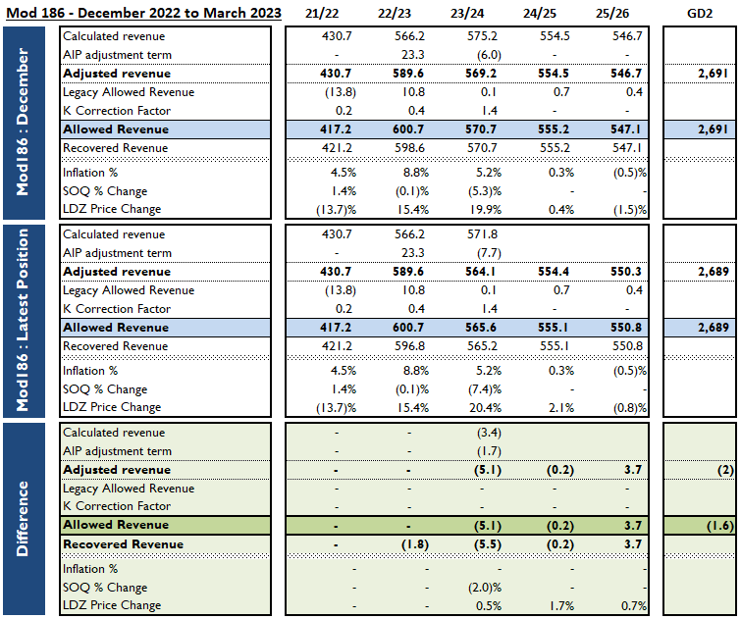

Slide 4
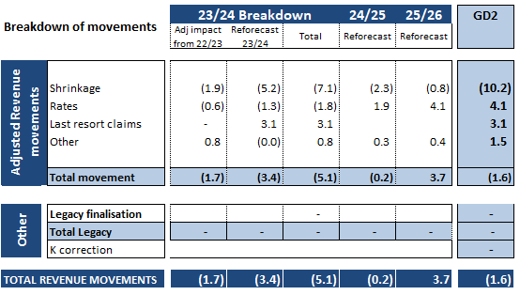
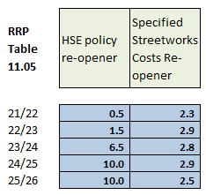
Movements from December 2022 to March 2023
Pipeline of re-opener applications
These are the largest reopeners as presented in Table 11.05 in RRP. Note this is the expenditure level increase not revenue – revenue increase would be smaller due to fast/slow money mechanics.

