Slide 1
Project 1Stop Part 2 – December Update
Megan Troth

Slide 2
Background
The new iteration of the Xoserve website was developed in November 2018.
Since this implementation, based on customer feedback, we have been looking to identify various ways in which we can improve the change pages and the overall customer journey, particularly in relation to change (both DSC and Investment).
Project 1Stop was created in order to completely understand of our customer’s needs, alleviate their pain points, and to create an overall more positive experience when navigating through Xoserve change information.
Part 1 of this iteration was delivered at the start of this year, and we have been working through customer driven user stories to deliver Part 2 of this Project

Slide 3
What has been delivered to date?
For part 1 of Project 1Stop, three User Stories were initially prioritised and delivered which included:
Consistent UKL Release Information across the website
An up to date and accurate change register that is simple and easy to use
Overhaul of the Change Proposal webpages with a breakdown of individual change documentation

Slide 4
Project 1Stop part 2
We have now aimed to deliver the remaining user stories for the final iteration of this project (full details on the following slides):
As a new customer working on DSC and Investment change, I would like to be given an overview of the change process in order to give me a further understanding of how change works in Xoserve
As a customer I want to be able to provide and update industry responses before final submission so that I can ensure I seek opinion from impacted teams within my organisation and give a single rounded response

Slide 5
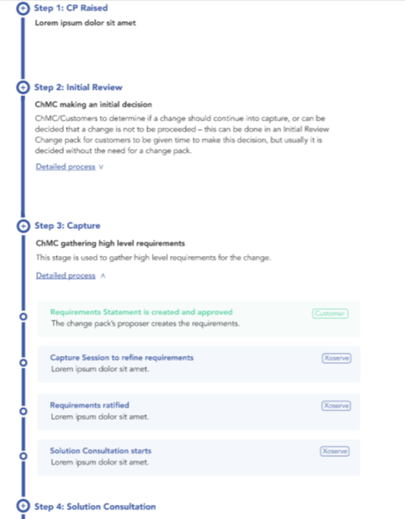
New online Change Process
Option of high level overview of step and detailed sub-steps available to view
Roles defined in process sections e.g. seeing where you feed in as the customer

Slide 6
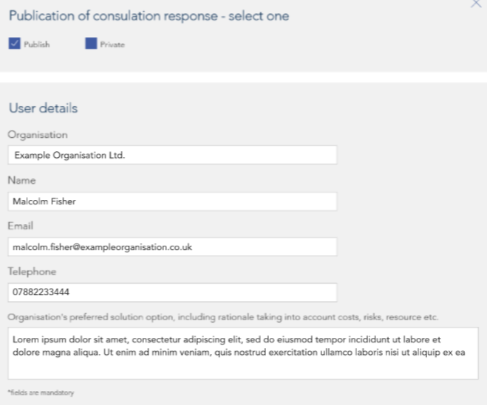
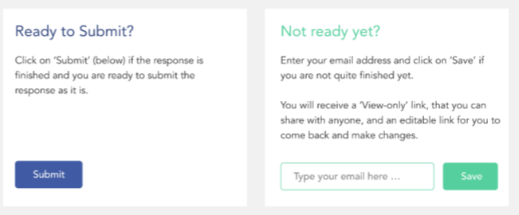
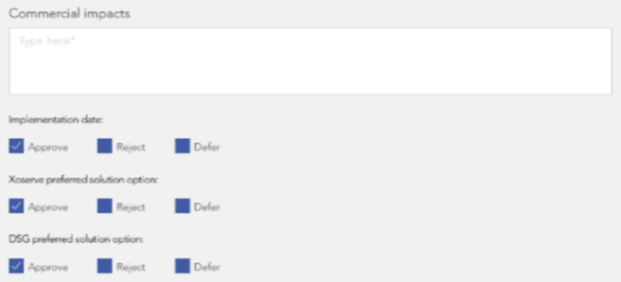
New Change Pack Representation Features
New feature enables you to populate the form as normal, with the option ‘Save’ your representation response for later and circulate it internally among your organisation without having to repopulate the form once you are ready to submit
As per feedback received, an additional feature has also been added whereby customers will automatically receive an email copy of their final representation responses once they have submitted them.

Slide 7
Next Steps
Changes above will be delivered in January 2023. An email communication will go out to customers once the date for implementation has been confirmed.

