Slide 1
September 2022 - ChMC Mod0651 Retrospective Data Update Provisions Recap of Solution and Proposed Next Steps

Slide 2
Purpose of ChMC Update
Confirm the current position of XRN4914 – Mod0651 Retrospective Data Update Provisions
ReCap on Mod0651 compliant Solution Option – including key features and customer considerations
Propose the next steps

Slide 3
Current Position of XRN4914 – Mod0651 Retrospective Data Update Provisions
Following a consultation exercise in summer 2021, it was agreed that a whilst CSSC and related gas industry changes were a priority, a Mod0651 compliant solution should be progressed at the earliest available opportunity
Delivery of Central Switching Service Consequential Programme in July 2022 has enabled key resource that are required to progress a Retrospective Data Update solution forward
In order to progress the compliant solution into detailed requirements definition and solution design a project team will need to be mobilised
Approval of this Detailed Design phase project mobilisation will be required from ChMC
Costs and timescales for Detailed Design are yet to be shared with DSC Customers due to the dependencies on key resources and priority industry programme delivery

Slide 4
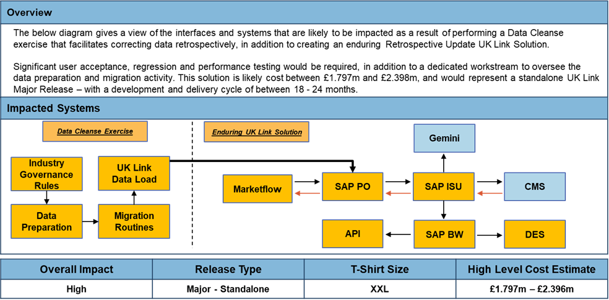
Mod0651 – Solution Recap

Slide 5
Proposed Next Steps
Xoserve are looking to provide clarity to customers on future Change Pipeline and scope of changes being progressed and delivered over the coming 18-24months
Plan to issue an EQR to ChMC in October for Approval – this will request funding to commence Detailed Design phase
Noted that a Shipper organisation at August Distribution Workgroup has discussed their intention to present a UNC Modification which proposes to prevent Mod0651 from being implemented
Should this Modification be raised, ChMC will be asked to confirm if Detailed Design should progress in parallel to UNC development or whether we await a Modification Decision

