Slide 1
DPM Update
March 2022
Contract Management Committee

Slide 2
DPM ‘For Information’ Changes
At Jan 22 CoMC:
We agreed the need to keep the DPM / DAM aligned in readiness for REC v3 Go Live
This will help with Transition for when we want to split the DPM / DAM
Ensure that the DPM / DAM is correct for CSS Go Live
We indicated that changes to the DPM that were as a result of projected changes to the DAM we would send these to CoMC as ‘For Information’
At Feb 22 CoMC:
We added additional rows to the DPM / aligned these to existing UNC data items
Elaborated the functionality introduced at CSS Implementation Date around release of REL data and CSS Registration information
Agreed that the PAFA data would continue to be managed under the DPM

Slide 3
DPM ‘For Information’ Changes
‘For Information Change 1’ – Further clarification obtained regarding solution
At the previous CoMCs we added certain REC Data Items and also REC synonyms (a column stating ‘REC Equivalent Name’, further understanding obtained regarding the way this data is released requires minor change to the DPM
The functionality to release Incoming Registration data to the Current Supplier has been referenced in the DPM
Amended DPM shown on the following page with cells marked in Amber

Slide 4
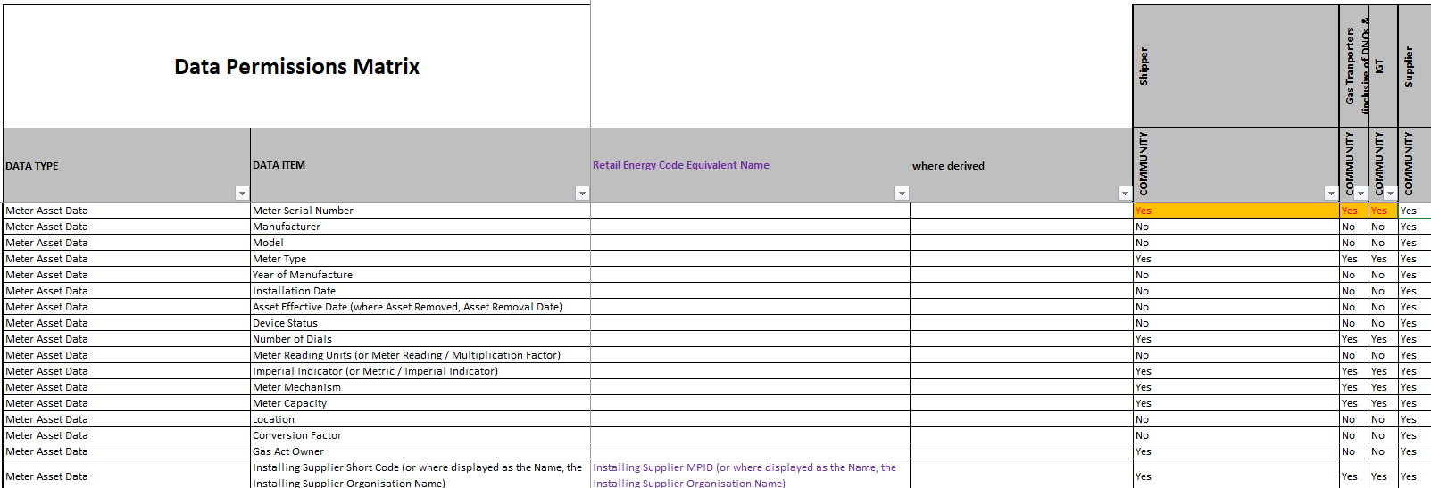
DPM ‘For Information’ Changes
‘For Information Change 2’ – Aligning existing Data Items
Currently metering data is released to Community View users.
MSN is also released but was not reflected in the DPM (note: this was shown as released to Suppliers but not DSC parties)

Slide 5
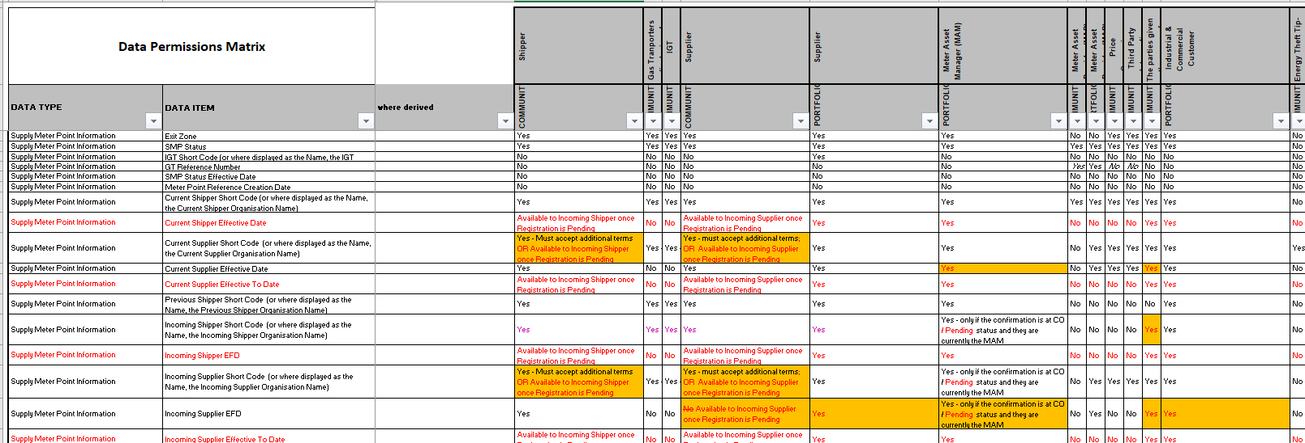
DPM ‘For Information’ Changes
‘For Information Change 1’ – Further clarification obtained regarding solution

Slide 6
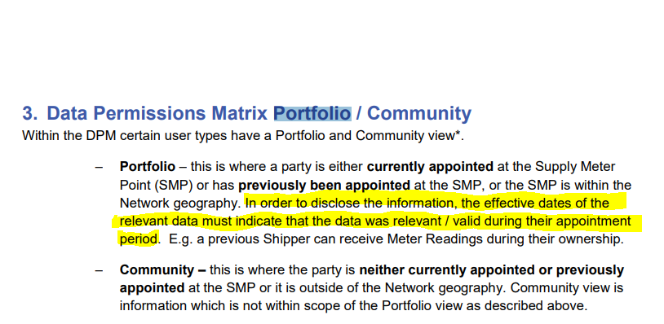
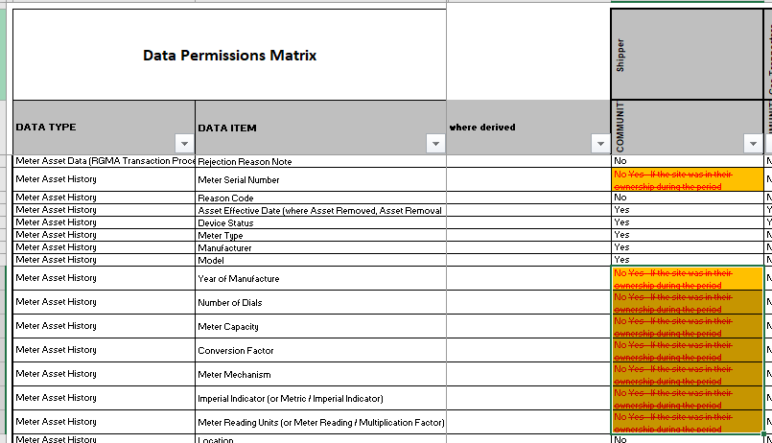
DPM ‘For Information’ Changes
‘For Information Change 3’ – Amended Conditionality
The DPM has some cells that state that data will be released to a Community User ‘where it was in their period of ownership’ – i.e. when they were the Portfolio User
Changes were made to the DPM conditionality document to further clarify ‘Portfolio’ to include previous periods of ownership.
Therefore the following text can be amended:

