Slide 1
Contract Management Committee
4. Contract Management Report 17th May 2023

Slide 2
Contents
4.1 KPM Reporting v1.1 (final version will be published by the 15th May)
4.3 Monthly Contract Metrics
4.4 Incident summary
4.5 Customer Issue Dashboard
4.6 GRDA Reporting
Appendixes

Slide 3
KPM Reporting (April reporting period)
Agenda item 4.1

Slide 4
DSC Credit and Risk Performance Indicators
Energy Performance Indicators
Measure Detail (Right First Time) | Target | April
Energy Balancing Credit Rules adhered to, to ensure adequate security in place | 100% | 100%
Measure Detail (Cycle Time) | Target | April
% of revenue collected by due date | 98% | 99.83%
% of revenue collected by due date (+2 days) | 100% | 100%
CDSP Performance Indicators (Cycle Time)
Measure Detail (Cycle Time) | Target | April
% of revenue collected by due date | 98% | 98.16%
% of revenue collected by due date (+3 days) | 98% | 99.89%

Slide 5
Monthly Contract Management reports and updates
Agenda Item 4.3

Slide 6
Performance monitoring (April 2023)
Third Party and Additional Services Reporting
Gemini Performance and UK Link Availability
Reporting Area | April | Year to date
Additional Services | £2,843.00 | £2,843.00
Third Party Services | £51,373.66 | £51,373.66
UK Link Availability and Performance
 | Target | Actual
Batch Transfer | 99% | 100%
Service Desk Availability | 99% | 100%
All Transportation Invoice Charging obligations were achieved

Slide 7
Meter Count Report (April 2023)
Overall 53% of the entire Meter Portfolio is Smart

Slide 8
Xoserve Incident Summary
Agenda Item 4.4

Slide 9
Summary
System Affected | Priority | Impact | Remedial Actions | KPM Breach | Resolved | Customer Segment Impacted
CMS | P2 | Customers attempting to access the CMS Application would not have been able to successfully login during the restart of the system. | A controlled restart of CMS application was performed to allow customers contacts to be processed successfully. | No | Yes | Shippers, IGTs and DNs
AMT | P2 | A large volume of data was received causing a delay in outbound file processing. The inbound files were successfully processed in UK Link (SAP), however when processing the response files in AMT, this caused slowness within the AMT application. | Additional storage memory was applied to allow the increased volume of files to be processed. A controlled release of the files was undertaken based on priority; continuous monitoring was in place until the backlog had been cleared | No | Yes | Shippers, IGTs, Networks and DMSPs

Slide 10
Customer Issue Dashboard
Agenda item 4.5

Slide 11
Open Issues Impacting Customers
Issue Area | Issue Summary | Further Information and Action Being Undertaken | Customers Impacted
Missing Secured Active Messages (SAMs) | 357 missing SAM’s relating to switching activities | Latest position on missing messages (as of 5 May 2023) 132 confirmed as valid registrations. These have been processed and communications sent. Completed. 19 resolved, no further action required 204 cancelled registrations, no further action 1 pending customer response 1 pending CSS reconciliation (new missing message on 28 April 2023) | Shippers DNs IGTs
Amendment Invoice Defects | 6 open defects impacting the Amendment invoice | Profiling carried out monthly to identify impacted MPRNs Charges for impacted MPRNs are held and not invoiced until the fix is deployed and energy is corrected, where required, prior to the charges being released | Shippers DNs
AQ Defects | 9 AQ impacting defects (defects impacting AQ calculation) | Profiling carried out to identify impacted MPRNs AQs are corrected to limit impact on the customer. All profiled sites for outstanding AQ calculation impacting defects have been corrected along with the new Formula Year | Shippers DNs IGTs
Consumer Contact Data | Consumer contact data provided by Shippers is not complete when sent in the portfolio files to IGTs & DNs | Defect raised and is being progressed. All consumer data is being checked on quarterly (IQL) file. For completeness, the DNs portfolio report is also being reviewed (EDL & EQL) Report providing all consumer contact data will be issued following IQL submission in April 2023 Checks performed have confirmed IDL report is correct and complete | IGTs DNs

Slide 12
Issue Summary – Distribution Networks
Missing Secured Active Messages (SAMs)
Total of 357 missing messages as of 5 May 2023 relating to Registration notifications from CSS.
132 confirmed as valid registrations. These have been processed and communications sent. Completed.
19 resolved, no further action required
204 cancelled registrations, no further action
1 pending customer response
1 pending CSS reconciliation (new missing message on 28 April 2023)
Potential Impacts:
Transportation charges issued to the incorrect Shipper
Portfolio reports showing incorrect Shipper/Supplier
AQ Defects:
There are 9 open defects impacting the AQ calculation ​. A further 7 defects closed during April
AQs are corrected where required to limit impact on customer
All profiled sites for outstanding AQ calculation impacting defects have been corrected along with the Formula Year AQ.
Potential Impacts:
Incorrect transportation rates applied to charges
Amendment Invoice Defects
6 open defects impacting the Amendment invoice: reconciliation charges, 5 defects fixed during April
Charges for impacted MPRNs are held and not invoiced until the fix is deployed and energy is corrected, where required, prior to the charges being released
Potential Impact:
Reconciliation charges are incorrect if defect is not identified prior to invoice issue
Reconciliation charges are held until the defect is fixed and data corrected
Portfolio Files
Checks being carried out on the daily and quarterly portfolio files following identification of data discrepancies

Slide 13
Issue Summary - Shippers
Missing Secured Active Messages (SAMs)
Total of 357 missing messages as of 5 May 2023 relating to Registration notifications from CSS.
132 confirmed as valid registrations. These have been processed and communications sent. Completed.
19 resolved, no further action required
204 cancelled registrations, no further action
1 pending customer response
1 pending CSS reconciliation (new missing message on 28 April 2023)
Potential impacts:
Shipper / Supplier not recorded on UKLink or Gemini
Outgoing Shipper continues to receive transportation charges
AQ Defects:
There are 9 open defects impacting the AQ calculation ​. A further 7 defects closed during April
AQs are corrected where required to limit impact on customer
All profiled sites for outstanding AQ calculation impacting defects have been corrected along with the Formula Year AQ.
Potential Impacts:
Incorrect transportation rates applied to charges,
Over/under allocation of energy for demand estimation processes, impacts to UIG
Amendment Invoice Defects
6 open defects impacting the Amendment invoice: reconciliation charges, 5 defects fixed during April
Charges for impacted MPRNs are held and not invoiced until the fix is deployed and energy is corrected, where required, prior to the charges being released
Potential Impact:
Reconciliation charges are incorrect if defect is not identified prior to invoice issue
Reconciliation charges are held until the defect is fixed and data corrected

Slide 14
Issue Summary – IGTs
Missing Secured Active Messages (SAMs)
Total of 357 missing messages as of 5 May 2023 relating to Registration notifications from CSS.
132 confirmed as valid registrations. These have been processed and communications sent. Completed.
19 resolved, no further action required
204 cancelled registrations, no further action
1 pending customer response
1 pending CSS reconciliation (new missing message on 28 April 2023)
Potential impacts:
Shipper / Supplier not recorded on UKLink or Gemini
Outgoing Shipper continues to receive transportation charges
AQ Defects:
There are 9 open defects impacting the AQ calculation ​. A further 7 defects closed during April
AQs are corrected where required to limit impact on customer
All profiled sites for outstanding AQ calculation impacting defects have been corrected along with the Formula Year AQ.
Consumer Contact Data not complete in the Quarterly Portfolio Files (IQL):
Consumer Contact data provided by Shippers is not complete when sent in the quarterly portfolio files
A defect has been raised and this is being progressed
Report providing all consumer contact data will be issued following IQL submission in April 2023
Checks have confirmed that the daily portfolio file (IDL) is complete and correct

Slide 15
GRDA Performance Agenda Item 4.6

Slide 16
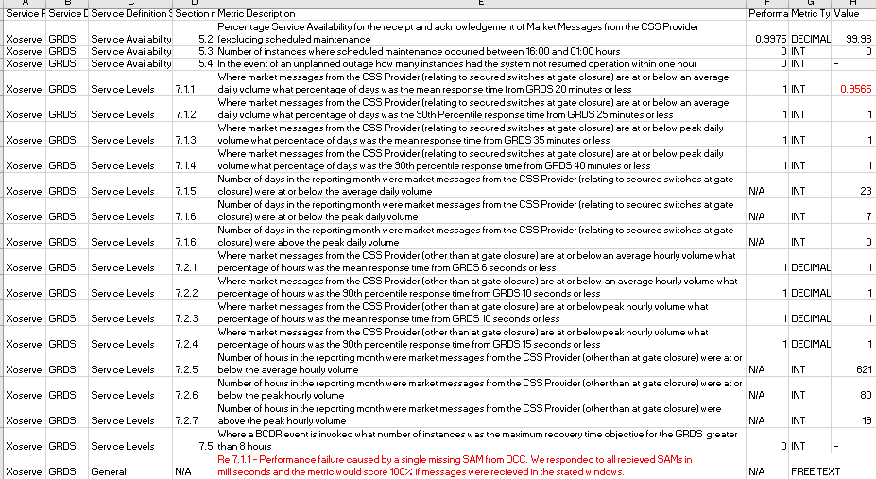
GRDA Performance – April 2023
target
actual
Key points to note April 2023 - Figures quoted based on draft RPA report due to CoMC paper deadline – indicates:
Any failures due to missing messages:
1 of 23 days at average volume with at least one missing message.
All other targets were met

Slide 17
APPENDIXES
Appendix 1 - KPM slides (Final version will be available on the 15th May )
Appendix 2 - Xoserve Incident Summary (item 4.4)
Appendix 3 -Customer Issue Dashboard(item 4.5)

Slide 18
KPM Slides
Appendix1

Slide 19
Xoserve Incident Summary
Appendix 2

Slide 20
High Level Summary of P1/P2 Incidents: Mar 2023
Ref. | What happened? | Why did it happen? | What do we understand our customers experienced? | What did we do to resolve the issue? | Incident Date | Resolved Date
INC0358137 | Customer contacts did not process as expected within the CMS application. | Due to the slow running job, a small number of customer contacts were prevented from being processed. | Customers attempting to access the CMS Application would not have been able to successfully login during the restart of the system. | A controlled restart of CMS application was performed to allow customers contacts to be processed successfully. | 4th Apr | 4th Apr
INC0358335 | During routine monitoring, we detected that files were processing at a reduced rate, causing a backlog of files. | A large volume of data was received causing a delay in outbound file processing. The inbound files were successfully processed in UK Link (SAP), however when processing the response files in AMT, this caused slowness within the AMT application. | Customers may have experienced a short delay in receiving their files. | Additional storage memory was applied to allow the increased volume of files to be processed. A controlled release of the files was undertaken based on priority; continuous monitoring was in place until the backlog had been cleared.. | 4th Apr | 5th Apr

Slide 21
What is Happening Overall?
 | Correla Identified | Customer Identified
Correla Controllable | Correla Identified the incident and the incident could have been avoided had Correla taken earlier action | Customer Identified the incident and the incident could have been avoided had Correla taken earlier action
Correla Uncontrollable | Correla Identified the incident but the incident could not have been avoided had Correla taken earlier action | Customer Identified the incident but the incident could not have been avoided had Correla taken earlier action

Slide 22
What is Happening Overall?
Key:
 | Apr 2023
 | Correla Identified | Customer Identified
Correla Controllable | 1 | 1
Correla Uncontrollable | 0 | 0
 | Performance Year to Date
 | Correla Identified | Customer Identified
Correla Controllable | 1 | 1
Correla Uncontrollable | 0 | 0
 | Correla Identified | Customer Identified
Correla Controllable | Correla Identified the incident and the incident could have been avoided had Correla taken earlier action | Customer Identified the incident and the incident could have been avoided had Correla taken earlier action
Correla Uncontrollable | Correla Identified the incident but the incident could not have been avoided had Correla taken earlier action | Customer Identified the incident but the incident could not have been avoided had Correla taken earlier action

Slide 23
Customer Issue Dashboard
Appendix 3

Slide 24
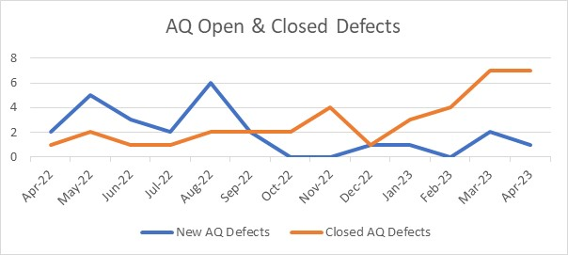
AQ Defects – Open & Closed over 12 Month Period

Slide 25
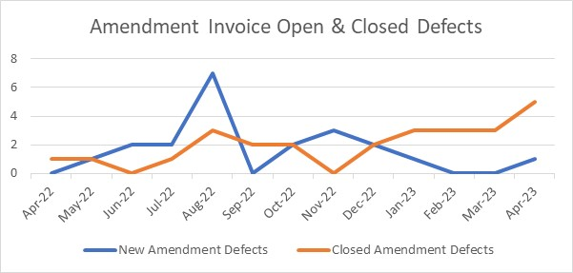
Amendment Invoice Defects – Open & Closed over 12 Month Period

Slide 26
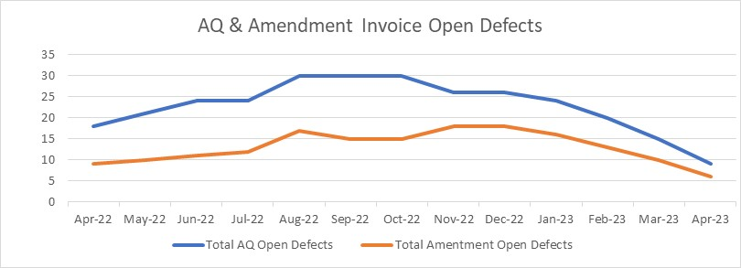
AQ & Amendment Invoice Open Defects

Slide 27
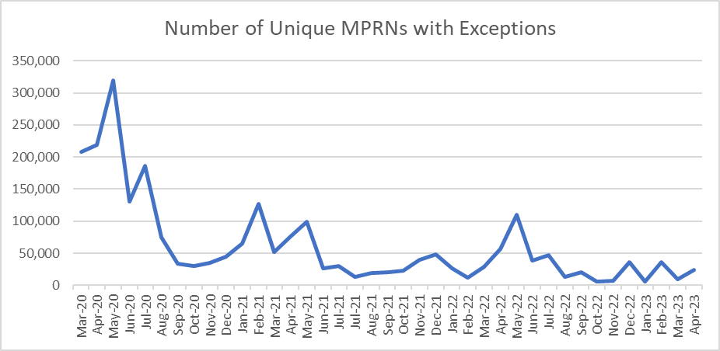
Amendment Invoice – Outstanding Exceptions

Slide 28
Further Information
Please contact the Issue Management Team box.xoserve.IssueResolution@xoserve.com
System status, planned outages and info on current system impacting issues can be found at the following location:
https://www.xoserve.com/news-updates/news-and-updates/system-outages/

