Slide 1
Contract Management Committee
4. Contract Management Report 17th May 2023

Slide 2
Contents
4.1 KPM Reporting v1.2 (final version will be published by the 15th May)
4.3 Monthly Contract Metrics
4.4 Incident summary
4.5 Customer Issue Dashboard
4.6 GRDA Reporting
Appendixes

Slide 3
KPM Reporting (April reporting period)
Agenda item 4.1

Slide 4
KPMs Overall Summary:- April 2023
Performance Area | (Reportable) Achieved | (Reportable) Failed | Not applicable to the reporting month
KPMs (20 total) | 19 (Pending KPM.13 on 15th May) | 1 | 0
KPMs Failure Summary:- April 2023
KPM Ref | Measure Detail | Journey / Process | Measure Type | Target | Performance | Failure / Remedial Action | Impacted Constituent/s (GT / iGT / NG / Shipper)
KPM.07 | Percentage of requests processed within the Completion Time Service Level in DSC | Meter Read / Asset Processing | Cycle Time | 100.00% | 99.99% | 127,396,670 reads and 287,376 asset updates were received. 750 reads and 201 asset updates were not processed due to Exception processes | GT / iGT / Shipper

Slide 5
PIs Overall Summary:- April 2023
Performance Area | (Reportable) Achieved | (Reportable) Failed | Not applicable to the reporting month
PIs (26 total) | 18 | 0 | 8
PIs Failure Summary:- April 2023
PI Ref | Measure Detail | Journey / Process | Measure Type | Target | Performance | Failure / Remedial Action | Impacted Constituent/s (GT / iGT / NG / Shipper)
N/A | N/A | N/A | N/A | N/A | N/A | N/A | N/A

Slide 6
DSC Credit and Risk Performance Indicators
Energy Performance Indicators
Measure Detail (Right First Time) | Target | April
Energy Balancing Credit Rules adhered to, to ensure adequate security in place | 100% | 100%
Measure Detail (Cycle Time) | Target | April
% of revenue collected by due date | 98% | 99.83%
% of revenue collected by due date (+2 days) | 100% | 100%
CDSP Performance Indicators (Cycle Time)
Measure Detail (Cycle Time) | Target | April
% of revenue collected by due date | 98% | 98.16%
% of revenue collected by due date (+3 days) | 98% | 99.89%

Slide 7
Monthly Contract Management reports and updates
Agenda Item 4.3

Slide 8
Communications Highlights – April 2023
Looking back
Looking ahead
ICS survey results
We’ve achieved our highest ever customer service levels, with a score of 78.9, rising by 4.7 points since 2021/22.
The ICS survey provides valuable insight and shapes how we continually improve the customer experience. We use the results to identify solid action points, define our processes and invest more resource. Work is underway to address improvement areas, and engagement with constituent groups to provide clarity.
Learning
Request to Bill (RTB) online module
Gas Safety Regulations (GSR) online module
New Xoserve delivered by Correla branding
The Xoserve/Correla hybrid brand positioning has changed
Correla on behalf of Xoserve will no longer be used
Documents and email signatures will be updated, where appropriate
Blogs
5 April - National Grid ESO’s Future Energy Scenarios examine the different, credible ways that Great Britain's energy system can be decarbonised
18 April – Xoserve CEO, Stephanie Ward, highlights the inconvenient truths facing the energy sector, and the industry goals needed to meet our Net Zero targets
24 April -John Baldwin, CEO of CNG Services, talks about the role of biomethane in the energy sector
DeliveringDecarb Newsletter
Providing the latest news and updates on gas decarbonisation
April’s edition shines a spotlight on the rise of biomethane
Utility Week Live 16-17 May 2023 at NEC Birmingham
FREE-to-attend content programme, with over 3,000 utility professionals,
150 industry-leading speakers, and 200 exhibitors
Register for free here
Net Promoter Score (How likely you would recommend Xoserve to others)
Increased by 18.6, from 7.5 in 2021/22 to 26.1.
Customer Effort
3.8 out of 10 (a lower score means less effort was required by the customer); a 0.5 improvement from 2021/22.
Events
(+10.9)
(+10.2)
(+6.2)
(+0.2)
(+2.4)
(+6.2)
06 April - Distribution Network Constituency
12 April - Change Management Committee
14 April - IGT Constituency
14 April - Hydrogen implementation forum for Shippers
17 April - Gas Goes Green insights forum, with Xoserve on hydrogen blending panel
19 April –Contract Management Committee
24 April - Ofgem hosted the 2023 Vulnerability Summit
24 April - DSC Delivery Sub-Group
25 April - Customer Induction Day
25 April - IGT Constituency Operational Call
27 April - Xoserve customers and colleagues visited Hydrogen Homes
28 April - Hydrogen Implementation forum for metering held

Slide 9
Performance monitoring (April 2023)
Third Party and Additional Services Reporting
Gemini Performance and UK Link Availability
Reporting Area | April | Year to date
Additional Services | £2,843.00 | £2,843.00
Third Party Services | £51,373.66 | £51,373.66
UK Link Availability and Performance
 | Target | Actual
Batch Transfer | 99% | 100%
Service Desk Availability | 99% | 100%
All Transportation Invoice Charging obligations were achieved

Slide 10
Meter Count Report (April 2023)
Overall 53% of the entire Meter Portfolio is Smart

Slide 11
Xoserve Incident Summary
Agenda Item 5.4

Slide 12
Summary
System Affected | Priority | Impact | Remedial Actions | KPM Breach | Resolved | Customer Segment Impacted
CMS | P2 | Customers attempting to access the CMS Application would not have been able to successfully login during the restart of the system. | A controlled restart of CMS application was performed to allow customers contacts to be processed successfully. | No | Yes | Shippers, IGTs and DNs
AMT | P2 | A large volume of data was received causing a delay in outbound file processing. The inbound files were successfully processed in UK Link (SAP), however when processing the response files in AMT, this caused slowness within the AMT application. | Additional storage memory was applied to allow the increased volume of files to be processed. A controlled release of the files was undertaken based on priority; continuous monitoring was in place until the backlog had been cleared | No | Yes | Shippers, IGTs, Networks and DMSPs

Slide 13
Customer Issue Dashboard
Agenda item 5.5

Slide 14
Open Issues Impacting Customers
Issue Area | Issue Summary | Further Information and Action Being Undertaken | Customers Impacted
Missing Secured Active Messages (SAMs) | 357 missing SAM’s relating to switching activities | Latest position on missing messages (as of 5 May 2023) 132 confirmed as valid registrations. These have been processed and communications sent. Completed. 19 resolved, no further action required 204 cancelled registrations, no further action 1 pending customer response 1 pending CSS reconciliation (new missing message on 28 April 2023) | Shippers DNs IGTs
Amendment Invoice Defects | 6 open defects impacting the Amendment invoice | Profiling carried out monthly to identify impacted MPRNs Charges for impacted MPRNs are held and not invoiced until the fix is deployed and energy is corrected, where required, prior to the charges being released | Shippers DNs
AQ Defects | 9 AQ impacting defects (defects impacting AQ calculation) | Profiling carried out to identify impacted MPRNs AQs are corrected to limit impact on the customer. All profiled sites for outstanding AQ calculation impacting defects have been corrected along with the new Formula Year | Shippers DNs IGTs
Consumer Contact Data | Consumer contact data provided by Shippers is not complete when sent in the portfolio files to IGTs & DNs | Defect raised and is being progressed. All consumer data is being checked on quarterly (IQL) file. For completeness, the DNs portfolio report is also being reviewed (EDL & EQL) Report providing all consumer contact data will be issued following IQL submission in April 2023 Checks performed have confirmed IDL report is correct and complete | IGTs DNs

Slide 15
Issue Summary – Distribution Networks
Missing Secured Active Messages (SAMs)
Total of 357 missing messages as of 5 May 2023 relating to Registration notifications from CSS.
132 confirmed as valid registrations. These have been processed and communications sent. Completed.
19 resolved, no further action required
204 cancelled registrations, no further action
1 pending customer response
1 pending CSS reconciliation (new missing message on 28 April 2023)
Potential Impacts:
Transportation charges issued to the incorrect Shipper
Portfolio reports showing incorrect Shipper/Supplier
AQ Defects:
There are 9 open defects impacting the AQ calculation ​. A further 7 defects closed during April
AQs are corrected where required to limit impact on customer
All profiled sites for outstanding AQ calculation impacting defects have been corrected along with the Formula Year AQ.
Potential Impacts:
Incorrect transportation rates applied to charges
Amendment Invoice Defects
6 open defects impacting the Amendment invoice: reconciliation charges, 5 defects fixed during April
Charges for impacted MPRNs are held and not invoiced until the fix is deployed and energy is corrected, where required, prior to the charges being released
Potential Impact:
Reconciliation charges are incorrect if defect is not identified prior to invoice issue
Reconciliation charges are held until the defect is fixed and data corrected
Portfolio Files
Checks being carried out on the daily and quarterly portfolio files following identification of data discrepancies

Slide 16
Issue Summary - Shippers
Missing Secured Active Messages (SAMs)
Total of 357 missing messages as of 5 May 2023 relating to Registration notifications from CSS.
132 confirmed as valid registrations. These have been processed and communications sent. Completed.
19 resolved, no further action required
204 cancelled registrations, no further action
1 pending customer response
1 pending CSS reconciliation (new missing message on 28 April 2023)
Potential impacts:
Shipper / Supplier not recorded on UKLink or Gemini
Outgoing Shipper continues to receive transportation charges
AQ Defects:
There are 9 open defects impacting the AQ calculation ​. A further 7 defects closed during April
AQs are corrected where required to limit impact on customer
All profiled sites for outstanding AQ calculation impacting defects have been corrected along with the Formula Year AQ.
Potential Impacts:
Incorrect transportation rates applied to charges,
Over/under allocation of energy for demand estimation processes, impacts to UIG
Amendment Invoice Defects
6 open defects impacting the Amendment invoice: reconciliation charges, 5 defects fixed during April
Charges for impacted MPRNs are held and not invoiced until the fix is deployed and energy is corrected, where required, prior to the charges being released
Potential Impact:
Reconciliation charges are incorrect if defect is not identified prior to invoice issue
Reconciliation charges are held until the defect is fixed and data corrected

Slide 17
Issue Summary – IGTs
Missing Secured Active Messages (SAMs)
Total of 357 missing messages as of 5 May 2023 relating to Registration notifications from CSS.
132 confirmed as valid registrations. These have been processed and communications sent. Completed.
19 resolved, no further action required
204 cancelled registrations, no further action
1 pending customer response
1 pending CSS reconciliation (new missing message on 28 April 2023)
Potential impacts:
Shipper / Supplier not recorded on UKLink or Gemini
Outgoing Shipper continues to receive transportation charges
AQ Defects:
There are 9 open defects impacting the AQ calculation ​. A further 7 defects closed during April
AQs are corrected where required to limit impact on customer
All profiled sites for outstanding AQ calculation impacting defects have been corrected along with the Formula Year AQ.
Consumer Contact Data not complete in the Quarterly Portfolio Files (IQL):
Consumer Contact data provided by Shippers is not complete when sent in the quarterly portfolio files
A defect has been raised and this is being progressed
Report providing all consumer contact data will be issued following IQL submission in April 2023
Checks have confirmed that the daily portfolio file (IDL) is complete and correct

Slide 18
GRDA Performance Agenda Item 4.6

Slide 19
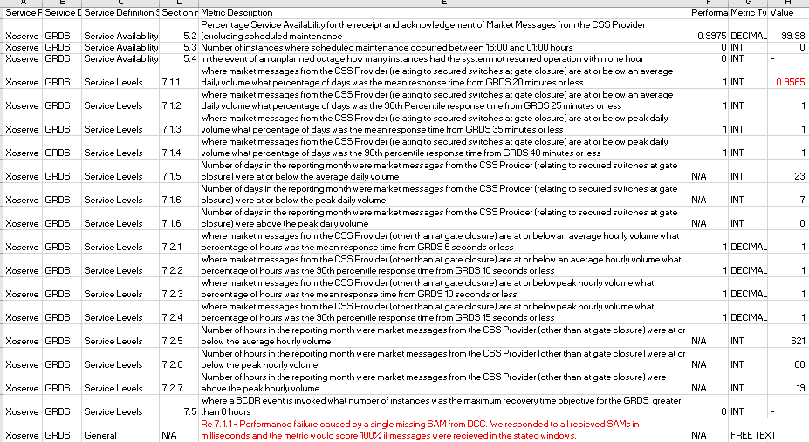
GRDA Performance – April 2023
target
actual
Key points to note April 2023 - Figures quoted based on draft RPA report due to CoMC paper deadline – indicates:
Any failures due to missing messages:
1 of 23 days at average volume with at least one missing message.
All other targets were met

Slide 20
APPENDIXES
Appendix 1 - KPM slides (Final version will be available on the 15th May )
Appendix 2 - Xoserve Incident Summary (item 4.4)
Appendix 3 -Customer Issue Dashboard(item 4.5)

Slide 21
KPM Slides
Appendix1

Slide 22
DSC KPM Performance:- April 2023
DSC Unique Identifier | Measure Detail | Journey / Process | Owner (CMT / SLT) | Measure Type | DSC Target Metric | Volume | Apr-23
KPM.01 | Percentage of shipper transfers processed | Manage Shipper Transfers | Andy Szabo / Neil Laird | Right First Time | 100.00% | 339,019 | 100.00%
KPM.02 | Percentage of meter reads successfully processed | Meter Read / Asset Processing | Andy Szabo / Neil Laird | Right First Time | 99.50% | 127,699,945 | 99.99%
KPM.03 | % of asset updates successfully processed | Meter Read / Asset Processing | Andy Szabo / Neil Laird | Right First Time | 99.50% | 276,595 | 99.93%
KPM.04 | % of AQs processed successfully | Monthly AQ Processes | Andy Szabo / Neil Laird | Right First Time | 100.00% | 13,948,590 | 100.00%
KPM.05 | Percentage of total LDZ AQ energy at risk of being impacted | Monthly AQ Processes | Andy Szabo / Neil Laird | Right First Time | 0.75% | 2,244 | 0.20%
KPM.06 | Percentage processed within the Completion Time Service Level in DSC | Manage Shipper Transfers | Andy Szabo / Neil Laird | Cycle Time | 100.00% | 339,019 | 100.00%
KPM.07 | Percentage of requests processed within the Completion Time Service Level in DSC | Meter Read / Asset Processing | Andy Szabo / Neil Laird | Cycle Time | 100.00% | 127,190,985 | 99.99%
KPM.08 | % Notifications sent by due date | Monthly AQ Processes | Andy Szabo / Neil Laird | Cycle Time | 100.00% | 13,946,443 | 100.00%
KPM.09 | % of invoices not requiring adjustment post original invoice dispatch | Invoicing DSC Customers | Andy Szabo / Neil Laird | Right First Time | 98.00% | 2,482 | 100.00%
KPM.10 | % of DSC customers that have been invoiced without issues/ exceptions (exc. AMS) | Invoicing DSC Customers | Andy Szabo / Neil Laird | Right First Time | 100.00% | 221 | 100.00%
KPM.11 | % of DSC customers with less than 1% of MPRNs which have an AMS Invoice exception | Invoicing DSC Customers | Andy Szabo / Neil Laird | Right First Time | 97.00% | 72 | 100.00%
KPM.12 | % of invoices sent on due date | Invoicing DSC Customers | Andy Szabo / Neil Laird | Cycle Time | 100.00% | 2,482 | 100.00%
KPM.13 | % of exceptions resolved within 2 invoice cycles of creation date | Invoicing DSC Customers | Andy Szabo / Neil Laird | Cycle Time | 100.00% | TBC 15/05 | TBC 15/05
KPM.14 | Number of valid P1 and P2 defects raised within the PIS period relating to relevant change (excluding programmes) | Managing Change | Andy Szabo / Linda Whitcroft | Right First Time | 0 | 0 | 0
KPM.15 | Number of valid P3 defects raised within PIS period relating to relevant change (excluding programmes) | Managing Change | Andy Szabo / Linda Whitcroft | Right First Time | 4 | 0 | 0
KPM.16 | Number of valid P4 defects raised within PIS period relating to relevant change (excluding programmes | Managing Change | Andy Szabo / Linda Whitcroft | Right First Time | 5 | 0 | 0
KPM.17 | % of tickets not re-opened within period | Customer Contacts (technical) | Andy Szabo / Trefor Price | Right First Time | 95.00% | 528 | 96.02%
KPM.18 | % of customer tickets (Incidents & Requests) responded to within SLA | Customer Contacts (technical) | Andy Szabo / Trefor Price | Cycle Time | 90.00% | 1,920 | 99.18%
KPM.19 | UK Link Core Service Availability | UKLink | Andy Szabo / Trefor Price | Cycle Time | 99.00% | N/A | 99.92%
KPM.20 | Gemini Core Service Availability | Gemini | Andy Szabo / Trefor Price | Cycle Time | 99.00% | N/A | 100.00%

Slide 23
DSC PI Performance:- April 2023
DSC Unique Identifier | Measure Detail | Journey / Process | Owner (CMT / SLT) | Measure Type | DSC Target Metric | Volume | Apr-23
PI.01 | % CMS Contacts processed within SLA (95% in D+10) | Manage Updates To Customer Portfolio | Andy Szabo / Neil Laird | Cycle Time | 95.00% | 19,666 | 97.51%
PI.02 | % CMS Contacts processed within SLA (80% in D+4) | Manage Updates To Customer Portfolio | Andy Szabo / Neil Laird | Cycle Time | 80.00% | 17,463 | 86.59%
PI.03 | % CMS Contacts processed within SLA (98% in D+20) | Manage Updates To Customer Portfolio | Andy Szabo / Neil Laird | Cycle Time | 98.00% | 19,769 | 98.02%
PI.04 | % customer queries responded to within SLA/OLA | Customer Contacts | Andy Szabo / Neil Laird | Cycle Time | 90.00% | 989 | 96.39%
PI.05 | Percentage of queries resolved RFT | Customer Contacts | Andy Szabo / Neil Laird | Right First Time | 95.00% | 1,009 | 98.34%
PI.06 | % of reports dispatched on due date against total reports expected | Customer Reporting (all forms) | Andy Szabo / Neil Laird | Cycle Time | 100.00% | 733 | 100.00%
PI.07 | % of RFT against all reports dispatched | Customer Reporting (all forms) | Andy Szabo / Neil Laird | Right First Time | 99.00% | 733 | 100.00%
PI.08 | % of valid CMS challenges received (PSCs) | Manage Updates To Customer Portfolio | Andy Szabo / Neil Laird | Right First Time | 1.00% | 6 | 0.03%
PI.09 | % of Telephone Enquiry Service calls answered within SLA | Customer Contacts | Andy Szabo / Neil Laird | Cycle Time | 90.00% | 4,516 | 93.56%
PI.10 | Confidence in DE Team to deliver DESC obligations (via Survey of DESC Members) | Demand Estimation Obligations | Andy Szabo / Neil Laird | Right First Time | 75.00% | N/A | N/A
PI.11 | DESC / CDSP DE obligations delivered on time | Demand Estimation Obligations | Andy Szabo / Neil Laird | Cycle Time | 100.00% | 9 | 100.00%
PI.12 | KPM relationship management survey | Customer Relationship Management | Andy Szabo / Alison Jennings | Right First Time | 95.00% | N/A | 98.35%
PI.13 | Plan accepted by customers & upheld (Key Milestones Met as agreed by customers) | Management Of Customer Issues | Andy Szabo / Neil Laird | Cycle Time | 90.00% | N/A | 100.00%
PI.14 | Provision of relevant issue updates to customers accepted at CoMC and no negativity on how the issue is managed. | Management Of Customer Issues | Andy Szabo / Neil Laird | Right First Time | 100.00% | 0 | 100.00%
PI.15 | Survey results delivered to CoMC in Month +1 | Customer Relationship Management | Andy Szabo / Alison Jennings | Cycle Time | 100.00% | N/A | 100.00%
PI.16 | % closure/termination notices issued in line with Service Lines (leave) Shipper | Customer Joiners/Leavers (UK Gas Market) | Andy Szabo / Neil Laird | Cycle Time | 100.00% | N/A | N/A
PI.17 | % key milestones met on readiness plan (join) Non Shipper | Customer Joiners/Leavers (UK Gas Market) | Andy Szabo / Neil Laird | Cycle Time | 100.00% | N/A | N/A
PI.18 | % key milestones met on readiness plan (join) Shipper | Customer Joiners/Leavers (UK Gas Market) | Andy Szabo / Neil Laird | Cycle Time | 100.00% | N/A | N/A
PI.19 | % of closure notices issued within 1 business day following last exit obligation being met (leave) Non Shipper | Customer Joiners/Leavers (UK Gas Market) | Andy Szabo / Neil Laird | Cycle Time | 100.00% | N/A | N/A
PI.20 | % of exit criteria approved and account deactivated within D+1 of cessation notice being issued (leave) Shippers | Customer Joiners/Leavers (UK Gas Market) | Andy Szabo / Neil Laird | Right First Time | 100.00% | 1 | 100.00%
PI.21 | % of exit criteria approved and account deactivated within D+1 of cessation notice being issued. (leave) Non-Shippers | Customer Joiners/Leavers (UK Gas Market) | Andy Szabo / Neil Laird | Right First Time | 100.00% | N/A | N/A
PI.22 | % of readiness criteria approved by customer (join) Non Shippers | Customer Joiners/Leavers (UK Gas Market) | Andy Szabo / Neil Laird | Right First Time | 100.00% | N/A | N/A
PI.23 | % of readiness criteria approved by customer (join) Shippers | Customer Joiners/Leavers (UK Gas Market) | Andy Szabo / Neil Laird | Right First Time | 100.00% | N/A | N/A
PI.27 | % level 1 milestones met | Managing Change | Andy Szabo / Linda Whitcroft | Cycle Time | 95.00% | 9 | 100.00%
PI.28 | DDP Core Service Availability (0900-1700 normal business hours) | DDP | Andy Szabo / Trefor Price | Cycle Time | 99.00% | N/A | 100.00%
PI.29 | Number of valid DDP defects raised per release (Post PIS) | Managing Change | Andy Szabo / Trefor Price | Right First Time | 3 | 0 | 0

Slide 24
Xoserve Incident Summary
Appendix 2

Slide 25
High Level Summary of P1/P2 Incidents: Mar 2023
Ref. | What happened? | Why did it happen? | What do we understand our customers experienced? | What did we do to resolve the issue? | Incident Date | Resolved Date
INC0358137 | Customer contacts did not process as expected within the CMS application. | Due to the slow running job, a small number of customer contacts were prevented from being processed. | Customers attempting to access the CMS Application would not have been able to successfully login during the restart of the system. | A controlled restart of CMS application was performed to allow customers contacts to be processed successfully. | 4th Apr | 4th Apr
INC0358335 | During routine monitoring, we detected that files were processing at a reduced rate, causing a backlog of files. | A large volume of data was received causing a delay in outbound file processing. The inbound files were successfully processed in UK Link (SAP), however when processing the response files in AMT, this caused slowness within the AMT application. | Customers may have experienced a short delay in receiving their files. | Additional storage memory was applied to allow the increased volume of files to be processed. A controlled release of the files was undertaken based on priority; continuous monitoring was in place until the backlog had been cleared.. | 4th Apr | 5th Apr

Slide 26
What is Happening Overall?
 | Correla Identified | Customer Identified
Correla Controllable | Correla Identified the incident and the incident could have been avoided had Correla taken earlier action | Customer Identified the incident and the incident could have been avoided had Correla taken earlier action
Correla Uncontrollable | Correla Identified the incident but the incident could not have been avoided had Correla taken earlier action | Customer Identified the incident but the incident could not have been avoided had Correla taken earlier action

Slide 27
What is Happening Overall?
Key:
 | Apr 2023
 | Correla Identified | Customer Identified
Correla Controllable | 1 | 1
Correla Uncontrollable | 0 | 0
 | Performance Year to Date
 | Correla Identified | Customer Identified
Correla Controllable | 1 | 1
Correla Uncontrollable | 0 | 0
 | Correla Identified | Customer Identified
Correla Controllable | Correla Identified the incident and the incident could have been avoided had Correla taken earlier action | Customer Identified the incident and the incident could have been avoided had Correla taken earlier action
Correla Uncontrollable | Correla Identified the incident but the incident could not have been avoided had Correla taken earlier action | Customer Identified the incident but the incident could not have been avoided had Correla taken earlier action

Slide 28
Customer Issue Dashboard
Appendix 3

Slide 29
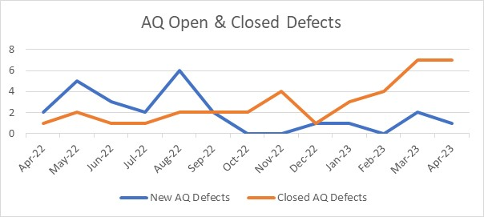
AQ Defects – Open & Closed over 12 Month Period

Slide 30
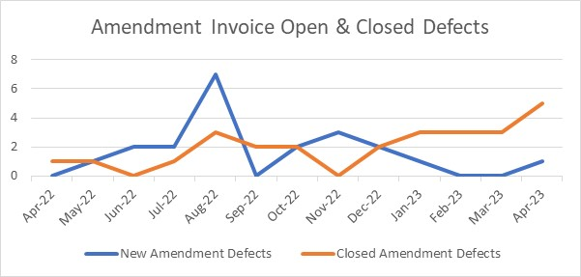
Amendment Invoice Defects – Open & Closed over 12 Month Period

Slide 31
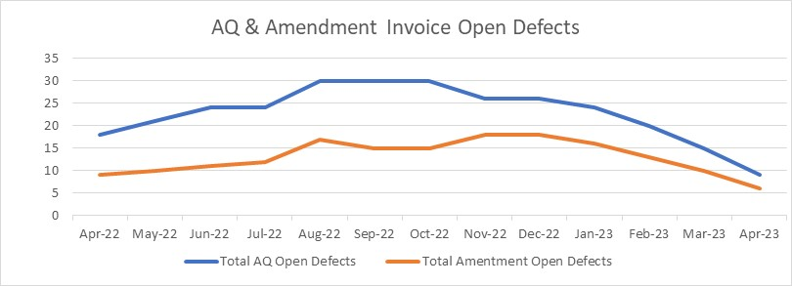
AQ & Amendment Invoice Open Defects

Slide 32
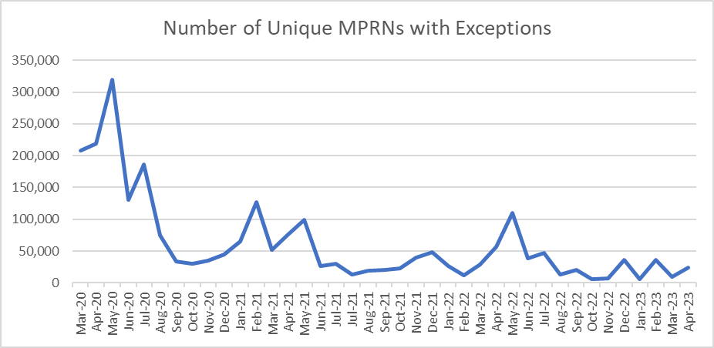
Amendment Invoice – Outstanding Exceptions

Slide 33
Further Information
Please contact the Issue Management Team box.xoserve.IssueResolution@xoserve.com
System status, planned outages and info on current system impacting issues can be found at the following location:
https://www.xoserve.com/news-updates/news-and-updates/system-outages/

