Slide 1
XRN5579 Gemini Regulatory Change
CV01 Long Term Flow Swap Automation

Slide 2
Summary
Background
National Gas Transmission (NGT) are proposing an update to the Gemini system to improve the Long-Term Flow Swap (LTFS) process.
This change only impacts NGT and Distribution Network Operator (DNO) users of the system.
Currently Gemini only allows users to manually add the LTFS details daily, this can lead to errors which have added significant work to NGT’s time-constrained month-end financial reporting processes. There have been examples which have required invoicing adjustments which create additional work.
Going forward NGT and DNO Users will be able to enter the LTFS details for a period of time. Cancel and Accept functionality will also be introduced to reject/accept the flow swap details.

Slide 3
Summary
Background (continued)
In summary:
The change only applies to LTFS between NGT and DNOs
The change only applies to Gemini Exit (not Gemini)
The change will allow LTFS to be set-up for a pre-defined period rather than require daily manual input
The change would allow for adding locations, updating the amount of capacity and changing the dates from and to for the LTFS
This change would be specifically applicable to the DNO Flow Swap ‘Add’ screen in Gemini Exit (Home > Product > Flow Swap > DNO Flow Swap > Add / Query)

Slide 4
Key Milestone Dates
Please be advised that prior to Go-Live of the LTFS change there will be an exercise undertaken to walkthrough / demo the impacted screens with impacted Users. Further details and invites will be issued in due course.
The key dates for this change for your awareness are captured below;
Go-Live – 19/03/23
PIS – 20/03/23 to 31/03/23

Slide 5
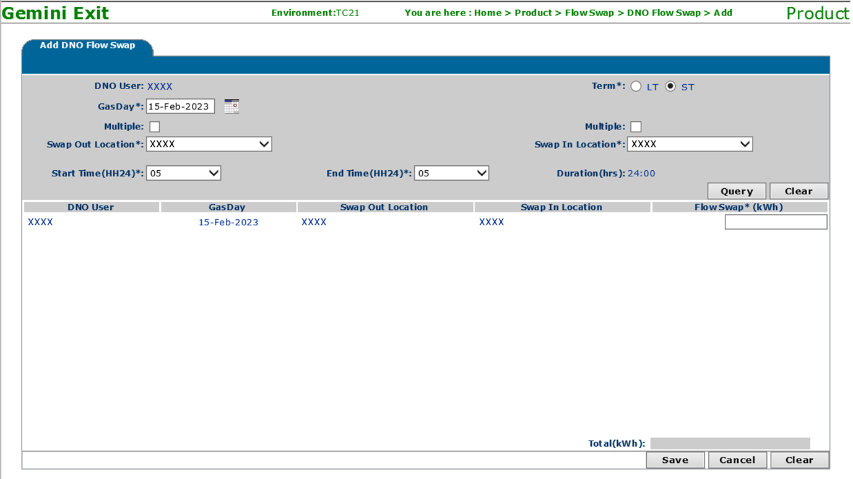
Impacted Gemini Exit Screens
Add DNO Flow Swap Screen (Short Term):
LT/ST toggle button introduced and by default ST (Short Term) option will be selected
The Gas Day value will allow a maximum up to the current System date +30

Slide 6
Impacted Gemini Exit Screens
Add DNO Flow Swap Screen (Long Term):
By changing the toggle button LT (Long Term), the user can select the date range up to the current Gas Year end date
The Gas Day ‘From’ value will allow a maximum up to the current System date +30
Start Time and End Time values will be default to 05 and Duration will be Not Applicable (NA)
In the Query results, a user can enter the Long-Term Flow Swap quantity that will be applicable for the date range selected (Inclusive of Gas Day From and Gas Day To)

Slide 7
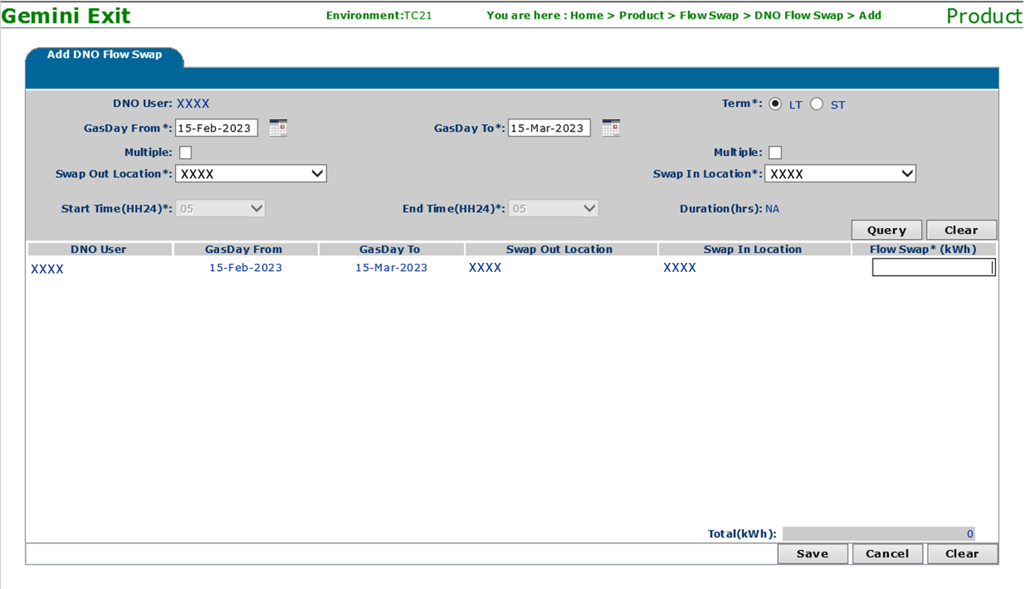
Impacted Gemini Exit Screens
Add DNO Flow Swap Screen (Long Term) (continued):

Slide 8
Impacted Gemini Exit Screens
View DNO Flow Swap Screen:
Select All or multi Select option is included to select more than one record and perform Bulk Withdraw
A user can withdraw the feature dated records (Gas Day >= current System date) if the status is New/Accepted
The System will reject (Auto time) the Long-Term Flow Swap requests if not accepted before the end of the Gas Day

Slide 9
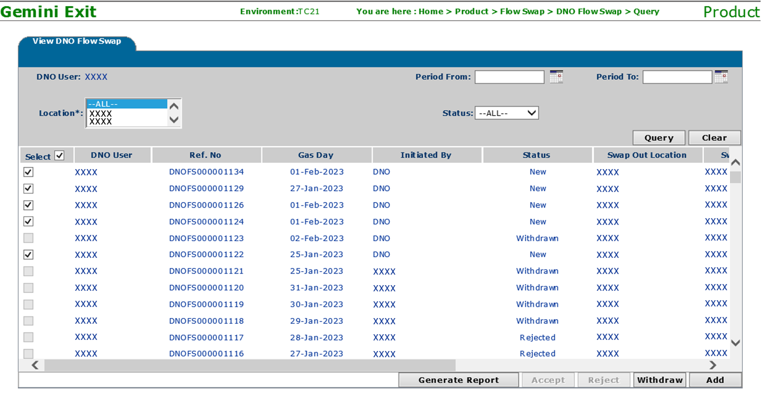
Impacted Gemini Exit Screens
View DNO Flow Swap Screen (continued):

