Slide 1
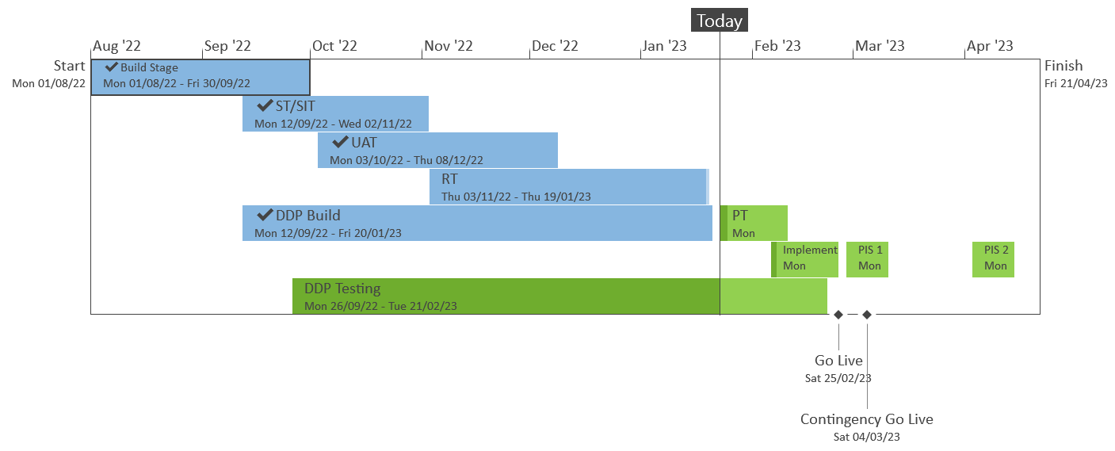
XRN5533 – February 23 Major Release - Status Update
 | Overall Project RAG Status
 | Schedule | Risks and Issues |  | Cost
RAG Status
Status Justification
Schedule | Overall release is tracking on target; Green, UK Link regression testing phase completed on 19/01 as per plan. Currently on track to complete performance testing phase 17/02 Progress update: Regression testing complete on 19/01 Performance testing in progress, on track to complete on 17/02 DDP build for XRN4990 completed on 18/01 DDP testing for XRN4990 in progress, on track to complete by 21/02 February 23 Change Awareness Session with Industry participants completed on 24/01 Progress update provided in Shipper Constituency meeting on 25/01 Implementation preparation commenced ready for planned go live on 25/02 Implementation Approach walkthrough included in this ChMC meeting. Decision in February ChMC: None |  | Implementation date of 25th February; with a contingency implementation date of 4th March
Risks and Issues | There is a risk that the solution being delivered under XRN5298 may not work as expected at the point SGN go live with the H100 project - due to a gap between XRN5298 being delivered as part of the Feb 23 release, and the date at which the H100 project itself is scheduled to go live Update – SGN have confirmed that Q4 2024 is when the first H100 connections will go live. Discussions underway regarding options for carrying out additional regression testing closer to the H100 go live
Cost | Forecast to complete delivery against approved BER
Scope | XRN4900 - Biomethane/Propane Reduction XRN4978 - Shipper - Notification of Rolling AQ Value XRN4989B - Residual AMT activities XRN4990 - MOD0664 – Transfer of Sites with Low Read Submission Performance from Class 2 and 3 into Class 4 XRN4992B - MOD0797 - Last Resort Supply Payments Volumetric Charges XRN5298 - H100 Fife Project – Hydrogen Network Trial
Complete
On Track
At Risk
Overdue
Slide updated on 25th January 2023

Slide 2
XRN5533 February 23 Release Implementation Approach
February 2023

Slide 3
Principles
Project plan for each activity for both Implementation Dress Rehearsal (IDR) and Implementation will be defined and agreed by all parties involved
All external customers and internal business training and awareness sessions will have been completed prior to implementation (see Further Comms slide)
All critical activities will be completed prior to implementation date (25th February 23), communication will be provided (as per Further Comms slide)
Standard maintenance window will be utilised for code deployments (from 5am -7am)

Slide 4
XRNs in Scope of February 23 Release
Change Reference | Change Title
XRN4900 | Biomethane Sites with Reduced Propane Injection
XRN5298 | MOD0799 - H100 Fife Project Phase 1
XRN4978 | Shipper - Notification of Rolling AQ Value
XRN4989B | AMT Residual activities
XRN4990 | MOD0664 - Transfer of Sites with Low Read Submission Performance from Class 2 and 3 to Class 4
XRN4992B | MOD0797 (Urgent) - Last Resort Supply Payments Volumetric Charges (Enduring Solution)

Slide 5
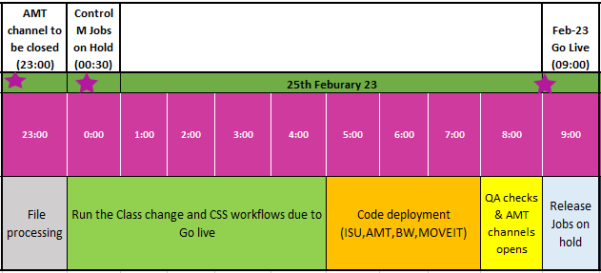
February 23 Release High Level Implementation Plan
The implementation for the 5 changes consists of code transports for multiple systems
Go live date is 25th February 23

Slide 6
File Transition
To incorporate the changes to files and associated processing the EFT/AMT channels will need to be closed
We will follow the standard processing times and ensure that none of the file types identified in the following slide are awaiting processing and/or have processed successfully before we close the channels
Monitoring of all inbound files and confirmation of all response outbound files will be completed by Friday 24th February 23:59:59 prior to any transports taking place
Channels will be re-opened by Saturday 25th February 09:00:00 for the next standard job processing time

Slide 7
File Format Transition plan
Inbound files
SPC ,CNF, BRN ,*CVD and CSS files
All the inbounds files will be processed by 23:00:00 (24/02/23) and will restart processing as per the BAU timing once the channels would be restored on 25/02/23.
* The CVD file would start processing from 09:30 hrs. (25/02/23).
Outbound files
SCR, ASN, TMC, BRR, NRL, ZCS, IIS,**CVN ,***CVR, JRS,URS, SFR, SCR, AQR, MDR and MBR.
All the outbound files will be processed by 23:59:00 (24/02/23) and will restart processing as per the BAU timing once the channels would be restored on 25/02/23.
**CVN file would start processing from 11:00 hrs. (25/02/23).
***CVR file would start processing from 10:00 hrs. (25/02/23).
NB-CSS files with reduced SLA of 4hrs will be taken into consideration while planning.

Slide 8
Further Communications
Implementation Go Live is planned for 25th February 2023
Please note REC Major Release Implementation is 24th February, however the Feb-23 DSC Release does not contain any REC dependencies therefore its planned delivery over the weekend will reduce the risk as agreed in ChMC
Should we need to use a contingency date the following weekend of 4th March 2023 will be utilised
Key implementation communications:
Confirmation of planned implementation – 24th February 2023
Successful / Unsuccessful Implementation – 25th February 2023
Further information and training awareness material is available here

Slide 9
If you have any queries on the changes being delivered as part of the February 23 Release please contact
UKLinkDelivery@xoserve.com

