Slide 1
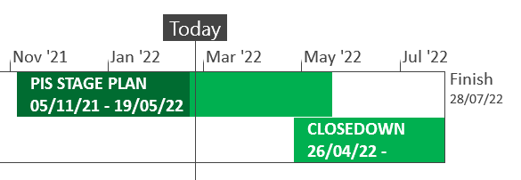
XRN5289 – November 21 Major Release - Status Update
 | Overall Project RAG Status
 | Schedule | Risks and Issues |  | Cost
RAG Status
Status Justification
Schedule | XRN5142: Final usage (.IQL) has run; being validated Deferred Changes: First usage and data cleanses progressing against plan XRN4780C .MON files are currently on hold XRN4992a: Build is in progress Overall plan in final stages of approval prior to baselining XRN5188b: Design is in progress Overall plan in final stages of approval prior to baselining Decision in March ChMC: None |  | XRN5289
Risks and Issues | None
Cost | Forecast to complete delivery against approved BER
Scope | In Scope - XRN4941 - MOD0692 - Auto updates to meter read frequency In scope - XRN5007 - Enhancement to reconciliation process where prevailing volume is zero​ In Scope - XRN5072 - Application and derivation of TTZ indicator and calculation of volume and energy – all classes​ In Scope - XRN5142 - New allowable values for DCC Service Flag in DXI File from DCC​ In Scope - XRN5180 - Inner tolerance validation for replacement reads and read insertions​ In Scope - XRN4780C – Inclusion of Meter Asset Provider Identity (MAP Id) in the UK Link system (CSS Consequential Change) In Scope - XRN4992a - Modification 0687 Clarification of Supplier of Last Resort (SoLR) Cost Recovery Process In Scope - XRN5188b - Interim Data Loads of MAP Id into UK Link Descoped - XRN5091 - Deferral of creation of Class change reads at transfer of ownership​ Descoped - XRN5186 MOD0701 – Aligning capacity booking under the UNC and arrangements set out in relevant NExAs​ Descoped - XRN5187 MOD0696 – Addressing inequalities between capacity booking under the UNC and arrangements set out in the relevant NExAs
Complete
On Track
At Risk
Overdue
Not Baselined
Slide updated on 24th February 2022

