Slide 1
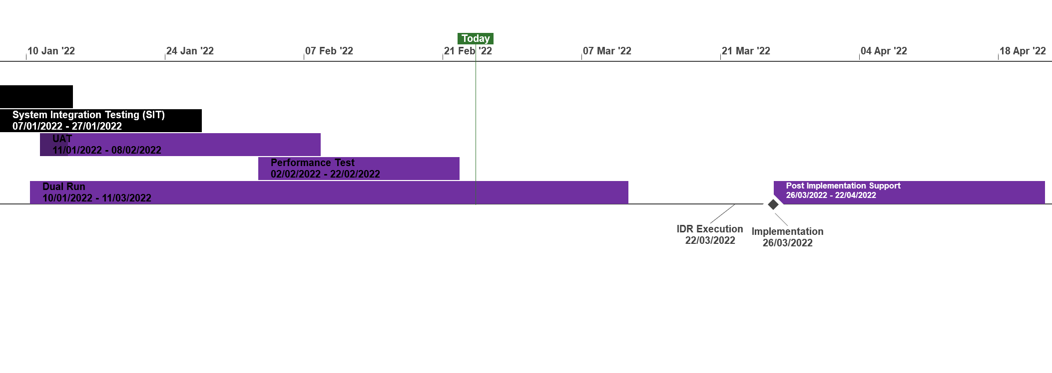
XRN5231 Flow Weighted Average CV
 | Overall Project RAG Status
 | Schedule | Risks and Issues |  | Cost
RAG Status
Status Justification
Schedule | Overall RAG status is tracking at Purple as project is now in re-planning phase due to the position that we will not be able to implement by 1st April 22. The project has continued with its planned activities alongside the replan. To support the re-plan activity the project is conducting a Gap Analysis exercise on the defined requirements to ensure we have a baselined position for Day 1 Implementation. An Impact Assessment will then be conducted against the change variations to support the re-plan activity UAT execution and assurance is in progress, revised completion date to be confirmed as part of re-plan Dual Run Preparation continues with Connectivity Testing and Master Data Readiness. Resolution of the Master Data Issue is a significant step forward to support Dual Run Testing and Data Migration approach for cutover Re-planning to be completed post completion of Gap Analysis activity with the intention to agree revised plan in March and present updated BER for approval at April ChMC Next Steps: Finalise Gap Analysis exercise with DNs and National Grid to agree Day 1 Must Have requirements & any decisions in order to meet a proposed Go Live date (Mid June 22) Define full re-plan based on Gap Analysis Impact Assessment and Business Readiness requirements Target to issue revised BER from replan for approval at the April 22 ChMC Risk of FWACV Imp to CSSC is in assessment, this is deemed low risk as there is no code conflict |  | Replan in progress to confirm revised dates at the April ChMC
Risks and Issues | The dependencies for NG to provide Master data and DNs connectivity details for Dual Run/MT have not been provided as per the plan defined in the approach leading to a delay to this phase of testing Update: A plan was defined to mitigate this issue through validating and cross-checking data with National Grid and Distribution Networks (DNs). Plan is nearing completion with final checks now being completed by DNs. Issue to be closed once Data loaded to testing environment The Project is not able to meet its planned Implementation Date of 1st April due to delays to the start of Dual Run, volume of parallel activity required prior to the planned implementation and identification of gaps in the As Is and To Be processes that could lead to further changes to approved solution Update: The project is carrying out a re-plan activity with the priority being to complete Analysis on approved scope/processes to confirm Day 1 must have requirements. The plan and activities has been agreed with Xoserve, NG and DNs on 22/02 and the activities are tracking to plan
Cost | Forecast costs tracking to approved BER costs at present. Revised plan options will require a full cost assessment to be completed on the replan position for Day 1
Scope | XRN5231 Flow Weighted Average (CV) Gemini consequential change part A - PRCMS validation/processing Gemini consequential change part B - LDZ Stock Change and Embedded LDZ Unique Sites
Complete
On Track
At Risk
Overdue
Not Baselined

