Slide 1
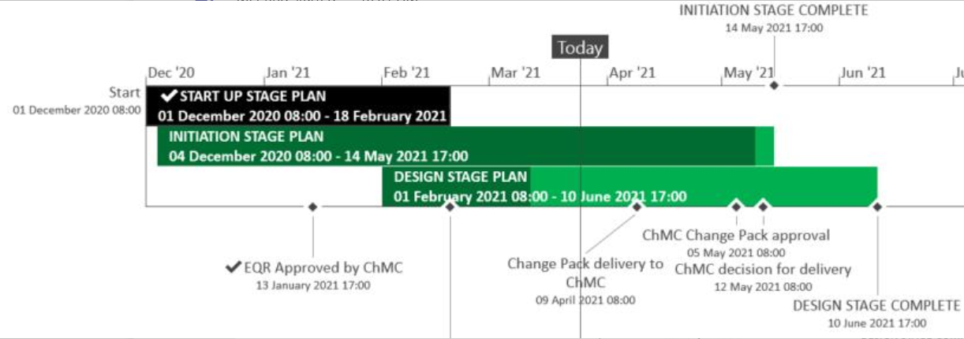
XRN5289 – November 21 Major Release - Status Update
 | Overall Project RAG Status
 | Schedule | Risks and Issues | Cost
RAG Status
Status Justification
Schedule | Design phase on track to complete to current schedule Remaining 3 change packs to be delivered on the 9th April on plan; eChMC arranged for 5th May for approval Attending ChMC on the 12th May, with recommendation for delivery and BER Decision in April ChMC Approved issued change packs (XRN5007, 5072 & 5142)
Risks and Issues | ​RISK (XRN5142) - Unknown plans from DCC on their plan of delivery and design​ for cleanse Mitigation - Regular touch points with DCC to understand their plan and design have been set up; Plan on a page is due shortly also outstanding question on design was due by the 20th April 2021
Cost | Forecast to complete design against approved EQR
Scope | XRN4941 - MOD0692 - Auto updates to meter read frequency​ XRN5007 - Enhancement to reconciliation process where prevailing volume is zero​ XRN5072 - Application and derivation of TTZ indicator and calculation of volume and energy – all classes​ XRN5091 - Deferral of creation of Class change reads at transfer of ownership​ XRN5142 - New allowable values for DCC Service Flag in DXI File from DCC​ XRN5180 - Inner tolerance validation for replacement reads and read insertions​ Descoped - XRN5186 MOD0701 – Aligning capacity booking under the UNC and arrangements set out in relevant NExAs​ Descoped - XRN5187 MOD0696 – Addressing inequalities between capacity booking under the UNC and arrangements set out in the relevant NExAs
Slide updated on 26th March 2021

