Slide 1
UNC Data Dictionary Refresh
UNCC October 2020

Slide 2
UNC Data Dictionary Changes
Updates to the UNC Data Dictionary have been made as per the below:
Reconciliation between MIPI and the UNC data dictionary. Ensured 100% of the data currently available on MIPI is present in the UNC Data Dictionary.
Added some status fields (Live/Not Live; First Published and Last Published; Link to the MIPI Report if applicable)
Improved the data definitions, making it easier for new entrants and wider stakeholders (e.g. academics) to understand the data.
Removed Data items no longer published >= 5 years. (MIPI holds data up to 5 years old.)
Due to the volume of change UNCC requested industry engagement ahead of approval

Slide 3
Industry engagement since September UNCC
Following September UNCC and the request for a final opportunity for feedback we have:
Issued email to industry on 21st September inviting any feedback or comments on changes to National Grid; no comments received
Discussed at Transmission Workgroup in October; one question raised in relation to a report within MIPI, this query is independent to the changes in the UNC Data Dictionary – no further feedback received since

Slide 4
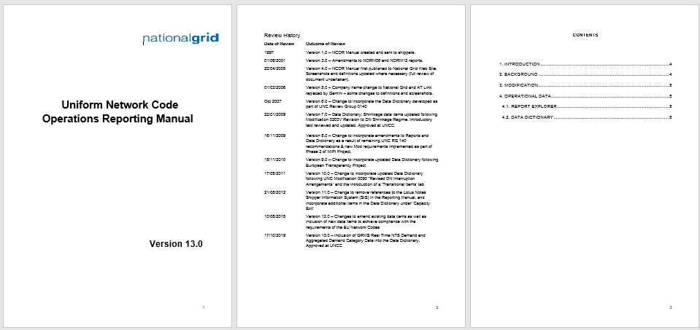
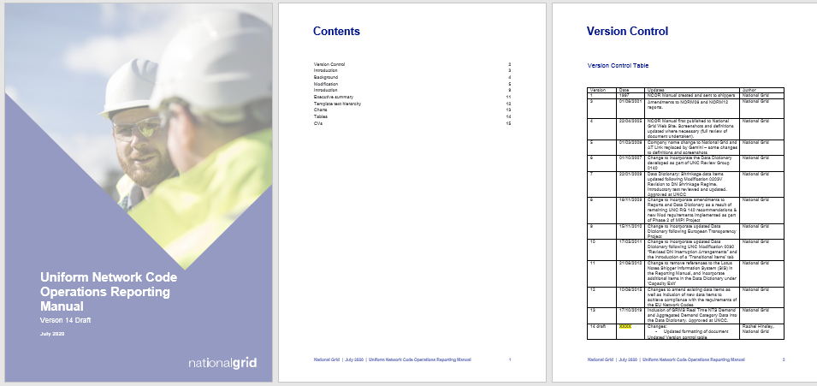
Updates to the UNCORM
The UNC Data Dictionary is subordinate to the UNCORM. When a change is made to the UNC Data Dictionary the UNCORM is updated and approval sought on both documents.
The UNCORM has been amended:
The document has been updated onto a new document template
References to UK Link Committee have been removed

Slide 5
UNCC Approval
UNCC Approval for the changes is requested today;
Should approval be granted the next step will be for the documents to be made Live and updated on the JO website.

Slide 7
Appendix 1
UNC TPD Section 9.4.5
9.4.5 If National Grid NTS proposes to revise the Uniform Network Code Operations Reporting Manual, it shall obtain prior approval by Panel Majority of the Uniform Network Code Committee, and if such revision materially increases the extent of the information relating to Users to be published pursuant thereto:
(a) National Grid NTS will notify Users of its proposal not less than one month before implementing such proposal;
(b) any User may, within 14 Days after National Grid NTS's notification under paragraph (a), notify National Grid NTS that the User objects to such revision, providing reasonable details of the grounds for the User's objection;
(c) if a User so notifies an objection to National Grid NTS, National Grid NTS will not implement the revision unless the Authority shall (upon National Grid NTS's application) give Condition A11(18) Approval to its doing so.

