Slide 1
NGN Mod186 Pricing Statement
Movement from October to December 2022

Slide 2
Summary of updates Oct Dec – largest movements:
Inflation:
Inflation remains high @ 8.8% in 22/23, we have now included November 22 OBR forecast, which predicts inflation to be 5.2% for 23/24, this has resulted in an increase to allowed revenue of £23.1M for 23/24.
Shrinkage:
Our current forecasts include process of 22/23 @ £2.37 per therm, 23/24 @ £3.58, 24/25 @ £2.49 and 25/26 @ £1.168.
Rates
There has been a reduction in business rates which has resulted in a reduction in allowed revenue of £9.6M in 23/24.
Other things to consider:
SOLR: Final minded to decisions have been published OfGem so this price change has been included.
Real price effects: Ofgem have updated the indices used to account for the latest view of inflation.
WACC: The regulator has updated the cost of debt calculation to account for the latest iBoxx indices, and the equity cost calculation to account for the latest view of yields from UK government securities

Slide 3
Timeline between now and 23/24 60 day notice
As a guide this is the process between now and 31st January; in terms of other
changes which may impact the price change for 23/24:
The Annual Iteration Process (AIP) was completed and published in November and we have used the latest draft of the PCFM, issued by e-mail following the update for latest OBR forecast, therefore no further changes are expected.
Shrinkage – dependant on gas price variations vs. what is currently assumed, possible amendment.
SOLR – we have included the minded to decisions from Ofgem, therefore, no further changes are expected.
Capacity– we will review the snapshot of capacity data taken on c. 1st Dec by Xoserve. Whilst this doesn’t impact the value of Allowed Revenue it will impact on the price change needed. We have currently assumed a reduction in the SOQ of 5.3%.

Slide 4
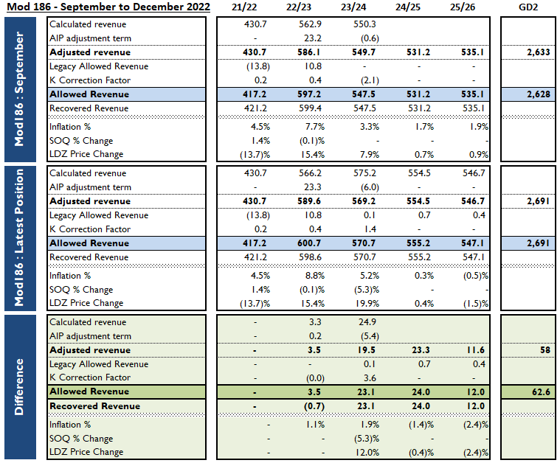

Slide 5
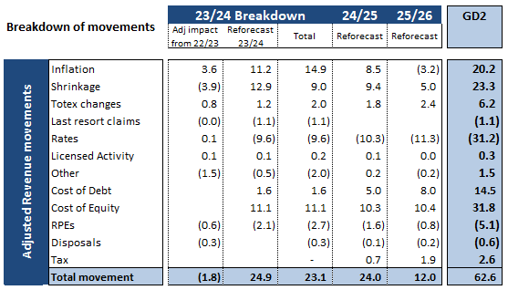
Movements from September to December 2022
Pipeline of re-opener applications
These are the largest reopeners as presented in Table 11.05 in RRP. Note this is the expenditure level increase not revenue – revenue increase would be smaller due to fast/slow money mechanics.

