Slide 1
PAC Strategic Workshop #1
26th January 2021
Rachel Clarke

Slide 2
Introduction
The aim of the meeting is to formulate a strategic plan for 2022 including a renewed targeting strategy and steer on Performance Assurance Techniques.
The PAC will be asked to make two decisions in order to contribute to the strategy for 2022.
Other areas of consideration will be around market entry, which while not currently under current PAC vires, undeniably is covered by assurance.
Following the 2021 Annual Review it has become apparent that renewed focus and steer is needed for both the PAFA and CDSP in their industry interactions.

Slide 3
Current arrangements
Performance Assurance Framework and subsequent PAC documents (2 – 7) set out the role of PAC and the function.
PAC have put into practise the technique of performance improvement plans, observation letters and escalation meetings if needed.
This Shipper engagement currently sits outside of Code.
PAC meet monthly to discuss PARR reports across a number of areas.
PAC review risks pertaining to the industry and are advised on mitigations against these.

Slide 4
Statistics – Expected Trajectory
Based on current trends split by Product Class, below gives an indicative view of when parties will reach and maintain current UNC targets.
^ Based on two years of data (20/21). Data collected before XRN4795 was implemented is in line with current data gathered and therefore is not suitable to include in this trajectory.

Slide 5
Statistics – Plan facts
51 plans endorsed by PAC.
11 plans closed throughout the duration.
6 closed through achieving target.
5 closed due to SOLRs
Current success rate of plans closed from parties achieving target across various product classes.
11%

Slide 6
Statistics – Open Plan duration
^ Longest plan has been running for over 2 years.
^ Average plan circa 16 months.
^ Found plans are clustered in line with PC4Monthly targeting.

Slide 7
Statistics – Closed plan duration
Graph shows the distribution of completed plans with the longest plan taking 26 months to close and the quickest being 9 months.
^ 45% of plans are under 12 months old.
^50% of plans are aged 12 months and older.
^ 5% of plans are aged over 2 years.

Slide 8
Engagement stats

Slide 9
Statistics - with PAC intervention
This graph shows an assumed direction following greater PAC intervention over the same period.
^The forecasting is based on a full year worth of improvement. For example if action was taken in March 2020, the overlay applied uses difference in industry average performance over that period.
*For PC1, a step change forecast has been applied based on the fact that as the smaller sites are resolved, the increase would on performance for this class would be greater.

Slide 10
What does good look like?
To discuss current UNC target levels, measurable successes of the regime and the potential impacts of UNC674.

Slide 11
What does good look like?
For Discussion
To discuss current UNC target levels, measurable successes of the regime and the potential impacts of UNC674.
What is PAC here to do?

Slide 12
What does good look like?
For Discussion
To discuss current UNC target levels, measurable successes of the regime and the potential impacts of UNC674.
What are we trying to achieve?
Mission statement – To be instrumental in driving change for improved gas Settlement, taking industry along the journey.
Questions to answer;
How do we achieve this?
How do we engage the industry?
How are we instrumental?
What do we need to do to drive change?

Slide 13
What does good look like? Cont.
For Discussion
To discuss current UNC target levels, measurable successes of the regime and the potential impacts of UNC674.
Current UNC target levels (Read Performance) challenges:
Small portfolio sizes can mean parties do not meet UNC target;
Metering issues;
Outside influences may be a contributing factor e.g. COVID-19 lockdowns, large enduring weather events.
What do the UNC targets represent;
Standardised across the industry, does not favour market type or company size;
Universal aim for parties;
Level of credibility for Gas Settlement accuracy.
 | PC1 | PC2 | PC3 | PC4M | PC4A
Target | 97.5% | 97.5% | 90% | 90% | 90%
Not Smart | - | - | - | 90% | 90%
Smart | - | - | 90% | 90% | 90%

Slide 14
What does good look like? Cont.
For Discussion
To discuss current UNC target levels, measurable successes of the regime and the potential impacts of UNC674.
Historic UNC target setting:
Targets set in 1996;
derived from British Gas standards at the time; and
CMA recommendation introduced mandatory obligations to submit annual meter read across all PCs.
Electricity comparison
Non-Half Hourly (NHH) – 97% (Based on Grid Supply point the targets range from 30-97%); and
Half Hourly (HH) – 99%.
Benchmarking exercise between electricity and/or water may be beneficial.

Slide 15
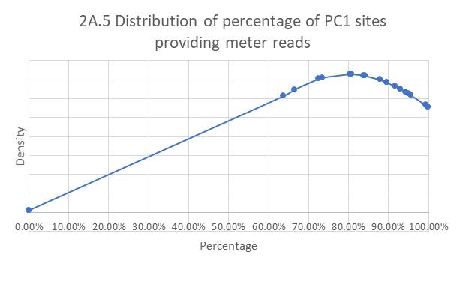
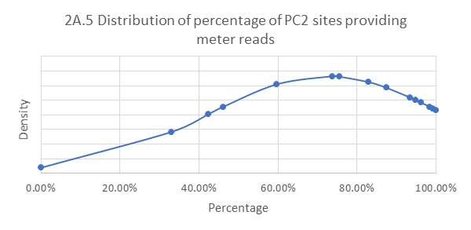
Density statistics – feasibility OF TARGETS
Target for PC1 and 2 is 97.5%.
Graph 1 shows a cluster of parties around 90%+ with the average circa 80%.
Graph 2 shows a cluster of parties around 90%+ with the average circa 75%.

Slide 16
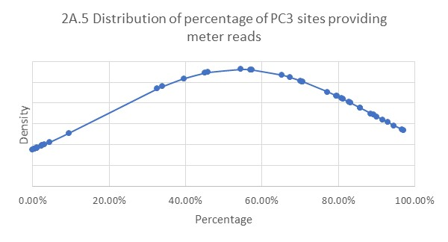
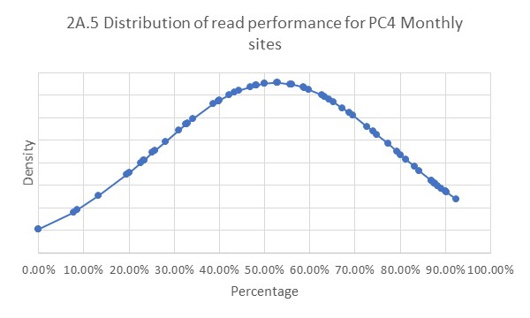
Density statistics – feasibility OF TARGETS
The target for PC3 and PC4 monthly is 90%.
Graph 3 shows most parties are achieving 80%+ with an average performance of circa 57%.
Graph 4 shows almost all parties are below UNC target. With the average performance levels being circa 55%.

Slide 17
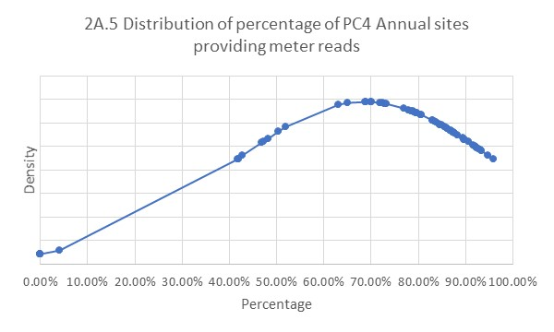
Density statistics – feasibility OF TARGETS
Target for PC4 Annual is 90%.
Graph 5 shows most parties are at 80%+ with the average performance being circa 70%.
Are current UNC targets achievable?
From 2021 data, average performance across PCs is substantially below UNC targets. However, there are parties who are achieving these targets and sustaining that performance over a long period.
Is there an argument for trying to move industry incrementally towards UNC targets?
What is the PACs view on allowances on target numbers e.g. 10%, 5% target, absolute etc.

Slide 18
What does good look like? Cont.
For Discussion
To discuss current UNC target levels, measurable successes of the regime and the potential impacts of UNC674.
PACs potential measure of success;
% population of those at or above UNC targets;
% of completed Performance Improvement plans (PIP);
Number of PIPs raised on parties not meeting UNC target;
Sustained level of maintenance?
Notes:
Shipper who is performing in one area but not in another.

Slide 19
UNC674 – What next?
For Discussion
To discuss current UNC target levels, measurable successes of the regime and the potential impacts of UNC674
Potential impacts of 674;
More Performance Assurance Techniques available;
Embedding the management of those techniques within PAC;
How those techniques are applied/to whom by whom;
Transparency with the industry.

Slide 20
Expected UNC674 & IGT138 Timeline
UNC PANEL consider & decide on UNC674
AUTHORITY consideration & decision on UNC674
AUTHORITY consideration & decision on IGT138
UNC PANEL subsequent consultation period (15 BD)
IMPLEMENTATION of UNC674
IMPLEMENTATION of IGT138
UNC PANEL approve 3 month reporting date extension
IGT UNC PANEL consider & decide on IGT138
6 WEEK TRANSITION PERIOD for UNC674
UNC WORKGROUP consider revised modification / legal text
IGT UNC WORKGROUP review revised legal text for UNC674, update IGT138
D
J
F
M
A
M
J
J
A
S
O
N
D
J
F
M
A
M
J
J
2022
2023
UNC674 Final Modification Report dated 15th July 2021 notes a 3 month implementation lead time.
IGT138 is currently showing a February 2023 implementation date, as this would be the next available scheduled release. However, there is potential for the implementation to aligned with UNC674 as part of an extraordinary release. The final implementation date will be determined by the Panel.
UNC674 Final Modification Report dated 15th July 2021 highlights Workgroup discussions regarding a transition period. Where by after implementation, new performance failures would be addressed using the PATs set out in the PAFD and not less than 6 weeks after implementation. The PAC will be unable to write out to parties during this time as it will put them in breach of Code.

