Slide 1
DPM Conditionality Document Updates
19 January 2022
Contract Management Committee

Slide 2
Background
The DPM is the document used to determine who CDSP is permitted to provide data to.
The DPM CD is the document that supports the DPM
The DPM and DPM CD are the reference point for any data request received by Xoserve
Xoserve are required to carry out a periodic review of the DPM CD.
Following review of the DPM and DPM CD, CoMC are requested to approve a number of changes.

Slide 3
Changes for Approval - 1
DSC Core Customer Portfolio/Community View
Clarified definition of ‘Community’ in section 3
Added in reference to Portfolio/Community definitions in section 4
Included statement that DSC Core Customer Community view will be accessed in accordance with the REC DAM post CSS go live
Added ‘Community View’ to DSC Core Customer in Section 6 to clarify that DPM only covers Community view access for DSC Core Customers
Does CoMC approve the above changes to the DPM CD?

Slide 4
Changes for Approval - 2
DPM User Types - Meter Asset Provider
Added in a condition that allows CDSP to provide data relating to multiple MAPs in one report provided the MAPs are part of the same group of affiliate companies.
Added Data Item conditionality to clarify data provision
Does CoMC approve the above changes to the DPM CD?

Slide 5
Changes for Approval - 3
Ofgem – access to data
Introduced a section to include Ofgem data access requests.
Ofgem is not listed on the DPM, making reference to Ofgem data access requests in the DPM CD provides clarity of how Ofgem data requests should be assessed to understand whether or not the request is required to be made direct to GTs under SSLC A26.
Does CoMC approve the above changes to the DPM CD?

Slide 6
Change for Approval – 4
Cosmetic changes made to DPM CD to amend some wording to present tense.
Change to Table of Contents to update new section and page numbers.
Does CoMC approve the above changes to the DPM CD?

Slide 7
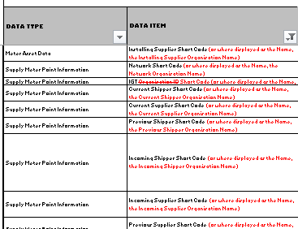
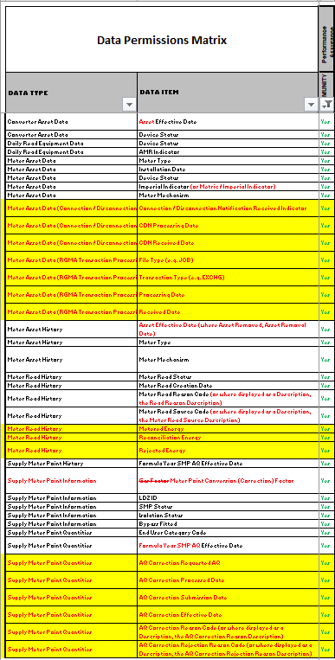
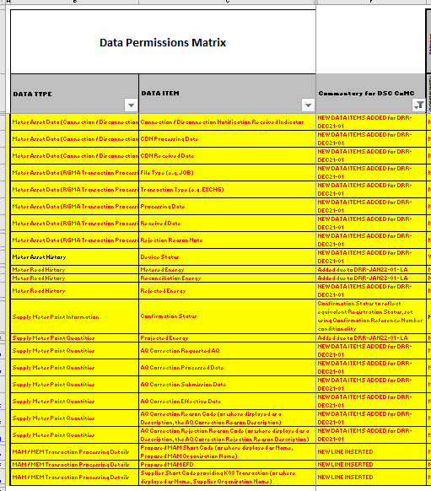
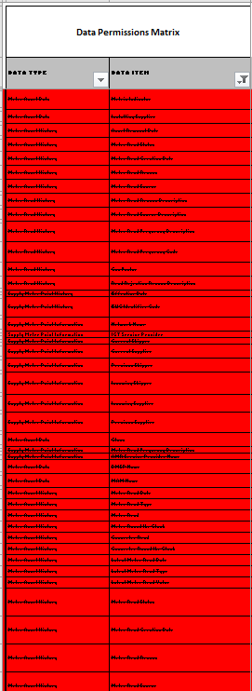
Change for Approval – 5
DPM Changes
Review of the DPM highlighted inconsistencies / cosmetic changes:
‘Organisation Name’ was released when ‘Short Code’ wasn’t and vice versa, so merged the lines to make it consistent and used common approval
Release based on hybrid of both data items – e.g. if Short Code or Name = Yes, hybrid data item = Y
Reason Code and Description (e.g. Rejection Reason Code) were both listed – if Reason Code is provided then Description is not Protected Information.
Identified some synonyms – e.g. adding of Metric Indicator – when Imperial Indicator is present, deleted synonyms and extended data item name e.g.
A number of cosmetic changes have been made to the DPM, regrouping into data types (new items had been appended at the bottom of the DPM)
Updates to DPM to reflect DRR-DEC21-01 DPM – data to PAFA by DDP (new additions shown in column Z in green text)
Missed updates to DPM to reflect DRR for release of data to RECCo (new lines shown in yellow – reason for insertion in column F)
Lots of data items deleted – due to point 1, 2, 3 and removed duplication of rows in invalid data types (lines shown with red cells)
Added in column ‘where derived’ to show where a data item is derived from another data item.
Does CoMC approve the above changes to the DPM?

Slide 8
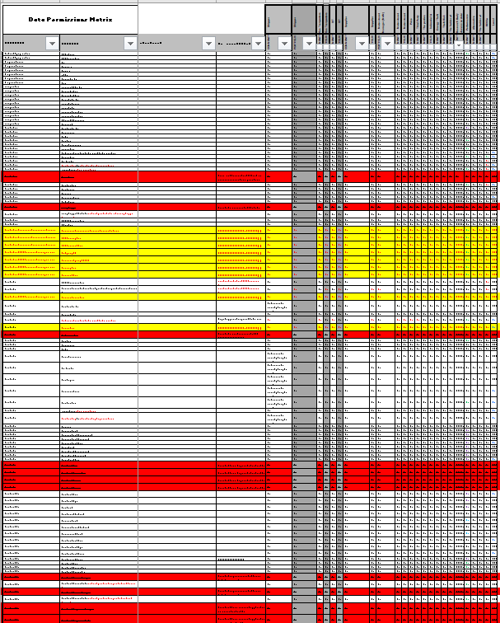
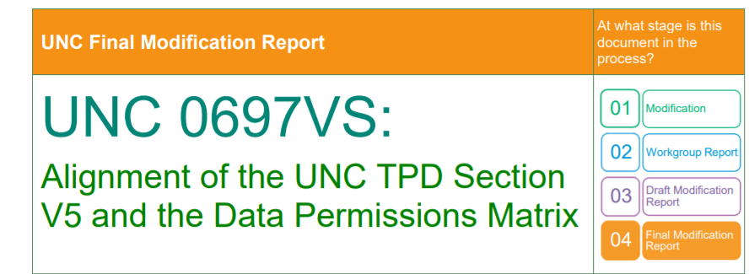
Change for Approval – 6
An anomaly of the DPM is that it defines Portfolio access for DSC Core Customers – this should have been removed at Mod to revisit the DPM
Can we remove these columns now? Columns to be deleted shown in grey
Does CoMC approve the above changes to the DPM?

Slide 9
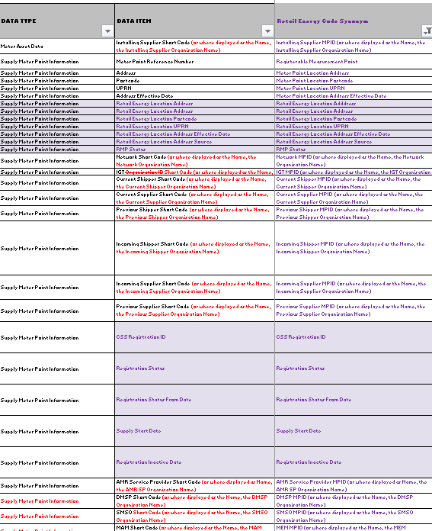
Change for Information
REC RTS and RECCo asked us to provide a version of the DPM in readiness for Faster Switching SCR so they could create the DAM
Added new REC Data Items (shaded purple in G to AD) and assessed the proposed access (based on understood requirements) – these will be tested with the REC
Included REC Synonyms for existing UNC Data Items – e.g. MAM = MEM (column D populated); Short Code = MPID
These will be approved through the FS SCR and may be subject to change.
These data items will not be set to ‘live’ until the SCR is approved.
Does CoMC agree that we update the DPM with new REC data items noting that these aren’t live until CSS Go Live?

Slide 10
CoMC asked to Note
Xoserve has commenced an exercise to ‘normalise’ the DPM and align to the data naming conventions in the UK Link Communications. We will keep CoMC updated on progress of this piece of work.

