Slide 1
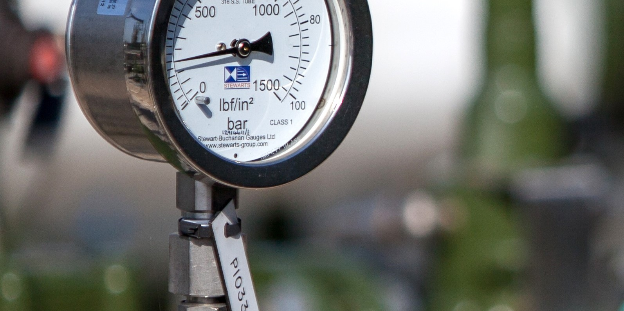
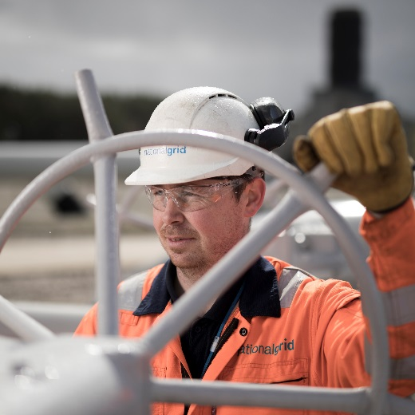

GS(M)R Review
CV Shrinkage Analysis
Transmission Workgroup
5th May 2022

Slide 2
Background
HSE has consulted on a proposal to amend the lower limit for Wobbe Index in GS(M)R from 47.2 MJ/m³ to 46.5 MJ/m³
If this amendment is approved, it may result in some NTS entry points delivering gas with a lower Wobbe Index and consequently lower CV
If gas is offtaken at a GDN offtake with a CV lower than 1 MJ/m³ below the flow-weighted average CV (FWACV) of all inputs to that charging area, the CV used for charging consumers is capped at that lowest source plus 1 MJ/m³
This generates an amount of unbilled energy, aka CV shrinkage, which NGG procures, the costs of which are passed through to NTS shippers
We therefore wished to assess the potential for additional CV shrinkage as a consequence of the GS(M)R Review

Slide 3
Survey of NTS Entry Terminals
We issued a survey to NTS entry terminal operators which contained the following two questions:
If HSE’s proposals are implemented and your entry point was eligible to deliver gas with a Wobbe Index of 46.5 MJ/m³, what CV would you expect your terminal to deliver to the NTS during calendar years 2023-2025? (Low, central, high case)
If HSE’s proposals are not implemented and the UK lower limit for Wobbe Index remains at 47.2 MJ/m³, what CV do you expect your terminal to deliver to the NTS during calendar years 2023-2025? (Low, central, high case)
We committed to report on the results of our analysis anonymously to encourage maximum participation

Slide 4
Summary of Survey Results
13 responses were received out of 18 surveys issued
8 responses indicated no change to the range of CV of gas expected to be delivered
3 responses indicated changes <0.2 MJ/m³ to the lowest CV they may deliver
2 responses indicated potential changes between 0.5 MJ/m³ and 0.8 MJ/m³ to the lowest CV they may deliver

Slide 5
Analysis Approach
The two terminals that indicated potential CV changes between 0.5 MJ/m³ and 0.8 MJ/m³ were selected
Actual volumes and CVs of relevant network offtakes plus actual FWACVs for the relevant charging areas were taken from 15 sample high demand days in the past 12 months
FWACVs for the relevant charging areas were recalculated using the new lower CV provided by the relevant terminals
The nearest network offtake to the terminals was assumed to measure the revised lower CV
Other relevant NTS entry flows and CVs were held constant to their actual values on those days

Slide 6
Analysis Results
Terminal A:
Due to comingling with other supplies, the FWACV remained within 1 MJ/m³ of the lowest source input, therefore no additional CV shrinkage was observed
Terminal B:
Additional CV shrinkage was calculated at an average of 2.9 GWh/day and an average cost of £249k/day* based on the days modelled
However, we would not expect this to occur in reality due to:
the configuration of how gas enters the nearest network offtake
the operator’s view that any low CV gas delivered would only occur during start-up/shutdown processes lasting a few hours, i.e. the daily CV used for the shrinkage calculation would be a higher value
* Based on actual SAPs on the days modelled

Slide 7
Conclusions
If the Wobbe Index lower limit is reduced as proposed by the GS(M)R Review, we consider it unlikely that a change to the CV range of gas delivered from the majority of NTS entry points will manifest
We could see minor reductions in CV levels at a few terminals which are unlikely to result in a material increased CV shrinkage risk
Two terminals may deliver more materially lower CV supplies. We consider it unlikely that additional CV shrinkage will arise as a consequence, either because of comingling with other supplies before reaching a network offtake or such instances being short-term transient events

