Slide 1
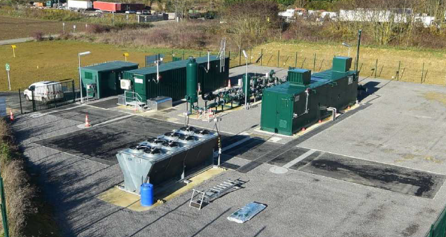
Reverse Compression UNC Mod
Briefing
19th April 22
John Baldwin
Managing Director
CNG Services Ltd john.baldwin@cngservices.co.uk www.cngservices.co.uk
07831 241217

Slide 2
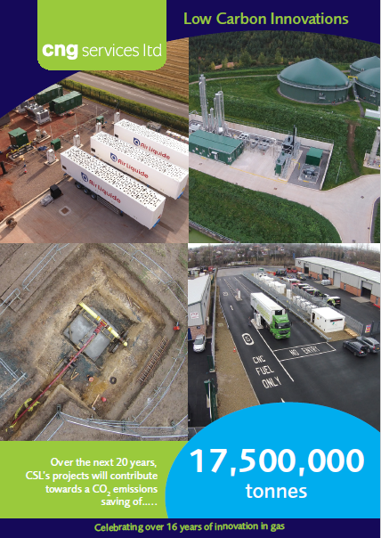
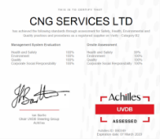
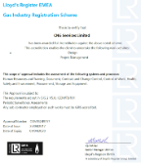

CNG Services Ltd
CNG Services Limited (CSL) provides consultancy, design and build services to the biomethane industry, all focused on reducing Greenhouse Gas (GHG) emissions
In the past 10 years our efforts have produced a material impact with an estimated 20 year project life reduction in CO₂ emissions of 17,500,000 tonnes through:
  Biomethane injection into the gas grid
  Running trucks on Bio-CNG
  Acting as developer and design and build contractor for the Highlands CNG Project
Part owner of CNG Fuels Ltd, a company set up to build a national network of Bio-CNG stations on the high pressure grid
  National network of CNG Stations
  84% saving in GHG compared to diesel
Part owner of Barrow Shipping Ltd, GB’s leading shipper of biomethane and a company that only buys and sells biomethane, no fossil gas
CSL is an ISO 9001, 14001 and 45001 approved company and has also achieved Achilles certification. CSL is GIRS accredited for design and project management and has been certified as a competent design organisation for high pressure UK onshore natural gas works by DNVGL
Working on a number of H₂ and CCUS innovation projects

Slide 3
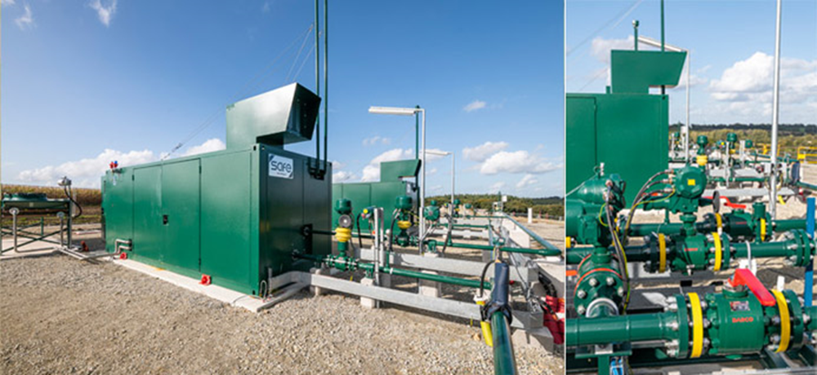
Summary
Reverse Flow options was presented at the Entry Customer Forum on 7th September
WWU & Cadent are currently carrying out an innovation project with compression at a site near Doncaster
Based on that project, the GDNs have produced a specification for GDN owned and operated compressors
This briefing is to support a UNC Mod to facilitate biomethane producer owned compressors with a number of changes:
  No LDX exit Charges
  No LDZ Entry Charges/Rebate
  No impact on CV or odorisation
Slides in Appendix attached by way of background
  GasUnie Within Grid Compressor 6 bar pipeline to 40 bar
  GRTgaz Safe reverse flow compression projects in France
  LTS/NTS – Direct Compression 19/38/42/70 bar LTS
  LTS –Private 6.9 bar pipeline to LTS (19 – 42 bar)/NTS

Slide 4
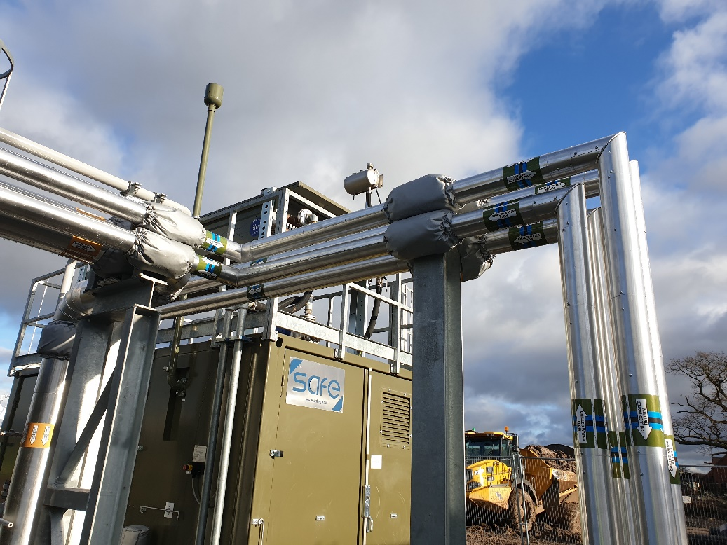
Within Grid Operating Principles
The operating principle underpinning within-grid-compression is that during the summer the gas network will be able to reduce the regulator set points at the AGIs that feed the localised network a biomethane site is connected to
This will give a compressor a pressure band to operate in and ensure that the compressor is not moving gas from low pressure to high pressure networks for the regulators on an AGI to then flow the gas back from high to low pressure
For example, the IP distribution networks in GB operate at a nominal pressure of 7 barg and as such, the maximum operating pressure that the AGI regulators will be set at is 6.9 barg. If this is reduced to 6.5 barg during times of low network capacity (i.e. summer) it will give the compressor a band to operate in from 6.5 bar to 6.9 barg
The pressure cannot rise above 6.9 barg as the compressor will be switched on to move gas out of the network
If the pressure falls and approaches 6.5 barg then compressor will turn off
If the network pressure falls even further below 6.5 barg then the AGI regulators will start to open and move gas from the high pressure network to low pressure
Maintaining 6.5 barg for summer demand will generally be acceptable in terms of gas security of supply due to absence of 1 in 20 peak day demand

Slide 5
Within Grid Ownership Options – the UNC Mod is to allow Option 2
Option 1 – GDN Owned | Option 2 – Biomethane Producer Owned
Compressor is owned operated and maintained by the GDN and forms part of the network | Compressor is owned, operated and maintained by the biomethane producer and does not form part of the network
Comprises an Exit to the lower pressure grid (2 bar or 7 bar) and an Entry into the high pressure grid (7 bar or 19/40/70 bar LTS) | Comprises an Exit to the lower pressure grid (2 bar or 7 bar) and an Entry into the high pressure grid (7 bar or 19/40/70 bar LTS)
Exit meter for management information | Exit meter for management information
No charges as gas does not leave network | At present the gas shipper would pay an Exit Charge to leave the MP/IP and receive Entry Rebate to enter IP/LTS (the UNC mod aims to exempt from these charges/payments)
Funding may be from the biomethane producer in the form of up front CAPEX or a tariff | Funding from the biomethane producer
Ongoing charge for maintenance and compression levied by the GDN | Ongoing charge for maintenance and compression paid for by the biomethane producer
Compressor design approved by the GDN – common specification across all GDNs | Compressor design set by the Biomethane Producer but the GDN can set out specific requirements eg Process Safety and Oil related – common requirements from all GDNs
Self-lay may be an option | Responsibility for design, build and maintenance with the biomethane producer
Land and planning likely to be arranged by the biomethane producer | Land and planning to be arranged by the biomethane producer
Pressure in lower pressure grid reduced in summer months to facilitate compressor operation and ensure there is no circular flow | Pressure in lower pressure grid reduced in summer months to facilitate compressor operation and ensure there is no circular flow

Slide 6
Within Grid Compressor Fundamental Principles
These are based on CSL work in this area and research in EU
For LTS and NTS >40 bar pressure, gas reciprocating compressors should normally be used
For LTS <40 bar pressure, screw compressors can also be used
Oil free compressors should be used or ones with a system to capture any oil that passes through the compressor (as used on membrane upgrading plants which ensure nom oil passes to the membranes)
There should be no risk to security of supply by design - key is to reduce grid pressure in summer and have simple Operating Philosophy with no scenario possible to impact security of supply to existing customers
Usually only one compressor will be required due to low running hours
To reduce cost and increase reliability, ideally use standard compressors from CNG/Biomethane/Biogas upgrading
  Already comply with ATEX, PED and are CE marked
  Minimal changes (if any)
Similar examples as the 6 bar to 19/38/42 bar remote compressors installed by CNG Services at Euston, Methwold, Bay Farm, Bonby
2 bar to 7 bar is very simple, should be <9 months project
Aim to keep it simple, keep costs down to ensure more biomethane projects are economic
Operating philosophy is very simple – for IP to LTS, switch on at 6.7 bar in the IP, switch off at 6.4 bar
No need for gas recycle, but have Variable Speed Drive to go down to 50% flow
Probably no need for chiller as the gas temperature at inlet to the compressors will generally be <15 deg C
Have a gas meter (on the low pressure Exit) to provide useful management information (alongside electricity meter)
Aim not to install projects which will never operate – small is best, can add 2nd compressor later if needed

Slide 7
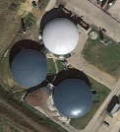
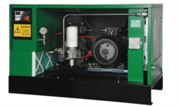
MP to IP Compression plant
AD Plant
1.3- 1.6 bar pressure Compressor operates when insufficient capacity in the MP for
the biomethane – it takes gas out of MP via Exit Meter and Injects into IP (only one meter)
Compressor starts when pressure hits 1.6 bar (as grid getting full) and stops when it falls to 1.3 bar
CSL owned and operated assets shown in yellow box
AD
BUU
Propane
GEU
Estimated flow rate of 300 scmh for 8 hours per night
Biomethane Producer
GDN Network
New MP
Connection
Pipeline ( 100m)
New IP
Connection
Pipeline ( 100m)
Meter
Compressor
Existing
7 bar network
500 scmh injection
1.3- 1.6 bar
6.9 bar
300 scmh injection
Into 7 bar
300 scmh Exit
from MP
Existing 2 bar MP
1.3 – 1.6 bar
200 scmh flow to other customers

Slide 8
IP to LTS Compression plant
AD
BUU
6.4- 6.7 bar pressure Compressor operates when insufficient capacity in the IP for
the biomethane – it takes gas out of IP via Exit Meter and Injects into LTS (only one meter)
Compressor starts when pressure hits 6.7 bar (as grid getting full) and stops when it falls to 6.4 bar
CSL owned and operated assets shown in orange box
Propane
GEU
LTS Compressor
Estimated flow rate of 500 scmh for 8 hours per night
Biomethane Producer
GDN Network
ROV
New IP
Connection
Pipeline ( 100m)
New IP
Connection
Pipeline ( 100m)
Meter
Compressor
Existing
38 bar network
700 scmh injection
6.4- 6.7 bar
38 bar
500 scmh injection
Into 38 bar
500 scmh Exit
from MP
Existing 7 bar IP
6.4- 6.7 bar
200 scmh flow to other customers

Slide 9
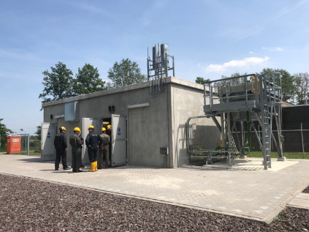
Background Briefing a)
GasUnie Within Grid Compressor 6 bar pipeline to 40 bar
Site Visit
4rd June 2019

Slide 10
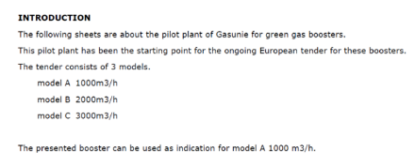
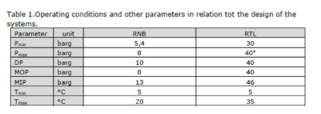
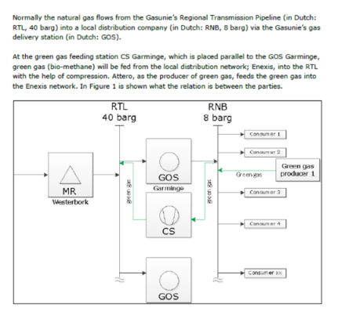
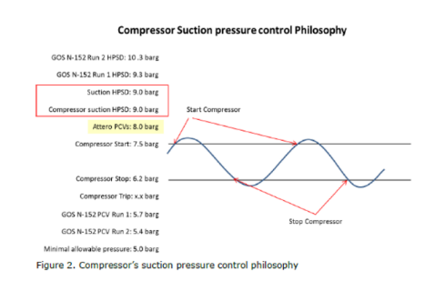

Slide 11
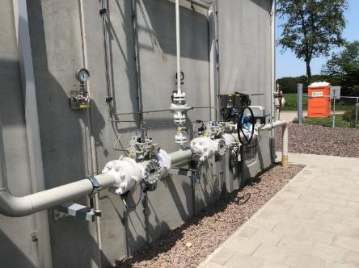
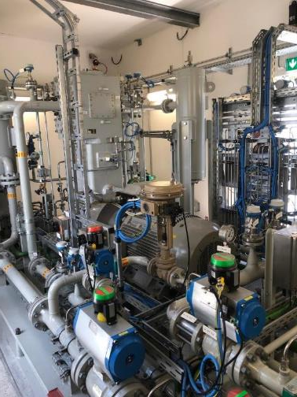
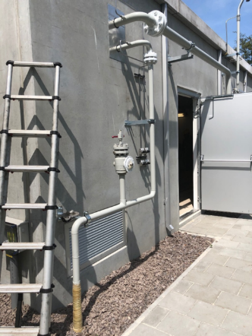
Site Lower pressure (8 bar) inlet (1)
Reciprocating Compressor
Site High Pressure (40 bar) Outlet

Slide 12

Background Briefing b)
GRTgaz France

Slide 13
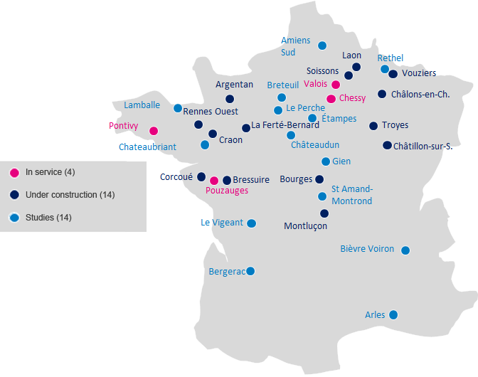
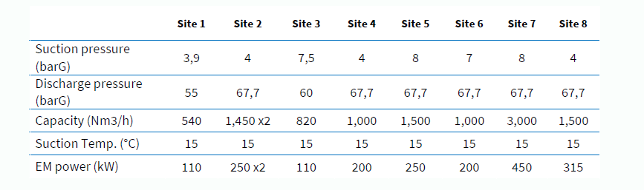

Reverse Flow – 32 Projects on French Network
Using Safe Compression

Slide 14
Background Briefing c)
LTS/NTS – Direct Compression 19/38/42/70 bar LTS
The key issue for these projects is managing the start up of the compressor and Biogas Upgrading Unit to ensure that the Grid Entry Unit doers not trip due to propane issues (too high or too low CV for a minute which trips the plant)
Following is a typical project
Note – load factor for each reciprocating compressor is typically 50% which is high. For screw, normally only one and so 100%

Slide 15
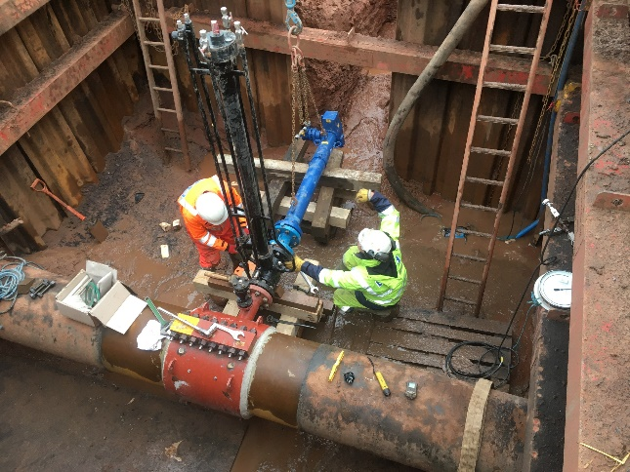
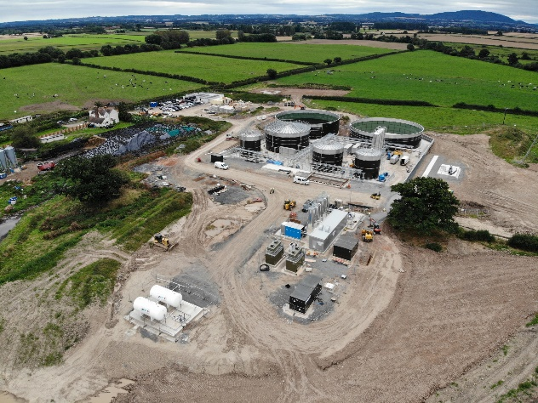
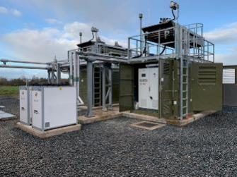
Barnes Farm Biomethane Project
Client | Air Liquide
Gas Network Operator | Cadent Gas
Location | Barnes Farm, Rowton, Telford, Shropshire
Type of Project | Biomethane
Local or Remote Compressor | Local
Entry/Exit | Entry
Project Scope:
  Design and construction of a 70 bar steel biomethane injection LTS pipeline under Cadent Self Lay process
  Design and construction of the customer facilities including twin reciprocating compressors & customer HP steel outlet, GEU, ROV and RTU
  Special crossing required under field drain
  G17 & GL5 Mechanical. Civil, CP Detailed Design with Appraisal and Approval
Pipeline Length, Material and Diameter | 600m 100NB/50NB steel LTS adopted pipeline, 40m 50NB steel HP compressor outlet
Maximum Operating Pressure (MOP) | 70 barg
Maximum Flowrate/LTS Diameter | 950 scmh/600NB
Compressor Type | SAFE reciprocating compressors
Completion Date | December 2019

Slide 16
Background Briefing d)
LTS –Private 6.9 bar pipeline to LTS (19 – 42 bar)/NTS
Cadent projects (Cadent allow self-lay of LTS connection which is critical for these projects)
The propane is added at 6.9 bar and so there are no issues with compressor/BUU/GEU issues that happen at sites with Direct Compression
Following shows typical LTS and NTS projects

Slide 17
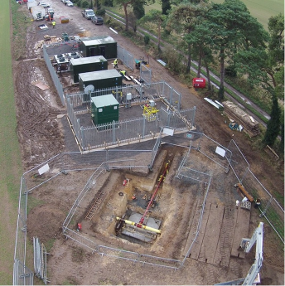
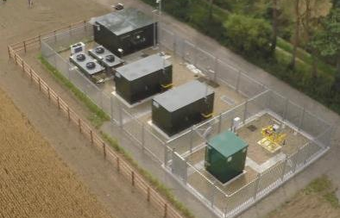
Methwold Biomethane Project
Client | Warren Energy (Future Biogas Operator)
Gas Network Operator | Cadent Gas
Location | Methwold, Thetford, Norfolk
Type of Project | Biomethane
Local or Remote Compressor | Remote
Entry/Exit | Entry
Project Scope: Design and construction of an IP gas pipeline between the AD Plant and remote compressor, including HV supply and fibre optic communications, owned and operated by Warren Energy Design and construction of a customer compressor compound incl twin reciprocating compressors and HP steel outlet pipework Design and construction under Self Lay process of Cadent MEC facilities including Remote Operated Valve, HP inlet and outlet pipework, RTU, compound & final connection to Cadent LTS GL5 & G17 Mechanical Detailed Design with Appraisal and Approval.
Pipeline Length, Material and Diameter | 3.5km 90mm PE IP pipeline to remote compressor, 20m 100/50NB steel LTS rated compressor outlet/ROV Inlet & outlet connections
Maximum Operating Pressure (MOP) | 42 barg
Maximum Flowrate/LTS Diameter | 600 scmh/200NB
Compressor Type | SAFE reciprocating compressors
Completion Date | November 2015

Slide 18
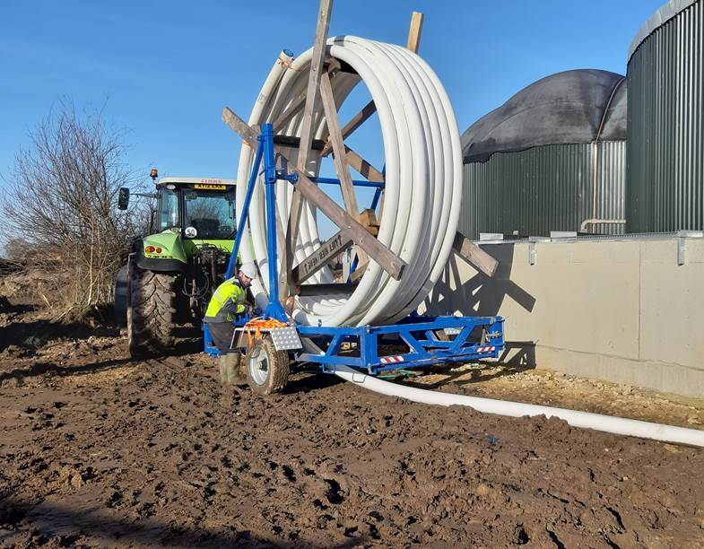
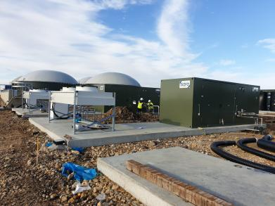
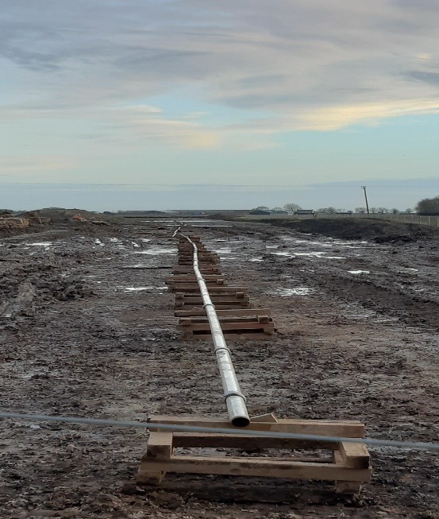
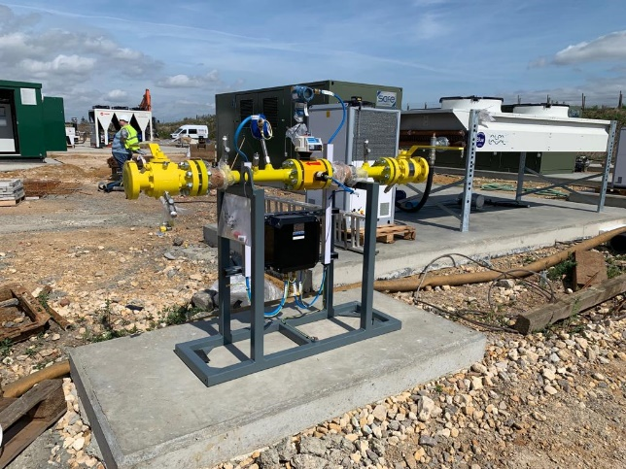
Somerset Farm Biomethane to NTS Project
Client | BioCow
Gas Network Operator | National Grid Gas
Location | Somerset Farm, Cants Drove, Murrow, Wisbech, Cambridgeshire, PE13 4HN
Type of Project | Biomethane
Local or Remote Anaerobic Digester | Remote
Entry/Exit | Entry
Project Scope:
  Design and construction of a 75 bar 100NB steel 1Km private gas pipeline & fibre optic communications from the AD plant boundary to a new NGG NTS MEC at an existing block valve, CSL Duty Holder operator under full Safety Case
  Design and construction of HP customer compressor outlets from twin reciprocating compressors to HP meter and 150NB HP Soluforce RTP meter outlet pipework to boundary ROV compound
  GL5 Mechanical. Civil, CP Detailed Design with Appraisal and Approval.
  This was the first NTS Biomethane Injection project
Pipeline Length, Material and Diameter | 1Km 80NB steel private pipeline, 140m 150NB Soluforce RTP, 80m 80NB & 50NB Steel HP compressor outlet connecting pipework
Maximum Operating Pressure (MOP) | 75 barg
Maximum Flowrate/NTS Diameter | 4000 scmh/100NB
Compressor Type | SAFE reciprocating compressors
Completion Date | August 2020

