Slide 1
Change Management Committee
8th February 2023

Slide 2
Section 2: DSC Change Budget & Horizon Planning

Slide 3
General Change Budget BP22 YTD

Slide 4
General Change Budget BP22 YTD

Slide 5
Forecasted Year End Spend (BP22)
The graph below illustrates the current forecast for financial year-end utilisation of the General Change investment budget (BP22) – this is subject to change should ChMC approve further change delivery
Total committed spend has increased since last reported by £542k
Link to Spreadsheet

Slide 6
Change Pipeline

Slide 7
Change Delivery Plan January 23 – April 24
Jan-23
Apr-23
Aug-23
Dec-23
Apr-24
February 23 - Major Release (XRN5533)
XRN4900, XRN4978, XRN4990, XRN4989, XRN4992b, XRN5298
XRN5535
XRN5567
March 23 - AdHoc Release (XRN5575)
XRN5379, XRN5143, XRN5472
June 23 - Major Release (XRN5562)
XRN5091, XRN5186, XRN5482
XRN5595
November 23 – Major Release
XRN5604, XRN5605, XRN5607
February 24 – Major Release
XRN5555
XRN5606
XRN5454
XRN4713
XRN5602
XRN5547
Delivery Key
= Firm Implementation Date – Funding Approved by ChMC and / or Non-Negotiable Industry Implementation Date in place
= Indicative Implementation Date – Changes are scoped for delivery – Funding and/or Implementation Date not yet approved by ChMC
= Delivered on Target Implementation Date
Slide produced 28 January 2023

Slide 8
Change Pipeline - Delivery Plan - January 2023 – May 2023
XRN | Change Title | Proposer | Benefit / Impact | Funding | HLSO Max Cost | Target Implementation Date | Release Type | Delivered / Firm / Indicative
5555 | Amend existing Large Load Site Reporting | SGN | DN | DN | N/A | January 2023 | Adhoc | Indicative
4713 | Actual read following estimated transfer read calculating AQ of 1 | Npower | Shipper | Shipper | £7k | January 2023 | AdHoc | Indicative
4900 | Biomethane/Propane Reduction | SGN | Shipper DN | DN Decarb | N/A | 25th February 23 | Major | Firm
4978 | Notification of Rolling AQ Value (following Transfer of Ownership between M-5 and M) | British Gas | Shipper | Shipper | £90.6k | 25th February 23 | Major | Firm
4990 | Transfer of Sites with Low Read Submission Performance from Class 2 and 3 into Class 4 – MOD 0664 | SSE | Shipper | Shipper | £232k | 25th February 23 | Major | Firm
4989 | Residual AMT activities | CDSP | Shipper | Shipper | N/A | 25th February 23 | Major | Firm
4992 | XRN4992 - Modification 0687 Clarification of Supplier of Last Resort (SoLR) Cost Recovery Process | Total | Shipper DN | Shipper DNO | £108.7k | 25th February 23 | Major | Firm
5298 | H100 Fife Project – Hydrogen Network Trial | SGN | Shipper DN | DN Decarb | N/A | 25th February 23 | Major | Firm
5595 | Changes to the REC Switching Operator Outage Notification Lead Time (R0055) | Xoserve | Shipper | N/A | N/A | 25th Feb 23 | Major | Firm
5379 | Class 1 Read Service Procurement Exercise - MOD0710 (DM Sampling) | Xoserve | Shipper DN | Shipper | £150k | 1st April 2023 | AdHoc | Firm
5143 | Transfer of NDM sampling obligations from Cadent, WWU, and NGN to the CDSP | Cadent | DN | WWU, Cadent, NGN only | £75k | 1st April 2023 | AdHoc | Firm
5472 | Creation of a UK Link API to consume daily weather data for Demand Estimation | CDSP | Shipper DN | Shipper DN | £75k | 1st April 2023 | AdHoc | Firm
5606 | Revision of Virtual Last Resort User and Contingent Procurement of Supplier Demand Event Triggers (Modification 0813) | NGT | NGT Shipper Supplier | NGT | N/A | Following Ofgem Decision | Adhoc | Indicative
5602 | Releasing of unused capacity under a specific set of circumstances (Modification 0818) | NGN | Shipper DN | DN | N/A | Following Ofgem Decision | Adhoc | Indicative

Slide 9
Change Delivery Plan - June 2023 – December 2023
XRN | Change Title | Proposer | Benefit / Impact | Funding | HLSO Max Cost | Target Implementation Date | Release Type | Firm / Indicative
5091 | Deferral of creation of Class change reads at transfer of ownership | EDF | Shipper | Shipper | £200k | 24th June 23 | Major | Firm
5186 | MOD0701 - Aligning Capacity booking under the UNC and arrangements set out in relevant NEXAs | NGN | Shipper DN | Shipper DN | £200k | 24th June 23 | Major | Firm
5482 | Replacement of reads associated to a meter asset technical details change or update (RGMA) | Scottish Power | Shipper | Shipper DN | £300k | June 23 (tbc) | Major | Indicative
5454 | SoLR Reporting Suite | EDF | Shipper | Shipper | Tbc | July 23 | Tbc | Indicative
5547 | Updating the Comprehensive Invoice Master List and INV template | Eon | Shipper DN | Shipper | Tbc | July 23 | Tbc | Indicative
5535A | Processing of CSS Switch Requests Received in ‘Time Period 5’ | Xoserve | All DSC Customers | Shipper | £44k | August 23 | Adhoc | Indicative
5567 | Implementation of Resend Functionality for Messages from CSS to GRDA (REC CP R0067) | Xoserve | All DSC Customers | Shipper | £93k | August 23 | Adhoc | Indicative
5604 | Shipper Agreed Read (SAR) exceptions process (Modification 0811S) | SEFE | Shipper | Shipper | Tbc | November 23 | Tbc | Indicative
5605 | Amendments to the must read process (IGT159V) | Centrica | Shipper IGT | Shipper IGT | Tbc | November 23 | Tbc | Indicative
5607 | Update to the AQ correction processes (Modification 0816S) | EON Next | Shipper DN IGT | Shipper | Tbc | November 23 | Tbc | Indicative

Slide 10
Change Backlog Details
XRN | Change Title | Proposer | Benefit / Impact | Funding | HLSO Max Cost | Target Implementation Date | Release Type | Firm / Indicative
5316 | Rejecting Pre LIS Replacement Reads | Xoserve | Shipper | N/A | N/A | Tbc | Tbc | N/A
5531 | Hydrogen Village Trial | SGN | All DSC Customers | DN Decarb | Tbc | Tbc | Tbc | N/A
5546 | Resolution of Address Interactions between DCC and CDSP | Xoserve | DN IGT Shipper | Shipper | Tbc | Tbc | Tbc | N/A
5569 | Contact Data Provision for IGT Customers | BUUK | IGT | IGT | Tbc | Tbc | Tbc | N/A
5573 | Updates to the Priority Consumer process (as designated by the Secretary of State for Business, Energy, and Industrial Strategy - BEIS) – Urgent | Xoserve | All DSC Customers | Part B - Tbc | Part B - Tbc | Part B - Tbc | Part B - Tbc | Part B - Tbc
5584 | Procurement of Climate Change Methodology for Demand Estimation Purposes | Xoserve | DN Shipper | DN Shipper | Tbc | Mid 2023 | AdHoc | Indicative
5585 | Flow Weighted Average Calorific Value - Phase 2 Service Improvements | Cadent | DN | DN | Tbc | Tbc | Tbc | N/A
5614 | Improving IGT SMP New Connection Process to support accurate and timely Supplier Registrations | BUUK | Shipper IGT | Shipper IGT | Tbc | Tbc | Tbc | N/A
5616 | CSEP Annual Quantity Capacity Management | WWU | DN IGT Shipper | DN IGT | Tbc | Tbc | Tbc | N/A
REC IA Demand – Priority Change
Title | Description | XRN | Proposer | Impact/Funding | Status | Release Type | Priority
R0048 | DCC Service Organisation Control 2 (SOC2) Assessments | N/A | DCC | - | Solution development | TBC | Low
R0073 | Introduction of a Housekeeping Change Proposal Process | N/A | Gemserv | - | Preliminary Assessment | TBC | Low
R0088 | Make Shipper NExA values available on the GES portal | N/A | Xoserve | - | New | Major, June 23 | Medium

Slide 11
Change Backlog – On Hold Details
XRN | Change Title | Proposer | Benefit / Impact | Funding | HLSO Max Cost | Target Implementation Date | Release Type | Firm / Indicative
4914 | *Mod0651 – Retrospective Data Update Provisions* | Cadent | Shipper DN | Tbc | £1.8m – £2.4m | Tbc | Major | N/A
5144 | Enabling Re-assignment of Supplier Short Codes to Implement Supplier of Last Resort Directions | Xoserve | Shipper DN IGT | Tbc | Tbc | Tbc | Tbc | N/A
5187 | MOD0696 - Addressing inequities between Capacity booking under the UNC and arrangements set out in relevant NExAs | Gazprom | Shipper DN | Shipper DN | Tbc | Tbc | Tbc | N/A
5345 | Deferral of creation of Class change reads for DM to NDM and NDM to DM sites at Transfer | CDSP | Xoserve | Shipper | Tbc | Tbc | Tbc | N/A
5453 | GSOS 2, 3 & 13 Payment Automation | SGN | Shipper DN | DN | Tbc | Tbc | Tbc | N/A
5471 | DSC Core Customer Access to Data | CDSP | Shipper DN IGT | IGT Shipper DN | Tbc | Tbc | Tbc | N/A
5473 | Meter Asset Details Proactive Management Service | CDSP | Shipper | Shipper | Tbc | Tbc | Tbc | N/A
*Mod0651 : 28.01.23 - Change Status remains on hold and will be reviewed on a monthly basis with ChMC – in line with request from UNCC

Slide 12
DSC Change Pack Plan
February-23
March-23
April-23
XRN5547 - Updating the Comprehensive Invoice Master List and INV template
XRN5454 – SOLR Reporting Suite
XRN5606 - Revision of Virtual Last Resort User and Contingent Procurement of Supplier Demand Event Triggers (Modification 0813)
XRN5604 - Shipper Agreed Read (SAR) exceptions process (Modification 0811S)
XRN5602 - Releasing of unused capacity under a specific set of circumstances (Modification 0818)
XRN5605 - Amendments to the must read process (IGT159V)
XRN5556D – CMS Project
Isolation and Dead to Live Contacts
XRN5482 - Replacement of reads associated to a meter asset technical details change or update (RGMA)
XRN5535A - Processing of CSS Switch Requests Received in ‘Time Period 5’
XRN5379 - Class 1 Read Service Procurement Exercise - MOD0710 (DM Sampling)
Delivery Key
= Design Change Pack for Consultation
= Solution Option Change Pack for Consultation
= For Information Change Pack
Slide produced 28 January 2023

Slide 13
REC Change
8th February 2022

Slide 14
Introduction
The following 7 slides have been included in this months ChMC pack to give you an overview of the ongoing REC Changes, we have broken these down into the following sections:
In progress – we are currently progressing through the Change journey
Under Prioritisation Review by REC Code Managers – due to CM workload/prioritisation
We have included a new slide this month on the Changes which will be coming into our space in the next few weeks.
We believe the changes will require CDSP action and therefore need to draw attention to this demand as it will require prioritisation over other DSC changes in our Change Backlog
As agreed last month, I have also included REC related Changes which do not have an associated R00 number but do have an XRN.
Note: We are currently undertaking a review of all REC Change and have began removing Changes which we have confirmed have no impact to Gas services. In the coming months, we will continue to monitor the Changes listed and add/remove from this pack as required.
Further information on the Changes can be found on the REC Portal
Notes:
Draw committees attention to red line (will make it black once slides are approved before submission)

Slide 15
Overview of REC Changes (high level)
In Progress Change
4

Slide 16
REC Change Pipeline – In progress
Title | Description | XRN / UNC Mod | Proposer | Impact/ Funding | Status | Next Action date | Release Type | REC Priority | Attachments
R0025 | Service Provider Performance Charges (DCC) | N/A | Deloitte (RPA) | - | Awaiting Authority decision | 01/04/2023 – Proposed Implementation date | TBC | High
R0047 | Metering Code of Practice Consolidation Review | N/A | RECCo | - | Approved - awaiting implementation | 01/04/2023 – Proposed Implementation date | Standalone | High | N/A
R0052 | GES Service Definition Document | N/A | Deloitte | GES | Approved - awaiting implementation | 24/02/2023 – Proposed Implementation date | Major, Feb 23 | Medium | N/A
R0055 | Switching Operator Outage Notification Lead Time | XRN 5595 | DCC | GRDS, GES | Approved - awaiting implementation | 24/02/2023 – Proposed Implementation date | Major, Feb 23 | Medium | N/A
R0063 | Addition of key information to all Service Now tickets | N/A | St Clements Ltd (on behalf of DNOs) | - | Solution development | 07/02/2023 – Solution Development closeout date | TBC | Medium | N/A
Key:
Currently working on
Upcoming
Monitoring

Slide 17
Title | Description | XRN / UNC Mod | Proposer | Impact/ Funding | Status | Next Action date | Release Type | REC Priority | Attachments
R0067 | Introduction of CSS refresh functionality | XRN 5567 / UNC Mod expected | Capgemini (RTS) | GRDS | Consultation | 02/2023 –Technical Release planning 30/06/2023 – Legal text change implemented | Legal text – Major, June 23 Technical Change - Standalone | High | N/A
R0070 | Provision of Enduring Test Environments | N/A | Capgemini | GRDS, GES | Consultation | 02/02/2023 – Initial impact assessment due to be issued | Standalone | High | N/A
R0074 | Release of Community View Data Items to MEMs in GES | N/A | Xoserve | GES | Consultation | 22/02/2023 – Technical expert Panel review 24/02/2023 - Changes to the DAM 27/02/2023 – Functional Change planning | Changes to the DAM – Major, Feb 23 Functional Change - TBC | High
Key:
Currently working on
Upcoming
Monitoring

Slide 18
REC IA Demand
Title | Description | XRN | Proposer | Impact/ Funding | Status | Next Action date | Release Type | Priority | Attachments
R0048 | DCC Service Organisation Control 2 (SOC2) Assessments | N/A | DCC | - | Solution development | 17/02/2023 -Preliminary Change Report and consultation issued | TBC | Low
R0073 | Introduction of a Housekeeping Change Proposal Process | N/A | Gemserv | - | Preliminary Assessment | 27/01/2023 - Preliminary Change Report and consultation issued | TBC | Low
R0088 | Make Shipper NExA values available on the GES portal | N/A | Xoserve | - | New | 02/2023 - Impact assessment being issued (awaiting formal approval from Code manager before IA date is confirmed) | Major, June 23 to align with | Medium
Key:
Currently working on
Upcoming
Monitoring

Slide 19
REC Related XRN Changes
Description | XRN | Proposer | Impact/ Funding | Status | Next Action date | Release Type | Priority
Processing of CSS Switch Requests Received in ‘Time Period 5 | XRN 5535 | Xoserve | GRDS | Under Development | Progression of BER / Design Change Pack | TBC | High
Resolution of Address Interactions between DCC and CDSP | XRN 5546 | Xoserve | GRDS | Under development | Regular conversations with DCC as work is ongoing | TBC | Medium
Key:
Currently working on
Upcoming
Monitoring

Slide 20
REC Change Pipeline – Under Prioritisation Review
Title | Description | Status
R0049 | Intellectual Property Rights and Services Data Main Body changes | Initial Assessment
R0051 | Switch Request Objections (Change of Occupier) | Initial Assessment
R0056 | EES/GES additional service request for Housing Associations to be added to the Matrix | Initial Assessment
R0059 | Maintenance of Qualification Schedule Change | Initial Assessment
R0068 | REC Data Protection Changes | Initial Assessment
R0069 | Amendments to Sample Access Agreement | Initial Assessment
R0071 | DCC access to EES and GES | Initial Assessment
R0073 | Introduction of a Housekeeping Change Proposal Process | Initial Assessment
R0075 | Enabling Software Product Qualification | Initial Assessment
R0080 | Improvements to "Failed to deliver" CSS messages | Initial Assessment
R0081 | CSS Market message retry strategy | Initial Assessment
R0082 | Formalising the Submission of PPMIP Unallocated Transaction Report (UTR) Files | Initial Assessment
R0084 | Housekeeping changes to the approved legal text for R0047 | Initial Assessment
R0085 | Switching Programme Designation of the Steady State Commencement Date | Initial Assessment
R0087 | MAP GES data access | Initial Assessment
R0089 | Removal of Pre-COVID AQ Value from Data Access Matrix | Initial Assessment
R0090 | Alignment of Data Specification with Pre-REC Rules and Consequential Impacts on R0011 Legal Text | Initial Assessment
R0091 | Clarifications to the Theft Detection Incentive Schemes | Initial Assessment

Slide 21
Section 3: Capture

Slide 22
New Change Proposals
For Approval
XRN5614 Improving IGT SMP New Connection Process to support accurate and timely Supplier Registrations
XRN5616 CSEP Annual Quantity Capacity Management

Slide 23
XRN5614 Improving IGT SMP New Connection Process to support accurate and timely Supplier Registrations
Customer Class | Impacted /Voting Party?
Shipper | X
Distribution Network Operators (DNOs)
National Grid Transmission
IGTs | X
Change Description
In circumstances where Shipper and / or Supplier details agreed with a Developer differ to those recorded within central industry systems, IGTs require a mechanism to ensure this information can be passed to the relevant Shipper organisations, allowing appropriate action to be taken. The provision of this information, tracking of relevant updates to central industry records and monitoring of performance can be used to assess realisation of intended benefits of this change and should be considered as an enduring requirement. Link to CP
DSC Service Area and Associated Funding Split | Service Area 3: Manage updates to customer portfolio 90% Shipper, 10% DNO
Proposed Funding Split from Proposer | 50% Shipper 50% IGT
Change Type | Non-regulatory
Priority Score | Medium
Sponsor Representative | Xoserve

Slide 24
XRN5616 CSEP Annual Quantity Capacity Management
Customer Class | Impacted /Voting Party?
Shipper | X
Distribution Network Operators (DNOs) | X
National Grid Transmission
IGTs | X
Change Description
This change will introduce a process to enable GDNs to review, authorise and approve the application for the creation of MPRNs on IGT CSEP sites where the CSEP will exceed the agreed demands aligned to obligations set out in IGTAD B 2.2.1 (c). Link to CP
DSC Service Area and Associated Funding Split | Service Area 3: Manage updates to customer portfolio 90% Shipper, 10% DNO
Proposed Funding Split from Proposer | 50% DNO 50% IGT
Change Type | Non-regulatory
Priority Score | Medium
Sponsor Representative | Xoserve

Slide 25
section 4. Design & Delivery

Slide 26
Design Change Pack
For Approval
XRN4990- Transfer of Sites with Low Valid Meter Reading Submission Performance from Classes 2 and 3 into Class 4
XRN5567 Detailed Design Change Pack - Implementation of Resend Functionality for Messages from CSS to GRDA (REC CP R0067)
For Information
XRN5472 Creation of a UK Link API to consume daily weather data for Demand Estimation processes

Slide 27
XRN4990 Transfer of Sites with Low Valid Meter Reading Submission Performance from Classes 2 and 3 into Class 4 (Modification 0664VS)
Detailed Design Consultation Summary
Change Pack Ref | Funding | Voting | Impacted | Release | Link to CP | Representation Summary
 |  |  |  |  |  | Approve | Defer | Reject
3128.1 - VO - PO | Service Area 1 100% Shipper | Shipper | Shipper | February 23 | Link to CP
Org | Status | Comments
 |  | No representations received

Slide 28
XRN 5567 Implementation of Resend Functionality for Messages from CSS to GRDA (REC CP R0067)
Detailed Design Consultation Summary
Change Pack Ref | Funding | Voting | Impacted | Release | Link to CP | Representation Summary
 |  |  |  |  |  | Approve | Defer | Reject
3128.2 - VO - PO | Service Area 1 Split: 100% Shipper | Shipper, DNO, IGT | Shipper, DNO, IGT | Adhoc – July/August 2023 | Link to CP
Org | Status | Comments
 |  | No representations received

Slide 29
XRN5472 Creation of a UK Link API to consume daily weather data for Demand Estimation processes
Detailed Design Consultation Summary
Change Pack Ref | Funding | Voting | Impacted | Release | Link to CP | Representation Summary
 |  |  |  |  |  | Approve | Defer | Reject
3128.3 - VO - PO | Service Area 5 Split: 50% Shipper, 50% DNO | N/A – For information | Shipper, DNO, IGT, NGT | March 2023 | Link to CP
Org | Status | Comments
 |  | For information - No representations received

Slide 30
Standalone Change Documents for Approval (BER, CCR, EQR)

Slide 31
Standalone Change Documents for Approval (BER, CCR, EQR)
BER for XRN5535 - Processing of CSS Switch Requests Received in ‘Time Period 5’ Receive Updates
Voting Shippers
CCR for XRN5231 - Provision of a FWACV Service
Voting DNO, NTS
CCR for XRN5368 - Gemini Sustain Year 1 Roadmap
Voting NTS

Slide 32
March 23 Release XRN5472 Creation of a UK Link API to consume daily weather data for Demand Estimation processes
*ChMC Decision Required*
Withdrawal from scope of March23 Release

Slide 33
Project Update – Change to Weather Data Service Provider API and implications to XRN 5472 Delivery Approach
Background
Following ongoing engagement with our weather data service provider on the proposed API solution, we have been informed that they intend to move all of their clients onto a new version of their API services
This activity is expected to take place in late 2023 and will require all clients to upgrade any existing APIs to this new version (version 2) in order to continue to receive the relevant weather data
In light of this upgrade, the weather data service provider has offered to extend the existing data transfer mechanism (File Transfer Protocol)
This would allow our service to transition to the new API version later in the year without impacting our DSC services continuity
As a result this would also avoid the need for the proposed XRN5472 changes to be deployed on 1st April as have been previously communicated and approved
Following completion of our associated Detailed Design phase (issued in January-23 Change Pack), we have established that the required technical change do not impact or have any interaction with DSC Customers – confirming that the change is entirely internal to the CDSP

Slide 34
XRN 5472 Proposal to withdraw Change
CDSP Recommendation and related Next Steps
Having confirmed that the technical changes do not impact or involve DSC customers we recommend that XRN5472 is withdrawn from the scope of March-23 Release
The associated funds that were reserved for this change within the March-23 BER will be returned to DSC Customers
The CCR will be the mechanism to reconcile funds to the DSC Change Budget
Technical upgrade to the weather data service providers new API version will be planned and coordinated as an internal CDSP project
This approach allows the scope of the March Release, and any later Release to consist of only changes that are Customer impacting and benefitting
DSC ChMC Decision – Approval of Xoserve’s recommendation to withdraw XRN5472 from March-23 Release scope
Vote required from DN and Shipper Customer Classes

Slide 35
XRN5575 March 23 Release
February 2023

Slide 36
XRN5575 – March 23 Adhoc Release - Status Update
 | Overall Project RAG Status
 | Schedule | Risks and Issues |  | Cost
RAG Status
Status Justification
Schedule | Overall release is tracking at risk; Amber. Design phase continues for all three XRNs scoped for this release. Build completed as planned for 5379 and 5472 but this is at risk due to status of design. Testing is underway for 5379 and 5472. Return to green is completion of design as planned and approved detailed project plan for delivery including touch-points with DM and NDM service providers. Progress update: UK Link build complete as planned for 5379 and 5472, build for 5143 due to commence this week DM and NDM SP onboarding activities preparation underway Engagement with the service provider continues for 5379 including resolving of design queries Project in startup and initiation phase including development of detailed project plan. PID, comms plan and RACI have been approved. Decision in February ChMC: Approval is being sought to descope 5472 from March-23 due to the weather data supplier making available the file based solution for long enough to allow Xoserve to move to their strategic platform in one implementation as opposed to two implementations in 2023 |  | Implementation date of 25th March with a go-live of 1st April, the contingency implementation date is 1st April with a go-live of 1st April
Risks and Issues | 68566 (I) Delay to test commencement for March-23 impacting delivery plan, work underway to mitigate this before using available contingency 68488 & 68489: (R) The design has not yet completed for the changes in this release, therefore the aspirational delivery timescales are at risk 68126: (R) The NDM service provider (SP) is not yet agreed, until the NDM SP is engaged and plans shared there is a risk that plans will not align to validate end to end functionality before 1st April 68498: (R) The DM SP is agreed, but not yet fully engaged, until the DM SP is engaged and plans shared there is a risk that plans will not align to validate end to end functionality before 1st April
Cost | Forecast to complete delivery against approved BER
Scope | XRN5143 - Transfer of NDM sampling obligations from Cadent, WWU, and NGN to the CDSP XRN5379 - Class 1 Read Service Procurement Exercise (Modification 0710) XRN5472 - Creation of a UK Link API to consume daily weather data for Demand Estimation processes
Complete
On Track
At Risk
Overdue
Slide updated on 24th January 2022

Slide 37
February 2023 Major Release

Slide 38
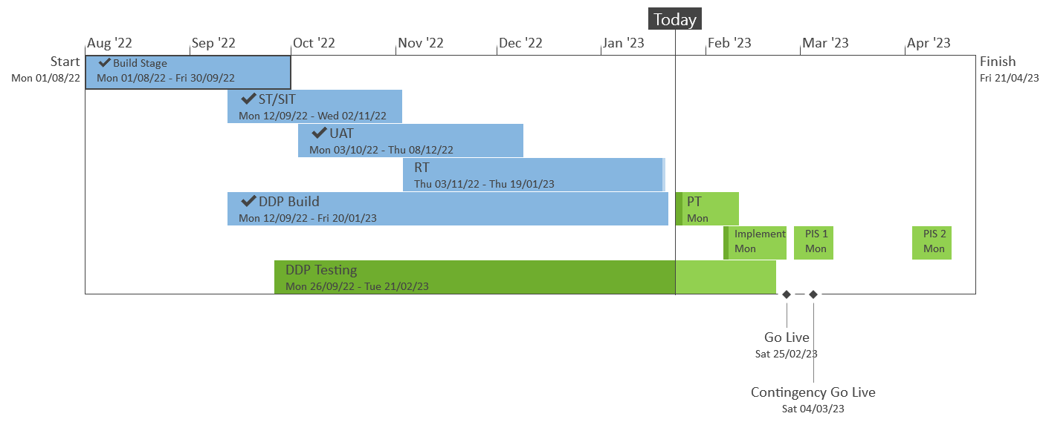
XRN5533 – February 23 Major Release - Status Update
 | Overall Project RAG Status
 | Schedule | Risks and Issues |  | Cost
RAG Status
Status Justification
Schedule | Overall release is tracking on target; Green, UK Link regression testing phase completed on 19/01 as per plan. Currently on track to complete performance testing phase 17/02 Progress update: Regression testing complete on 19/01 Performance testing in progress, on track to complete on 17/02 DDP build for XRN4990 completed on 18/01 DDP testing for XRN4990 in progress, on track to complete by 21/02 February 23 Change Awareness Session with Industry participants completed on 24/01 Progress update provided in Shipper Constituency meeting on 25/01 Implementation preparation commenced ready for planned go live on 25/02 Implementation Approach walkthrough included in this ChMC meeting. Decision in February ChMC: None |  | Implementation date of 25th February; with a contingency implementation date of 4th March
Risks and Issues | There is a risk that the solution being delivered under XRN5298 may not work as expected at the point SGN go live with the H100 project - due to a gap between XRN5298 being delivered as part of the Feb 23 release, and the date at which the H100 project itself is scheduled to go live Update – SGN have confirmed that Q4 2024 is when the first H100 connections will go live. Discussions underway regarding options for carrying out additional regression testing closer to the H100 go live
Cost | Forecast to complete delivery against approved BER
Scope | XRN4900 - Biomethane/Propane Reduction XRN4978 - Shipper - Notification of Rolling AQ Value XRN4989B - Residual AMT activities XRN4990 - MOD0664 – Transfer of Sites with Low Read Submission Performance from Class 2 and 3 into Class 4 XRN4992B - MOD0797 - Last Resort Supply Payments Volumetric Charges XRN5298 - H100 Fife Project – Hydrogen Network Trial
Complete
On Track
At Risk
Overdue
Slide updated on 25th January 2023

Slide 39
XRN5533 February 23 Release Implementation Approach
February 2023

Slide 40
Principles
Project plan for each activity for both Implementation Dress Rehearsal (IDR) and Implementation will be defined and agreed by all parties involved
All external customers and internal business training and awareness sessions will have been completed prior to implementation (see Further Comms slide)
All critical activities will be completed prior to implementation date (25th February 23), communication will be provided (as per Further Comms slide)
Standard maintenance window will be utilised for code deployments (from 5am -7am)

Slide 41
XRNs in Scope of February 23 Release
Change Reference | Change Title
XRN4900 | Biomethane Sites with Reduced Propane Injection
XRN5298 | MOD0799 - H100 Fife Project Phase 1
XRN4978 | Shipper - Notification of Rolling AQ Value
XRN4989B | AMT Residual activities
XRN4990 | MOD0664 - Transfer of Sites with Low Read Submission Performance from Class 2 and 3 to Class 4
XRN4992B | MOD0797 (Urgent) - Last Resort Supply Payments Volumetric Charges (Enduring Solution)

Slide 42
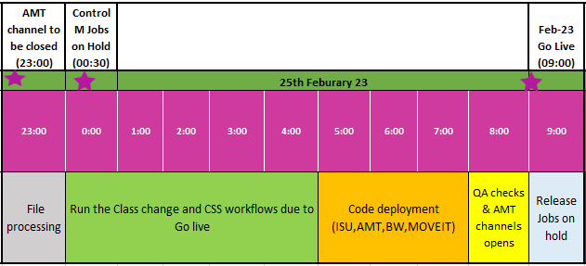
February 23 Release High Level Implementation Plan
The implementation for the 5 changes consists of code transports for multiple systems
Go live date is 25th February 23

Slide 43
File Transition
To incorporate the changes to files and associated processing the EFT/AMT channels will need to be closed
We will follow the standard processing times and ensure that none of the file types identified in the following slide are awaiting processing and/or have processed successfully before we close the channels
Monitoring of all inbound files and confirmation of all response outbound files will be completed by Friday 24th February 23:59:59 prior to any transports taking place
Channels will be re-opened by Saturday 25th February 09:00:00 for the next standard job processing time

Slide 44
File Format Transition plan
Inbound files
SPC ,CNF, BRN ,*CVD and CSS files
All the inbounds files will be processed by 23:00:00 (24/02/23) and will restart processing as per the BAU timing once the channels would be restored on 25/02/23.
* The CVD file would start processing from 09:30 hrs. (25/02/23).
Outbound files
SCR, ASN, TMC, BRR, NRL, ZCS, IIS,**CVN ,***CVR, JRS,URS, SFR, SCR, AQR, MDR and MBR.
All the outbound files will be processed by 23:59:00 (24/02/23) and will restart processing as per the BAU timing once the channels would be restored on 25/02/23.
**CVN file would start processing from 11:00 hrs. (25/02/23).
***CVR file would start processing from 10:00 hrs. (25/02/23).
NB-CSS files with reduced SLA of 4hrs will be taken into consideration while planning.

Slide 45
Further Communications
Implementation Go Live is planned for 25th February 2023
Please note REC Major Release Implementation is 24th February, however the Feb-23 DSC Release does not contain any REC dependencies therefore its planned delivery over the weekend will reduce the risk as agreed in ChMC
Should we need to use a contingency date the following weekend of 4th March 2023 will be utilised
Key implementation communications:
Confirmation of planned implementation – 24th February 2023
Successful / Unsuccessful Implementation – 25th February 2023
Further information and training awareness material is available here

Slide 46
If you have any queries on the changes being delivered as part of the February 23 Release please contact
UKLinkDelivery@xoserve.com

Slide 47
June 2023 Major Release

Slide 48
XRN 5482 Update – June 23 Delivery
XRN5482 was raised by Shipper customers to address issues with the volume of consumption adjustments that were needing to be submitted via CMS to the CDSP, and the operational effort and timescales associated with the reconciliation of consumption charges
In July 2022 the volume of outstanding RFAs stood at ~25,000 - CDSP has subsequently worked to reduce this to a current backlog level of ~2,500 and are receiving ~4,000 new RFAs per month.
The change was approved into the scope of the June 23 Major Release at ChMC in September 2022
At that point in time the Solution Option had not yet been shared with DSC Customers and no detailed analysis or design work had been undertaken on the proposed solution
Solution Options were shared in November 2022 and following consultation were approved at December 2022 ChMC
Detailed analysis of the requirements has identified 60 different data scenarios, with approx. 190 business rules that need to be catered for within the CDSP solution
Following the completion of this detailed analysis activity, a Detailed Design phase has started but is yet to be completed – our target is to issue a Design Change Pack for consultation in April
To protect service performance of several key customer facing processes, the CDSP will require test cases to cover each of the data scenarios identified for this solution
Regrettably with Design outstanding and the degree of testing required to deliver this change successfully there is insufficient time left in our June 23 Release plan to incorporate delivery of XRN5482
Options and costs for the delivery of XRN5482 are being investigated including the November 23 Release or alternative Adhoc release dates
Once these have been confirmed and the Design Change Pack has been completed, a BER will be presented to ChMC to approve the delivery of the change

Slide 49
XRN5562 – June 23 Major Release- Status Update
 | Overall Project RAG Status
 | Schedule | Risks and Issues |  | Cost
RAG Status
Status Justification
Schedule | Overall release is tracking Amber, Start up and initiation phase is in progress. Build commenced and in progress ​Progress update:​ Start up and initiation phase is in progress and on track to be completed 02/02 All Level1 & Level2 milestones approved at DSC+ Change Decision board against approved detailed project plan Build phase commenced on 28/11 on track for completion against milestone of 10/02 System integration testing test cases approved Commenced system integration testing on 23/01 Decision in February ChMC: None |  | Implementation date of 24th June, with a contingency implementation date of 1st July
Risks and Issues | Medium 68572 - There is a risk that code changes made for different XRNs within the release will become interdependent because they will be affecting commons objects in the system(s). Mitigation Action – monitoring the risk with ongoing conversations with supplier. Currently no interdependency has been highlighted, will continue to monitor to the end of build. Expecting confirmation by 27/01
Cost | Forecast to complete delivery against approved BER
Scope | XRN5091 - Deferral of creation of Class change reads at transfer of ownership XRN5186 - MOD0701 – Aligning Capacity booking under the UNC and arrangements set out in relevant NEXAs
Complete
On Track
At Risk
Overdue
Slide updated on 24th January 2023

Slide 50
XRN5579 Gemini Regulatory Change
CV01 Long Term Flow Swap Automation

Slide 51
Summary
Background
National Gas Transmission (NGT) are proposing an update to the Gemini system to improve the Long-Term Flow Swap (LTFS) process.
This change only impacts NGT and Distribution Network Operator (DNO) users of the system.
Currently Gemini only allows users to manually add the LTFS details daily, this can lead to errors which have added significant work to NGT’s time-constrained month-end financial reporting processes. There have been examples which have required invoicing adjustments which create additional work.
Going forward NGT and DNO Users will be able to enter the LTFS details for a period of time. Cancel and Accept functionality will also be introduced to reject/accept the flow swap details.

Slide 52
Summary
Background (continued)
In summary:
The change only applies to LTFS between NGT and DNOs
The change only applies to Gemini Exit (not Gemini)
The change will allow LTFS to be set-up for a pre-defined period rather than require daily manual input
The change would allow for adding locations, updating the amount of capacity and changing the dates from and to for the LTFS
This change would be specifically applicable to the DNO Flow Swap ‘Add’ screen in Gemini Exit (Home > Product > Flow Swap > DNO Flow Swap > Add / Query)

Slide 53
Key Milestone Dates
Please be advised that prior to Go-Live of the LTFS change there will be an exercise undertaken to walkthrough / demo the impacted screens with impacted Users. Further details and invites will be issued in due course.
The key dates for this change for your awareness are captured below;
Go-Live – 19/03/23
PIS – 20/03/23 to 31/03/23

Slide 54
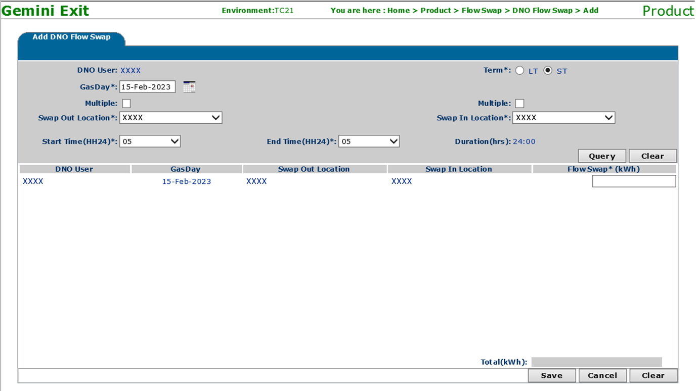
Impacted Gemini Exit Screens
Add DNO Flow Swap Screen (Short Term):
LT/ST toggle button introduced and by default ST (Short Term) option will be selected
The Gas Day value will allow a maximum up to the current System date +30

Slide 55
Impacted Gemini Exit Screens
Add DNO Flow Swap Screen (Long Term):
By changing the toggle button LT (Long Term), the user can select the date range up to the current Gas Year end date
The Gas Day ‘From’ value will allow a maximum up to the current System date +30
Start Time and End Time values will be default to 05 and Duration will be Not Applicable (NA)
In the Query results, a user can enter the Long-Term Flow Swap quantity that will be applicable for the date range selected (Inclusive of Gas Day From and Gas Day To)

Slide 56
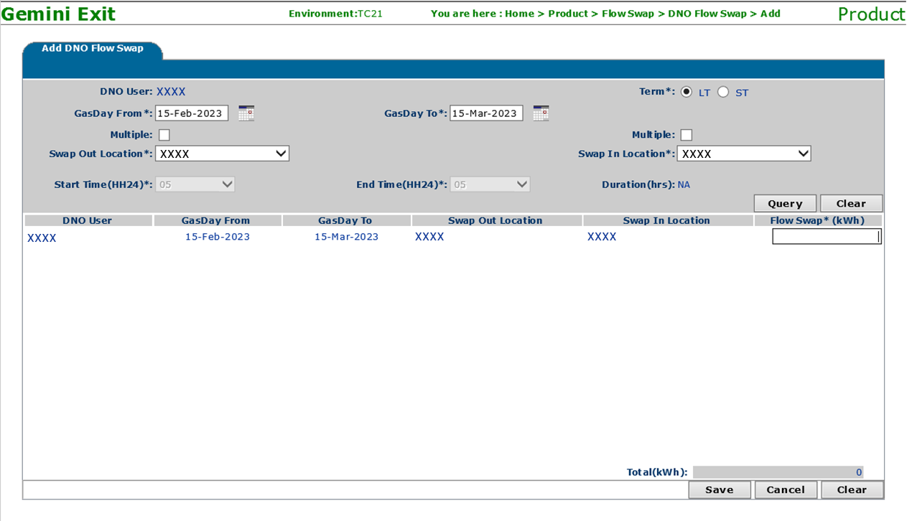
Impacted Gemini Exit Screens
Add DNO Flow Swap Screen (Long Term) (continued):

Slide 57
Impacted Gemini Exit Screens
View DNO Flow Swap Screen:
Select All or multi Select option is included to select more than one record and perform Bulk Withdraw
A user can withdraw the feature dated records (Gas Day >= current System date) if the status is New/Accepted
The System will reject (Auto time) the Long-Term Flow Swap requests if not accepted before the end of the Gas Day

Slide 58
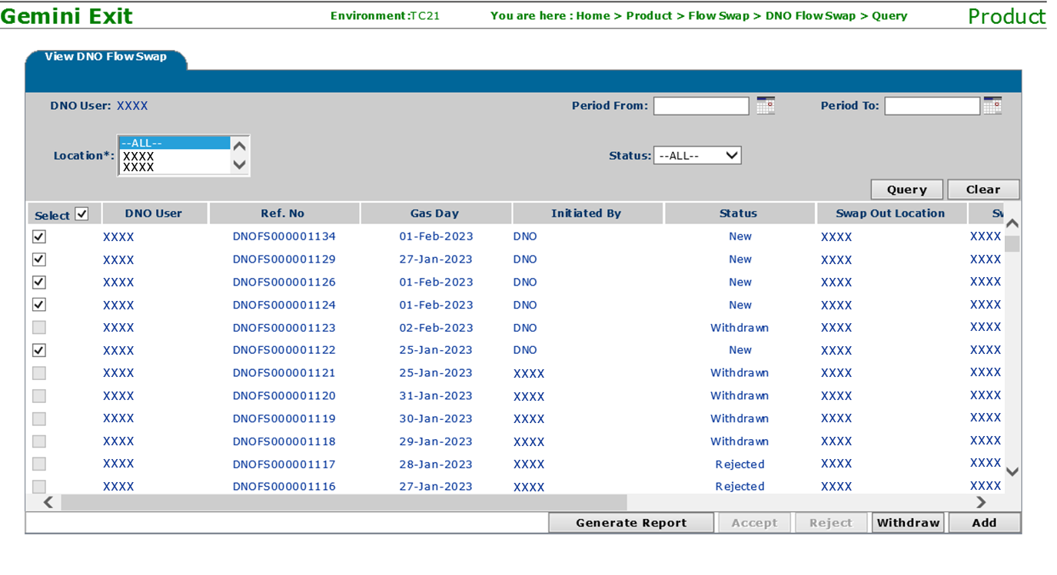
Impacted Gemini Exit Screens
View DNO Flow Swap Screen (continued):

Slide 59
NG TRANSMISSION CHANGE HORIZON PLAN 0 - 2 YEARS JAN 2023 – DEC 2025
JANUARY 2023

Slide 60
NG TRANSMISSION CHANGE HORIZON PLAN 0-2 YEARS 2023 – 2025
Programmes & Projects 2023-2025 |  |  | 2023 |  |  |  |  |  |  |  |  |  |  |  | 2025
 |  |  | Jan | Feb | Mar | Apr | May | Jun | Jul | Aug | Sep | Oct | Nov | Dec | Jan | Feb | Mar | Apr | May | Jun | Jul | Aug | Sep | Oct | Nov | Dec
MAJOR RELEASES | Regulatory / Customer Requested Change | XRN5455 Autumn Release
 | UK Link Consequential Changes | XRN5231 Flow Weighted Average CV FWACV
 | Gemini Sustain Yr 1 | XRN5368 Gemini Change Programme Sustain Yr1
 | Gemini Sustain + | CP5564 Gemini Change Programme Sustain +
 | Regulatory / Customer Requested Change | XRN5579 Gemini Change
Closedown
in Progress
Nov 22
to
Jan 23
Closedown
in Progress
Oct 22
to
Jan 23
Closedown
in Progress
Oct 22
to
Feb 23
Design to PIS Oct 22 to Oct 24
Jan 23 to Mar 23
Notes:
XRN5393 – Gemini Spring 22 Release - RFC
CHG0033706 - Go Live 25/02 - UNC785 - Aggregate Bacton Exit Points - Part A (Operational)
CHG0033667 - Contingency 27/02 - UNC785 - Aggregate Bacton Exit Points - Part A (Operational)
CHG0033668 - Go Live 03/04 - UNC785 - Aggregate Bacton Exit Points - Part B (Charging Theory)
CHG0033767 - Contingency 10/04 - UNC785 - Aggregate Bacton Exit Points - Part B (Charging Theory
XRN5231 - Flow Weighted Average - RFC
CHG0033749 – Go Live 30/06 - Flow weighted Average CV Calculation
XRN5368.2 - Single Sign on Experience - RFC
CHG0033809 – Go Live 29/05 - SSO/MFA /SSPR
CHG0033828 – Contingency 12/06 - SSO/MFA /SSPR - Placeholder
XRN5368.3 - API Enhancements - RFC
CHG0033766 Go Live 10/04 - Azure APIM API’s over the internet - TBC
XRN5368.1 - Control M and Batch Processing - RFC
CHG0033808 Go Live 01/03 - Deletion & Housekeeping
CHG0033810 Go Live 15/03 - Deletion & Housekeeping
XRN5368.5 - Site Minder Upgrade - RFC
CHG0033777 - Siteminder upgrade - Prod change 1
CHG0033778 - Siteminder upgrade - Prod change 2 - Log4j re-fix.

Slide 61
DDP Feb CHMC update

Slide 62
Agenda
Roadmap update
Latest Sprint update
Appendix
3.A Previous release updates

Slide 63
Roadmap
PRODUCT DEVELOPMENT AND ROLLOUT
2022
2023
2024
04
05
06
07
08
09
10
11
12
01
02
03
04
05
06
07
08
09
10
11
12
01
02
03
ACTIVITY
Release 1 – Shipper Pack
Change freeze
Release 2 – Golden Bullet forecast & IGT MDD data analysis
Release 3 – Golden Bullet invoice
Release 4 – XRN4990
Release 5 – XRN4990
Release 6 – DN tbc
KEY
On track
Issue – (Requires escalation/support)
At risk - (Risk is being managed)
Complete
Milestone

Slide 64
Data Discovery Platform | Inflight Sprint (part of release 5)
Goals: Complete Build – complete Establish besta team – complete Establish DN sprint goal for release 6 – ongoing
Outcomes: XRn4490 build milestone met – complete Beta team working with delivery team refine dashboards in preparation for implementation (in line with feb release) – ongoing Work with DNs to establish sprint goal ahead of release 6

Slide 65
DDP Appendix

Slide 66
Data Discovery Platform | Release 4
Goals: Complete detailed design Complete source to target Build 50% data model Enable additional Shipper Pack reports to be self served via DDP Facilitate MDD vs UKLink analysis for IGTs – Stretch
Outcomes: Detailed Design for the XRN4990 Solution pertaining to DDP Source to target completed for XRN4990 50% of XRN4990 data model built Additional Shipper pack delivery enabling Incorrect read factor and units to be self served via DDP Additional shipper pack delivery Shipper read frequency giving shipper portfolio count by MRF and a view of the average industry % by MRF code Stretch Targets: Additional analysis of UKLink / MDD data quality Industry view of read rejections by reasons code to compare company performance against industry average

Slide 67
Data Discovery Platform | Release 2
Goal: Enable Distribution Network Users to access a financial forecasting report (part of the golden bullet), to understand variances between formula year AQ / SOQ and rolling AQ / SOQ to understand the impact this has on revenue.
User Stories: As a DN I want a view of my Formula year AQ/ SOQ and Rolling AQ / SOQ simulation data grouped by: LDZ, Exit Zone, Shipper Short, EUC, Code, Charge Type, Charge Rate, Asset Type, AQ Band and Class As a DN I want total FY AQ / SOQ and Rolling AQ / SOQ displayed in kwh and as a percentage, and the difference between the two As a DN I want total charges by Rolling and Formula Year AQ / SOQ totals and difference As a DN I want the number of MPRNs grouped by charge type between Formula year AQ / SOQ and Rolling AQ /SOQ (by kwh and percentage difference) so I can see how many MPRNs fall into each group and the difference between FY and Rolling for each charge type in both kwh and percent age and split by LDZ, Exit Zone, Class, AQ band, Shipper Short Code and Asset Type Charge types: ZCA, 891, CCA, CFI, ECN, C04 As a DN I want a trend view between Formula Year and Rolling AQ and SOQ with the total charge position for both Stretch element: As a DN I want the number of MPRNs grouped by % difference between FY AQ and rolling AQ and between FY SOQ and Rolling SOQ As a DN I want the number of MPRNs grouped by kwh difference between FY AQ and Rolling AQ and FY SOQ and rolling SOQ so I can see how many MPRNs fall into each group As a DN I want to see the total number of MPRNs that have had a rate change within the last month, and have these split by reason for the rate change (Shipper change, Class change, other) so I can understand how rate changes are affecting my revenues

Slide 68
Data Discovery Platform | Release 3
Goals: Complete model to enable the aggregated invoice element of the Golden Bullet Report Enable more elements of the Shipper pack to be self served
User Stories: Build the data model to enable the DN aggregated invoice element of the golden bullet to be delivered via DDP including A new monthly report that consolidates all the detail information shown in : BOPRI SCH606 Geninf shows the cash invoices values on aswell that we have received Summarises it separately by EUC and also by Load Band It is also to be used to generate the December ""snapshot"" position and a forward forecast of new charging years monthly invoices so we would like to know in December what the new invoice values will be the following April - so forward forecast what the new capacity values will be inclusive of the new load factors and latest snapshot AQ use this report to populate the results Note: December snapshot: Capacity charges are established based on the December AQ / SOQ for the following financial year As a Shipper I want to be able to report on Dead meters via a monthly snapshot and see a trend over 12 months, so that the dead report in the Shipper pack can be retired As a Shipper I want my read performance for class 3 sites to be displayed as 'MET' when I have achieved 90% of reads accepted so that I can monitor my read performance Analysis of the below user story; As a Shipper I want an industry view of read rejection reasons so that I can compare my performance with industry Read rejections by reason code (numbers). Existing report need enhancing to give; Read rejections by reason code percentage value for a Shipper needs to be added to current dashboard Industry average number of read rejections (number and percentage) needs adding Performance enhancement to give a greater user experience of the large volumes Stretch targets: As a Shipper I want to see a list of sites in my portfolio containing plot addresses so that I can assess and update the address details correctly & in a timely manner. As a Shipper I want the WAR Bands dashboard to be moved out of UIG area of DDP and added to the Reads area of DDP so that it sits more logically from a business process perspective

Slide 69
Data Discovery Platform | Inflight Sprint (part of release 3)
Goals: Build the golden bullet invoice report Build the detailed design for the XRN4990 solution
User Stories: Build the dashboards to enable the DN aggregated invoice element of the golden bullet to be delivered via DDP including A new monthly report that consolidates all the detail information shown in : BOPRI SCH606 Geninf shows the cash invoices values on as well that we have received Summarises it separately by EUC and also by Load Band It is also to be used to generate the December ""snapshot"" position and a forward forecast of new charging years monthly invoices so we would like to know in December what the new invoice values will be the following April - so forward forecast what the new capacity values will be inclusive of the new load factors and latest snapshot AQ use this report to populate the results Note: December snapshot: Capacity charges are established based on the December AQ / SOQ for the following financial year Performance optimisation for read dashboards Detailed Design for the XRN4990 Solution pertaining to DDP Stretch Target: Must read enhancement to align BAU enhancement to DDP Industry view of number of MPRN associated to MRF (part of Shipper Pack XRN 5200)

Slide 70
Section 5: Non-DSC Change Budget Impacting Programmes

Slide 71
CMS Rebuild Update

Slide 72
Progress to Date
I am pleased to confirm that the XRN 5556.D containing the Isolations (ISO) and Dead to Lives (DTL) processes are targeting a launch date of 24th April 2023.
We had some additional clarifications from the Customer Focus Group session in January which resulted in some minor changes being added into the change packs. These will be issued for approval at March’s ChMC.
We are still assessing the potential delivery dates for the remainder of the processes alongside the prioritisation, in particular:
Should RFA and CDQ be delivered next in advance of ADD / UNC
IGT Must Read Modification (IGT159 - XRN5605)
XRN5604 - Shipper Agreed Read Exceptions Process (MOD0811S)
The CMS Rebuild webpage (https://www.xoserve.com/products-services/data-products/contact-management-service-cms/cms-rebuild/) contains the link to register for future Customer Focus Groups which are captured below, please note the agenda for the Focus Groups will be issued between 3 - 7 days prior to the session.

Slide 73
CMS Rebuild Delivery Roadmap – Potential Reprioritisation
XRN 5556.a
Supplier Theft of Gas (SUT)
Meter Number Creation (MNC)
Isolations
(ISO)
Dead to Live
(DTL)
Request for Adjustment (RFA)
Consumption Dispute Query (CDQ)
Address Amendments (ADD/ UNC)
New MPRN Creation
(FOM)
Daily Metered Query (DMQ)
Theft of Gas
(TOG)–
Network Raised MNC (DMN)
Must Reads
(MUR)
Manage Unregistered Sites
(MUS)
Gas Safety Regulation
(GSR)
Main Release
24th April 2023
XRN 5556.b
Duplicate MPRNs (DUP)
Set to Extinct
Swapped Address
(SWA)
Release Content
DUP Enhancements
Enhancements to MNC Process including Network
Generic Enhancements
SUT Enhancements
Additional Stretch Enhancements
Generic to desk workflows – AGG, PSI, PSR
Generic to desk
workflows – GIC
Generic to desk
workflows – FLE
Now
Next
Later
A little Later
New Process

Slide 74
Section 6: AnY Other Business

Slide 75
Appendix

Slide 76
Portfolio POAP

