Slide 1
Change Management Committee
8th September 2021

Slide 2
Section 2: DSC Change Budget & Horizon Planning

Slide 3
DSC Change Budget 21/22 YTD

Slide 4
Budget v Committed Spend BP21/22
Link to the full finance tracker with commentary on monthly variance

Slide 5
Change Pipeline

Slide 6
Change Development & Delivery Pipeline (DSC Change / Minor Release Budget)
* Pre-capture may contain changes that won’t require delivery / funding

Slide 7


2020-2022 DSC Change / MiR Pipeline
 | 2021 |  |  |  |  |  |  |  |  |  |  |  | 2022
 | Jan | Feb | Mar | Apr | May | Jun | Jul | Aug | Sep | Oct | Nov | Dec | Jan | Feb | Mar | Apr | May | Jun | Jul | Aug | Sep | Oct | Nov | Dec
Minor Releases
Major Releases
CSSC
Standalone Change
MiR 9
CCR
Key:
Approval on track
Scope
MiR 10
MiR 11
CCR
Approved
Scope
MiR 12
CCR
Scope
June 2021 (DBTI + PIS/Closedown)
CCR
Approval at risk
Nov 2021 Analysis / Design
November 2021 Build/Test Implement/PIS
BER
XRN
4780C
CCR
Nov 20 PIS
CCR
*Nov 2022 Analysis / Design
November 2022 Build/Test/Implement/PIS
* Subject to no delays/impact from CSSC implementation
* Feb 23 & June 23 Release development and scoping
Nov 21 IA
Regression
EXTERNAL(MT/UEPT/E2E/Defect Mgmt)
Planning
Transition
Go Live Range
PIS
XRN
4780C
Retro (MOD 0651)
Key:
XRN
5206
5237
XRN
5146
XRN
5038
EQR 5379 5231
BER
5183
XRN
5183
XRN
5231
On Track
Potential Activity
XOS Change Fund 21/22
Complete
PAC
BER
Potential risk to plan
PAC XRN4876
BER
CCR
Plan At Risk

Slide 8
Section 3: Capture

Slide 9
New Change Proposals – Initial Review
XRN / Title | Voting |  |  |  | DSC Service Area
 | Shipper | DNO | IGT | NTS
XRN5371 Minor Release Drop 10 | For Information |  |  |  | N/A

Slide 10
XRN5371 Minor Release Drop 10
Voting Parties
Change Details
Customer Class | Voting Party?
Shipper | N/A
Distribution Network Operators (DNOs) | N/A
National Grid Transmission | N/A
IGT’s | N/A
For Information
Change Description
This is a parent XRN to enable the tracking of delivery against the child XRNs for Minor Release Drop 10 XRN5309 Automating the FSR Standard Liability process - Provides DNs with automated FSR file / reporting mechanism. XRN5188 Interim Data Loads of MAP Id into UK Link - An additional data load of MAP ID into UK Link to ensure data integrity prior to CSS implementation. XRN5246 Confirmation File (.CNF) Processing Capacity Improvement - Amends cap on daily automated portfolio transfer to reduce manual effort.
DSC Service Area: | N/A
Link to Change Proposal | Link to CP
Change Type | Non Regulatory
Priority Score | Medium
Sponsor Representative | Xoserve

Slide 11
Change Update
XRN 5235 Request for access to SOQ data & capacity figures which influence transportation charges

Slide 12
XRN 5235 Request for access to SOQ data & capacity figures which influence transportation charges
Please note: XRN 5235 was originally raised under the title:
Include SOQ in the “UIG Additional National Data” report (Originally introduced by XRN 4806).
On consultation with the CP proposer the title was amended to better reflect the scope of the change.

Slide 13
Change Overview
Gazprom raised CP XRN 5235 to request access to aggregated SOQ and AQ data to better understand how capacity levels have been changing and how this might affect the annual Distribution Network Transportation Charges.
A request for historical data was also included within the CP to allow Shippers to compare and contrast with the previous year/s’ data and associated charges.
Our service provider is currently working on solution options for this CP. The aggregation level is yet to be determined and will be taken to CoMC for approval.

Slide 14
What we need to know is?
Is there still sufficient interest from other DSC customers to progress XRN 5235 as a DSC funded Change Budget?

Slide 15
Next steps?
If ChMC are happy to continue to progress XRN 5235 as a DSC funded change, then Xoserve will work to the following timeline:
  Issue HLSO/s in September Change Pack;
  Go to September CoMC for sign off on the proposed aggregation level as one proposed option includes the use of an existing DN report;
  HLSO/s to be reviewed at September DSG;
  HLSO/s to be discussed/approved at October ChMC.

Slide 16
3.2 Change Proposals – Post Solution Review for Approval
XRN4900 - Biomethane Sites with Reduced Propane Injection
XRN4978 - Notification of Rolling AQ value
XRN5186 - Modification 0701 Aligning Capacity booking under the UNC and arrangements set out in relevant NExAs
XRN5231 - Provision of a FWACV Service

Slide 17
XRN4900 - Biomethane Sites with Reduced Propane Injection
Proposed Release Link to Change Proposal Change Pak Comm Ref Voting Funding | DSG/ Xoserve Preferred Option | Solution Summary Outcome and implementation date outcome |  |  |  | Comments
 |  | Organisation | Approve | Defer | Reject
Proposed delivery: Major Link to Change Pack ref: 2878.2 - MT - PO Voting: DNO, Shippers Funding: From the DNs’ BP21 Decarbonisation Investment line DSC Service Area – TBC | Option 1 - Xoserve No preferred option from DSG | EDF |  | X |  | Our primary concern is how the impacts is suppliers & shippers is being considered (following the lack of this in the HyDeploy trial). The use of site specific calorific value by CDSP for settlements, AQ etc. is fine, however shippers may have systems that use and load the CV for settlement invoice validation purposes, customer billing purposes etc. Therefore, consideration must be given to how these values might be received by shippers/suppliers and how they might be used. Suppliers may have automated processes that loads and bills to CVs received using standard industry processes and therefore discussions should happen many months in advance of any trial solution being decided to give all impacted parties a chance to consider impacts and feed in to the process. In addition where a party may not be a supplier/shipper to any of the trial sites at go-live, they may during the trial take supply of one of these sites, therefore consideration should be given to that.
 |  | SSE |  | X |  | The solution discusses changes to Xoserve’s systems, but makes no mention of the issue it could cause for shipper and supplier systems, and processes as they are often built with a single CV value allowed for each LDZ. How would these new CV values be communicated to shippers and could this solution lead to some customers receiving ‘off-spec’ gas.
 |  | EON (Approve with Comments) | X |  |  | There is only a single solution proposed. We have yet to fully scope out the impact of this solution but it is likely that there will need to be changes to our billing systems to support this (suppliers will need to use the site specific CV rather than FCAW in billing calculations for relevant sites). We expect this could be a fairly significant and costly change for Shippers/suppliers, but the change pack does not include the detail on this, nor how the file transfers will work. The impacts to Shippers and Suppliers need to be considered and clearly communicated.

Slide 18
XRN4978 - Notification of Rolling AQ value
Proposed Release Link to Change Proposal Change Pak Comm Ref Voting Funding | DSG/ Xoserve Preferred Option | Solution Summary Outcome and implementation date outcome |  |  |  | Comments
 |  | Organisation | Approve | Defer | Reject
Proposed delivery: Minor Release 11 Link to Change Pack ref: 2878.3 - MT - PO Voting: Shipper Funding: MTB DSC Service Area – TBC dependent on Option | Option 1 – Xoserve No preferred option from DSG | EDF |  | X |  | We need further information on quantity of impacted sites in order to make an informed decision. In addition we would like an option considered whether updating the AQ value in the TRF based on SSD may be feasible. Regarding the options presented in the change pack: Option 1 - this seems like the most sensible option, however until further impact assessment is undertaken, we cannot agree that a minor release will be suitable. Option 2 - it is unclear how this report will be formatted - i would assume that a new file type would be required to pass across IX and therefore this wouldn't be a minor release Option 3 - seems to deliver the same as option 1 to shippers, with differences being in CDSP processes and resulting cost Option 4 - this is an option potentially if numbers are low. Awaiting confirmation on numbers of sites involved.
 |  | SSE |  | X |  | Agree with Solution Option 1, but implementation should be at least 6 months after approval by the DSC Change Management Committee.
 |  | EON | X |  |  | Our preference is option 3, providing it delivers a single file containing all registrations encompassed in one file after the event has passed. If this is not what option 3 will deliver, then our preference is option 1

Slide 19
XRN5186 - Modification 0701 Aligning Capacity booking under the UNC and arrangements set out in relevant NExAs
Proposed Release Link to Change Proposal Change Pak Comm Ref Voting Funding | DSG/ Xoserve Preferred Option | Solution Summary Outcome and implementation date outcome |  |  |  | Comments
 |  | Organisation | Approve | Defer | Reject
Proposed delivery: November 22 Link to Change Pack ref: 2878.4 - MT - PO Voting: Shipper, DNO Funding: Proposed 50% Shipper, 50% DNOs. To be established at Release scoping stage DSC Service Area – TBC | Option 1 - Xoserve No preferred option from DSG | Northern Gas Networks | X |  |  | We support the solution option for this change but we would prefer that the delivery mechanism for the reports is via email and not DDP due to the expected low volume.

Slide 20
XRN5231 - Provision of a FWACV Service
Proposed Release Link to Change Proposal Change Pak Comm Ref Voting Funding | DSG/ Xoserve Preferred Option | Solution Summary Outcome and implementation date outcome |  |  |  | Comments
 |  | Organisation | Approve | Defer | Reject
Proposed delivery: TBC Link to Change Pack ref: 2878.5 - MT - PO Voting: NTS, Shipper, DNO Funding: DSC budget DSC Service Area – New service, TBC | Option 1 – Xoserve No preferred option from DSG | EDF | X |  |  | Happy with the proposal - we just want to make sure that the information provided at: https://www.nationalgrid.com/uk/gas-transmission/data-and-operations/calorific-value-cv including Data Item Explorer and Report Explorer - either remains or is replaced with an equivalent as this is something that we use
 |  | SSE | X |  |  | We agree with the solution as detailed by Xoserve. However, given the critical importance of the SC9 file to industry parties, the solution must be fully tested before being implemented.
 |  | EON | X |  |  | There is only one option being presented We would expect the same level of validation to be carried out by the CDSP as is currently done by National Grid. We would like clarity on what contingency there is to prevent impacts on FWACV; we would want sufficient flexibility to prevent a missing value or a low CV entry impacting the FWACV inappropriately.

Slide 21
section 4. Design & Delivery

Slide 22
Design Change Pack
  XRN5379 - Mod0710 - Class 1 read service - Procurement Exercise
  CSSC Programme - Gemini Monthly File Timing Change

Slide 23
XRN5379 - Mod0710 - Class 1 read service - Procurement Exercise
Functional Changes
Change Pack ref: 2878.6 - MT - PO Implementation: 01st April 2023 Voting: n/a - Change Pack requested representation, no vote is required. Funding: 100% Shipper | Solution & Implementation Summary outcome |  |  |  | Comments
 | Organisation | Approve | Defer | Reject
 | EON | X |  |  | This particular procurement activity is not one that the CDSP has carried out before, but we would expect that learnings are taken from other, recent procurement process activity such as the AUGE and PAFA as certain things were overlooked. It is imperative that there is absolute transparency as to what the service will include. If there are any changes to the current service, (for example file transfer timings) the impacts will need to be fully understood. We would expect regular updates at both ChCM and CoMC so that industry is kept appraised of progress – perhaps a standing agenda item with a dashboard similar to that used for the 0710 updates (including timelines). We would also expect any risk to be minimised and for the CDSP to negotiate the best possible position.
 | SSE | X |  |  | Agree with the change, but there must be full transparency of the costs of the service.

Slide 24
CSSC Programme - Gemini Monthly File Timing Change
Functional Changes
Change Pack ref: 2879.1 - MT - PO Release: June 2022 (alongside CSSC Implementation) Voting: NTS, Shipper Funding: CSSC programme | Solution & Implementation Summary outcome |  |  |  | Comments
 | Organisation | Approve | Defer | Reject
 | EON (Approve with Comments) | X |  |  | We would wish it to be noted that the more the timescales for Shippers are reduced, the more likely it is there will be an imbalance in the gas day. We trust that all available options have been explored.

Slide 25
Standalone Change Documents for Approval (BER, CCR, EQR)
BER for XRN5183 Access to Daily Biomethane Injections
  Voting – DNO

Slide 26
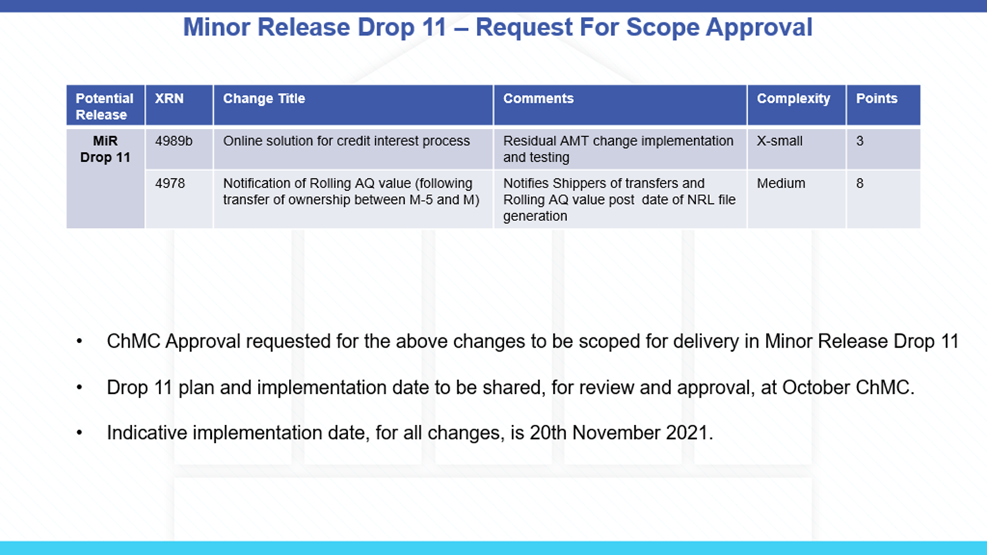

Slide 27
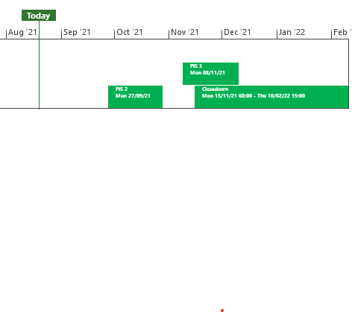
XRN5253 June 21 Major Release - Status Update
 | Overall Project RAG Status
 | Schedule | Risks and Issues | Cost
RAG Status
Status Justification
Schedule | Project On Track Post Implementation Support (PIS) period 2 to commence on 27/09/21 Decision In September ChMC None
Risks and Issues | None Applicable
Cost | Forecast costs on track to complete within approved BER
Scope | In Scope (XRN5093) - MOD0711 – Update of AUG Table to reflect new EUC bands Descoped (XRN4992) - MOD0687 – Creation of new charge to recover last resort supply payments – Descoped at Extraordinary ChMC on 26th October 2020 Descoped (XRN4941) - MOD0692 - Auto updates to meter read frequency – Descoped at ChMC on 11th November 2020
Complete
On Track
At Risk
Overdue
Not Baselined
Slide updated on 19th August 2021

Slide 28
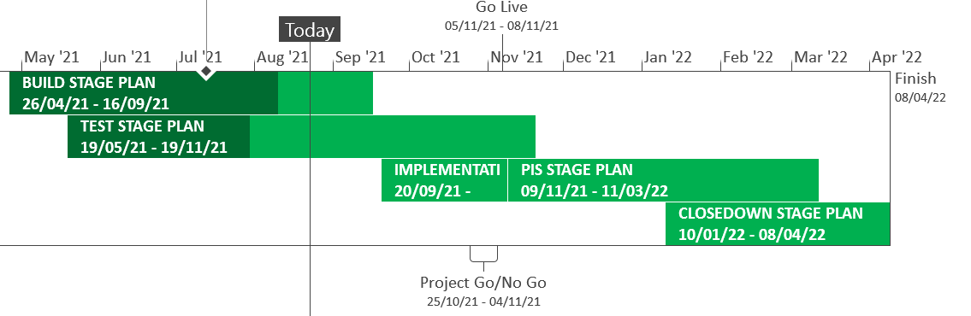
XRN5289 – November 21 Major Release - Status Update
 | Overall Project RAG Status
 | Schedule | Risks and Issues |  | Cost
RAG Status
Status Justification
Schedule | User Acceptance Testing is complete for XRN5142 and in progress for remaining changes XRN4780C is in progress through build and test Regression Testing is in preparation and has commenced for XRN5142 Decision In September ChMC: No decisions are required this month.
Risks and Issues | Risk (RTC66544) - ​Increase in the number of BAU defects being found impacting XRN5072, XRN5007 and XRN5180 during testing. Mitigation, defects are currently all planned to be deployed prior to exiting test
Cost | Forecast to complete delivery against approved BER
Scope | In Scope – XRN4941 - MOD0692 - Auto updates to meter read frequency In Scope - XRN5007 - Enhancement to reconciliation process where prevailing volume is zero​ In Scope - XRN5072 - Application and derivation of TTZ indicator and calculation of volume and energy – all classes​ In Scope - XRN5142 - New allowable values for DCC Service Flag in DXI File from DCC​ In Scope - XRN5180 - Inner tolerance validation for replacement reads and read insertions​ In Scope – XRN4780C – Inclusion of Meter Asset Provider Identity (MAP Id) in the UK Link system (CSS Consequential Change) Descoped - XRN5091 - Deferral of creation of Class change reads at transfer of ownership​ Descoped - XRN5186 MOD0701 – Aligning capacity booking under the UNC and arrangements set out in relevant NExAs​ Descoped - XRN5187 MOD0696 – Addressing inequalities between capacity booking under the UNC and arrangements set out in the relevant NExAs
Complete
On Track
At Risk
Overdue
Not Baselined
Slide updated on 20th August 2021

Slide 29
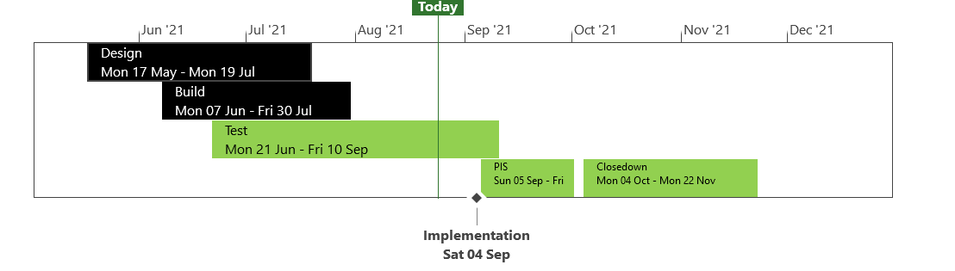
XRN5371 - Minor Release Drop 10 - Status Update
 | Overall Project RAG Status
 | Schedule |  | Risks and Issues | Cost
RAG Status
Status Justification
Schedule | Testing has completed for XRN5309 and XRN5188 and is continuing for XRN5246 Implementation preparation is in progress Implementation is on track for 4th September 21 Decision in September ChMC: None
Risks and Issues | None applicable
Cost | On track to complete within approved spend
Scope | XRN5309 - FSG Automation of FSR Process XRN5188 - MAP ID Data Upload to UK Link XRN5246 - Confirmation File Performance improvements
Complete
On Track
At Risk
Overdue
Not Baselined
Slide Updated on 24th August 2021

Slide 30
NG TRANSMISSION CHANGE HORIZON PLAN
0 - 2 YEARS AUG 2021 - JULY 2023
August 2021

Slide 31
NG TRANSMISSION CHANGE HORIZON PLAN 0-2 YEARS AUG 2021 – JULY 2023
Programmes & Projects 2021-2023 |  |  |  | 2021 |  |  |  |  | 2022 |  |  |  |  |  |  |  |  |  |  |  | 2023
 |  |  |  | Aug | Sep | Oct | Nov | Dec | Jan | Feb | Mar | Apr | May | Jun | July | Aug | Sept | Oct | Nov | Dec
MAJOR RELEASES | Regulatory / Customer Requested Change | PM Matthew Rider | MOD0745 - Setting of Auction Bid Parameter
 |  |  | MOD0728B – UK Link & Gemini Delivered as part of CP5341
 | Gemini Sustain | PM Nicky Patmore | Gemini Customer Enhancements
 | UK Link Consequential Changes |  | CSS Cons Change
 |  |  | CSS Cons Change
 | Gemini Change Programme Sustain | PM Manisha Bhardwaj | Single Sign on Experience
 |  | PM Matthew Stephens | API Enhancements
 |  |  | Site Minder Upgrade
Implementation
19th Sept 21
Implementation
26th Sept 21 (C)
Build/Test – Aug to Sept 21
Pre-Implementation - Sept to Oct 21
Regression Testing UKL
2nd Aug to 20th Aug 21
UKL Implementation
27th Aug 21
Gemini Implementation
19th Sept 21
Build/Test – Aug to Sept 21
KEY RISK & % = Certainty of Scope
 | Approved on Track
 | Approved
 | Approval at Risk
 | Change Completion Report
 | External User Activity
PIS UKL - Sept to Nov 21
PIS Gemini - Sept to Dec 21
PIS July - Sept 21
Content: External Test Phase Jul - Dec 21
KEY – Project Status
On Track
Complete
Potential Risk to Plan
Plan at Risk
Design to PIS – Sept 21 to Apr 22 – Indicative timeline
Design to PIS – Sept 21 to Dec 21– Indicative timeline
Design to PIS – Oct 21 to Jan 22 – Indicative timeline

Slide 32

CSSC Programme Dashboard
Sept 2021

Slide 33
Programme Update
Programme Health – RAG |  |  | Return to Green Plan
Overall Programme Status | Previous | Current | The programme remains at a Green status. Programme activities all remain on track. A CR has been raised to extend UEPT, which has a significant financial impact on Xoserve. This has been fed back as part of our response. BP22 submissions are also in progress. These will be shared as per the comms schedule. Our submission this year provides an updated view of the Maintain the Business cost as last year’s submissions were based on assumptions. Aspects such as service management and environment needs have now been clarified, however uncertainties exist around volumetrics (defects, queries, etc), which are reflected in this year’s submission
Programme Plan | Previous | Current
Risk Profile | Previous | Current
Resources | Previous | Current
Executive Summary |  |  |  | Upcoming Activities & Milestones (Next Month)
Key Programme Updates To date, all Xoserve key internal and external milestones have been met Transition: LR Cycle 2 is continuing to plan. Preparatory activities towards Transition Testing is ongoing, with testing starting on 05/11. Internal & External Testing: All testing activities are on track. UEPT continues with no major impacts or defects. E2E Testing has commenced successfully. No defects to date. Business Change: Internal activities continue to plan including Target Operating Model set up Service Management: Xoserve’s CR-D072 which was aiming to change the Response SLAs has now been approved at Design Authority Data Migration: Planning ongoing to support Rel cycle 4b – due in Oct. |  |  |  | Live Rehearsal: Commence Cycle 2 Internal Test: Progress CR testing and any relevant regression tests DES:& Secondary APIs Continue Test support Transition: Continue Transition planning MAP C: Delivery continues to plan, build updates will be provided via Nov 21 updates. REC: REC v2 Go-live from 1st Sept. Business Change: Continue awareness and knowledge transfer sessions

Slide 34
CMS Rebuild Update
ChMC Updates
Jo Williams

Slide 35
CMS Rebuild - Progress to date
Summary of progress to date
All activities continue to plan, we are refining the Workshop plan for both internal and external workshops, internal workshops will commence first to provide as much input as possible to the external workshops to ensure we use customers time effectively. The first Extraordinary CMS DSG Kick off session was held on 24th August which had a great attendance of 30 participants , during this the proposed dates of future extraordinary CMS DSGs (slide 4) were discussed and it provided an opportunity to ask questions too. Following on from the Must Reads Workshop and consequential discussions we are continuing to analyse the Must Read Options to understand the benefits to all customer constituencies, as well as understanding additional process overheads that the options may create. We will be talking directly to customers where requested, as well as discussing at the relevant Detailed Analysis Workshop. The Team will be taking this to the Constituency sessions for wider discussion. Internal teams are continuing to revisit the GSR process to see if additional improvements can be identified and built into the Ideal “To Be” process, which will form the foundations of the GSR Detailed Analysis Workshop. Still refining the process and working through the options, these will be presented internally and then presented at a separate session prior to the GSR CMS DSG on the 05/10/2021. The CMS Rebuild Team have completed the input to Rec Schedule 3 review. The CSSC Programme Senior BA has visibility of requirements of the CMS processes and shall be a key attendant at the relevant CMS Workshops to ensure we understand any consequences. We shall continue to do this for any other key changes that are inflight too. We continue to work on the TOG Mod, the team are currently liaising with Xoserve to draft out an Interim process that may have to be utilised prior to CMS Rebuild going live. The outputs shall be shared shortly.

Slide 36
CMS Rebuild Detailed Analysis
Detailed Analysis Approach
CMS Rebuild Core Team will build out Use Cases from each step of the processes
These will then be walked through with relevant additional SMEs and wider Project Team to ensure
  Clear requirements
  System functionality captured
  NFRs included
The output then shall be walked through the DSG Group to capture comments / approval
They will then be transferred into a BRD for DSG and ChMC Approval

Slide 37
Proposed CMS DSG Dates
CMS DSG Timetable
Date | Weekday | Time | Recommended Process | Clashes with
24-Aug | Tues | 14:00-16:00 | Intro
31-Aug | Tues | 14:00-16:00 | ISO/ DTL
03-Sep | Fri | 10:00-12:00 | FOM | IGT Constituency
10-Sep | Fri | 10:00-12:00 | CDQ/RFA
17-Sep | Fri | 10:00-12:00 | ADD/UNC
21-Sep | Tues | 14:00-16:00 | DUP
29-Sep | Weds | 14:00-16:00 | MNC
05-Oct | Tues | 10:00-12:00 | GSR | NTSCMF
14-Oct | Thurs | 14:00-16:00 | MUS
22-Oct | Fri | 10:00-12:00 | MUR
27-Oct | Weds | 10:00-12:00 | TOG

Slide 38
Section 6: Any Other Business

Slide 39
Project 1Stop – September Update
Megan Troth

Slide 40
Background
The new iteration of the Xoserve website was developed in November 2018.
Since this implementation, based on customer feedback, we have been looking to identify various ways in which we can improve the change pages and the overall customer journey, particularly in relation to change (both DSC and Investment).
Project 1Stop has been created in order to completely understand all of our customer’s needs, alleviate their pain points, and to create an overall more positive experience when navigating through Xoserve change information.

Slide 41
September Update
Now the top three User Stories have been prioritised (as seen below), we are beginning to work with customers based on the feedback they gave in order to further develop these User stories into prototypes
As a customer I would like to access uniform and up to date information on all UKL Releases and Investment Change on the Xoserve website so that I can accurately plan all upcoming change into my change pipeline
As a Customer, I would like to be able to easily navigate individual Change Proposal documents that contain key details only - this will help give me more of a concise view of a change, with further details/documentation being available elsewhere
As a customer, I want to be able to access one clear and concise view of change in the form of an up to date and accurate change register that is simple and easy to use - this will help me filter on the changes I need to view and help me forward plan
1
2
3

Slide 42
September Update Cont’d
An internal workshop has been set up on 9th September to discuss these prototypes, and work up a timeline to give customers an idea of when they can expect to see the changes roll out to the website
A dedicated webpage has now been set up for Project 1Stop where you can find all the latest updates

Slide 43
Next Steps
Hold further requirements gathering sessions with customers based around the prioritised User Stories
These requirements will then help us develop some prototypes customers to look at and provide feedback along with some costing estimates and timelines

Slide 44
APPENDIX

Slide 45
Outages
Outages
Change Request Number | Impacted System | Outage Duration |  |  |  |  | Committee Notified Date
 |  | Start Date | Start Time | End Date | End Time | Brief Description
CHG0031149 | UKLink | TBC |  | TBC |  | UKLINK Disaster Recovery Test 2021 This is an annual activity to confirm UKLink services can be migrated to a secondary data centre location should there be a catastrophic failure within the primary data centre. During this phase of the test UKLink services will failover from the primary site to the secondary site. | 11/08/2021 - Postponed until later in the year
CHG0031149 | UKLink | TBC |  | TBC |  | UKLINK Disaster Recovery Test 2021 During this phase of the test UKLink services will failback from the secondary site to the primary site. | 11/08/2021 - Postponed until later in the year

Slide 46
Portfolio POAP

Slide 47
CSSC Programme Dashboard
Sept 2021

Slide 48
Green Workstream Updates
RAG Previous MONTH | RAG Current MONTH | WORK STREAM | SUMMARY
 |  | DES & Secondary API | Overall Green: UEPT/E2E support continues. No defects raised to date for the external testing phases.
 |  | Testing | The overall status remains Green. UEPT and E2E continues well. At the point of writing this, no significant defects have been seen. Operational Testing with DCC is now complete, with no defects raised against Xoserve.
 |  | Service Management | CR-D072 has now been approved. Operational readiness activities are ongoing
 |  | Batch | The overall status is green, with testing support underway for UEPT/E2E activities
 |  | Gemini | The overall status is green
 |  | Reporting | An internal CR will be raised to incorporate the impact of one newly identified report that will need changes.
 |  | UK Link | Status continues to be Green with work underway to impact assess, deliver and test Switching Programme changes raised through the last few months

Slide 49
Green Workstream Updates
RAG Previous MONTH | RAG Current MONTH | WORK STREAM | SUMMARY
 |  | REC | REC version 3 consultation is complete.
 |  | Data Migration | Planning ongoing to support Rel cycle 4b - due in Oct.
 |  | Environments | Workstream continues to be Green with all activities continuing to track to plan for all upcoming activities. Environment readiness for Transition is in progress.
 |  | MAP C (XRN-4780C) | Delivery continues to plan, UAT in progress, detailed delivery updates will be provided via Nov 21 updates.
 |  | SoLR (XRN-5144) | Engagement continues with Ofgem. SoLR options in discussions will be tabled at upcoming DSG sessions

Slide 50
Key Programme Risks (1/2)
RTC | RAG | Workstream | Description | Mitigation Strategy | Latest Update | Resolution Date
65426 |  | Transition & Cutover | There is a risk that the Go Live assumption day of Monday may get changed because various variables (factors) are being looked at by OFGEM leading to rework on Transition plan and related activities. | The Go-live principles have been approved at Delivery Group. Xoserve's concerns have been logged with Ofgem | Impact of non-Monday Go-live on Xoserve's Transition testing has been fed back to Ofgem. Internal contingency planning is underway | 30/09//21
55513 |  | Programme | There is a risk that in the Programme participants might interpret business rules differently because business rules underpinning the CSS Interfaces have not been published alongside the interface document as well as discrepancies between business rules defined within REC and captured in ABACUS. Leading to significant process mismatches at a later stage (i.e. SIT, UEPT) and potential rework and timeline slippages. | Xoserve to publish design assumptions as part of the RAID reporting to the SI to ensure visibility of Xoserve design assumptions around business rules and processes. | Continues to be monitored until E2E is complete | 30/11//21
65156 |  | Transition & Cutover | There is risk that the change freeze scope could impact Transition because the scope of Programme Change Freeze from 03/01/22 is not clearly defined leading to impacts during actual Transition | Work with the SI to collectively define the scope of Change Freeze | Internal discussions are ongoing within Ofgem to define the scope of this Change Freeze | 30/09/21

Slide 51
Key Programme Risks (2/2)
RTC | RAG | Workstream | Description | Mitigation Strategy | Latest Update | Resolution Date
64171 |  | Transition and Cutover | There is a risk that the SoLR process might kick off during the transition period because of a supplier going out of business at that time leading to Landmark needing to cater to additional volumes and also the potential for additional requirements for PUIs to undertake to ensure Transition timelines are maintained | Raise the risk with Ofgem and SI to understand what non-functional considerations have been applied to enable Landmark to manage the increased volumes Raise with the SI to include a transition test scenario if relevant to mitigate this possibility | There is a potential that SoLR related implications during Transition may be considered for Transition Testing. Currently expected to be discussed in September. Dates have been aligned accordingly | 30/09/21
65122 |  | Transition and Cutover | There is risk that additional Transitional changes could change scope of Transition because more changes are identified as Transition planning continues at the Central programme level leading to changes to the Transition plan and Xoserve planned activities. | Xoserve are actively involved in all programme work groups to monitor and mitigate this risk. | The impact of CR-D059 on Transiitin is being assessed | 30/09/21
64513 |  | Data | There is a risk that data cleansing requirements may not be met because Xoserve are not responsible for the data in UK Link, and can't compel shippers / GTs / iGTs to correct their data leading to incorrect data at the point of go live. | Communicate requirements through DSG and track progress | MDD data cleansing is with Customer Advocates to process. Additionally, further work is ongoing on REL reports | 30/12/22
65176 |  | Transition and Cutover | There is a risk that the Runbook may not be properly tested because schedules to be used across test phases (DM LR / Transition testing) are being developed seperately leading to potential for discrepancies and for insights from one activity being missed by the other | Liaise with the SI to ensure that all plans are aligned. Request early sight of plans to ensure adequate review in advance | Awaiting DM LR plans to compare against the latest issued Transition Test schedule | 01/03/22
65157 |  | Transition & Cutover | There is risk that the catch up processing could impact transition timelines because the catch up processing is not being exercised/rehearsed during Central Programme Transition Testing leading to impacts during actual Transition. | Work with the SI to assess if this activity can be tested in advance of Transition | Awaiting baseline of the Held Switches approach. | 30/09/21

Slide 52
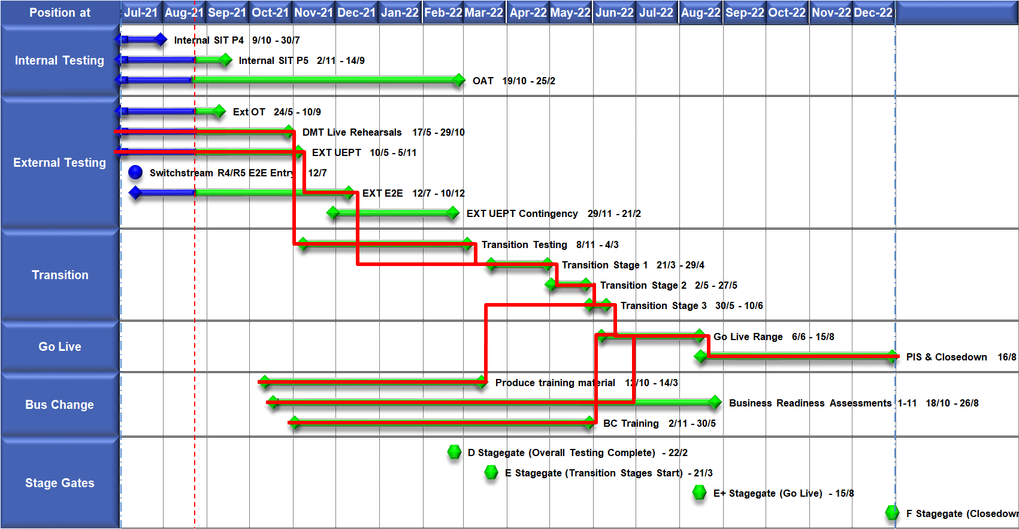
High Level Plan

Slide 53
Switching Programme CR Position – CRs impacting Xoserve
CR Name | CR Ref | High Level Cost IA Cost | Date Raised | Status
Programme Plan Re-Baseline | CR-D002 | £0.00 | 07/11/2019 | Approved - Complete
Updates to the CSS Physical Interface Design (PhID). | CR-D008 | £17,250.00 | 22/01/2020 | Approved - Internal CR Created
CSS_Exception_Handling_Strategy_v0.2 | CR-D014 | £0.00 | 26/02/2020 | Approved - Internal CR Created
Provide_CSS_RegistrationID_to_PUI_and_LPs | CR-D016 | £12,643.00 | 07/08/2020 | Approved - Internal CR Created
Licence Exempt Network Customer Identifier – ABACUS Data Model update | CR-E51 | £0.00 | 29/10/2019 | Approved - Complete
Amendments to the DMS artefact suite | CR-D019 | £6,500.00 | 16/03/2020 | Approved - Internal CR Created
Migration of Terminated Gas RMPS | CR-D022 | £0.00 | 10/06/2020 | Approved - Internal CR Created
Amendments to the NC-0079 for REL (Retail Energy Location) Data Migration and Reconciliation | CR-D024 | £20,000.00 | 06/07/2020 | Approved - Internal CR Created
DMS - PHID Alignment Parties | CR-D026 | £0.00 | 06/07/2020 | Approved - Internal CR Created
Request For a New or Upgraded DMT Environment | CR-D027 | £256,009.00 | 07/08/2020 | Approved - Internal CR Created
Enable TLS connection pooling for all directly connected parties to CSS] | CR-D028 | £2,500.00 | 13/07/2020 | Approved - Internal CR Created
Message Header Format for PKI Certificate Identification] | CR-D029 | £2,500.00 | 13/07/2020 | Approved - Internal CR Created
SIT Functional Test Re Plan Enabling Parallel Testing | CR-D030 | £56,000.00 | 20/07/2020 | Approved - Internal CR Created
DM_Validation Catalogue_Shipper_Effective_Date_Change_ | CR-D032 | £0.00 | 03/08/2020 | Approved - Internal CR Created
Compression During Data Migration | CR-D034 | £500.00 | 09/09/2020 | Approved - Internal CR Created
Uplift to the CSS Interface Specifications | CR-D038 | £70,000.00 | 07/10/2020 | Approved - Internal CR Created
Uplift to Business Data Validation Rules | CR-D039 | £20,000.00 | 25/09/2020 | Approved - Internal CR Created
Programme Plan Re-Baseline | CR-D042 | £14,913,000.00 | 28/09/2020 | Approved - Internal CR Created
Changes to Support Energy Company Data | CR-D059 | £37,500.00 | 03/08/2021 | Awaiting Decision
Operational Choreography Detection 0.5 | CR-D060 | £308,205.00 | 25/01/2021 | Awaiting Decision
Operational Choreography Rectification 0.3 | CR-D061 | £0.00 | 25/01/2021 | Awaiting Decision
Amendment of Data Migration Solution to Protect Programme Timescales - Removal of Transition Stage 1 Delta files | CR-D062 | £83,490.00 | 25/02/2021 | Approved - Internal CR Created
Change to Management of In-Flight Switches Approach | CR-D071 | £0.00 | 15/03/2021 | Approved - Internal CR Created
Increase Cadence of Data cuts | CR-D080 | £24,600.00 | 10/05/2021 | Approved - Internal CR Created
Amendment to Assumptions as a result of analysis undertaken during CP1 v0.4] | CR-D083 | £0.00 | 24/05/2021 | Approved - Complete
TT Remediation & Paper-Based Testing Workshop | CR-D095 | £34,000.00 | 23/08/2021 | Pending PIA
Continuation of support for UEPT | CR-D098 | £308,000.00 | 03/08/2021 | Awaiting Decision
Documentation only updates to NCT-0134 DMT Live Rehearsal Test Plan and NCD-0012 Data Migration Solution Design Catalogue | CR-D103 | £0.00 | 17/08/2021 | Pending PIA
Elaborations for Service Management Requirements DB4 | CR-D104 | £0.00 | 17/08/2021 | Pending SI Response

Slide 54
Switching Programme CR Position – CRs not impacting Xoserve ((Cost Implication)
CR Name | CR Ref | Date Raised | Status
Non_Mandatory_MPAS_Metered_Indicator_v0.4 | CR-D001 | 27/01/2020 | Complete - No Xoserve Impact
REC Manager Procurement Timelines | CR-D003 | 02/12/2019 | Complete - No Xoserve Impact
MPAS Related MPAN Disconnection | CR-D004 |  | Withdrawn
Introduction of Validation Message to Logical Mode | CR-D005 | 25/11/2019 | Withdrawn
Modification of Related MPAN Cleanse Checkpoint Milestones | CR-D006 | 27/11/2019 | Complete - No Xoserve Impact
ABACUS Corrections and Re-alignments | CR-D007 | 04/12/2019 | Complete - No Xoserve Impact
ECOES REL API Webmethod | CR-D009 | 17/12/2019 | Complete - No Xoserve Impact
CSSIA Uplift to Implement IG Recommendations | CR-D010 | 17/12/2019 | Complete - No Xoserve Impact
Update 3 E2Es to align to CSSIA | CR-D011 | 10/06/2020 | Complete - No Xoserve Impact
CSS_Physical_Interface_Design_Updates_mpxn_v0.2 | CR-D012 | 30/01/2020 | Complete - No Xoserve Impact
Messaging_Requirements_Revisions_REC_Code_Manager_and_CSS_v0.1 Clean | CR-D013 | 28/01/2020 | Complete - No Xoserve Impact
Amendment_of_Xoserve_Consequential_Change_Milestone_Delivery_Dates_v0.2[DRAFT] | CR-D015 | 26/02/2020 | Withdrawn
CSS_Handling_of_MPAS_Business_Dates_v0.2[DRAFT] | CR-D017 | 20/07/2020 | Complete - No Xoserve Impact
Confirmation_Responses_to_Outbound_Synchronisations_v0.2[DRAFT] | CR-D018 | 02/03/2020 | Withdrawn
Regulatory Workstream – Programme Milestones Refresh | CR-D020 | 16/03/2020 | Withdrawn
Remove MPAS Interface | CR-D021 | 29/04/2020 | Withdrawn
DSP_Specific_ SIT_ Functional_Exit_Criteria | CR-D023 | 29/05/2020 | Complete - No Xoserve Impact
Changes to support enhanced Solar arrangements | CR-D025 |  | Withdrawn
CSS Role-based access control (RBAC) | CR-D031 | 24/07/2020 | Withdrawn
A Quality Analysis Activity of the Data being used for the DMT Non-Functional Test Phase​​ | CR-D033 |  | Withdrawn
CSS Change from UTC to Local Time | CR-D035 | 22/09/2020 | Complete - No Xoserve Impact
Xoserve CR for DES AI Removal | CR-D036 | 24/09/2020 | Complete - No Xoserve Impact
Provide_CSS_RegistrationID_to_LPs | CR-D037 | 06/10/2020 | Complete - No Xoserve Impact
UEPT Tranche Regulatory Change | CR-D040 | N/A | Complete - No Xoserve Impact
NCT-0073 Functional Script Master Changes | CR-D041 | 25/09/2020 | Complete - No Xoserve Impact
Update to the End to End Testing Plan | CR-D043 | 05/10/2020 | Complete - No Xoserve Impact
Request For a New DMT Environment for DMT Live Rehearsal | CR-D044 | 23/10/2020 | Complete - No Xoserve Impact
NC-0079 Adding Post Load Integrity Check Document | CR-D045 | 09/11/2020 | Complete - No Xoserve Impact
Uplift to the Code of Connection | CR-0046 | 09/11/2020 | Complete - No Xoserve Impact
Correctional Changes to MAD Log v2.0 & POAP v2.0 | CR-D047 | 13/11/2020 | Complete - No Xoserve Impact
Changes to Data Milestones in MAD Log v2.0 & POAP v2.0 | CR-D048 | 09/11/2020 | Complete - No Xoserve Impact
Consequential Changes to Testing Milestones in MAD Log | CR-D049 | 13/11/2020 | Withdrawn
CSS Environments for Faster Switching Enduring Service | CR-D050 |  | Withdrawn
Changes to Data Validation Rules | CR-D051 | 30/11/2020 | Complete - No Xoserve Impact

Slide 55
Switching Programme CR Position – CRs not impacting Xoserve (Cost Implication)
CR Name | CR Ref | Date Raised | Status
Additional and Further Correctional Changes to MAD Log v2.0 | CR-D052 | 05/12/2020 | Complete - No Xoserve Impact
Additional Onward Dependencies for MAD Log | CR-D053 | 18/12/2020 | Complete - No Xoserve Impact
Changing from GetOrganised to Landmark SFTP for SI receiving files | CR-D054 | 18/12/2020 | Complete - No Xoserve Impact
Amendments to the Data Cleansing Catalogue | CR-D055 | 18/12/2020 | Complete - No Xoserve Impact
MAD Log Changes for UIT Environment Verification | CR-D057 | 25/01/2021 | Complete - No Xoserve Impact
Discontinuance of Xoserve Consequential Change Market Trials | CR-D058 | 25/01/2021 | Complete - No Xoserve Impact
Uplift to SMS CoCo | CR-D063 | 29/01/2021 | Complete - No Xoserve Impact
Changes to SIT Functional Test Scenarios | CR-D064 | 29/01/2021 | Complete - No Xoserve Impact
Uplift to the Code of Connection | CR-D065 | 29/01/2021 | Complete - No Xoserve Impact
In-Flight Reg ID Dissemination | CR-D066 |  | Withdrawn
Uplift to the CSS Business Data Validation Rules Doc | CR-D067 | 19/03/2021 | Complete - No Xoserve Impact
Uplift to the CSS Interface Specification | CR-D068 | 15/03/2021 | Complete - No Xoserve Impact
REL Dissemination to iDNO and DNO | CR-D069 | 15/03/2021 | Complete - No Xoserve Impact
Removal of UEPT Stage 1 Data Allocation and Verification for Tranche 3 and 4 Participants and delivery acceleration of Stage 2 Data Allocation | CR-D070 | 05/03/2021 | Complete - No Xoserve Impact
Re-align Switching Programme Response SLAs with Xoserve response SLAs | CR-D072 | 07/05/2021 | Complete - No Xoserve Impact
Changes to MAD Log v2.2 to rectify incorrect milestone descriptions | CR-D074 | 29/03/2021 | Complete - No Xoserve Impact
Update Service Management Baseline Requirement | CR-D076 | 20/04/2021 | Complete - No Xoserve Impact
Amend the Transition Testing Milestones TR210 & TR220 for PUI Production Data Cuts v0.4 | CR-D078 | 14/05/2021 | Complete - No Xoserve Impact
Removal of SMS005 from UEPT Test Scenarios v0.2 | CR-D081 | 14/05/2021 | Complete - No Xoserve Impact
Engagement for Early E2E Testing v0.2 | CR-D082 | 14/05/2021 | Withdrawn
Change to Transition Stage 3 File-Based Migration Sequencing v0.2 | CR-D084 | 26/05/2021 | Complete - No Xoserve Impact
Request for an additional Data Reconciliation Activity at the end of DMT Live Rehearsal Cycle 2 v0.2 | CR-D086 | 01/06/2021 | Withdrawn
Update to UIT E2E Plan and Artefacts to incorporate the additional scope identified on the outcome of REL Gap Analysis v0.7 | CR-D087 | 17/06/2021 | Complete - No Xoserve Impact
Elevation of L2-TR070 (Transition Stage 1 Start) to a L1 milestone | CR-D088 | 04/06/2021 | Complete - No Xoserve Impact
NC-0107 Master Handover Pack Purpose Change | CR-D089 | 04/06/2021 | Complete - No Xoserve Impact
REC Code Manager Market Intelligence Reporting | CR-D090 | 11/06/2021 | Complete - No Xoserve Impact
Removal of Transition Test Artefacts | CR-D091 | 24/06/2021 | Complete - No Xoserve Impact

Slide 56
Switching Programme CR Position – CRs not impacting Xoserve (Cost Implication)
CR Name | CR Ref | Date Raised | Status
Feasibility study on potential to update Domestic Premises Indicator (DPI) electricity flags to reflect license status during transition stages, 1, 2 & 3 | CR-D093 | 28/06/2021 | Complete - No Xoserve Impact
Changes to Operational Testing | CR-D094 | 28/06/2021 | Complete - No Xoserve Impact
Changes to milestone date for L3-TE720 | CR-D096 | 29/07/2021 | Complete - No Xoserve Impact
Further consquential changes to DB4 and related artefacts following CR-D071 v0.2 | CR-D100 | 06/08/2021 | Complete - No Xoserve Impact
CSS Stage 1 ECOES Interface Specification Uplift to v2.0 | CR-D102 | 17/08/2021 | Complete - No Xoserve Impact

