Slide 1
Change Management Committee
9th June 2021

Slide 2
Section 2: DSC Change Budget & Horizon Planning

Slide 3
2.1 – DSC Change Budget 21/22 YTD

Slide 4
Budget v Committed Spend BP21/22
Total available funds decreased by £326k as result of Nov-21 BER replacing HLSO costs, XRN 5038 being CCR-d a zero cost and solution option 1 being approved for XRN 5188. See finance tracker ‘21-22 changes from last month’ tab for detail
Link to Change Budget

Slide 5
XRN 5321 - PAC ring-fenced budget reapportionment

Slide 6
Recommendation for approval
It was noted in the February 2021 ChMC that NTS does not have representation at the Performance Assurance Committee (PAC)
As such the NTS constituency group should not pay a % share of the ringfenced PAC budget - a 2.1% share (£2,108) for FY 21/22 was approved in BP21
On committee request (May ChMC) we have reapportioned the £2,108 based % weighting rather than a 3-way split between Shipper, DN and IGT as previously suggested
In monetary terms this would represent an extra £1,242 for shippers, £749 for DNs and £116 for IGTs constituencies
We are seeking committee approval to reapportion the costs as per the table

Slide 7
2.2 – Change Pipeline

Slide 8
Change Development & Delivery Pipeline (DSC Change / Minor Release Budget)
* Pre-capture may contain changes that won’t require delivery / funding

Slide 9

2020-2022 DSC Change / MiR Pipeline
 | 2021 |  |  |  |  |  |  |  |  |  |  |  | 2022
 | Jan | Feb | Mar | Apr | May | Jun | Jul | Aug | Sep | Oct | Nov | Dec | Jan | Feb | Mar | Apr | May | Jun | Jul | Aug | Sep | Oct | Nov | Dec
Minor Releases
Major Releases
CSSC
Standalone Change
MiR 9
CCR
Key:
Approval on track
Scope
MiR 10
Scope
MiR 11
CCR
Approved
Scope
MiR 12
CCR
June 2021 (DBTI + PIS/Closedown)
CCR
Approval at risk
Nov 2021 Analysis / Design
November 2021 Build/Test Implement/PIS
BER
XRN
4780C
CCR
Nov 20 PIS
CCR
Nov 2022 Analysis / Design
November 2022 Build/Test/Implement/PIS
Nov 21 IA
Regression
EXTERNAL(MT/UEPT/E2E/Defect Mgmt)
XRN
4780C
Planning
Transition
Go Live Range
PIS
XRN
5206
5237
XRN
5146
XRN
5038
XRN
5120
XRN
52185143
Key:
Retro
On Track
XOS CF
Potential Activity
PAC
Complete
PAC XRN4876
Potential risk to plan
BER
CCR
Plan At Risk

Slide 10
Section 3: Capture

Slide 11
3.1 New Change Proposals – Initial Review
XRN / Title | Voting |  |  |  | DSC Service Area
 | Shipper | DNO | IGT | NTS
XRN5365 - Request impact assessment on aligning Major Releases to the REC Release Schedule (Thursday release and 3 Major Releases per year) | Y | Y | Y | Y | N/A
XRN5368 - Gemini Change Programme Sustain | Y | Y |  | Y | Service Area 14 - Gemini Services

Slide 12
XRN5365 - Request impact assessment on aligning Major Releases to the REC Release Schedule (Thursday release and 3 Major Releases per year)
Voting Parties
Change Details
Customer Class | Voting Party?
Shipper | Y
Distribution Network Operators (DNOs) | Y
National Grid Transmission | Y
IGT’s | Y
Problem Statement
The Retail Energy Code Manager have provided a view they are proposing to align delivery of Retail Energy Code to other market sector delivery implementation day of a Thursday. At present all CDSP change delivery is implemented over a weekend due to the impacts of making changes during peak system activity and processing days. These impacts were informed to DSC Change Management Committee when this was assessed previously, with the main impacts being file processing with little system downtime, and the risk associated with having to roll back the system and it’s related code, if implementation were not successful. At the time DSC customers approved to continue with a weekend implementation. The Retail Energy Code Manager have provided a view they are proposing to utilise all 3 major releases in a year (Feb, June, Nov) for delivery of REC change, under current DSC funding arrangements customers fund 2 major releases per year, therefore need to understand impacts of increasing to 3 including costs to inform the investments made by our customers in each Business Planning exercise.
DSC Service Area: | N/A
Link to Change Proposal | Link to CP
Change Description
A detailed, deep dive assessment is being requested of Xoserve and it’s Service Provider, to identify the impacts of moving to a Thursday implementation for the delivery of DSC Change Proposals (DSC Change could include UNC modifications, REC change or other cross-regulatory impacting changes). The detailed, deep dive assessment needs to provide an understanding of: full impact assessment to systems/resource/processing/support, including specifically an assessment regarding cost impacts and justification for these Options available
Change Type | Regulatory
Priority Score | High
Sponsor Representative | Xoserve
See CP for full description

Slide 13
XRNXRN5368 - Gemini Change Programme Sustain
Voting Parties
Change Details
Customer Class | Voting Party?
Shipper | X
Distribution Network Operators (DNOs) | X
National Grid Transmission | X
IGT’s
Problem Statement
The Gemini IT system underpins the commercial gas transmission regime and accounts for all capacity and energy transactions. It is owned by NGG with technical support provided by Xoserve under the Data Services Contract. NG have a commitment to our customers and Ofgem to maintain compliance with the UNC and ensure that Gemini meets the needs of its users. Gemini Re-Platforming addressed the ageing hardware and brings the software versions back in support. Gemini Systems Enhancements is delivering improvements to the meet customer pain points. The next series of sustain improvements is to align with the longer-term roadmap of adapting/improving Gemini based on the needs of a changing industry to meet customer expectations.
DSC Service Area: | Service Area 14 - Gemini Services
Link to Change Proposal | Link to CP
Change Description
The purpose of this Change Proposal is to request Xoserve to deliver the below work streams as described in BP21 roadmap: Single Sign-on Solution Enhanced API platform Batch Processing Review Test Automation Workflow Automation Feasibility and Analysis BP22 Mobilisation SiteMinder upgrade
Change Type | Non Regulatory
Priority Score
Sponsor Representative | National Grid
Please see the CP for the full description

Slide 14
3.2 XRN5120 - MAP to UK Link Comparison Service
Progress Update and ChMC Decision Requested
Overview: | XRN5120 states a requirement to provide a monthly MAP Comparison Service – this Service and associated costs were approved by ChMC. Xoserve are unable to commit to providing the Service on a monthly basis, and instead are proposing to offer an adhoc, interim service to MAP customers for the remainder of 2021
Purpose | Provide ChMC with an update on the progress of XNR5120 since it gained BER approval on 9th December 2020 Explain rationale as to why Xoserve recommend that this XRN should be withdrawn, with all previously approved DSC Change Budget funds being returned to Shipper constituents

Slide 15
Progress Update and continued activities with MAPs
‘Lift and shift’ of previous adhoc service, to make this a monthly activity was discussed and agreed as the preferred solution option for this change
Architecture that underpins the adhoc service due to become unsupported inline with the CDSP’s ongoing UK Link Roadmap enhancements
The timelines for this coincides with the period (12 months) that were originally proposed – therefore a new solution would be needed in order to continue to provide the adhoc service on a monthly basis to MAPs
Discussions with MAPs directly has confirmed that this service remains beneficial however this is not a service that they will utilise on a monthly basis (due to factors such as portfolio size, resource, priority)
With XRN5188 (interim loads of MAP Id) being progressed, MAPs advised that they would be unlikely to accommodate both activities (Interim loads and UK Link Comparison) in the same month
We are now proposing to perform a set of agreed adhoc service runs - in the months of June (confirmed), September & December – MAPs have provided their support for this approach
This activity will assist preparing data to support XRN5188 interim data loads, whilst providing outputs to MAPs on a more regular basis during the remainder of 2021
In addition, MAP Portfolio reporting is being progressed (in line with CoMC direction with respect to data permissions) – this is being moved forward as a high priority request and will enable an enduring service to MAPs in the near future
1- BO Generated Reports
Existing reports will be amended and 2 new reports created to recreate the current charts that are manually created as of today Two new reports created on existing data model in BO Defect fix is required as none of the required reports will be possible without it The BW table DA_FCST_ALLOC_LDZ_UIG that is sourced from Gemini, and the ISU sourced table CONH will be used to populate all 3 charts: Weekly UIG Stats Allocation Reconciled UIG Post Rec

Slide 16
ChMC Decision
Xoserve recommendation
Approve to support withdrawal of XRN5120
Rationale
Withdrawal of XRN5120 will see £75,000 returned to Shipper constituents
An interim Comparison Service is being offered to MAPs and with be supported by Xoserve over the course of 2021 – in line with MAP customer requirements
Future enhanced services are being considered for MAP customers - these likely to progress under commercial agreements rather than DSC Change funded
Alternative to withdrawal of XRN – *Not recommended
Xoserve solution option and BER to be revisited - re-establish costs for building and mobilising the Comparison Service for MAP customers

Slide 17
section 4. Design & Delivery

Slide 18
Design Change Pack
XRN4117.3 IX Refresh Project
XRN5122 Gemini System Enhancements
XRN5251 – Exit Zone Change
XRN5341 MOD0745 Mandatory Setting of Auction Bid Parameters

Slide 19
XRN4117.3 IX Refresh Project
Functional Changes
Change Pack ref: 2827.1 - RT – PO Release: Adhoc immediately once approved Voting: Shipper, DNO, IGT, NTS Funding: N/A | Solution & Implementation Summary outcome |  |  |  | Comments
 | Organisation | Approve | Defer | Reject
 |  |  |  |  | No Reps received – Consultation closes on 01/06/2021 and any updates will be published by 03/06/2021

Slide 20
XRN5122 Gemini System Enhancements - Delivery
Functional Changes
Change Pack ref: 2827.2 - RT – PO Release: Adhoc TBC Voting: Shipper, DNO, NTS Funding: 100% NTS Service Area 20 UK Link Gemini System Services | Solution & Implementation Summary outcome |  |  |  | Comments
 | Organisation | Approve | Defer | Reject
 | SSE | X |  |  | This will improve the process for password resets.
 |  |  |  |  | Consultation closes on 01/06/2021 and any updates will be published by 03/06/2021

Slide 21
XRN5251 – Exit Zone Change
Functional Changes
Change Pack ref: 2827.3 - RT – PO Release: Adhoc TBC Voting: NTS, Shipper Funding: 100% NTS Service Area 14 Gemini Services | Solution & Implementation Summary outcome |  |  |  | Comments
 | Organisation | Approve | Defer | Reject
 |  |  |  |  | No Reps received – Consultation closes on 01/06/2021 and any updates will be published by 03/06/2021

Slide 22
XRN5341 MOD0745 Mandatory Setting of Auction Bid Parameters
Functional Changes
Change Pack ref: 2827.4 - RT – PO Release: Adhoc 19/09/2021 Voting: NTS, Shipper, DNO Funding: 100% NTS Service Area 14 Gemini Services | Solution & Implementation Summary outcome |  |  |  | Comments
 | Organisation | Approve | Defer | Reject
 | SSE | X |  |  | We agree that this should reduce errors.
 |  |  |  |  | Consultation closes on 01/06/2021 and any updates will be published by 03/06/2021

Slide 23
Notice of Delivery of Modification 0728B Change (related to XRN5341)
Functional Changes
Change Pack ref: TBC Release: Adhoc 19/09/2021 Voting: NTS, Shipper Funding: 100% NTS Service Area 14 Gemini Services | Solution & Implementation Summary outcome |  |  |  | Comments
 | Organisation | Approve | Defer | Reject
 |  |  |  |  | Consultation closes on 07/06/2021 and any updates will be published by 08/06/2021

Slide 24
Standalone Change Documents for Approval (BER, CCR, EQR)
CCR for XRN5153 iConversion Phase 2
  Voting NTS & DNO
BER for XRN5341 Mod745 Mandatory Setting of Auction Bid Parameters and Mod728B Introduction of Conditional Discount for Avoiding Inefficient Bypass of the NTS.
  Voting NTS

Slide 25
Gemini Horizon Plan

Slide 26
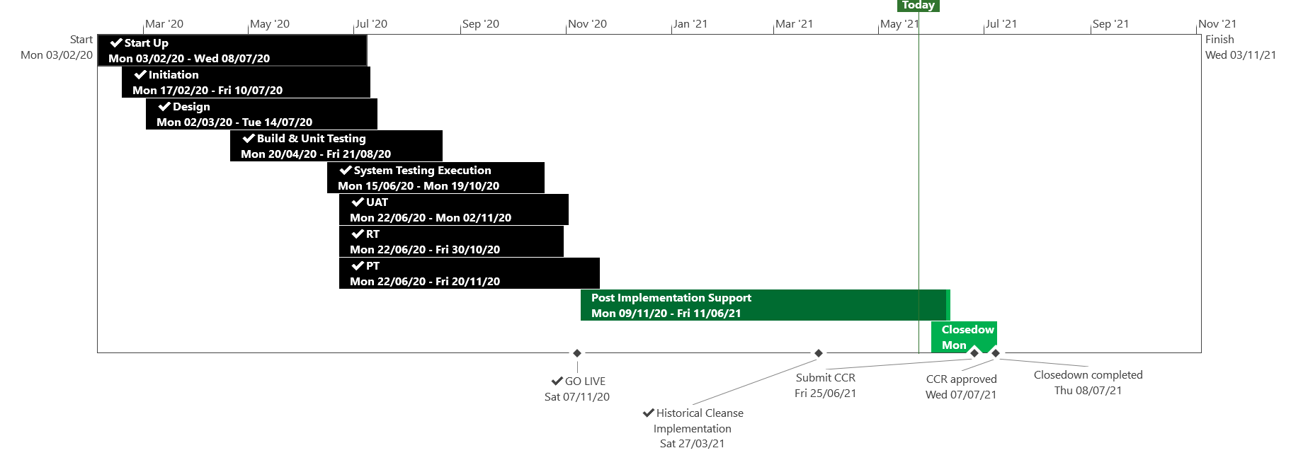
XRN5110 – Nov 20 Release - Status Update
 | Overall Project RAG Status
 | Schedule | Risks and Issues | Cost
RAG Status
Status Justification
Schedule | November 20 Release delivered, final activity for Historical Cleanse XRN4897/99 is on-going, due to be completed to schedule Historical Cleanse commenced on the 27th March and due to complete by 4th June CCR to be submitted to July ChMC Decision in June ChMC: None
Risks and Issues | ​Risk: UK Link may be non GDPR compliant following Historical Cleanse due to missing unknown scenarios Please Note: First usage has been completed and no new scenarios have been identified, risk closed Issue: XRN4897/99 Historical Cleanse Change Request needs to be completed to exit Post Implementation Support Return To Green: Completion of historical cleanse
Cost | Forecast to complete delivery against approved BER
Scope | XRN4897 - Resolution of deleted Contact Details (contained within the S66 records) at a Change of Shipper event XRN4899 - Treatment of Priority Service Register Data and Contact Details on Change of Supplier Event XRN4801 - Additional Information in DES XRN4871b - Rachet Regime Changes XRN5014 - Facilitating HyDeploy2 Live Pilot Descoped - XRN4931 Submission of a Space in Mandatory Data on Multiple SPA Files Descoped - XRN4941 MOD 692 – Auto Updates to Read Frequency Descoped - XRN4992 Supplier of Last Resort Charge Types Moved to CSSC - XRN4870c MAP ID
Complete
On Track
At Risk
Overdue
Not Baselined
Slide updated on 26th May 2021

Slide 27
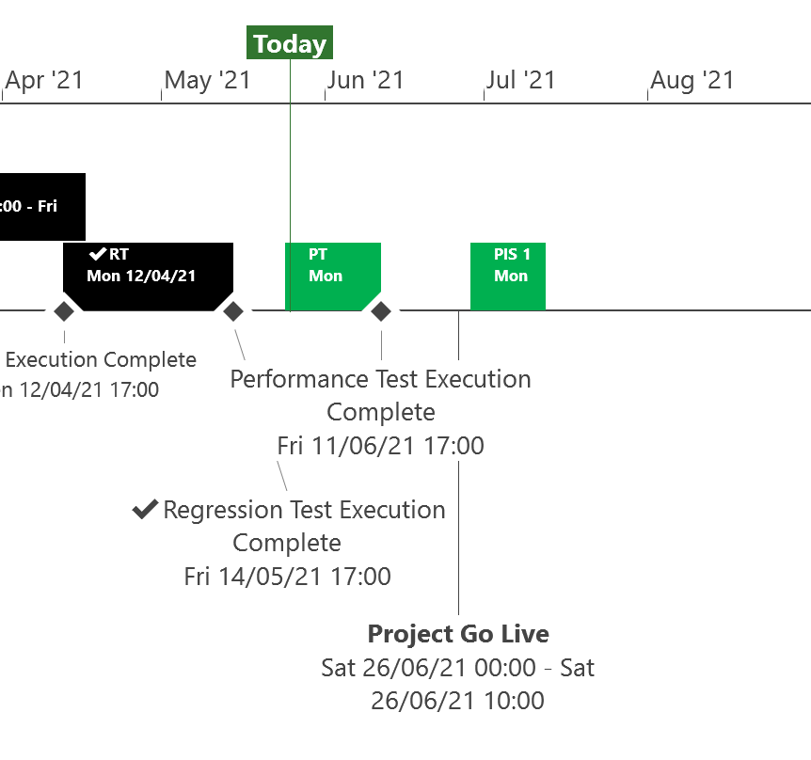
XRN5253 June 21 Major Release - Status Update
 | Overall Project RAG Status
 | Schedule | Risks and Issues | Cost
RAG Status
Status Justification
Schedule | Testing phase progressing to plan System, user and regression testing completed to plan in May Performance testing commenced to plan and due to finish by 11th June Go-live will take place on Saturday 26th June Post implementation support period agreed based on 1st usage timelines for MOD0700 (see next slide) Decision In June ChMC None
Risks and Issues | None applicable
Cost | Forecast costs on track to complete within approved BER
Scope | XRN5093 - MOD0711 – Update of AUG Table to reflect new EUC bands Descoped - XRN4992 - MOD0687 – Creation of new charge to recover last resort supply payments – Descoped at Extraordinary ChMC on 26th October 2020 Descoped - XRN4941 - MOD0692 - Auto updates to meter read frequency – Descoped at ChMC on 11th November 2020
Complete
On Track
At Risk
Overdue
Not Baselined
Slide updated on 28th May 2021

Slide 28
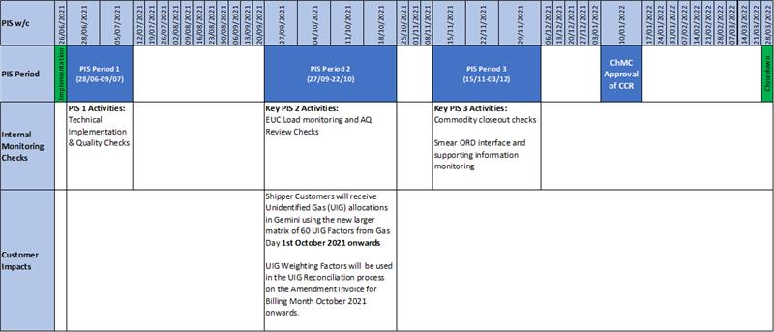
Post Implementation Support (PIS) Period
The below timeline details the PIS periods required for this Release based on 1st usage timings
NOTE: The 3 PIS Periods have been put in place to align to 1st usage

Slide 29
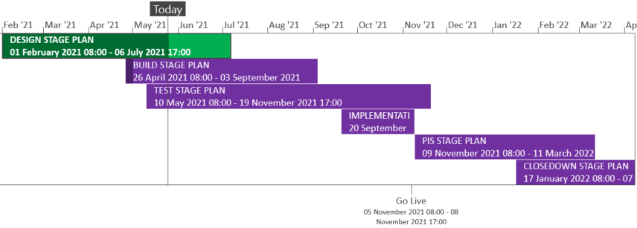
XRN5289 – November 21 Major Release - Status Update
 | Overall Project RAG Status
 | Schedule | Risks and Issues |  | Cost
RAG Status
Status Justification
Schedule | Finalising design phase governance and admin BER approved 12th May Delivery scope approved 12th May High level delivery plan is approved Detailed delivery plan is currently in approval Build has commenced Implementation approach is in review and will be shared in July ChMC Decision in June ChMC: None
Risks and Issues | RISK:XRN5142 - Unknown volumes for data cleanse Mitigation - Regular touch points with DCC to understand the expected volume and plan cleanse accordingly
Cost | Forecast to complete design against approved EQR Forecast to complete delivery against approved BER
Scope | XRN4941 - MOD0692 - Auto updates to meter read frequency​ XRN5007 - Enhancement to reconciliation process where prevailing volume is zero​ XRN5072 - Application and derivation of TTZ indicator and calculation of volume and energy – all classes​ XRN5142 - New allowable values for DCC Service Flag in DXI File from DCC​ XRN5180 - Inner tolerance validation for replacement reads and read insertions​ Descoped - XRN5091 - Deferral of creation of Class change reads at transfer of ownership​ Descoped - XRN5186 - MOD0701 – Aligning capacity booking under the UNC and arrangements set out in relevant NExAs​ Descoped - XRN5187 - MOD0696 – Addressing inequalities between capacity booking under the UNC and arrangements set out in the relevant NExAs
Complete
On Track
At Risk
Overdue
Not Baselined
Slide updated on 28th May 2021

Slide 30
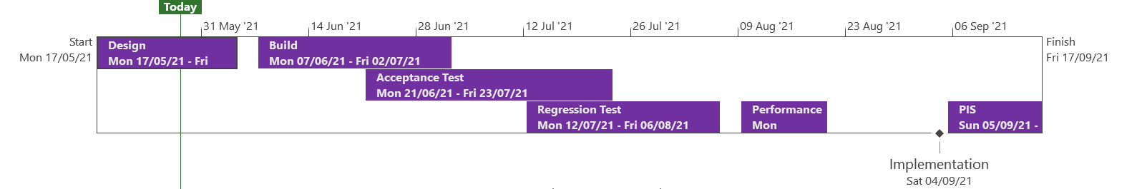
XRN5371 - Minor Release Drop 10 - Status Update
 | Overall Project RAG Status
 | Schedule |  | Risks and Issues | Cost
RAG Status
Status Justification
Schedule | Scope approved during May ChMC Currently in Design phase XRN5246: Solution Change pack to be issued in June Implementation date agreed for 4th September with a contingency date of 2nd October 2021 Decision in June ChMC: None
Risks and Issues | None applicable
Cost | On track to complete within approved spend
Scope | XRN5309 - FSG Automation of FSR Process XRN5188 - MAP ID Data Upload to UK Link XRN5246 - Confirmation File Performance improvements
Complete
On Track
At Risk
Overdue
Not Baselined
Slide Updated on 28th May 2021

Slide 31
XRN5294 – Minor Release Drop 9 - Status Update
 | Overall Project RAG Status
 | Schedule | Risks and Issues | Cost
RAG Status
Status Justification
Schedule | CCR approved at May ChMC | Costs for drop 9 by change:
Risks and Issues | None applicable
Cost | Completed within approved spend
Scope | XRN5080 - Failure to Supply Gas (FSG-GSOP1) – System Changes XRN5135 - DNO and NTS Invoice to Shippers and DNs VAT Compliance
 | Total | NTS 1.7% | DN 16% | IGT 0.3% | Shipper 82%
XRN5080 | £44,012.10 | £748.21 | £7,041.94 | £132.04 | £36,089.91
XRN5135 | £86,018.50 | £1,462.31 | £13,762.96 | £258.05 | £70,535.10
Slide Updated on 28^{h} May 2021

Slide 33
CMS Rebuild Update
May Updates for June's ChMC
Jo Williams

Slide 34
CMS Rebuild - Progress to date
Summary of progress to date
Of the five options provided, we have now shortlisted two options With the remaining options, we are seeking additional clarifications and working with suppliers to obtain these Additional activities are continuing on certain processes such as the Must Reads, ToG and GSR, which the team are targeting to communicate these to the wider audience at the end of May We are conscious that we were due to attend CoMC in May to provide the preferred solution, however we are currently undertaking additional due diligence to ensure the chosen solution meets all requirements and can adapt for future changes Following a session held with a customer rep, it has clarified that there is not duplication with the SDEP tool and the cross communication function requirement. Therefore the cross communication functionality remains in scope and the focus group shall continue to refine the requirements
Next Steps
Identify the preferred solution and present to CoMC Approval of processes to remain in scope of CMS Cross Communication workshop to be scheduled for the focus group Finalising the Must Reads, ToG and GSR high level requirements
Key Milestones | Due
Capture Exit | 30/06/2021

Slide 35
Section 6: Any Other Business

Slide 36
6.1 Revised Customer Change KVI Questions – June 2021 (for information)

Slide 37
Customer Change KVI -Background
Xoserve have issued quarterly Customer Change Surveys to DSC customers to allow for us to assess performance in the delivery of change
Since the creation of Correla, Xoserve’s delivery partner, there is still a need for us to ask our customers what we do well and where we can make improvements
Therefore we have changed the structure of the questions to accommodate the fact that Correla are our Delivery partner of change to ensure that we continue to receive feedback and improve the change journey.
With this in mind the new structure to the survey can be seen on the next page of this presentation

Slide 38
Customer Change KVI – Proposed structure
Thinking of Xoserve as your Central Data Service Provider….
I trust Xoserve to provide timely and fit for purpose information to enable me to manage new changes that impact my organisation
Xoserve presents a range of solution options for each change to enable choice
I trust Xoserve to identify solutions that benefit the whole industry where possible
Xoserve supports me to fully engage in the change process should I choose to
Thinking of Correla, delivering change on behalf of Xoserve…..
I trust Correla to deliver changes to agreed costs, timescales and quality
Costs associated with changes that Correla deliver are clear
I trust Correla to deliver right first time implementation for gas Industry Changes that affect my organisation
Finally, thinking of Xoserve and Correla delivering change collaboratively…….
Xoserve and Correla reacts quickly and effectively to gas industry changes that affect my organisation

Slide 39
Customer Change KVI – Recommendations & next steps
Xoserve Recommendation:
We are seeking approval to adopt the recommended amendments to the structure of the Customer Change KVI because:
  Allows for Xoserve to monitor the part of the journey we are accountable and responsible for
  Allows us to monitor customer sentiment with regards to our delivery partner, Correla
  Allows us to get an understanding with regards to customer sentiment around the collaboration and partnership of Xoserve and Correla in the delivery of change
Next Steps:
  Survey to be created with the new format and sent to Contract Managers prior to seeking approval at June's Contract Management Committee Meeting

Slide 40
Project 1Stop
Megan Troth

Slide 41
Background
The new iteration of the Xoserve website was developed in November 2018
Since this implementation, based on customer feedback, we have been looking to identify various ways in which we can improve the change pages and the overall customer journey, particularly in relation to change (DSC / investment)
Project 1Stop is underway so that we can further understand of our customer’s needs, address pain points, and create an overall more positive experience when navigating through Xoserve change information
The project will identify improvements, and articulate them as ‘user stories’ with delivery options to realise stated benefits presented – should there be any costs associated with any given user story ChMC will be consulted

Slide 42
Objectives
Less customer time required to consolidate change information from various places on xoserve.com
Increased ease of access, with information targeted to specific customer groups (e.g. easy-to-digest information for new market entrants)
Consistent, aligned and up-to-date information suitable for ‘light or heavy touch’ usage

Slide 43
Next Steps
Survey to be issued to gain customer sentiment on website improvement requirements
A complete view of user stories to be collated, based on the outputs of the survey, and presented to Governance Sub-Committee / ChMC
Where appropriate, a provision of mock-up pages, created for customers to review how all improvements will look (review sessions may also be held with customer groups)

Slide 44
What do we need from you?
As this project progresses, we are constantly looking to evolve the change function of the website in line with customer requirements
We are asking all customers to keep an eye out for the upcoming survey as we welcome all feedback which may help us in our development
Any ideas you may have for the website, or if you would like to discuss the project further, please do not hesitate to contact the change team at uklink@xoserve.com

Slide 45
APPENDIX

Slide 46
Outages
Outage Table
Change Request Number | Impacted System | Outage Duration |  |  |  |  | Committee Notified Date
 |  | Start Date | Start Time | End Date | End Time | Brief Description
CHG0031138 | CMS | 17/07/2021 | 00:00 | 17/07/2021 | 07:00 | CMS Disaster Recovery Test 2021 This is an annual activity to confirm CMS (Contact Management Service) services can be migrated to a secondary data centre location should there be a catastrophic failure within the primary data centre. During this phase of the test CMS services will failover from the primary site to the secondary site. NOTE: This activity will run during the normal CMS maintenance window so no extended outage is expected however if we experience issues when the system is released there may be an extended outage until 11:00 as we revert the system back | New Outage 09/06/2021
CHG0031138 | CMS | 18/07/2021 | 00:00 | 18/07/2021 | 07:00 | CMS Disaster Recovery Test 2021 During this phase of the test CMS services will failback from the secondary site to the primary site. NOTE: This activity will run during the normal CMS maintenance window so no extended outage is expected however if we experience issues when the system is released there may be an extended outage until 11:00 as we revert the system back | New Outage 09/06/2021

Slide 47
Portfolio POAP

Slide 48

CSSC Programme Dashboard
June 2021

Slide 49
Programme Update
Programme Health – RAG |  |  | Return to Green Plan
Overall Programme Status | Previous | Current | The programme remains at a Green status. The wider Switching Programme is reporting an Amber-Green status with the Amber portion being related to the planning activities around Transition Xoserve have successfully entered UEPT. Preparation continues for Transition, Business Change and Service Management activities. The inaugural Switching Programme Post Implementation Working Group was conducted on 26/05.
Programme Plan | Previous | Current
Risk Profile | Previous | Current
Resources | Previous | Current
Executive Summary |  |  |  | Upcoming Activities & Milestones (Next Month)
Key Programme Updates To date, all Xoserve key internal and external milestones have been met Transition: Live Rehearsal Cycle 1 continues to plan along with preparations for LR Cycle 2, which is more reflective of Transition. Artefact reviews continue with the Switching Programme, alongside internal workshops. CR-D071 (Treatment of Inflights during Transition) has now been approved Internal & External Testing: All testing activities are on track with planning Data Migration: REL cycle 4 data work has completed and has been delivered 1 week early. A request has been received for Cycle 5 (non-rel) Analysis reports due for delivery on July. Work on track Business Change: Internal knowledge transfer sessions continue. Target Operating Model activities are on track Service Management: Xoserve had raised a CR to align Service Management Response SLAs. This is currently under industry impact analysis. |  |  |  | Live Rehearsal: Continue Cycle 1 Internal Test: Progress CR testing and any relevant regression tests DES:& Secondary APIs Continue development and system test activities. Transition: Continue Live Rehearsal & Transition planning MAP C: Change Packs approved, delivery continues to plan REC: Continue REC schedule review as per Ofgem timelines Business Change: Continue awareness and knowledge transfer session

Slide 50
Green Workstream Updates
RAG Previous MONTH | RAG Current MONTH | WORK STREAM | SUMMARY
 |  | DES & Secondary API | Overall Green: Delivery on track for E2E
 |  | Testing | The overall status remains Green. Successful entry into UEPT, at the point of writing this, no significant defects have been seen Planning complete for all upcoming for OT.
 |  | Service Management | Internal Service Management activities continue to feed into OT and internal OAT A CR has been raised (CR-072) and discussed at Change Advisory Workgroup (CAT) to align Switching Programme SLAs to match Xoserve’s existing response times. Currently undergoing impact assessment.
 |  | Batch | The overall status is green, with testing support underway for UEPT/E2E activities
 |  | Gemini | The overall status is green
 |  | Reporting | An internal CR will be raised to incorporate the impact of one newly identified report that will need changes.
 |  | UK Link | Status continues to be Green with work underway to impact assess, deliver and test Switching Programme changes raised through the last few months

Slide 51
Green Workstream Updates
RAG Previous MONTH | RAG Current MONTH | WORK STREAM | SUMMARY
 |  | REC | REC consultation continues with Xoserve actively engaged in relevant RDUG meetings as well as reviewing REC schedules
 |  | Data Migration | REL cycle 4 data work has completed and has been delivered 1 week early. A request has been received for Cycle 5 (non-rel) Analysis reports due for delivery on July.
 |  | Environments | Workstream continues to be Green with all activities continuing to track to plan for all upcoming activities. Awaiting confirmation from DCC and REC around the need for enduring environments post Go-live
 |  | MAP C (XRN-4780C) | Delivery continues, with a plan to incorporate delivery governance into the November 21 major release
 |  | SoLR (XRN-5144) | Industry discussion continue with Ofgem

Slide 52
Key Programme Risks (1/3)
RTC | RAG | Workstream | Description | Mitigation Strategy | Latest Update | Resolution Date
65184 |  | Programme | There is a risk that supplier resources working on the programme will be diverted to support BAU activities and service provision because of the COVID-19 situation in India affecting significant numbers of people either directly or their friends and family leading to potential delays in CR and defect delivery, reduced support for environment provision and maintenance, delays to data migration and testing support. | Work with suppliers to understand pinch points within delivery teams and prioritise resource allocations accordingly to reduce impact | Suppliers continue to provide regular reports no impact to the programme currently. | 31/05/21
65244 |  | Transition & Cutover | There is a risk that the Xoserve DMLR Cycle 2 schedule will have to be changed at very short notice As the SI as not following the transition runbook for LR testing, and are planning to review / revise the plan as LR Cycle 1 progresses leading to very short notice changes, with potential resource conflicts and additional work to bring transition runbook into line | Request DMLR Cycle 2 stage 1 plan at the end of cycle 1 stage 1 | Xoserve to request that the cycle 2 stage 1 plan is issued shortly after the end of cycle 1 stage 1, rather than waiting until the whole cycle has completed | 25/06/21
65175 |  | Transition & Cutover | There is a risk that the overall Transition timeline may change because the Transition test stage 1 plan exceeds the 6 week limit leading to additional time required for transition as activity durations are confirmed in Transition testing and transferred to the Runbook | Liaise with the SI to close gaps and ensure plans are aligned to agreed Transition timelines | A revised plan was shared on 04/05. A review of this plan indicated several Microsoft project plan issues. A third review is planned once Darren issues a revised plan (ETA18/05) | 08/11/21
55513 |  | Programme | There is a risk that in the Programme participants might interpret business rules differently because business rules underpinning the CSS Interfaces have not been published alongside the interface document as well as discrepancies between business rules defined within REC and captured in ABACUS. Leading to significant process mismatches at a later stage (i.e. SIT, UEPT) and potential rework and timeline slippages. | Xoserve to publish design assumptions as part of the RAID reporting to the SI to ensure visibility of Xoserve design assumptions around business rules and processes. | Continues to be monitored until Tranche 1 of E2E is complete | 01/08/21
55549 |  | Programme | There is a risk that that the approval of the CSS Physical Design does not take into consideration the complete E2E impacts of the Switching Programme because the CSS design is solely focused on the core CSS and primary interactions with CSS. Leading to an inaccurate critical path being followed for the Programme and subsequent downstream delays to the delivery timeline. | 1. Raise with Ofgem to identify owner/RACI 2. E2E CSS design needs to be in place involving all components/systems/interactions which needs to be form the architectural baseline that the Programme is governed against. | Continues to be monitored until Tranche 1 of E2E is complete | 01/08/21

Slide 53
Key Programme Risks (2/3)
RTC | RAG | Workstream | Description | Mitigation Strategy | Latest Update | Resolution Date
61894 |  | Service Management | There is a risk that the CSS proposed SLA's do not align to current service model/SLA's because DCC/Ofgem are proposing a new set of SLA's for all parties regardless of existing arrangements, leading to target operating model changes and potential contractual changes with 3rd party suppliers (considerable increase in operational cost) | Our working assumption is that existing SLAs will prevail however, there are ongoing discussions taking place with DCC to understand their expectation. REC review - no such SLA's imposed on us currently. | CR-D072 received for IA in respect of SLAs. To be reviewed and sent back by 20/5 | 31/06/21
65156 |  | Transition & Cutover | There is risk that the change freeze scope could impact Transition because the scope of Programme Change Freeze from 03/01/22 is not clearly defined leading to impacts during actual Transition | Work with the SI to collectively define the scope of Change Freeze | Update at the SI Transition Group from Ofgem is that a view will be tabled at the next SI Transition Group | 26/07/21
64002 |  | Programme | There is a risk that ongoing pipeline of customer driven and regulatory change within the industry could impact the CSSC and wider Switching Programme delivery because of technical conflict with the design of other changes and demand on resources across Xoserve and the customer teams involved in Switching Programme delivery leading to additional regression testing activity, CRs raised to modify solutions already developed and tested by the programme, delays to the overall Switching Programme, and therefore unplanned costs for Xoserve. | 1. Discuss the potential for change moratoria with Ofgem that could restrict the volume of change being made and in particular mitigate some of this risk in relation to coding impacts 2. Investigate the availability of and if necessary invest in tooling to support more enhanced branching and merging in terms of development to mitigate the technical impact of any non-CSSC changes. 3. Work with the SI to monitor for any potential impact on programme resources, including customer resources, that may result from change initiatives running in parallel with critical path Switching Programme phases. | Update at the SI Transition Group is that this is a risk that will be need to be accepted. Will be marked accepted once the corresponding Switching Programme risk is accepted by Ofgem | 30/06/22
61894 |  | Service Management | There is a risk that the CSS proposed SLA's do not align to current service model/SLA's because DCC/Ofgem are proposing a new set of SLA's for all parties regardless of existing arrangements, leading to target operating model changes and potential contractual changes with 3rd party suppliers (considerable increase in operational cost) | Our working assumption is that existing SLAs will prevail however, there are ongoing discussions taking place with DCC to understand their expectation. REC review - no such SLA's imposed on us currently. | CR-D072 received for IA in respect of SLAs. To be reviewed and sent back by 20/5 | 31/06/21

Slide 54
RTC | RAG | Workstream | Description | Mitigation Strategy | Latest Update | Resolution Date
64158 |  | Programme | There is a risk that that the Operational Choreography CR that is in progress may be approved because it might be deemed necessary by the central programme leading to further plan considerations (at both the central and individual PUI's plans) and cost implications to Xoserve | This has been raised with SI/DCC & Ofgem. This is being tracked collectively via the MAD log actions. Should this CR be approved, this action will be addressed with central bodies | Awaiting update/confirm from Ofgem | 04/06/21
64171 |  | Transition and Cutover | There is a risk that the SoLR process might kick off during the transition period because of a supplier going out of business at that time leading to Landmark needing to cater to additional volumes and also the potential for additional requirements for PUIs to undertake to ensure Transition timelines are maintained | Raise the risk with Ofgem and SI to understand what non-functional considerations have been applied to enable Landmark to manage the increased volumes Raise with the SI to include a transition test scenario if relevant to mitigate this possibility | Update at the SI Transition Group is that this is a risk that will be need to be accepted. Will be marked accepted once the corresponding Switching Programme risk is accepted by Ofgem | 28/05/21
65176 |  | Transition and Cutover | There is a risk that the Runbook may not be properly tested because schedules to be used across test phases (DM LR / Transition testing) are being developed separately leading to potential for discrepancies and for insights from one activity being missed by the other | Liaise with the SI to ensure that all plans are aligned. Request early sight of plans to ensure adequate review in advance | Risk raised with SI in light of LR plan issue, showing a change in sequencing for DM LR | 28/05/21

Slide 55
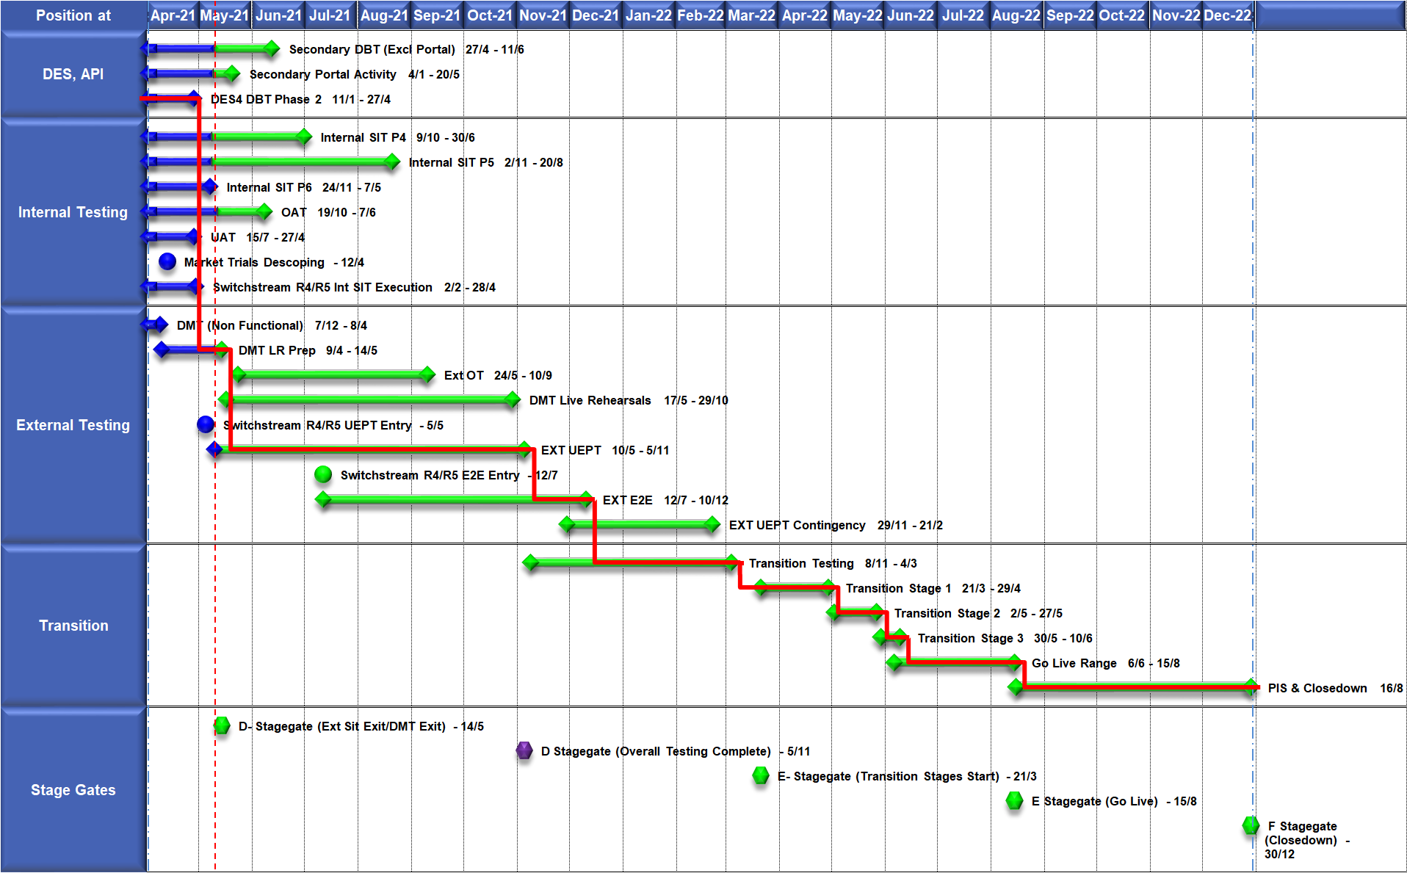
High Level Plan

Slide 56
Switching Programme CR Position – CRs impacting Xoserve
CR Name | CR Ref | High Level Cost IA Cost | Date Raised | Status
Programme Plan Re-Baseline | CR-D002 | £0.00 | 07/11/2019 | Approved - Complete
Updates to the CSS Physical Interface Design (PhID). | CR-D008 | £17,250.00 | 22/01/2020 | Approved - Internal CR Created
CSS_Exception_Handling_Strategy_v0.2 | CR-D014 | £0.00 | 26/02/2020 | Approved - Internal CR Created
Provide_CSS_RegistrationID_to_PUI_and_LPs | CR-D016 | £12,643.00 | 07/08/2020 | Approved - Internal CR Created
Licence Exempt Network Customer Identifier – ABACUS Data Model update | CR-E51 | £0.00 | 29/10/2019 | Approved - Complete
Amendments to the DMS artefact suite | CR-D019 | £6,500.00 | 16/03/2020 | Approved - Internal CR Created
Migration of Terminated Gas RMPS | CR-D022 | £0.00 | 10/06/2020 | Approved - Internal CR Created
Amendments to the NC-0079 for REL (Retail Energy Location) Data Migration and Reconciliation | CR-D024 | £20,000.00 | 06/07/2020 | Approved - Internal CR Created
DMS - PHID Alignment Parties | CR-D026 | £0.00 | 06/07/2020 | Approved - Internal CR Created
Request For a New or Upgraded DMT Environment | CR-D027 | £256,009.00 | 07/08/2020 | Approved - Internal CR Created
Enable TLS connection pooling for all directly connected parties to CSS] | CR-D028 | £2,500.00 | 13/07/2020 | Approved - Internal CR Created
Message Header Format for PKI Certificate Identification] | CR-D029 | £2,500.00 | 13/07/2020 | Approved - Internal CR Created
SIT Functional Test Re Plan Enabling Parallel Testing | CR-D030 | £56,000.00 | 20/07/2020 | Approved - Internal CR Created
DM_Validation Catalogue_Shipper_Effective_Date_Change_ | CR-D032 | £0.00 | 03/08/2020 | Approved - Internal CR Created
Compression During Data Migration | CR-D034 | £500.00 | 09/09/2020 | Approved - Internal CR Created

Slide 57
Switching Programme CR Position – CRs impacting Xoserve
CR Name | CR Ref | High Level Cost IA Cost | Date Raised | Status
Compression During Data Migration | CR-D034 | £500.00 | 09/09/2020 | Approved - Internal CR Created
Uplift to the CSS Interface Specifications | CR-D038 | £70,000.00 | 07/10/2020 | Approved - Internal CR Created
Uplift to Business Data Validation Rules | CR-D039 | £20,000.00 | 25/09/2020 | Approved - Internal CR Created
Programme Plan Re-Baseline | CR-D042 | £14,913,000.00 | 28/09/2020 | Approved - Internal CR Created
Changes to Support Energy Company Data | CR-D059 | £25,500.00 | 25/01/2021 | Awaiting Decision
Operational Choreography Detection 0.5 | CR-D060 | £308,205.00 | 25/01/2021 | Awaiting Decision
Operational Choreography Rectification 0.3 | CR-D061 | £0.00 | 25/01/2021 | Awaiting Decision
Amendment of Data Migration Solution to Protect Programme Timescales - Removal of Transition Stage 1 Delta files | CR-D062 | £83,490.00 | 25/02/2021 | Approved - Internal CR Created
Uplift to the CSS Business Data Validation Rules Doc | CR-D067 |  | 19/03/2021 | Approved - Internal CR Created
REL Dissemination to iDNO and DNO | CR-D069 |  | 15/03/2021 | Pending PIA
Change to Management of In-Flight Switches Approach | CR-D071 | £0.00 | 15/03/2021 | Pending SI Response
Increase Cadence of Data cuts | CR-D080 | £24,600.00 | 10/05/2021 | Pending SI Response
Re-align Switching Programme Response SLAs with Xoserve response SLAs | CR-D072 | £0.00 | 07/05/2021 | Complete

Slide 58
Switching Programme CR Position – Pending Xoserve Impact Assessment
CR Name | CR Ref | High Level Cost IA Cost | Date Raised | Status
Amend the Transition Testing Milestones TR210 & TR220 for PUI Production Data Cuts v0.4 | CR-D078 |  | 14/05/2021 | Pending PIA
Engagement for Early E2E Testing v0.2 | CR-D082 |  | 14/05/2021 | Pending PIA
Amendment to Assumptions as a result of analysis undertaken during CP1 v0.4] | CR-D083 |  | 24/05/2021 | Pending PIA

Slide 59
Switching Programme CR Position – CRs not impacting Xoserve
CR Name | CR Ref | Date Raised | Status
Non_Mandatory_MPAS_Metered_Indicator_v0.4 | CR-D001 | 27/01/2020 | Complete - No Xoserve Impact
REC Manager Procurement Timelines | CR-D003 | 02/12/2019 | Complete - No Xoserve Impact
MPAS Related MPAN Disconnection | CR-D004 |  | Withdrawn
Introduction of Validation Message to Logical Mode | CR-D005 | 25/11/2019 | Withdrawn
Modification of Related MPAN Cleanse Checkpoint Milestones | CR-D006 | 27/11/2019 | Complete - No Xoserve Impact
ABACUS Corrections and Re-alignments | CR-D007 | 04/12/2019 | Complete - No Xoserve Impact
ECOES REL API Webmethod | CR-D009 | 17/12/2019 | Complete - No Xoserve Impact
CSSIA Uplift to Implement IG Recommendations | CR-D010 | 17/12/2019 | Complete - No Xoserve Impact
Update 3 E2Es to align to CSSIA | CR-D011 | 10/06/2020 | Complete - No Xoserve Impact
CSS_Physical_Interface_Design_Updates_mpxn_v0.2 | CR-D012 | 30/01/2020 | Complete - No Xoserve Impact
Messaging_Requirements_Revisions_REC_Code_Manager_and_CSS_v0.1 Clean | CR-D013 | 28/01/2020 | Complete - No Xoserve Impact
Amendment_of_Xoserve_Consequential_Change_Milestone_Delivery_Dates_v0.2[DRAFT] | CR-D015 | 26/02/2020 | Withdrawn
CSS_Handling_of_MPAS_Business_Dates_v0.2[DRAFT] | CR-D017 | 20/07/2020 | Complete - No Xoserve Impact
Confirmation_Responses_to_Outbound_Synchronisations_v0.2[DRAFT] | CR-D018 | 02/03/2020 | Withdrawn
Regulatory Workstream – Programme Milestones Refresh | CR-D020 | 16/03/2020 | Withdrawn
Remove MPAS Interface | CR-D021 | 29/04/2020 | Withdrawn
DSP_Specific_ SIT_ Functional_Exit_Criteria | CR-D023 | 29/05/2020 | Complete - No Xoserve Impact
Changes to support enhanced Solar arrangements | CR-D025 |  | Withdrawn
CSS Role-based access control (RBAC) | CR-D031 | 24/07/2020 | Withdrawn
A Quality Analysis Activity of the Data being used for the DMT Non-Functional Test Phase​​ | CR-D033 |  | Withdrawn

Slide 60
Switching Programme CR Position – CRs not impacting Xoserve
CR Name | CR Ref | Date Raised | Status
CSS Change from UTC to Local Time | CR-D035 | 22/09/2020 | Complete - No Xoserve Impact
Xoserve CR for DES AI Removal | CR-D036 | 24/09/2020 | Complete - No Xoserve Impact
Provide_CSS_RegistrationID_to_LPs | CR-D037 | 06/10/2020 | Complete - No Xoserve Impact
UEPT Tranche Regulatory Change | CR-D040 | N/A | Complete - No Xoserve Impact
NCT-0073 Functional Script Master Changes | CR-D041 | 25/09/2020 | Complete - No Xoserve Impact
Update to the End to End Testing Plan | CR-D043 | 05/10/2020 | Complete - No Xoserve Impact
Request For a New DMT Environment for DMT Live Rehearsal | CR-D044 | 23/10/2020 | Complete - No Xoserve Impact
NC-0079 Adding Post Load Integrity Check Document | CR-D045 | 09/11/2020 | Complete - No Xoserve Impact
Uplift to the Code of Connection | CR-0046 | 09/11/2020 | Complete - No Xoserve Impact
Correctional Changes to MAD Log v2.0 & POAP v2.0 | CR-D047 | 13/11/2020 | Complete - No Xoserve Impact
Changes to Data Milestones in MAD Log v2.0 & POAP v2.0 | CR-D048 | 09/11/2020 | Complete - No Xoserve Impact
Consequential Changes to Testing Milestones in MAD Log | CR-D049 | 13/11/2020 | Withdrawn
CSS Environments for Faster Switching Enduring Service | CR-D050 |  | Withdrawn
Changes to Data Validation Rules | CR-D051 | 30/11/2020 | Complete - No Xoserve Impact
Additional and Further Correctional Changes to MAD Log v2.0 | CR-D052 | 05/12/2020 | Complete - No Xoserve Impact
Additional Onward Dependencies for MAD Log | CR-D053 | 18/12/2020 | Complete - No Xoserve Impact
Changing from GetOrganised to Landmark SFTP for SI receiving files | CR-D054 | 18/12/2020 | Complete - No Xoserve Impact
Amendments to the Data Cleansing Catalogue | CR-D055 | 18/12/2020 | Complete - No Xoserve Impact
MAD Log Changes for UIT Environment Verification | CR-D057 | 25/01/2021 | Complete - No Xoserve Impact
Discontinuance of Xoserve Consequential Change Market Trials | CR-D058 | 25/01/2021 | Complete - No Xoserve Impact
Uplift to SMS CoCo | CR-D063 | 29/01/2021 | Complete - No Xoserve Impact
Changes to SIT Functional Test Scenarios | CR-D064 | 29/01/2021 | Complete - No Xoserve Impact
Uplift to the Code of Connection | CR-D065 | 29/01/2021 | Complete - No Xoserve Impact

Slide 61
Switching Programme CR Position – CRs not impacting Xoserve
CR Name | CR Ref | Date Raised | Status
In-Flight Reg ID Dissemination | CR-D066 |  | Not Received
Uplift to the CSS Business Data Validation Rules Doc | CR-D067 | 19/03/2021 | Complete - No Xoserve Impact
Uplift to the CSS Interface Specification | CR-D068 | 15/03/2021 | Complete - No Xoserve Impact
REL Dissemination to iDNO and DNO | CR-D069 | 15/03/2021 | Complete - No Xoserve Impact
Removal of UEPT Stage 1 Data Allocation and Verification for Tranche 3 and 4 Participants and delivery acceleration of Stage 2 Data Allocation | CR-D070 | 05/03/2021 | Complete - No Xoserve Impact
Re-align Switching Programme Response SLAs with Xoserve response SLAs | CR-D072 | 07/05/2021 | Complete - No Xoserve Impact
Changes to MAD Log v2.2 to rectify incorrect milestone descriptions | CR-D074 | 29/03/2021 | Complete - No Xoserve Impact
Update Service Management Baseline Requirement | CR-D076 | 20/04/2021 | Complete - No Xoserve Impact
Removal of SMS005 from UEPT Test Scenarios v0.2 | CR-D081 | 14/05/2021 | Complete - No Xoserve Impact

