Slide 1
Hydrogen Blending: Commercial framework review and amendments UNC Review Group Request
Transmission Workgroup
4th May 2023
National Gas Transmission |

Slide 2
Purpose
Hydrogen is expected to play a vital role in transitioning to a low carbon future. Recent policy documents have begun to define the role of hydrogen, and in particular how blending hydrogen with natural gas in the existing gas infrastructure can support the transition to a net zero future.
Current assumptions are that blending hydrogen into the networks will provide an interim role to reduce carbon emissions as we transition to 100% Hydrogen, therefore the application of blending needs to be compatible with existing market arrangements, with minimal amendments to implement.
DESNZ are set to make a decision in principle on hydrogen blending into the distribution networks in 2023, with a decision for transmission likely to follow.
Purpose of review group, to identify and develop the necessary commercial framework changes required to enable hydrogen blending into the distribution and transmission network.

Slide 3
Indicative Timelines

Slide 4
Key Assumptions and Parameters
Key assumptions:
GS(M)R will be updated following a HSE safety evidence review in order to accept volumes of up to 20% hydrogen into the networks.
We believe required amendments will not impact Primary and Secondary Legislation, such as the Gas Act and GCoTER.
We expect initial hydrogen blend percentage volumes to not exceed C.5% in order to help manage risk of CV capping.

Slide 5
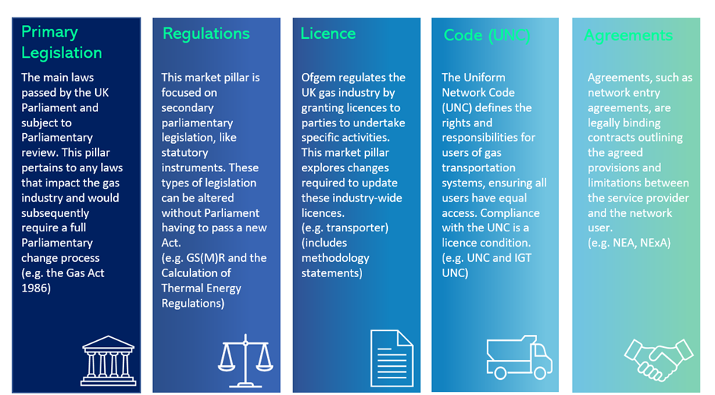
Proposal & recommended next steps
The ENA Gas Goes Green working group have been involved in a number of workshops to develop an initial thought piece on existing commercial framework compatibility and the required amendments necessary.
Recommendation to issue to a review group for a period of 6 months for development, with objective to agree commercial framework changes required with wider industry and raise suitable enabling modifications.

