Slide 1
UNC 0866: Amendments to Demand Side Response Arrangements
Proposer: Phil Hobbins, NGT
Panel Date: 18 January 2024

Slide 2
Why change?
NGT has been working intensively with industry and consumers in recent times to deliver gas DSR reforms which have sought to improve the effectiveness of DSR as a pre-emergency tool
Key changes have included:
Introduction of an ‘option and exercise’ procurement tender and contractual structure;
Enabling consumers to directly contract with NGT for DSR; and
Expanding the ability for participation in DSR to all daily metered consumers.
Whilst market growth has been achieved, the 0.6 mcmd of DSR pre-contracted for this winter is still a relatively low volume
During NGT’s engagement with consumers and their associations in 2023, a number of enhancements to existing arrangements were suggested, which, in addition to NGT’s own ideas, could help to increase the volumes of DSR offered
Notes:
Only a modest 0.2 mcm generated

Slide 3
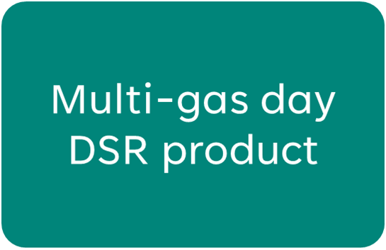
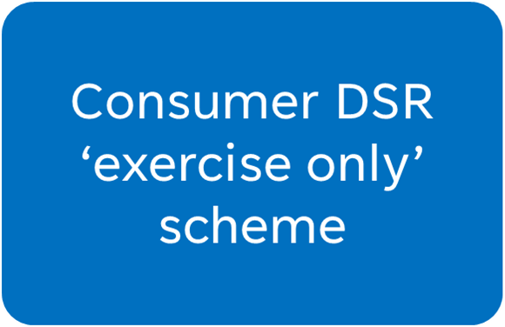
Options considered that are not being progressed at this stage
A ‘next 24 hours’ DSR product
No strong call for this product by consumers
Can already be priced in to an option offer
NGT could add an extra field to the tender proforma
Half of consumers polled show some interest
May extend DSR exercise period beyond when NGT requires it
Relatively low level of consumer interest

Slide 4
Solution
Modify the UNC to:
Amend the timings and content of the DSR Options procurement tender process
Change how the process of exercise of a DSR Option works, including how the ‘starting point’ for demand reduction is determined
Enable Class 2 Consumers to contract directly with NGT for DSR Options
Amend the credit rules for Consumer DSR
Amend liabilities for failure to deliver when a DSR Option is exercised

Slide 5
Recommended Steps
The Proposer recommends that this modification should:
be considered a non-material change and subject to Self-Governance.
be assessed by a Workgroup.
NGT proposes that Workgroup reports back to the April 2024 Panel to enable reforms to take effect within the 2024 DSR Options Tender

