Slide 1
Modification 0712: Amending the Oxygen Limit in the NEA at the St Fergus SAGE Plant NTS Penetration Analysis
Transmission Workgroup
6th February 2020

Slide 2
Mod 0712: NTS Penetration Analysis
At the last Workgroup meeting, National Grid provided ‘heat maps’ of the expected penetration of Ancala gas into the NTS in gas years 2019/20, 2025/26 and 2030/31
In recent years, a number of UNC Modifications have resulted in increased oxygen limits at other NTS entry points
Therefore the Workgroup requested that National Grid provide further analysis of the oxygen content that different areas of the NTS could expect to see if all NTS entry points were flowing:
At their contractual maximum oxygen content
Based on an average actual historical oxygen content
Supply and demand FES scenarios are the same as those used in the previous analysis – Steady Progression and Consumer Evolution

Slide 3
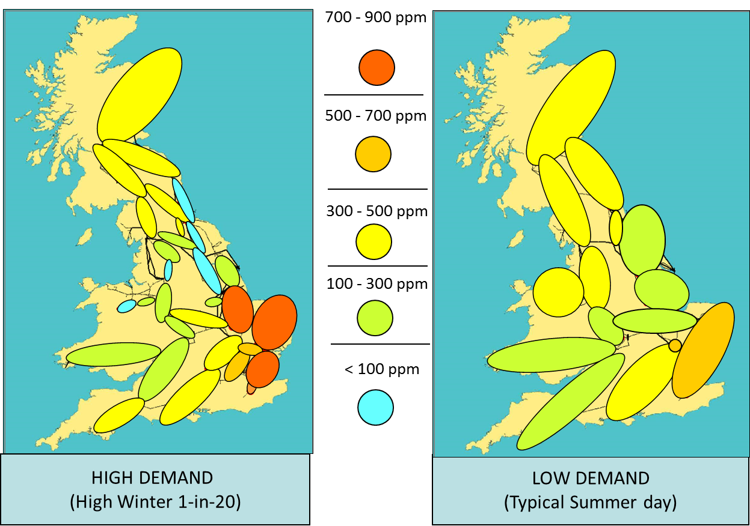
‘Maximum Contractual’ Heat Maps: Gas Year 2019/20

Slide 4
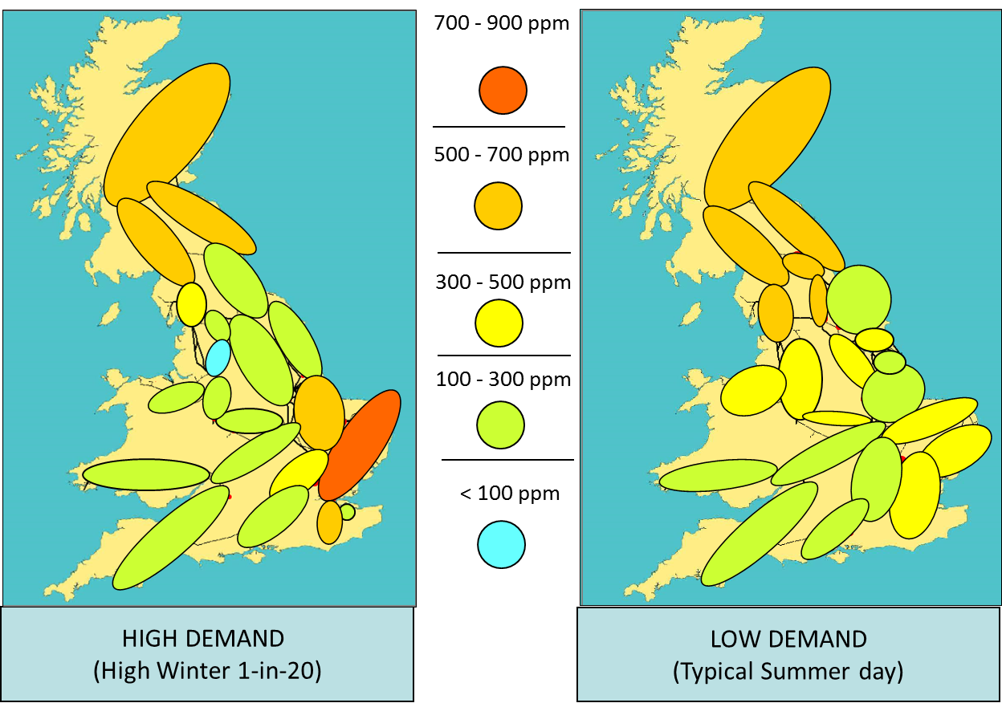
‘Maximum Contractual’ Heat Maps: Gas Year 2025/26

Slide 5
Maximum Contractual Heat Maps: Observations
All NTS beach entry points are assumed to be flowing at their maximum contractual oxygen levels
Maximum oxygen content in the NTS remains below 900 ppm
Highest concentration is in the south-east due to higher contractual maximums at Bacton entry points
No material effect if Ancala flows at 100 ppm

Slide 6
Heat Maps based on Historical Actual Oxygen Content
For this scenario, the oxygen content for each beach NTS entry point was set equal to the average observed oxygen content for that point on days when it was flowing gas into the NTS during calendar year 2019
Ancala gas is assumed to have an oxygen content of 50ppm
Under this scenario, the maximum oxygen content in the NTS is just above 100ppm
Highest concentration is in the north-east due to higher observed concentrations from Easington UKCS supplies
With Ancala assumed at 50ppm, the maximum concentration for Scotland offtakes is ~12 ppm
The heat map is based on the 2019/20 Gas Year FES network; we would expect a similar result for the 2025/26 network

Slide 7
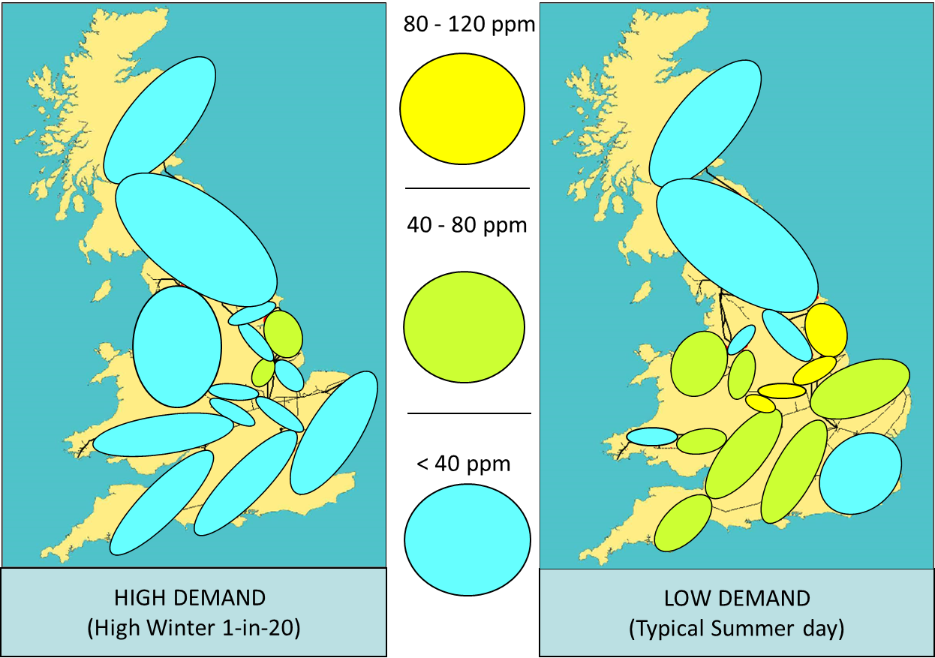
‘Average Actual’ Heat Maps: Gas Year 2019/20

