Slide 1
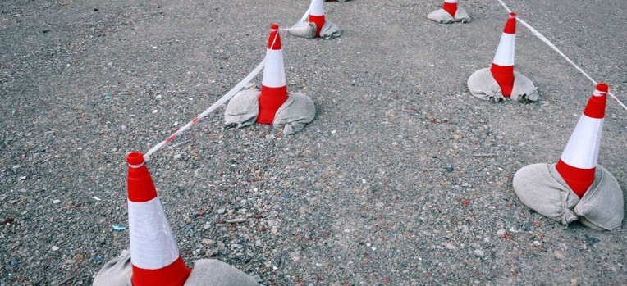

0630R – Review of the consequential changes required in UNC as a result of the Ofgem Switching Programme
Chris Warner
UNC Modification Panel
21 December 2017

Slide 2
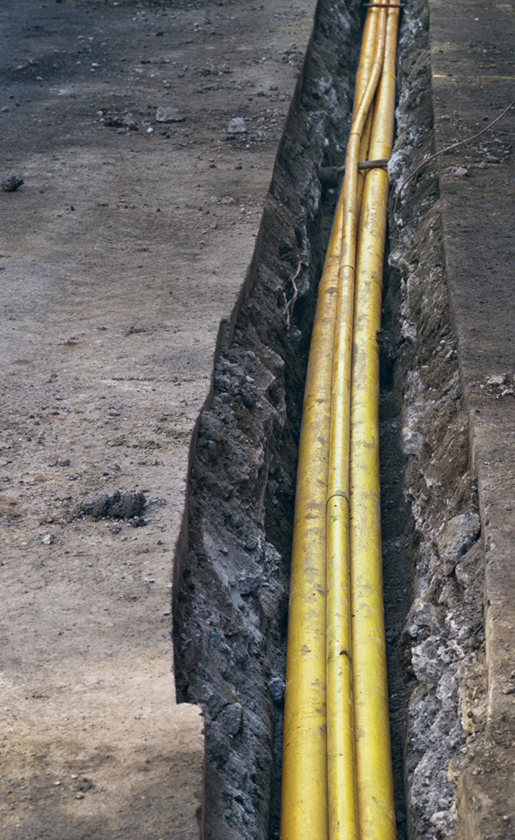
Background to 0630R
The Ofgem Switching Programme (OSP) has been formed to introduce a programme of work to develop a faster, more reliable switching service for end consumers to switch Supplier. A dual fuel Central Switching Service (CSS) will be established to facilitate the Supplier initiated switching process. Presently the switch event is proposed as being a minimum 5 Business Days with a glide path to next calendar day switching in the future
The OSP and CSS will require changes to existing UNC arrangements and supporting processes. The purpose of 0630R is to create a Workgroup to identify and understand the consequential changes that may be required to the UNC and or DSC and to explore the solution options that may be available.
0630R was approved at Panel on 19th October to progress to workgroup. A report is due back to Panel on 17th May 2018

Slide 3

0630R – First Meeting
The first meeting was held on 15th December 2017
A Business Requirements Document (BRD) was presented by Xoserve to form the basis of discussions through the development of the Review group. The BRD will evolve based on topic areas to include requirements and solution discussions
Within the BRD document there are 14 consequential changes (topic areas) which impact on UK Link Users, all of which have been identified as impacting on Shipper Users
Example change - How Shipper Users may obtain details of relevant transportation charges. The CSS switch event does not envisage the use of the Supply Point Nomination process.
During the meeting only 1 Shipper User was present (on teleconference)

Slide 4
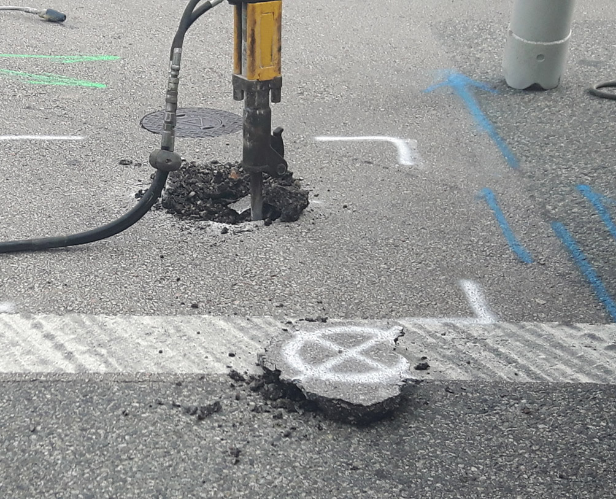
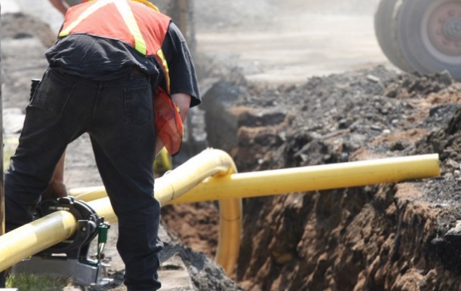
Summary
0630R is wide ranging. It is assumed that as a result of outputs from the Workgroup there will be UNC modifications and potentially substantial system changes and / or operational process changes, affecting all UNC parties
0630R is independent of the OSP therefore the topic areas will not be picked up in any OSP design forums. 0630R is the only arena to discuss these impacts
The workgroup would benefit from greater representation and input across impacted parties

