Slide 1
Modification 0607S - Amendment to Gas Quality NTS Entry Specification at the St Fergus NSMP System Entry Point
M. Kirkpatrick (BP) / D. O’Donnell (NSMP)

Slide 2
Action TR01201: BP Gas (MK) to produce analytical data of the number of occurrences when the CO2 limit could have been above 4mol%, including diagrams of the operational processes and flows at the site.
M. Kirkpatrick (BP) / D. O’Donnell (NSMP)

Slide 3
Schematic of St Fergus sub-terminal entry to NTS
CO₂ 2.5%
‘Frigg’ System

Slide 4
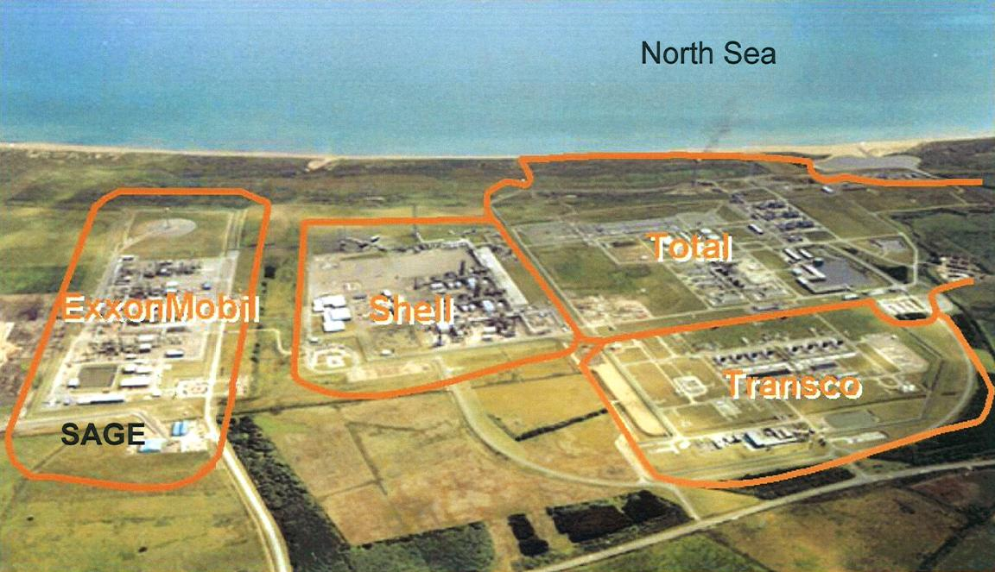
St Fergus Sub-terminals
NSMP
Shell
St. Fergus
Apache
SEGAL
Nat Grid

Slide 5
Occurrences when the St Fergus NSMP terminal CO2 limit could have been above 4mol%
Total of 8 separate “total” outages of the Laggan Tormore fields since start up of twin compressor operation in May 2016
Laggan Tormore blend gas was unavailable only 4% of the time.
Rhum owners however required to purchase firm volumes of low CO₂ Norwegian gas 100% of the time to mitigate against the risk of these unplanned outages causing breach of 4mol% CO₂ limit at the NSMP NTS Entry Point
The cost of purchasing this blend gas is prohibitive to Rhum and will lead to early CoP of both Rhum and Bruce fields.

Slide 6
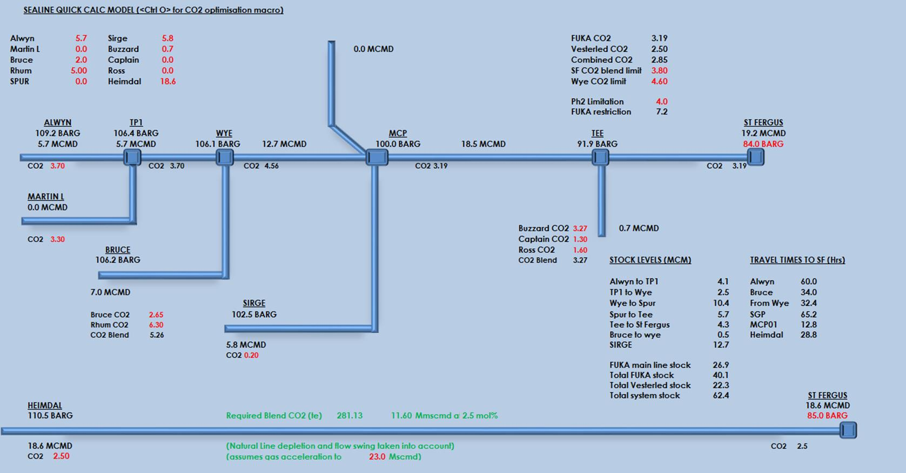
Example Operational flows at St Fergus NSMP terminal

Slide 7
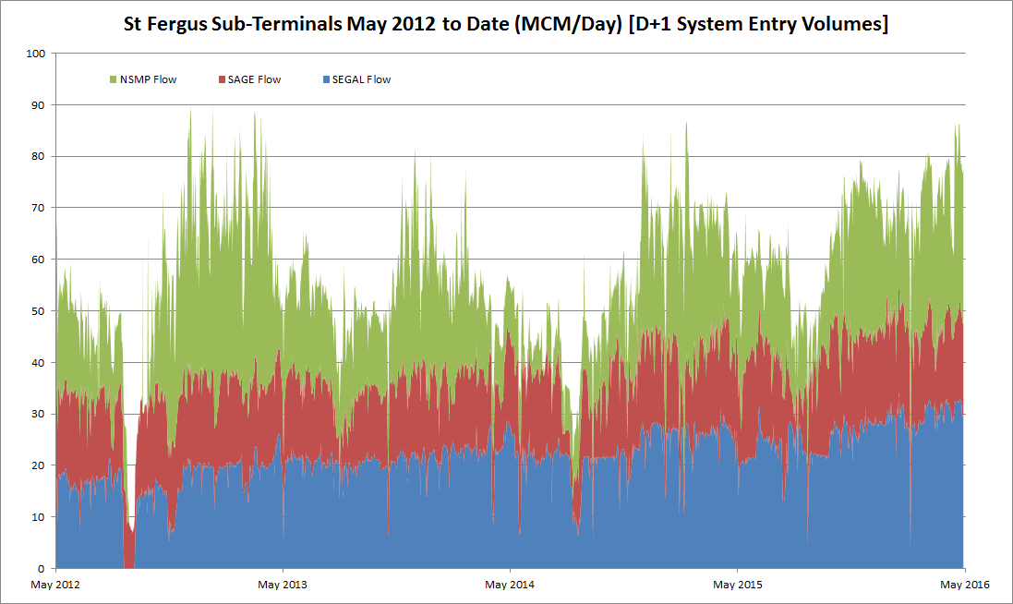
St Fergus Sub-Terminals System Entry Volumes
(May 2012 – May 2016)
Between May 2012 and May 2016 there were only 3 unplanned days when both SAGE and SEGAL were unavailable simultaneously (frequency of 0.2%).
NB: NSMP sub-terminal also shutdown in this period

Slide 8
St Fergus CO₂ Blending Analysis
Typical “Summer Norm” Day
M. Kirkpatrick

Slide 9
Summer Norm– Reference Day 30 June 2016
NTS Blending Scenario 1
This scenario imagines an offspec event on an ordinary summer’s day, using actual average flow rates from SAGE and SEGAL, but adjusting NSMP flows.
It assumes that flows are stable except for Laggan Tormore tripping
SAGE flow rate of 20MCM/d at 4% CO2 (No blending benefit)
SEGAL flow rate of 18.3MCM/d at 1.6% CO2 (entry spec)
Vesterled is flowing 8.2MCM/d at 4% CO2 (No blending benefit – assume some Valemon gas is flowing)
Frigg system is flowing near maximum rate (30MCM/d) until:
Laggan Tormore trips – zero flow for 60 hours
CO2 peaks out at 3.65%

Slide 10
Summer Norm– Reference Day 30 June 2016
NTS Blending Scenario 2
This scenario imagines an offspec event on an ordinary summer’s day, using actual average flow rates from SAGE and SEGAL, but adjusting NSMP flows.
It assumes that flows are stable except for Laggan Tormore tripping
SAGE flow rate of 20MCM/d at 4% CO2 (No blending benefit)
SEGAL flow rate of 18.3MCM/d at 1.6% CO2 (entry spec)
Vesterled is flowing 8.2MCM/d at 4% CO2 (No blending benefit – assume some Valemon gas is flowing)
Frigg system is flowing at high rates (23MCM/d – Alwyn is offline) until:
Laggan Tormore trips – zero flow for 60 hours
CO2 peaks out at 3.78% CO2

Slide 11
Summer Norm– Reference Day 30 June 2016
NTS Blending Scenario 3
This scenario imagines an offspec event on an ordinary summer’s day, using actual average flow rates from SAGE and SEGAL, but adjusting NSMP flows.
It assumes that flows are stable except for Laggan Tormore tripping
SAGE flow rate of 20MCM/d at 4% CO2 (No blending benefit)
SEGAL flow rate of 18.3MCM/d at 1.6% CO2 (entry spec)
Vesterled is flowing 8.2MCM/d at 4% CO2 (No blending benefit – assume some Valemon gas is flowing)
Frigg system is flowing at mid rates (21MCM/d – Alwyn is offline and Rhum has reduced to 3.5MCM/d) until:
Laggan Tormore trips – zero flow for 60 hours
CO2 peaks out at 3.66%

Slide 12
Summer Norm– Reference Day 30 June 2016
NTS Blending Scenario 4
This scenario imagines an offspec event on an ordinary summer’s day, using actual average flow rates from SAGE and SEGAL, but adjusting NSMP flows.
It assumes that flows are stable except for Laggan Tormore tripping
SAGE flow rate of 20MCM/d at 4% CO2 (No blending benefit)
SEGAL flow rate of 18.3MCM/d at 1.6% CO2 (entry spec)
Vesterled is flowing 8.2MCM/d at 4% CO2 (No blending benefit – assume some Valemon gas is flowing)
Frigg system is flowing at disrupted rates (22MCM/d – Alwyn is offline and Bruce has reduced to 1.5MCM/d) until:
Laggan Tormore trips – zero flow for 60 hours
CO2 peaks out at 3.87%

