Slide 1
EU Third Package: background and recent developments
15th April 2010
UNC Panel
European Strategy team

Slide 2
Third Package – overview
Euro Network Codes
Legally binding
Drafted by TSOs
EU funded body
Consumer
ACER
Independent
Power to investigate and impose sanctions
Non-discriminatory prices
Change supplier w/in 3 weeks
Framework for NRA Cooperation
Approved by ACER
NRAs
Unbundling
OU model
ISO model
ITO model
Derogation
DECC to lead on implementation
September 2009 - Became law
March 2011 -
Implementation deadline
Ofgem acts in advisory capacity

Slide 3
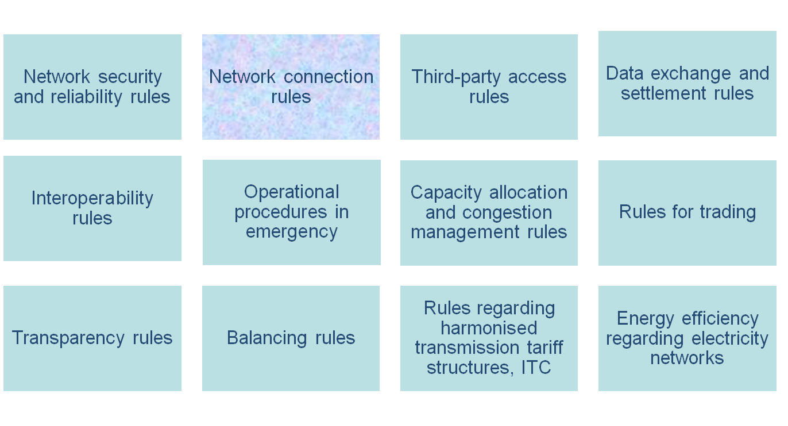
European network codes
To cover cross-border issues – with does this mean in a single market?;
Will be legally binding – and take precedence over national rules;
Through ERGEG, we are working on framework guidelines (FGs) for the codes.
System Operation FG
Connection FG
System Operation FG
System Operation FG
Wholesale Market FG
Market Information FG
Balancing FG
European Tariff FG
Code development
2012
May 2009
(or through Commission comitology proceedings)

Slide 4
Process for Network Codes development
ENTSO
Commission
Agency
ENTSO Work Programme
Agency
Commission
6 months
Preparation of
framework
guidelines
Framework
guidelines
Preparation of
network codes
Commission
12 months
Draft code
Agency
Commission
Industry Codes
impact & changes
6 months
First Network Codes: 2012+
Comitology
Legally binding
codes
Notes:
The ENTSOs (European Network of Transmission System Operators) are the successors to the various regional TSO associations which existed in the EU area prior to June 2009. Every TSO is a mandatory participant in the ENTSOs. The ENTSOs (ENTSO-E for the electricity association and ENTSO-G for the gas association) were formed after the regional associations were dissolved and have a wide remit, including the development of the European network codes.
As the diagram shows, the ENTSOs are expected to produce annual work programmes which will set out, amongst other things, their network development plans (a 10-year plan to be updated every two years). ACER will use the details of work programmes to establish the framework guidelines, with input from the EU Commission through each step of the process.
The preparation of the detailed codes will occur after the guidelines are in place and could potentially take some time. Should certain details be unresolved, the Commission could undertake a comitology exercise (resolving issues through a committee of representatives from the member states) prior to the codes having binding effect.
The current aim is that the European codes are effective in 2012. The codes will address cross-border issues but, in terms of their impact across the whole EU area, there is likely to be a knock-on effect on national codes which will need to be addressed through code changes. The exact impact will not emerge until closer to the finalisation of the European codes.

Slide 5
Unbundling
We are required to certify TSOs according to one of the options…
Ownership unbundling (OU)
Apply to all future TSOs
Same person may not control prod/gen/supply and “exercise any right over” a TSO (and vice versa)
Independent System Operator (ISO)
Only for existing transmission systems
Deeper than BETTA – investment decided by SO and approved by NRA
Independent Transmission Operator (ITO)
Only for existing transmission systems
Strong regulatory oversight into governance and investment
Derogation
Only for existing transmission systems
Where the arrangements guarantee more effective independence of the TSO than the ITO model
Notes:
There are three potential models for unbundled network ownership as highlighted in this slide. In each case, the requirement is that network owners’ interests are separated from any other interests in gas production, electricity generation and energy supply.
The first model applies to future TSOs and seeks to achieve full ownership unbundling. The exercise of control or a right over other interests is to be excluded.
The second and third models are applicable to existing transmission systems where the affected transmission systems belong to a vertically integrated undertaking on 3 September 2009 (the date the 3rd Package came into force). Unbundling can be achieved either by appointing an Independent System Operator (the ISO model) which would have significant powers over investment, or by compliance with the Independent Transmission Operator (ITO model) which allows vertical integration but with effective separation of the TSO from other interests i.e. Chinese walls.
Under the 3rd Package, National Regulatory Authorities are to certify that transmission system owners, including interconnectors (and possibly offshore transmission operators ), comply with one of these unbundling requirements. Where there is already more effective independence for other interests than under the ITO model, a derogation may be sought from the national regulator.
Ofgem intends to proceed with a consultation on how to address the certification of TSOs in due course.

Slide 6
National Regulatory Authorities (NRAs)
NRAs powers and duties include
Promote competitive, secure and environmentally sustainable internal market
Develop competitive and functioning regional markets
Promote restrictions on cross-border trade
Ensure consumer benefit
NRAs’ key features
There should be a single NRA at national level
Independent from government (NRA shall not “seek or take direct instruction” from government)
Decisions to be autonomous
Notes:
The NRAs are effectively the national regulatory bodies that already exist in EU member states and include the Gas and Electricity Markets Authority (GEMA). The powers and duties of the NRAs are set out in this slide. One impact on GEMA will be that it will have to take account of the effect on cross-border trade in its decisions as well as help to promote greater market integration.
Many of the Authority’s duties will take on an increasing European dimension because of the potential cross-border effect. These duties include:
fixing and approving, in accordance with transparent criteria, network charges and charging methodologies;
ensuring that market participants comply with their EU law obligations ;
cooperating with NRAs in other member states and with ACER concerning cross-border issues;
complying with, and implementing, any relevant legally binding decisions of ACER and the Commission;
monitoring investment plans of TSOs;
monitoring transparency within the national market, e.g. regarding wholesale prices; and
monitoring the levels and effectiveness of market opening and competition in wholesale and retail markets.
The NRAs are to have independence from governments and can make autonomous decisions. However, the practicality of doing so in all cases could be restricted where a government places a public service obligation on market participants, e.g. regarding security of supply, the quality and price of supplies and environmental protection, and this complies with EU law.

Slide 7
Consumer provisions
Change of supplier to be effected w/in 3 weeks;
Consumer to be supplied at transparent and non-discriminatory prices; and
Information on actual consumer frequently enough to allow consumer to enable consumer to regulate own consumption.

Slide 8
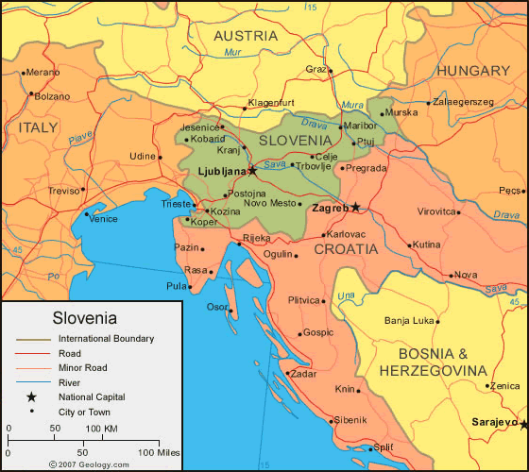
Agency for the co-operation of Energy Regulators
Operational by March 2011;
Organised into:
Administrative Board
Board of Regulators
Board of Appeals
Main functions
Develop a regulatory regime for cross-
border infrastructure;
Set the Framework Guidelines for/provide opinion on European Network Codes; and
Exemption decisions on infrastructure crossing at least two countries (last resort power).
Each NRA to have 1 vote on Board of Regulators
Welcome to Ljubljana…
Notes:
ACER was established by regulation and came into effect with the rest of the 3rd package in September 2009.
ACER will comprise an Administrative Board to oversee its budget and administration including two units, one for gas and another for electricity, headed up by an overall Director , a Board of Regulators to provide opinions or decisions on matters such as the development of the European network codes where it is advising various European entities (ENTSOs , European Commission), and a Board of Appeals which will hear appeals against any specific legally-binding decisions made by the Agency. The members of the Administrative Board will be appointed by the EU Commission, EU Parliament and EU Council. Each member of the Board of Regulators will come from a national regulator and the members of the Board of Appeals will come from member states’ regulators or competition bodies who have suitable energy sector experience.
ACER’s functions will be advisory although it will take a leading role in setting the framework guidelines which the ENTSOs will follow in developing the European network codes. Where NRAs are in dispute over cross-border issues and request ACER’s involvement, ACER will consider and consult and then provide a decision within 6 months. ACER may provide a ‘peer review’ opinion to the Commission on whether NRA decisions comply with EU law. ACER will also be able to make decisions on whether to exempt new gas infrastructure that crosses more than one border from the internal market rules for natural gas.
As noted, each NRA, including GEMA, has a seat on the Board of Regulators.

Slide 9
Questions?
Comments?
Siobhan.Carty@ofgem.gov.uk
020 79017112

