Slide 1
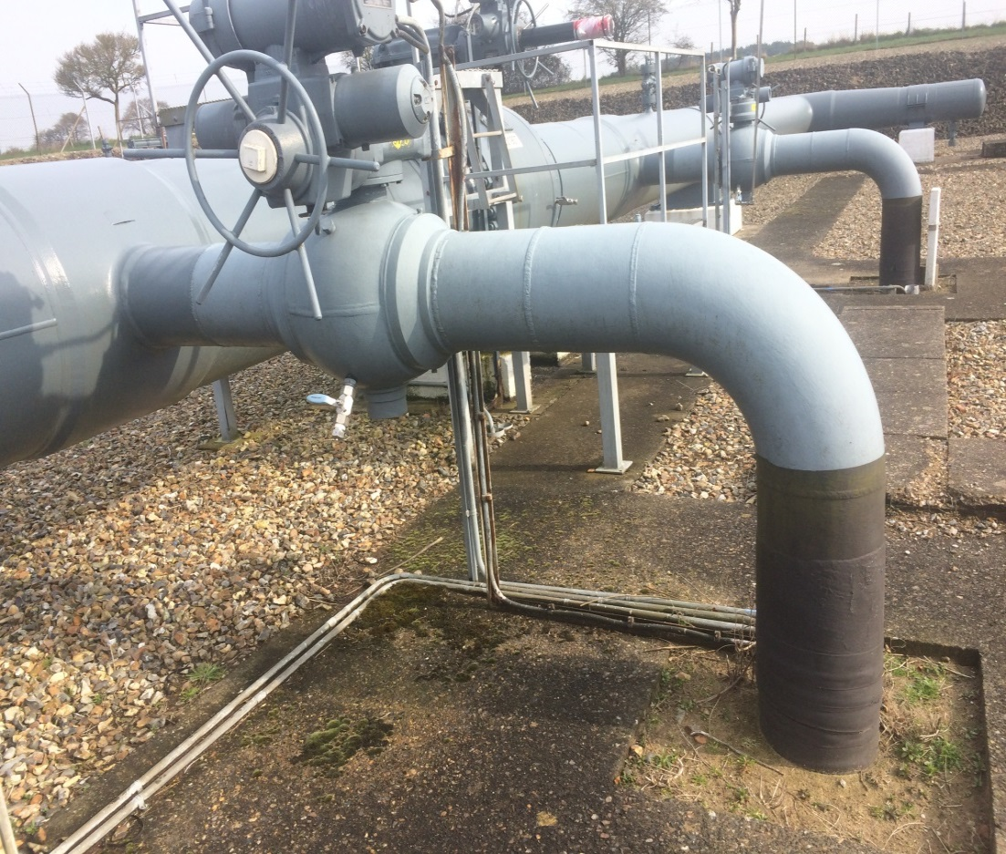
Proposed Changes for OAD Maintenance Requirements
Darren Dunkley
January 2024

Slide 2
OAD Maintenance Requirements Key Drivers
The OAD maintenance requirements have not been modified since they were first implemented in 2005. Change is necessary to ensure these are fit for purpose going forward and for consistent application between network operators.
The key drivers for the need for change are:
The stated maintenance requirements do not support how operators, plan, schedule and deliver maintenance in line with industry and engineering governance requirements;
Some arrangements create inefficient and non-value adding requirements for operators to comply with;
It is unclear, unambiguous and inconsistent as to what maintenance must be notified between operators:
Further requirements are needed to distinguish the difference between NRO and non-NRO maintenance activities.
The impacts arising from maintenance activities are the same as those for OAD Notice’s so alignment is necessary.
The planning process, as stated in OAD, requires amending following agreement at the 2018 workshop
The Maintenance template also requires revamping along with the maintenance definition types
Clear delineation between Maintenance requirements and the OAD Notification process is needed to ensure activities are reviewed by the respective staff in each organisation and consent ascertained via the correct process mechanisms, as these can and do differ between operators.

Slide 3
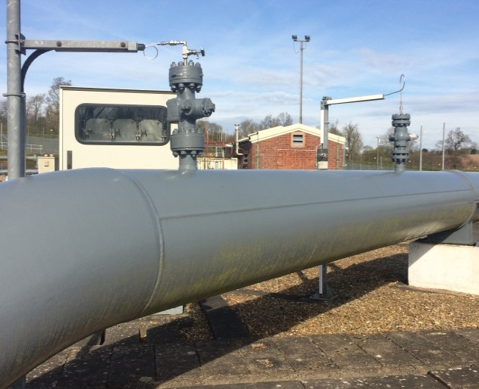
OAD Maintenance Requirements Other Key Considerations
Section G within OAD covers the maintenance requirements for operators to comply with for Offtakes and OAD Shared Sites.
However, there is a linkage between OAD Section G and the NTS maintenance requirements as located in TPD Section L.
The review of OAD Section G will need take into consideration the requirements set out in TPD and ensure any new requirements dovetail accordingly.
There is no intention, as part of this review, to propose any amendments to TPD.

Slide 4
OAD Maintenance Requirements High Level Overview
Summary:
The operators have already initially reviewed the potential modifications to OAD Section G as part of the work undertaken via the 0646r Work Group that was established back in 2018.
A workgroup was held between the operators in late 2018 to review the initial maintenance proposals and recommend a way forward. The proposed changes were put on hold by the 0646r workgroup as the modifications under 0683 were prioritised instead.
During the period since 2018 a more detailed understanding, through experience of managing the Shared Maintenance Plan requirements, has been developed by the proposing party Cadent.
The key requirements behind the initial proposal has not fundamentally changed but the experience to date will help shape and assist in developing the requirements that need to be amended so that these will be fit for purpose going forward.
A summary of the high-level requirements are shown opposite.
Review Maintenance Definitions and “Relevant Maintenance” categories.
Separate the Section G maintenance requirements from the OAD Section B notification requirements.
Align Maintenance impacts with those as defined in OAD Section B2.2.3 for consistency.
Distinguish the requirements between NRO and non-NRO maintenance activities;
Define and confirm the maintenance activities within each category
develop the appropriate arrangements for each category.
Revamp the maintenance notification processes:
Incorporate outcomes from 2018 workshop
Amend the arrangements for Maintenance Programme Revisions
Remove any Maintenance Reporting requirements
Amend the arrangements for Maintenance Postponements
Amend the common template (Annex G1) for sharing maintenance plans
Review the arrangements under “Urgent Maintenance”

Slide 6
OAD Maintenance Requirements High Level Overview Definitions
Clause | Issues
Section G1.2.1 - Relevant Maintenance is defined as follows: Safety Relevant Maintenance Flow Relevant Maintenance Maintenance the carrying out of which by the downstream Party has or is likely to have a significant effect on the flows of gas at an Offtake Measurement Equipment Maintenance Maintenance that requires the opening of an NTS or LDZ Closed Offtake. Maintenance of an LDZ Offtake under specific conditions | No operator refers to these definitions as part of Maintenance Sharing process. From experience, focus tends to be on Flow Restriction Maintenance and In-line Inspection activities whilst other maintenance categories are not mentioned or provided. The impact criteria for what type of maintenance needs to be notified is not explicitly clear. In Clause G2.1.1 to just refers to the “affected party” and no further details as to what “affected” constitutes.
Suggested Approach:
The suggested approach is to categorise the activities by the activity type that operators refer to these by i.e. Routine Maintenance and Non-Routine Maintenance. By defining the activities that will fall under Routine Maintenance and Non-Routine Maintenance, these will be clear and consistent across operators as to what should be included in their Maintenance Plan Submissions. The impacts for assessing whether the maintenance should/should not be notified ought to be the same as the criteria for OAD Notifications that are stated in OAD Section B2.2.4.

Slide 7
OAD Maintenance Requirements High Level Overview Definitions – Routine/Non Routine
Clause | Issues
Section G1.2.1 - For the purposes of this Document, maintenance (of the NTS or an LDZ) to be carried out by any Party is "Relevant Maintenance" in relation to another Party (the "affected" Party) where such maintenance: is maintenance ("Safety Relevant Maintenance") which can be carried out safely only if the affected Party is aware of the carrying out of such maintenance (whether such maintenance is of a routine or non-routine nature); | Routine / Non routine maintenance is referred as being under the “Safety Relevant Maintenance” definition only but these activities also extend to the other definitions found within G1.2.1 e.g. “Flow Maintenance”; “Measurement Equipment Maintenance” and “Closed Offtake Maintenance”
Suggested Approach:
The activities for Routine / Non routine maintenance can be defined and will be consistent across all operators. For Non-Routine activities these will include Flow Restrictions (further definition required); ME2’s; USM Calibration Maintenance; In-line Inspections; F-Schedules, Filter Maintenance; Mandatory PSSR Maintenance + any other activities that can be identified by operators. These can have a potential significant impact upon the other operator which is why an NRO is required in order to manage the associated risk. For Routine Maintenance, these are maintenance activities that are undertaken by an operator under their suite of engineering policy procedures. These do not require NRO’s, PTWs or FOAs but any routine activity that ticks the impact criteria should be included in the maintenance submission. The impact to the other operator is normally minimal but notice is required in case any adverse requirements occur. An operator should be trusted to complete such maintenance in line with their governance requirements. However, new arrangements will need to be developed to enable an operator to request that an asset has been maintained accordingly from another if an asset is seen to be impacting upon another operator’s operations.

Slide 8
OAD Maintenance Requirements High Level Overview Programme Planning Requirements 1
Clause | Issues
Section G2.2.1 - Planning cycle 2.2.1 Each Party (as planning Party) shall: prepare, and provide to and consult with the affected Party in relation to, a draft Maintenance Programme, setting out the Relevant Maintenance which such Party proposes to carry out in the relevant period; prepare (consistent with paragraph 2.2.6) and provide to the affected Party a final Maintenance Programme; and update such Maintenance Programme to take account of all planned changes to such maintenance, and provide such updated Maintenance Programme to the affected Party; periodically in accordance with (and in relation to the periods, and by the times specified in) the applicable part of Annex G-2. | The existing process as shown in Annex G2 does not appear to consider how downstream operators review, sanction and confirm their maintenance requirements. These are often formalised towards the end of financial year and therefore it is very difficult for DNO’s to provide any meaningful content at the start of the process in October each year. The operators agreed at the 2018 workshop to amend Annex G2 so that the Maintenance Plan process would be initiated by National Gas Transmission. However, the whole process requires a review to ensure that it aligns with any existing processes and aligns also with the process in TPD Section L.
Suggested Approach:
The operators agreed at the 2018 workshop to amend Annex G2 so that the Maintenance Plan process would be initiated by National Gas Transmission. A proposed alternative process is shown below: 30 November - NGT issue Indicative maintenance information for next summer plan and 24 months from the subsequent 1 April onwards 15 January - DNO’s to issue Indicative maintenance information for next summer plan and 24 months from the subsequent 1 April onwards 28 February - NGT issue 2nd Draft for comment for next summer plan and 24 months from the subsequent 1 April onwards 15 March - All operators to confirm Final maintenance plans April - Operators to review plans and identify any site/activity conflicts that may need to be resolved 30 April - Final Consolidated maintenance plans to be issued but only if updates have been necessary due to identified conflcts 30 June - NGT Draft update (Winter Plan) 6 months from next 1 October 15 September - NGT Final update (Winter Plan) 6 months from next 1 October

Slide 9
OAD Maintenance Requirements High Level Overview Programme Planning Requirements 2
Clause | Issues
Section G2.2.7 The planning Party may, but shall not be required to, prepare and provide to other Parties a consolidated Maintenance Programme containing maintenance which is Relevant Maintenance for all such Parties. Section B2.2.5 Any works carried out by a Party in connection with the alteration or replacement of any Connection Facilities shall be planned and carried out as Relevant Maintenance in accordance with Section G. | OAD implies that the issue of the annual Maintenance Plan should contain both maintenance items and those as notified via Section B OAD Notices. From experience, maintenance plans issued by other operators do not contain this consolidated approach. There is a risk that where planned future investment activity is notified via the maintenance route, that results in modifications taking place on site, that this is seen as the formal notification by one operator and bypasses the OAD Notice process as described in OAD Section B.
Suggested Approach:
The suggested approach is to keep the OAD Maintenance process in Section G separate from OAD Notice requirements in Section B. This will see the word “consolidated” removed from clause G2.2.7 and will also align with operators current working practices for these respective OAD requirements. By defining precisely the requirements for Non-Routine and Routine maintenance there is clear delineation as to what activity needs to be notified as maintenance, and those that will need to be as modifications (or investment led activity) and thus avoid any confusion between operators. However, as part of the Maintenance submission process, if any maintenance activity was inadvertently missed that should have been included on the annual plan, rather than re-issue the whole plan again it is recommended that such activity should be raised as an individual Section B OAD Notice if there is an impact to another operator,

Slide 10
OAD Maintenance Requirements High Level Overview Programme Planning Requirements 3
Clause | Issues
Section G2.4 - Revision of Maintenance Programmes Section G3.4 - Urgent Maintenance | It is accepted that revised maintenance plans may need to be issued as maintenance plans can and often change. However, the arrangements currently within OAD seem burdensome especially if maintenance has been inadvertently missed from the annual plan. Where Urgent Maintenance is necessary this is often a result that the maintenance requirements were not known at the time the plan was drafted and reviewed, or maintenance needs to be brought forward to maintain the safe operation or integrity of the affected asset.
Suggested Approach:
The suggested approach is that as the activities under Non-routine and Routine activities can be defined operators should be able to provide indicative maintenance programmes based upon the annual maintenance plan (AMP) processes. If changes are required, due to maintenance activities being missed it seems unnecessary to have to re-issue the whole plan again which will require the other operator to review and agree the content. To avoid this, the missed maintenance can be notified via the OAD Notification process instead. This is likely to impact Non-Routine maintenance items rather than Routine maintenance. For Urgent Maintenance, operators can utilise the Emergency NRO process that is already in place depending upon the severity of the situation in hand. If the severity is not so high, to avoid a separation notification being issued and/or the re-issue of the entire maintenance plan, again the OAD Notification process could be utilised for this purpose instead.

Slide 11
OAD Maintenance Requirements High Level Overview Other Requirements
Clause | Issues
Section G2.6 – Maintenance Reporting Section G3.3 - Postponement of maintenance | The arrangements under Section G2.6 state that the downstream operator must provide to the upstream party a monthly report in relation to Measurement Equipment Maintenance. None of the operators undertake this requirement at present and it does not seem like it would add any value either. Where Urgent Maintenance is necessary this is often a result that the maintenance requirements were not known at the time the plan was drafted and reviewed, or maintenance needs to be brought forward to maintain the safe operation or integrity of the affected asset.
Suggested Approach:
The suggested approach is that the Maintenance Reporting and Postponement of Maintenance requirements should be removed. The majority of the Measurement Equipment maintenance is undertaken as Routine maintenance and for some operators ME2 maintenance is undertaken as Non-Routine. As per the proposals for Routine and Non-Routine maintenance, ME2 activity will be confirmed on the Maintenance Plans whilst the Measurement Equipment maintenance would not be confirmed unless it has impact upon another operator. An operator should be trusted to complete such maintenance in line with their governance requirements. However, new arrangements will need to be developed to enable an operator to request that an asset has been maintained accordingly from another if an asset is seen to be impacting upon another operator’s operations. There are also existing provisions under OAD Section D concerning Measurement Equipment requirements, their maintenance of and validation processes if there are any concerns regarding Measurement Equipment assets.

Slide 12
OAD Maintenance Requirements High Level Overview Reporting Template
Clause | Issues
The reporting template is detailed in Annex G-1 Minimum details for Maintenance Programme: location of works; affected Offtakes; dates of works; type of maintenance (whether Safety Relevant Maintenance, Flow Relevant Maintenance and/or Measurement Equipment Maintenance); and ( reasonable details of the works. | Operators provide different information and formats. A common approach is recommended.
Suggested Approach:
The suggested approach is that the Annual Maintenance Plans contain the following information; Site Offtake Type – (this would be either NTS; LDZ or Shared Site Maintenance/Work Description Impact – (this would be Measure Equipment Maintenance, Flow Restriction; Site Restriction; Electrical Impacts; Telemetry Impacts etc) Start Date Finish Date Planned Year Additional Information The above structure can be applied for both Routine and Non-Routine activities.

Slide 13
OAD Maintenance Requirements Next Steps
All operators agreed that amendments to the OAD Maintenance arrangements were necessary as part of 0646r.
To ensure that any submitted Modification is processed as efficiently as possible, the operators need to review and agree the broad scope of the proposed amendments within this presentation before proceeding to develop the respective business rules.
It is recommended that this dialogue is facilitated via the Offtake Arrangements Workgroup (OAW) with a view that the business rules can be agreed by spring 2024 and a formal modification processed by late 2024.
If the principles can be agreed in time these can be tested as part of the 2025 Shared Maintenance Plan submissions.

Slide 14
Feedback Dialogue, questions or concerns

