Slide 1

WWU discussions
Related OAD docs
January 2024

Slide 2

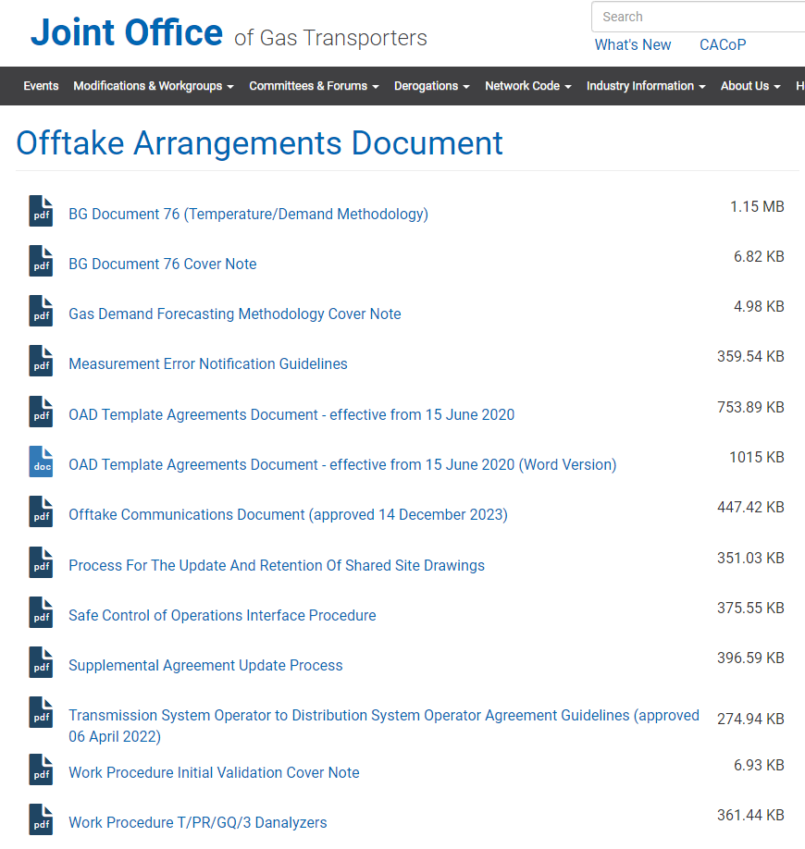
Discussion
Background
  The increased focus on physical and cyber security is leading to the implementation of new processes and systems within networks
  The Safe Control of Operations Interface Procedure is recognised as needing an update
  The Transmission System Operator to Distribution System Operator Agreement Guidelines is due for review and already on the agenda
Issue
  Following discussions at WWU, concerns have been raised around the appropriateness of keeping these documents in the public domain given the level of information contained on potentially sensitive processes and systems
Proposal
  Update the documents between networks
  Leave placeholders for the documents in the OAD database so that references remain whole
  As a minimum redact all information in the public versions and make reference to where the full versions are held, ideally remove altogether (for discussion)

