Slide 1
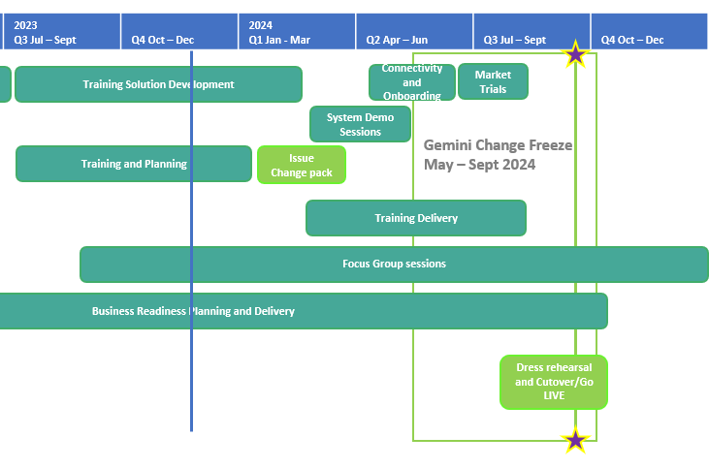
XRN5564 Gemini Sustain Plus
December 2023 ChMC Dashboard |  | Overall Project RAG Status
 |  | Schedule | Risks and Issues |  | Cost
RAG Status
Status Justification
Schedule | Overall RAG status is Amber. Gemini Sustain Plus is currently tracking to re-planned timescales. Programme Overview:​ Continuing to progress development and various testing phases for Capacity, Energy Balancing and Invoicing processes. The build for the new Gemini interfaces is underway. Detailed planning has commenced for end to end testing. Proposed log on/security profiles are being finalised ahead of socialising with internal NG teams and industry Training content has continued to be developed. Completed extraction of all legacy Gemini services. We hosted the November Focus Group where we saw an increase in attendees and organization numbers. We started to share information on Condensed Gemini user roles, API’s and more detailed information on phases coming up on the programme. Programme next steps: Continue development and testing of the Gemini process of functional components through the Agile development cycle. Continue to work with the Platform team for the interface build. Planning of end to end and Systems integration Testing will continue Training content will continue to be developed. | Overall RAG status is tracking at Purple as project is now in re-planning phase due to the position that we will not be able to implement by 1st April 22. The project has continued with its planned activities alongside the replan. To support the re-plan activity the project is conducting a Gap Analysis exercise on the defined requirements to ensure we have a baselined position for Day 1 Implementation. An Impact Assessment will then be conducted against the change variations to support the re-plan activity UAT execution and assurance is in progress, revised completion date to be confirmed as part of re-plan Dual Run Preparation continues with Connectivity Testing and Master Data Readiness. Resolution of the Master Data Issue is a significant step forward to support Dual Run Testing and Data Migration approach for cutover Re-planning to be completed post completion of Gap Analysis activity with the intention to agree revised plan in March and present updated BER for approval at April ChMC Next Steps: Finalise Gap Analysis exercise with DNs and National Grid to agree Day 1 Must Have requirements & any decisions in order to meet a proposed Go Live date (Mid June 22) Define full re-plan based on Gap Analysis Impact Assessment and Business Readiness requirements Target to issue revised BER from replan for approval at the April 22 ChMC Risk of FWACV Imp to CSSC is in assessment, this is deemed low risk as there is no code conflict
 | Engagement Opportunities Gemini Sustain Plus Focus Group - The next focus group is the 22nd January. We will continue with a series of Focus Groups to provide valuable insight to operational and technical developments within the programme including demonstration of screen changes and improvements, enhanced user experience and technical updates as part of the delivery. Please contact geminichanges@correla.com if you are not receiving the invitations Market Trial - Q2 2024, it is essential all companies that use Gemini participate in Market Trials. Details and invitation to participate will be issued in 2024. Training - Q2 2024, essential training will be provided to access and use the new Gemini system. We are looking for shippers that are willing to engage in assisting with shipper-based Gemini processes to assist creation and development of the e-modules. To participate in the Focus Groups, Market Trials or training please contact: geminichanges@correla.com .
Scope | The re-platform and development of the Gemini application and its processes. Further information can be found on the Xoserve XRN5564 webpage. A dedicated webpage is now available with FAQs collated so far and will develop over the course of the programme. Gemini Sustain Plus (xoserve.com). | XRN5231 Flow Weighted Average (CV) Gemini consequential change part A - PRCMS validation/processing Gemini consequential change part B - LDZ Stock Change and Embedded LDZ Unique Sites

