Slide 1
Overrun Reporting
Transmission Workgroup
04 May 2023
National Gas Transmission |
Private & Confidential

Slide 2
Entry Overruns (Oct 22 –Feb 23*†)
ENTRY | No of Overruns |  |  | Charge Quantity (mcm) |  |  | Charge Amount (£)
 | 22/23 | 21/22 | 20/21 | 22/23 | 21/22 | 20/21 | 22/23 | 21/22 | 20/21
Oct | 585 | 541 | 319 | 19.14 | 17.66 | 10.84 | 544,726.06 | 540,668 | 270,470
largest (3) | User F |  |  | 3.13 |  |  | 95,641
 | User M |  |  | 3.23 |  |  | 90,586
 | User F |  |  | 0.66 |  |  | 18,533
Nov | 587 | 569 | 369 | 17.51 | 22.82 | 15.83 | 492,429.47 | 697,866 | 442,615
largest (3) | User N |  |  | 0.95 |  |  | 26,706
 | User N |  |  | 0.93 |  |  | 26,189
 | User N |  |  | 0.92 |  |  | 25,903
Dec | 561 | 514 | 403 | 15.13 | 14.68 | 7.63 | 424,832 | 412,650 | 180,741
largest (3) | User O |  |  | 0.87 |  |  | 24,485
 | User A |  |  | 0.67 |  |  | 18,772
 | User F |  |  | 0.57 |  |  | 15,882
Jan | 476 | 537 | 379 | 11.99 | 29.38 | 8.73 | 332,459 | 898,500 | 203,890
largest (3) | User M |  |  | 0.47 |  |  | 13,153.26
 | User F |  |  | 0.34 |  |  | 9,468.76
 | User F |  |  | 0.33 |  |  | 9,340.59
Feb | 439 | 462 | 410 | 11.61 | 9.67 | 8.31 | 326,407 | 295,747 | 196,899
largest (3) | User P |  |  | 0.52 |  |  | 14,689
 | User B |  |  | 0.31 |  |  | 8,580
 | User B |  |  | 0.30 |  |  | 8,311
Total | 2648 | 2623 | 1880 | 75.37 | 94.20 | 51.34 | 2,120,854 | 2,845,432 | 1,294,616
*Adjustments not included.
†Largest User by Charge Amount

Slide 3
Entry Overruns

Slide 4
Exit Overruns (Oct 22 – Feb 23*†)
Exit | No of Overruns |  |  | Charge Quantity (mcm) |  |  | Charge Amount (£)
 | 22/23 | 21/22 | 20/21 | 22/23 | 21/22 | 20/21 | 22/23 | 21/22 | 20/21
Oct | 139 | 174 | 137 | 11.97 | 7.97 | 9.11 | 866,740.11 | 104,048 | 111,795
largest (3) | User I |  |  | 0.89 |  |  | 758,924.06
 | User F |  |  | 0.04 |  |  | 31,001.76
 | User B |  |  | 5.27 |  |  | 15,313.39
Nov | 107 | 174 | 137 | 25.77 | 7.97 | 9.11 | 16,259,847.42 | 104,048 | 111,795
largest (3) | User K |  |  | 3.36 |  |  | 4,302,116.93
 | User K |  |  | 3.35 |  |  | 3,851,882.22
 | User K |  |  | 2.50 |  |  | 2,842,909.83
Dec | 135 | 190 | 398 | 10.85 | 10.67 | 8.53 | 130,468.18 | 125,350 | 96,008
largest (3) | User A |  |  | 1.80 |  |  | 25,829.37
 | User A |  |  | 1.43 |  |  | 20,537.05
 | User C |  |  | 1.03 |  |  | 14,874.62
Jan | 109 | 201 | 142 | 2.46 |  |  | 25,038.50 | 85,106 | 131,627
largest (3) | User B |  |  | 0.28 |  |  | 3,982.13
 | User F |  |  | 0.26 |  |  | 3,736.30
 | User F |  |  | 0.54 |  |  | 1,560.68
Feb | 94 | 181 | 166 | 2.28 |  |  | 35,379.25 | 83,295 | 92,832
largest (3) | User C |  |  | 1.10 |  |  | 15,819.39
 | User L |  |  | 0.19 |  |  | 6,169.20
 | User D |  |  | 0.11 |  |  | 1,586.63
Total | 584 | 920 | 980 | 53 | 27 | 27 | 17,317,473 | 501,848 | 544,055
*Adjustments not included.
†Largest User by Charge Amount

Slide 5
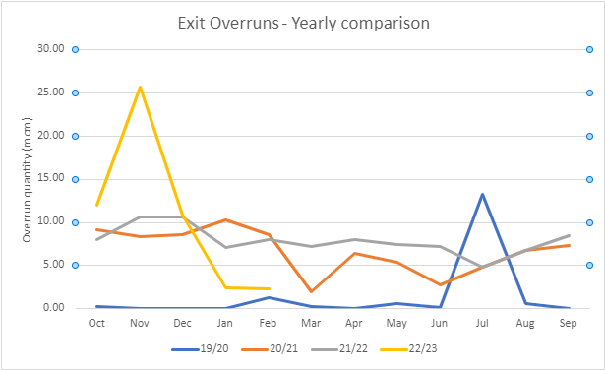
Exit Overruns

Slide 6
Thank you

