Slide 1
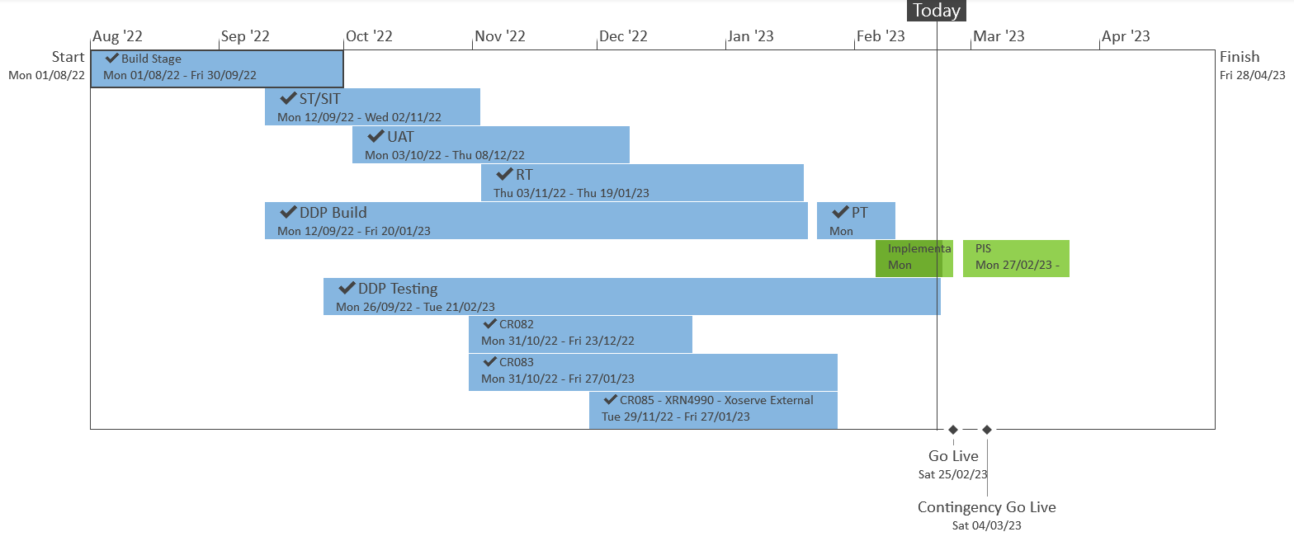
XRN5533 – February 23 Major Release - Status Update
 | Overall Project RAG Status
 | Schedule | Risks and Issues |  | Cost
RAG Status
Status Justification
Schedule | Overall release is tracking on target; Green, all UK Link testing completed on 17/02 as per plan. Currently on track to implement on 25/02 Progress update: Performance testing complete on 17/02 DDP testing for XRN4990 complete on 20/02 Implementation preparation in progress ready for planned go live on 25/02 Decision in March ChMC: None |  | Implementation date of 25th February; with a contingency implementation date of 4th March
Risks and Issues | There is a risk that the solutions being delivered under XRN4900 and XRN5298 may not work as expected at the point SGN go live with the Biomethane and H100 projects, due to the gap between these changes being delivered within the Feb 23 release and the respective go live dates of the projects. Update - SGN have confirmed that the first H100 connection will be sometime between June-Sept 2024. CDSP are awaiting further clarification regarding the go live date of the Girvan Biomethane project. Discussions are underway regarding options for carrying out additional testing closer to the project go live dates, which may incur additional charges that weren't originally accounted for.
Cost | Forecast to complete delivery against approved BER
Scope | XRN4900 - Biomethane/Propane Reduction XRN4978 - Shipper - Notification of Rolling AQ Value XRN4989B - Residual AMT activities XRN4990 - MOD0664 – Transfer of Sites with Low Read Submission Performance from Class 2 and 3 into Class 4 XRN4992B - MOD0797 - Last Resort Supply Payments Volumetric Charges XRN5298 - H100 Fife Project – Hydrogen Network Trial
Complete
On Track
At Risk
Overdue
Slide updated on 22nd February 2023

