Slide 1
REC Change
February 2022

Slide 2
Missing Messages
205 Missing Messages (as at 2nd February) – Last message 27th January 2023
3 messages of 5 in January were missed Cancellations – so will not require Registration in UKL
Highlighted CoMC escalation to RECCo, they have escalated to DCC
Secure Active Notification proxy reconciliation for Missing Messages identified by Xoserve expected w/c 6th February 2023
Further reconciliation with Switching Operator of messages not identified by Xoserve

Slide 3
Code Challenges – Missing Messages
Proposing to try and get the Registrations into UK Link as soon as possible
Phase 1 – suggestion to allow ‘Secured Active Notification’ proxy was confirmed at UNCC in November
Awaiting DCC to produce proxy Notification
Don’t expect a Code Mod to be required for this
No planned changes to UK Link Communications
February Progress Update:
Secure Active Notification proxy reconciliation for Missing Messages identified by Xoserve expected w/c 6th February 2023
Change pack 5535 part A that details the approach to these Registrations (and documents what has been discussed at CoMC / ChMC / DSG / Distribution WG / etc) will be issued 13th February 2023
Prospective Registration for Switches
Recommendation to resend BRN by the Proposing User (at least for backlog)
Proposing to write to all impacted parties to initiate the Registration in line with the Detail Design Change Pack in advance of approval at ChMC

Slide 4
Code Challenges – Missing Messages
Challenges – Phase 2:
Creation of Estimated Meter Read on CSS Registration Effective Date
Invoicing period
Use of R0067 Refresh functionality to act as prompt for Manual creation of Secured Active Notification by CDSP
February Progress Update:
Draft Mod issued to JO – hope that this will be presented to January Panel
Considers the above points
Also looking at whether a materiality test would be beneficial to parties

Slide 5
Introduction
The following 8 slides have been included in this months CoMC pack to give you an overview of the ongoing REC Changes, we have broken these down into the following sections:
In progress – we are currently progressing through the Change journey
Under Prioritisation Review by REC Code Managers – due to CM workload/prioritisation
We have included a new slide this month on the Changes which will be coming into our space in the next few weeks.
We believe the changes will require CDSP action and therefore need to draw attention to this demand as it will require prioritisation over other DSC changes in our Change Backlog
As agreed last month, I have also included REC related Changes which do not have an associated R00 number but do have an XRN.
Note: We are currently undertaking a review of all REC Change and have began removing Changes which we have confirmed have no impact to Gas services. In the coming months, we will continue to monitor the Changes listed and add/remove from this pack as required.
Further information on the Changes can be found on the REC Portal

Slide 6
Overview of REC Changes (high level)
In Progress Change
4

Slide 7
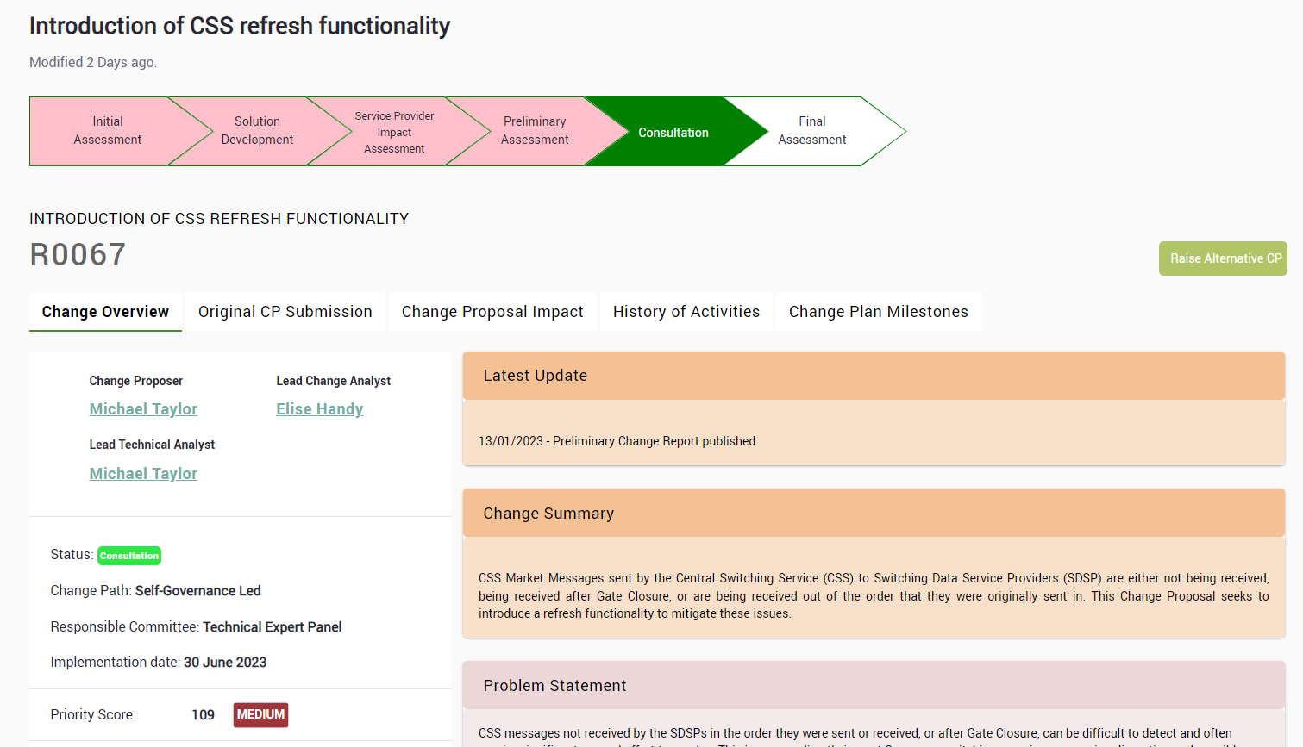
Overview of Change
CoMC asked us to provide additional commentary on the REC Changes …
REC Portal does provide a summary of the change, the links to each highlighted change are provided in the subsequent slides:
The following slides also include a GRDS summary of the change that highlights why we are monitoring changes and the potential impacts that we identify of changes to GRDS, and potentially impact to DSC Customers who are using other services through the REC. We have provided this to provide our view to assist DSC Customers, but recommend that parties do monitor the REC Change portal to form their own opinion regarding the impact to their organisation.

Slide 8
REC Change Pipeline – In progress
Title | Description | XRN / UNC Mod | Proposer | Impact/ Funding | Status | Next Action date | Release Type | REC Priority | Attachments
R0025 | Service Provider Performance Charges (DCC) | N/A | Deloitte (RPA) | - | Awaiting Authority decision | 01/04/2023 – Proposed Implementation date | Standalone | High
This Change was raised to introduce Service Provider Performance Charges linked to performance against service levels defined in the REC. We are monitoring this change as it references future performance charges on other service providers – including the GRDS.
R0047 | Metering Code of Practice Consolidation Review | N/A | RECCo | - | Approved - awaiting implementation | 01/04/2023 – Proposed Implementation date | Standalone | High | N/A
This Change was raised to to consolidate the current Metering Codes of Practice into a single set of arrangements. Although we are not a directly impacted party, if and when this takes place, we may need to adapt our interactions with MEMs, DNOs and Suppliers.
R0052 | GES Service Definition Document | N/A | Deloitte | GES | Approved - awaiting implementation | 24/02/2023 – Proposed Implementation date | Major, Feb 23 | Medium | N/A
This Change was raised to align the frequency of certain reports between the GES Service definition and the Retail Energy Code. As the GES Service provider, we need to monitor the outputs of this Change as we will need to amend the Service definition itself.
Key:
Please note that we have provided our view of the Change summary and impacts however we recommend that DSC Customers monitor the REC Portal to form their own opinion regarding the impact to their organisation
Currently working on
Upcoming
Monitoring

Slide 9
Title | Description | XRN / UNC Mod | Proposer | Impact/ Funding | Status | Next Action date | Release Type | REC Priority | Attachments
R0055 | Switching Operator Outage Notification Lead Time | XRN 5595 | DCC | GRDS, GES | Approved - awaiting implementation | 24/02/2023 – Proposed Implementation date | Major, Feb 23 | Medium | N/A
This is a documentation Change that was raised to align the outage notification time. The original time was 10 working days (WD) however in the CSS Provider’s (DCC) processes and the Switching Operator Change Management Process Category 3 document the notification time is 8 WD. As a result of this Change, as a Switching Data Service Provider, we need to amend processes surrounding interactions with the CSS Provider to allow for the revised 8WD notice.
R0063 | Addition of key information to all Service Now tickets | N/A | St Clements Ltd (on behalf of DNOs) | - | Solution development | 07/02/2023 – Solution Development closeout date | TBC | Medium | N/A
This Change was raised to improve the information that’s included on DCC’s Service Now Tickets which have been asynchronously rejected. We interact with DCC via SNow so we need to monitor and input into development.
R0067 | Introduction of CSS refresh functionality | XRN 5567 / UNC Mod expected | Capgemini (RTS) | GRDS | Consultation | 02/2023 –Technical Release planning 30/06/2023 – Legal text change implemented | Legal text – Major, June 23 Technical Change - Standalone | High
This Change will introduce a resend and refresh functionality to help with the message interactions between the CSS and Switching Data Service Providers. Currently, there are cases were messages are being received after Gate Closure or not being received at all. We are one of the impacted Service Providers which means this Change is very important to us so that we are able to complete customer switches successfully.
Key:
Currently working on
Upcoming
Monitoring

Slide 10
Title | Description | XRN / UNC Mod | Proposer | Impact/ Funding | Status | Next Action date | Release Type | REC Priority | Attachments
R0070 | Provision of Enduring Test Environments | N/A | Capgemini | GRDS, GES | Consultation | 02/02/2023 – Initial impact assessment due to be issued | Standalone | High | N/A
This Change was raised to introduce an obligation under the Retail Energy Code for the CSS or the Switching Operator (SO) to provide enduring test environments for REC parties to make the necessary system changes for REC Change Proposals (CPs) or internal system updates. We need to monitor this to ensure that the obligations on GRDS are understood, and that we contribute to the development of this change.
R0074 | Release of Community View Data Items to MEMs in GES | N/A | Xoserve | GES | Consultation | 22/02/2023 – Technical expert Panel review 24/02/2023 - Changes to the DAM 27/02/2023 – Functional Change planning | Changes to the DAM – Major, Feb 23 Functional Change - TBC | High
This Change was raised to enable MEMs to ‘Community View’ access to a limited set of data in the GES, for sites where they are not the appointed MEM. As the GES Provider we are heavily involved in the planning and delivery of this Change.
Key:
Currently working on
Upcoming
Monitoring

Slide 11
REC IA Demand
Title | Description | XRN | Proposer | Impact/ Funding | Status | Next Action date | Release Type | Priority | Attachments
R0048 | DCC Service Organisation Control 2 (SOC2) Assessments | N/A | DCC | - | Solution development | 17/02/2023 -Preliminary Change Report and consultation issued | TBC | Low
Currently, the CSS Provider is obligated to undertake system organisation control type 2 (SOC2) assessments on the CSS’s cloud-based infrastructure. This Change was raised to assess if the SOC2 assessment provides a proportionate level of assurance or the best value for money and if it should be change to ‘independently assessed’. We are monitoring to determine whether there are impacts to GRDS / GES.
R0073 | Introduction of a Housekeeping Change Proposal Process | N/A | Gemserv | - | Preliminary Assessment | 27/01/2023 - Preliminary Change Report and consultation issued | TBC | Low
This Change was introduced amend typographical errors, formatting, and consistency errors (such as Paragraph numbering), out-of-date references to documents and updating addresses (including email) in the Retail Energy Code. Although it is a housekeeping Change, we need to monitor it as it develops in case there are any amendments needed to our internal documents as a result or it creates inadvertent change.
R0088 | Make Shipper NExA values available on the GES portal | XRN 5186 MOD 0701 | Xoserve | - | New | 02/2023 - Impact assessment being issued (awaiting formal approval from Code manager before IA date is confirmed) | Major, June 23 to align with | Medium
XRN 5186 - Modification 0701: Aligning Capacity booking under the UNC and arrangements set out in relevant NExAs makes additional information available to GES Users which require reflection in the REC. Although all of the technical change has already been developed.
Key:
Currently working on
Upcoming
Monitoring

Slide 12
REC Related XRN Changes
Description | XRN | Proposer | Impact/ Funding | Status | Next Action date | Release Type | Priority
Processing of CSS Switch Requests Received in ‘Time Period 5 | XRN 5535A | Xoserve | GRDS | Under Development | Progression of BER / Design Change Pack | TBC | High
Resolution of Address Interactions between DCC and CDSP | XRN 5546 | Xoserve | GRDS | Under development | Regular conversations with DCC as work is ongoing | TBC | Medium
Key:
Currently working on
Upcoming
Monitoring

Slide 13
REC Change Pipeline – Under Prioritisation Review
Title | Description | Status
R0049 | Intellectual Property Rights and Services Data Main Body changes | Initial Assessment
R0051 | Switch Request Objections (Change of Occupier) | Initial Assessment
R0056 | EES/GES additional service request for Housing Associations to be added to the Matrix | Initial Assessment
R0059 | Maintenance of Qualification Schedule Change | Initial Assessment
R0068 | REC Data Protection Changes | Initial Assessment
R0069 | Amendments to Sample Access Agreement | Initial Assessment
R0071 | DCC access to EES and GES | Initial Assessment
R0073 | Introduction of a Housekeeping Change Proposal Process | Initial Assessment
R0075 | Enabling Software Product Qualification | Initial Assessment
R0080 | Improvements to "Failed to deliver" CSS messages | Initial Assessment
R0081 | CSS Market message retry strategy | Initial Assessment
R0082 | Formalising the Submission of PPMIP Unallocated Transaction Report (UTR) Files | Initial Assessment
R0084 | Housekeeping changes to the approved legal text for R0047 | Initial Assessment
R0085 | Switching Programme Designation of the Steady State Commencement Date | Initial Assessment
R0087 | MAP GES data access | Initial Assessment
R0089 | Removal of Pre-COVID AQ Value from Data Access Matrix | Initial Assessment
R0090 | Alignment of Data Specification with Pre-REC Rules and Consequential Impacts on R0011 Legal Text | Initial Assessment
R0091 | Clarifications to the Theft Detection Incentive Schemes | Initial Assessment

