Slide 1
Contract Management Committee
6. Monthly Contract Management Report August 2022

Slide 2
Contents
6.1 KPM Reporting (will be published Friday 12th August)
6.3 Monthly Contract Metrics
6.4 Incident summary
6.5 Customer Issue Dashboard
Appendixes

Slide 3
KPM Reporting (July reporting period)
Agenda item 6.1

Slide 4
Overall Summary
Performance Area | (Reportable) Achieved | (Reportable) Failed | Not applicable to the reporting month
KPMs (20 total) | 16 (@11th Aug) | 3 | 0
PIs (24 total) | 17 | 1 | 6
Failure Summary
KPM / PI Ref | Measure Detail | Journey / Process | Measure Type | Target | Performance | Failure / Remedial Action
KPM.01 | Percentage of shipper transfers processed | Manage Shipper Transfers | Right First Time | 100.00% | 99.92% | We completed 503,177 transfers in UK Link effective in July 2022. We processed 454,807 legacy confirmations and 48,370 CSS Switches. Performance is below 100% as delayed BRNs caused by the week one CSSC PIS AMT issues meant that 400 sites used default data to populate the ASN file rather than the Shipper provided values, as well as 10 transactions were impacted by the AMT special Characters issue, which affected the BRN and TMC files.
KPM.06 | Percentage processed within the Completion Time Service Level in DSC | Manage Shipper Transfers | Cycle Time | 100.00% | 99.92% | Performance is below 100% as week one CSSC PIS AMT issues meant we responded to 400 BRNs outside the 4 hour standard, and 10 transactions were impacted by the AMT special Characters issue.
KPM.07 | Percentage of requests processed within the Completion Time Service Level in DSC | Meter Read / Asset Processing | Cycle Time | 100.00% | 99.99% | 12,582,9270 reads and 254,934 asset updates were received. 3686 reads and 55 asset updates were not processed due to Exception processes.
PI.01 | % CMS Contacts processed within SLA (95% in D+10) | Manage Updates To Customer Portfolio | Cycle Time | 95% | 84.85% | Contacts such as ISOs and DTLs that require third party action continue to impact performance for the month, however the main reason for the D+10 target failure is due to the ever-increasing RFA volumes and the outstanding backlog. RFAs continue to be worked in a prioritisation order which is agreed between our Ops teams and our customers, which most of the time conflict with the chronological order of the RFA contacts landing into CMS.

Slide 5
DSC KPM (Credit and Risk)
Right First Time
Responsible | Frequency | Measure Detail | Target | Annual Target | May-22 | Jun-22 | Jul-22
Brendan Gill / Sharon Bright | Monthly | Energy Balancing Credit Rules adhered to, to ensure adequate security in place | 100% | 12/12* Months | 100% | 100% | 100%
Cycle Time
Responsible | Frequency | Measure Detail | Target | Annual Target | May-22 | Jun-22 | Jul-22
Brendan Gill / Sharon Bright | Monthly | % of revenue collected by due date | 98% | 98%​ avg rolling* 12 mth period | 99.59% (98.64%) | 99.79% (98.72%) | 98.89% (98.78%)
Brendan Gill / Sharon Bright | Monthly | % of revenue collected by due date (+2 days) | 100% | 12/12* Months | 99.61% (99.50%) | 99.81% (99.49%) | 100% (99.47%)

Slide 6
Monthly Contract Management reports and updates
Agenda Item 6.3

Slide 7
Performance monitoring (July 2022)
Third Party and Additional Services Reporting
Gemini Performance and UK Link Availability
Reporting area | Jul-22 | Year to date
Additional Services | £6,188.00 | £84,744.00
Third Party Services | £12,899.43 | 181,961.14
Gemini service Performance
Target | Actual
99% | 99.87%
UK Link Availability and Performance
 | Target | Actual
Batch Transfer | 99% | 100%
Service Desk Availability | 99% | 100%
All Transportation Invoice Charging obligations were achieved

Slide 8
Meter Count Report (July 2022)
Class | MPRN Count | Smart Count | Total | Smart %
1 | 619 | 0 | 619 | 0.00%
2 | 577 | 0 | 577 | 0.00%
3 | 177,833 | 4,556,245 | 4,734,078 | 96.24%
4 | 12,409,566 | 7,798,679 | 20,208,246 | 38.59%
Total | 12,588,595 | 12,354,924 | 24,943,520 | 49.52%

Slide 9
Customer Highlights
More Details on the Stories below can be found on the Xoserve Website:- https://www.xoserve.com/
Contact Management System (CMS) Disaster Recovery Test 2022
Notification of the annual disaster recovery test on 30th & 31st of July (published 25/7/22)
Guest Blog – Hydrogen Guarantees of Origin
Suki Ferris, Strategy Lead at National Grid explains the importance of hydrogen Guarantees of Origin (published 26/7/22)
Xoserve Business Plan – Final Principles & Approach 2023-2024
Notification of the publication of the Final Principles & Approach 2023-2024 of the Xoserve Business Plan (published 28/7/22)

Slide 10
Xoserve Incident Summary
Agenda Item 6.4

Slide 11
Summary
During July we experienced 2 P2 incidents
System Affected | Priority | Impact | Remedial Actions | KPM Breach | Resolved
Gemini | P2 | Users were unable to access Gemini via online screens. | Removal of problematic node from the cluster. Restart performed during the maintenance window. Node added back to the cluster. Extended monitoring. | No | Yes
AMT | P2 | Delays to processing and issuing of outbound files. | Application of 2 missing database patches which re-instated a missing routing table. | No | Yes

Slide 12
Customer Issue Dashboard
Agenda item 6.5

Slide 13
Summary
CSSC Files/Processes:
Since go live of CSSC, a few issues have been identified and communicated to customers.
Nine issues raised in total, six are closed (although monitoring will continue), three remain open.
Of the three open issues, two are with the vendor for resolution. The third relates to Portal & GES.
Missing Secured Active Messages (SAM’s) – over the past week we have seen instances of missing SAM’s not issued to Xoserve from the CSSP. Incidents have been raised and escalated. In total we have approx. 135 missing SAM’s (at the point of writing these slides). The CSSP have confirmed this is a defect and are working with Microsoft to fix. Any customers affected by this issue are being contacted.
GES/Portal
Main frustration for customers has been access and functionality issues with Portal and Gas Enquiry Service (GES)
Fixes were deployed on 4 August 2022; these mainly relate to LSO/MAU functionality and data related issues.
Sessions will be arranged week commencing 8 August 2022 with customer users to troubleshoot the access issues. We have and will continue to support technical triage sessions to understand root cause with these customers.
We recognise that the communications issued prior to go live were not sufficient and lacked information. This will be registered in lessons learnt and actions taken.
Non CSSC
AQ defects remains a concern, however, the volume of MPRNs impacted remains low. Most defects raised are being identified by the AQ team following monthly checks on high value AQs/sudden increases in AQ .

Slide 14
Open CSS UKLink Related Issues Impacting Customers
Issue Area | Issue Summary | Issue Status | Customers Impacted
Irregularities with File Sequence Numbering for new CSS files (BRR, TMC & ASN) | Issue within AMT MarketFlow when generating the file sequence number of the file, are not as per normal sequential numbering of files issued from UKLink. | AMT have confirmed today that the fix is in testing, however, have not yet been able to confirm when this fix will be released to us for deployment. | Shippers who receive file types BRR, TMC & ASR.
Users experiencing issues with Portal & GES | Customer users experiencing different issues relating to Portal & GES. | A number of fixes were deployed on 4 August. Calls will be set up with customer users to troubleshoot GES issues. These will begin to be scheduled from next week. | Range of customer users
Files unable to be issued due to ‘special characters’ contained within the file | Where a special character is included within a file, UK Link is not processing the file as expected, the file is processed; however, response files or notification files are not being submitted to the customer until special character is removed | AMT have confirmed they are testing a fix for this issue and will update us once they have results, in parallel we are investigating and testing our own temporary workaround fix in case resolution from AMT takes longer than expected. | All customers but current examples have affected Shippers only

Slide 15
APPENDIXES
Appendix 1 - KPM slides (item 6.1 will be published 11th August)
Appendix 2 - Xoserve Incident Summary (item 6.4)
Appendix 3 -Customer Issue Dashboard(item 6.5)

Slide 16
KPM Slides
Appendix1

Slide 17
DSC KPM Performance for July 2022
DSC+ Unique Identifier | Measure Detail | Journey / Process | Owner (CMT / SLT) | Measure Type | Volumes | DSC Target Metric | Jul-22
KPM.01 | Percentage of shipper transfers processed | Manage Shipper Transfers | Andy Szabo / Alex Stuart | Right First Time | 343,673 | 100.00% | 99.92%
KPM.02 | Percentage of meter reads successfully processed | Meter Read / Asset Processing | Andy Szabo / Alex Stuart | Right First Time | 116,837,766 | 99.50% | 99.98%
KPM.03 | % of asset updates successfully processed | Meter Read / Asset Processing | Andy Szabo / Alex Stuart | Right First Time | 493,060 | 99.50% | 99.98%
KPM.04 | % of AQs processed successfully | Monthly AQ Processes | Andy Szabo / Alex Stuart | Right First Time | 11,812,708 | 100.00% | 99.9998%
KPM.05 | Percentage of total LDZ AQ energy at risk of being impacted | Monthly AQ Processes | Andy Szabo / Alex Stuart | Right First Time | 70,355 | 0.75% | 0.43%
KPM.06 | Percentage processed within the Completion Time Service Level in DSC | Manage Shipper Transfers | Andy Szabo / Alex Stuart | Cycle Time | 343,673 | 100.00% | 99.92%
KPM.07 | Percentage of requests processed within the Completion Time Service Level in DSC | Meter Read / Asset Processing | Andy Szabo / Alex Stuart | Cycle Time | 126,260,859 | 100.00% | 99.99%
KPM.08 | % Notifications sent by due date | Monthly AQ Processes | Andy Szabo / Alex Stuart | Cycle Time | 9,443,968 | 100.00% | 100.00%
KPM.09 | % of invoices not requiring adjustment post original invoice dispatch | Invoicing DSC Customers | Andy Szabo / Alex Stuart | Right First Time | 2,848 | 98.00% | 100.00%
KPM.10 | % of DSC customers that have been invoiced without issues/ exceptions (exc. AMS) | Invoicing DSC Customers | Andy Szabo / Alex Stuart | Right First Time | 241 | 100.00% | 100.00%
KPM.11 | % customers DSC with less than 1% of MPRNs which have an AMS Invoice exception | Invoicing DSC Customers | Andy Szabo / Alex Stuart | Right First Time | 68 | 97.00% | 100.00%
KPM.12 | % of invoices sent on due date | Invoicing DSC Customers | Andy Szabo / Alex Stuart | Cycle Time | 2,848 | 100.00% | 100.00%
KPM.13 | % of exceptions resolved within 2 invoice cycles of creation date | Invoicing DSC Customers | Andy Szabo / Alex Stuart | Cycle Time | TBC 15/08 | 100.00% | TBC 15/08
KPM.14 | Number of valid P1 and P2 defects raised within PIS period relating to relevant change (excluding programmes) | Managing Change | Lee Foster / Andy Simpson | Right First Time | 0 | 0 | 0
KPM.15 | Number of valid P3 defects raised within PIS period relating to relevant change (excluding programmes) | Managing Change | Lee Foster / Andy Simpson | Right First Time | 0 | 4 | 0
KPM.16 | Number of valid P4 defects raised within PIS period relating to relevant change (excluding programmes) | Managing Change | Lee Foster / Andy Simpson | Right First Time | 0 | 5 | 0
KPM.17 | % of tickets not re-opened within period | Customer Contacts (technical) | Lee Foster / Neil Laird | Right First Time | 507 | 95.00% | 98.26%
KPM.18 | % of customer tickets (Incidents & Requests) responded to within SLA | Customer Contacts (technical) | Lee Foster / Neil Laird | Cycle Time | 2,174 | 90.00% | 95.99%
KPM.19 | UK Link Core Service Availability | UKLink | Lee Foster / Neil Laird | Cycle Time | N/A | 99.00% | 99.93%
KPM.20 | Gemini Core Service Availability | Gemini | Lee Foster / Neil Laird | Cycle Time | N/A | 99.00% | 99.87%

Slide 18
DSC PI Performance for July 2022
DSC+ Unique Identifier | Measure Detail | Journey / Process | Owner (CMT / SLT) | Measure Type | Volumes | DSC Target Metric | Jul-22
PI.01 | % CMS Contacts processed within SLA (95% in D+10) | Manage Updates To Customer Portfolio | Andy Szabo / Alex Stuart | Cycle Time | 16,385 | 95.00% | 84.85%
PI.02 | % CMS Contacts processed within SLA (80% in D+4) | Manage Updates To Customer Portfolio | Andy Szabo / Alex Stuart | Cycle Time | 16,208 | 80.00% | 83.93%
PI.03 | % CMS Contacts processed within SLA (98% in D+20) | Manage Updates To Customer Portfolio | Andy Szabo / Alex Stuart | Cycle Time | 19,111 | 98.00% | 98.96%
PI.04 | % customer queries responded to within SLA/OLA | Customer Contacts | Andy Szabo / Alex Stuart | Cycle Time | 525 | 90.00% | 100.00%
PI.05 | Percentage of queries resolved RFT | Customer Contacts | Andy Szabo / Alex Stuart | Right First Time | 525 | 95.00% | 98.10%
PI.06 | % of reports dispatched on due date against total reports expected | Customer Reporting (all forms) | Andy Szabo / Alex Stuart | Cycle Time | 699 | 100.00% | 100.00%
PI.07 | % of RFT against all reports dispatched | Customer Reporting (all forms) | Andy Szabo / Alex Stuart | Right First Time | 699 | 99.00% | 100.00%
PI.08 | % of valid CMS challenges received (PSCs) | Manage Updates To Customer Portfolio | Andy Szabo / Alex Stuart | Right First Time | 9 | 1.00% | 0.05%
PI.09 | % of Telephone Enquiry Service calls answered within SLA | Customer Contacts | Andy Szabo / Alex Stuart | Cycle Time | 6,808 | 90.00% | 94.08%
PI.10 | Confidence in DE Team to deliver DESC obligations (via Survey of DESC Members) | Demand Estimation Obligations | Andy Szabo / Alex Stuart | Right First Time | 6 | 75.00% | 100.00%
PI.11 | DESC / CDSP DE obligations delivered on time | Demand Estimation Obligations | Andy Szabo / Alex Stuart | Cycle Time | 15 | 100.00% | 100.00%
PI.12 | KVI relationship survey | Customer Relationship Management | Andy Szabo / Alison Jennings | Right First Time | N/A | 95.00% | N/A
PI.13 | Plan accepted by customers & upheld (Key Milestones Met as agreed by customers) | Management Of Customer Issues | Andy Szabo / Alex Stuart | Cycle Time | 2 | 90.00% | 100.00%
PI.14 | Provision of relevant issue updates to customers accepted at CoMC and no negativity on how the issue is managed. | Management Of Customer Issues | Andy Szabo / Alex Stuart | Right First Time | N/A | 100.00% | 100.00%
PI.15 | Survey results delivered to CoMC in Month +1 | Customer Relationship Management | Andy Szabo / Alison Jennings | Cycle Time | N/A | 100.00% | 100.00%
PI.16 | % closure/termination notices issued in line with Service Lines (leave) Shipper | Customer Joiners/Leavers (UK Gas Market) | Andy Szabo / Alex Stuart | Cycle Time | N/A | 100.00% | N/A
PI.17 | % key milestones met on readiness plan (join) Non Shipper | Customer Joiners/Leavers (UK Gas Market) | Andy Szabo / Alex Stuart | Cycle Time | N/A | 100.00% | N/A
PI.18 | % key milestones met on readiness plan (join) Shipper | Customer Joiners/Leavers (UK Gas Market) | Andy Szabo / Alex Stuart | Cycle Time | 1 | 100.00% | 100.00%
PI.19 | % of closure notices issued within 1 business day following last exit obligation being met (leave) Non Shipper | Customer Joiners/Leavers (UK Gas Market) | Andy Szabo / Alex Stuart | Cycle Time | N/A | 100.00% | N/A
PI.20 | % of exit criteria approved and account deactivated within D+1 of cessation notice being issued (leave) Shippers | Customer Joiners/Leavers (UK Gas Market) | Andy Szabo / Alex Stuart | Right First Time | N/A | 100.00% | N/A
PI.21 | % of exit criteria approved and account deactivated within D+1 of cessation notice being issued. (leave) Non-Shippers | Customer Joiners/Leavers (UK Gas Market) | Andy Szabo / Alex Stuart | Right First Time | 1 | 100.00% | 100.00%
PI.22 | % of readiness criteria approved by customer (join) Non Shippers | Customer Joiners/Leavers (UK Gas Market) | Andy Szabo / Alex Stuart | Right First Time | N/A | 100.00% | N/A
PI.23 | % of readiness criteria approved by customer (join) Shippers | Customer Joiners/Leavers (UK Gas Market) | Andy Szabo / Alex Stuart | Right First Time | 1 | 100.00% | 100.00%
PI.27 | % level 1 milestones met | Managing Change | Lee Foster / Andy Simpson / Ian Leitch | Cycle Time | 16 | 95.00% | 100.00%

Slide 19
Xoserve Incident Summary
Appendix 2

Slide 20
High-level summary of P1/2 incidents: Jul 2022
Ref. | What happened? | Why did it happen? | What do we understand our customers experienced? | What did we do to resolve the issue? | Incident Date | Resolved Date
INC0241812 | Shippers and National Grid customers were unable to access Gemini Online screens. | The Gemini managed server was unable to set up an onward connection and went into hung state resulting in the unavailability of the Gemini application. Analysis found that the Trend Micro process failed on node 2. Further RCA is being carried out by Trend Micro to understand why this happened. | Customers were unable to log into the Gemini Platform for 55 minutes and would have experienced an exception error message | The impacted node was removed from the cluster and restarted. Following the restart, the node returned to normal performance. After overnight monitoring the server returned to the cluster. | 14th July | 14th July
INC0244055 | AMT File flow stopped; all outbound files remained within AMT. | The Incident occurred due to a missing routing table within AMT. Root cause of issue was the missed application of database patch releases during CSSC AMT deployment. An assumption was made that the latest version of the software from AMT would include all prior updates; this was not the case. | The delay in processing & sending of outbound files may have impacted customers downstream processes, no KPI’s or KPM’s were breached. | Wipro Application Support team applied RL90 and RL98 database patches which re-instated the missing routing table. The overall duration of the incident was 10 hours and 27 minutes. | 18th July | 18th July

Slide 21
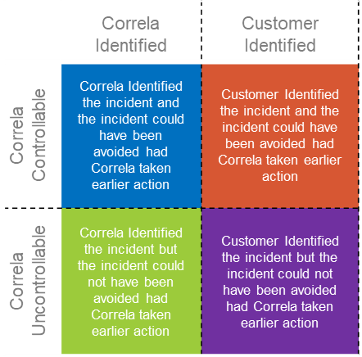
What is happening Overall
A fault that has developed that only impacts Correla colleagues or an incident on core services that has had no customer impact
Notes:
5

Slide 22
What is happening Overall?
Key:
 | Jul 2022
 | Correla Identified | Customer Identified
Correla Controllable | 1 | 1
Correla Uncontrollable | 0 | 0
 | Performance Year to Date
 | Correla Identified | Customer Identified
Correla Controllable | 7 | 1
Correla Uncontrollable | 0 | 0
 | Correla Identified | Customer Identified
Correla Controllable | Correla Identified the incident and the incident could have been avoided had Correla taken earlier action | Customer Identified the incident and the incident could have been avoided had Correla taken earlier action
Correla Uncontrollable | Correla Identified the incident but the incident could not have been avoided had Correla taken earlier action | Customer Identified the incident but the incident could not have been avoided had Correla taken earlier action

Slide 23
Customer Issue Dashboard
Appendix 3

Slide 24
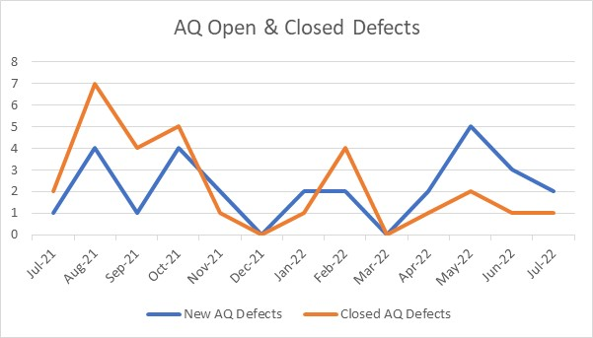
AQ Defects – Open & Closed over 12 Month Period

Slide 25
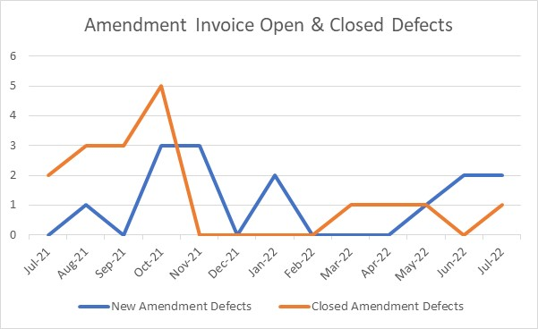
Amendment Invoice Defects – Open & Closed over 12 Month Period

Slide 26
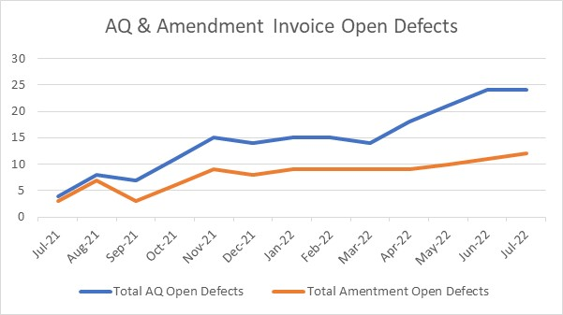
AQ & Amendment Invoice Open Defects

Slide 27
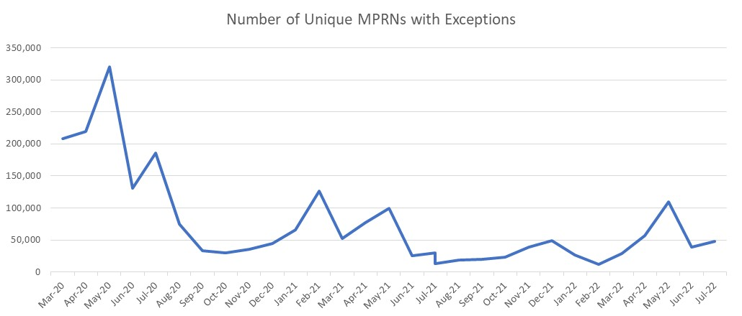
Amendment Invoice Dashboard – Outstanding Exceptions

Slide 28
Further Information
The Customer Issue Register, published on xoserve.com and updated weekly, can be found at the following location:
https://www.xoserve.com/news-updates/news-and-updates/issues-register/
System status, planned outages and info on current system impacting issues can be found at the following location:
https://www.xoserve.com/news-updates/news-and-updates/system-outages/

