Slide 1
Xoserve Incident Summary: March 2022
1st April 2022

Slide 2
What is this presentation covering?
This presentation provides an overview of P1/2 incidents experienced in the previous calendar month
It will describe high level impacts and causes, and the resolution Correla undertook (or is undertaking) to resolve
This information is provided to enable customers to have a greater insight of the activities within Correla’s platforms that support your critical business process
It is also shared with the intention to provide customers with an understanding of what Correla are doing to maintain and improve service, and;
It is provided to enable customers to provide feedback if they believe improvements can be made

Slide 3
High-level summary of P1/2 incidents: February 2022
Ref. | What happened? | Why did it happen? | What do we understand our customers experienced? | What did we do to resolve the issue? | Incident Date | Resolved Date
No P1/P2 incidents occurred in March

Slide 4
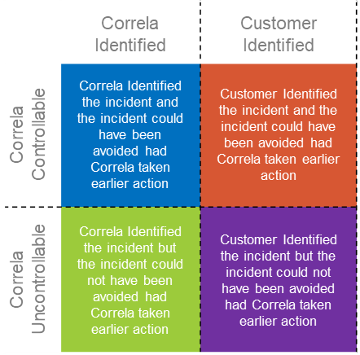
What is happening Overall
A fault that has developed that only impacts Correla colleagues or an incident on core services that has had no customer impact
Notes:
5

Slide 5
What is happening Overall?
Key:
 | March 2022
 | Correla Identified | Customer Identified
Correla Controllable | 0 | 0
Correla Uncontrollable | 0 | 0
 | Performance Year to Date
 | Correla Identified | Customer Identified
Correla Controllable | 7 | 2
Correla Uncontrollable | 5 | 1
 | Correla Identified | Customer Identified
Correla Controllable | Correla Identified the incident and the incident could have been avoided had Correla taken earlier action | Customer Identified the incident and the incident could have been avoided had Correla taken earlier action
Correla Uncontrollable | Correla Identified the incident but the incident could not have been avoided had Correla taken earlier action | Customer Identified the incident but the incident could not have been avoided had Correla taken earlier action

