Slide 1
Xoserve Incident Summary: June 2021
1st July 2021

Slide 2
What is this presentation covering?
This presentation provides an overview of P1/2 incidents experienced in the previous calendar month
It will describe high level impacts and causes, and the resolution Correla undertook (or is undertaking) to resolve
This information is provided to enable customers to have a greater insight of the activities within Correla’s platforms that support your critical business process
It is also shared with the intention to provide customers with an understanding of what Correla are doing to maintain and improve service, and;
It is provided to enable customers to provide feedback if they believe improvements can be made

Slide 3
High-level summary of P1/2 incidents: June 2021
Ref. | What happened? | Why did it happen? | What do Correla understand our customers experienced? | What did your Correla team do to resolve? | Incident Date | Resolved Date
INC0079940 | Mon. 7th June at 23.55 Correla monitoring identified a connectivity issue with circa 20 customer IX servers Connectivity resolved at Tuesday 8th June 09:05. | A change made by our network partner to network routing resulted in an outage to the IX network (file flows and Gemini access) for some customers. | During the event, 9 Incidents were raised by customers with our Service Desk however we have identified that up to 135 sites could have been impacted. We also proactively contacted the GNCC to advise them of the issue in the event any customers contacted National Grid directly. File flows were delayed, but no data was lost and once connectivity was restored data was processed within 30 minutes. Gemini access via IX was unavailable however the XP1 access route (which is the agreed contingency in the event of an issue with IX) was not impacted. | The issue with the change was identified and resolved. This restored connectivity and also placed the network in the desired end state for the change control. We are following up with our network provider on RCA and Change process to understand how this fault was allowed to occur and why the Correla network team were not engaged in testing and due diligence prior to implementation. We do not expect re-occurrence of this fault, as it was a one time change linked to the decommissioning of two data centres last year. | 07-Jun-20 23:55 | 08/06/2020 09:05
INC0082377 | Thurs. 17th Correla monitoring detected that the LinePack values for the 19:00 hour bar were delayed from being published within Gemini. | The filesystem within National Grid C.I.S. system was fully utilized, causing .SSILP and .DFNTS files to be sent to Correla without any data content. | There was a delay in being able to view LinePack values within the Gemini system for 19:00 Hour Bar causing disruption when submitting accurate Nominations to secure Capacity. | The incident was escalated to National Grid support teams and the Service Desk National Grid technicians freed up some space within the affected filesystem which then allowed the file processing to complete successfully. | 17/06/2021 19:18 | 17/06/2021 20:15

Slide 4
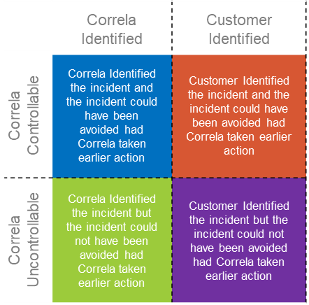
What is happening Overall
A fault that has developed that only impacts Correla colleagues or an incident on core services that has had no customer impact
Notes:
5

Slide 5
What is happening Overall?
Key:
 | June 2021
 | Correla Identified | Customer Identified
Correla Controllable | 1 | 0
Correla Uncontrollable | 1 | 0
 | Year to Date
 | Correla Identified | Customer Identified
Correla Controllable | 2 | 0
Correla Uncontrollable | 3 | 0
 | Correla Identified | Customer Identified
Correla Controllable | Correla Identified the incident and the incident could have been avoided had Correla taken earlier action | Customer Identified the incident and the incident could have been avoided had Correla taken earlier action
Correla Uncontrollable | Correla Identified the incident but the incident could not have been avoided had Correla taken earlier action | Customer Identified the incident but the incident could not have been avoided had Correla taken earlier action

