Slide 1
Change Management Committee
7th July 2021

Slide 2
Section 2: DSC Change Budget & Horizon Planning

Slide 3
DSC Change Budget 21/22 YTD

Slide 4
Budget v Committed Spend BP21/22
PAC funding adjusted in line with vote in June committee
Full finance tracker link

Slide 5
Change Pipeline

Slide 6
Change Development & Delivery Pipeline (DSC Change / Minor Release Budget)
* Pre-capture may contain changes that won’t require delivery / funding

Slide 7
2020-2022 DSC Change / MiR Pipeline
 | 2021 |  |  |  |  |  |  |  |  |  |  |  | 2022
 | Jan | Feb | Mar | Apr | May | Jun | Jul | Aug | Sep | Oct | Nov | Dec | Jan | Feb | Mar | Apr | May | Jun | Jul | Aug | Sep | Oct | Nov | Dec
Minor Releases
Major Releases
CSSC
Standalone Change
MiR 9
CCR
Key:
Approval on track
Scope
MiR 10
Scope
MiR 11
CCR
Approved
Scope
MiR 12
CCR
June 2021 (DBTI + PIS/Closedown)
CCR
Approval at risk
Nov 2021 Analysis / Design
November 2021 Build/Test Implement/PIS
BER
XRN
4780C
CCR
Nov 20 PIS
CCR
Nov 2022 Analysis / Design
November 2022 Build/Test/Implement/PIS
Nov 21 IA
Regression
EXTERNAL(MT/UEPT/E2E/Defect Mgmt)
XRN
4780C
Planning
Transition
Go Live Range
PIS
XRN
5206
5237
XRN
5146
XRN
5038
XRN
5120
XRN
52185143
Key:
Retro
On Track
XOS CF
Potential Activity
PAC
Complete
PAC XRN4876
Potential risk to plan
BER
CCR
Plan At Risk

Slide 8
Section 3: Capture

Slide 9
3.1 New Change Proposals – Initial Review
XRN / Title | Voting |  |  |  | DSC Service Area
 | Shipper | DNO | IGT | NTS
XRN5377 Addition of ‘Class’ field to supply point data reports |  | Y |  |  | TBC
XRN5379 Class 1 Read Service Procurement Exercise | Y | Y | Y | Y | TBC
XRN5380 Introduction of a Micro Business identifier in Central Systems | Y |  |  |  | TBC
XRN5381 Changes to SDT v18 | For Information |  |  |  | N/A
XRN5382 FWACV: PRCMS validation/processing - analysis | Y | Y |  | Y | TBC
XRN5383 LDZ Stock Change and Embedded LDZ Unique Sites - new service | Y | Y |  | Y | TBC

Slide 10
XRN5377 Addition of ‘Class’ field to supply point data reports
Voting Parties
Change Details
Customer Class | Voting Party?
Shipper
Distribution Network Operators (DNOs) | Y
National Grid Transmission
IGT’s
Problem Statement
Certain monthly supply point data reports which provide formula and rolling AQ and SOQ information, do not contain details on the class of the sites. For Class 1 and 2 sites there is no formula year AQ and SOQ, but it is difficult to identify these at present.
DSC Service Area: | TBC
Link to Change Proposal | Link to CP
Change Description
WWU, SGN and NGN would like the addition of ‘Class’ as a field in the following supply point data reports: • BOPRI_1 GT5 Revenue Assurance Data • SPA09 NDM CSEP Report • SPA11 NDMCEPS • Rec121 • SCH606 • DN Geninf Report
Change Type | Non Regulatory
Priority Score | Medium
Sponsor Representative | Wales & West Utilities

Slide 11
XRN5379 Class 1 Read Service Procurement Exercise (MOD 0710)
Voting Parties
Change Details
Customer Class | Voting Party?
Shipper | Y
Distribution Network Operators (DNOs) | Y
National Grid Transmission | Y
IGT’s | Y
Problem Statement
The current contracts for the Class 1 Read Service between the DNOs and the Daily Metered Service Providers (DMSPs) will expire on 31 March 2023. From 01 April 2023, Modification 0710 will be implemented, and a new contract must become effective between the CDSP and the Class 1 Service Provider. To ensure this happens, a procurement process is required to appoint a Service Provider and put in place a new contract.
Change Description
Modification 0710S was raised to obligate the CDSP to take on Class 1 Read Service provision on behalf of Shippers. This was to transfer the obligation to provide the Class 1 Supply Meter Point Read Service from the Transporters to the CDSP. The Change Proposal XRN5218 - CDSP provision of Class 1 read service was previously raised to carry out a novation of the existing contracts currently in place between the DNOs and the DMSPs, across to the CDSP. The decision was taken in June 2021, by the DNOs with the existing contracts in place for the Class 1 read service to continue with the current contracts and service as is until the contract expiry. The current contracts for this service expire on 31 March 2023. To confirm, the CDSP will not novate the existing contracts for the Class 1 read service, the CDSP will run the procurement exercise to appoint a Service Provider and new contract as of 01 April 2023. As a result of Modification 0710, it will be the responsibility of the CDSP to appoint a new Service Provider on behalf of Shippers, to provide the Class 1 Daily Read Service from 01 April 2023 onwards. This Change Proposal has been raised in order to proceed with the procurement exercise to procure a new Service Provider for this service.
DSC Service Area: | TBC
Link to Change Proposal | Link to CP
Change Type | Regulatory
Priority Score | High
Sponsor Representative | Xoserve
Verbal update on XRN5218 CDSP provision of Class 1 read service to be included with this agenda item

Slide 12
XRN5380 Introduction of a Micro Business identifier in Central
Voting Parties
Change Details
Customer Class | Voting Party?
Shipper | Y
Distribution Network Operators (DNOs)
National Grid Transmission
IGT’s
Problem Statement
The increasing introduction of Micro Business specific arrangements within Suppliers Licences creates a growing need to be able to easily and efficiently identify such sites within Central Systems. Without a central view of a customer’s status, we will inhibit the ability for all stakeholders to be able to provide services to those customers efficiently and consistently across the market.
Change Description
A UNC Modification (reference number awaiting assignment), has been raised to introduce a Micro Business identifier within Central Systems. Ofgem launched the review of the Micro Business market as a result of evidence showing that the market was not working well for some Micro Businesses. In July 2020 Ofgem consulted upon an initial package of measures designed to improve Micro Businesses experience of the market. In particular, the introduction of a Micro Business Cooling Off period will create challenges for Suppliers and Brokers to be able to identify these customers in a timely fashion without the benefit of an identifier within Central Systems. This Change Proposal has been raised in order to introduce the Micro Business identifier within Central Systems to be used by relevant parties. The suggested approach for this is to re-use the existing Market Sector Code by expanding the allowable value set to include an additional value.
DSC Service Area: | TBC
Link to Change Proposal | Link to CP
Change Type | Regulatory
Priority Score | High
Sponsor Representative | Xoserve
Please see the CP for the full description

Slide 13
XRN5381 Changes to SDT v18
Voting Parties
Change Details
Customer Class | Voting Party?
Shipper
Distribution Network Operators (DNOs)
National Grid Transmission
IGT’s
For Information only
Change Description
Service Description Table V18 has been amended to align the service lines to the new Process Journeys that came into effect on 1st April 2021. They now reflect the changes to the Service Areas as detailed within the charge base Appointment Table as per CDSP Service Document Budget and Charging Methodology version 5. In addition, the service lines contained within Column B Service Reference with effect from 01/04/21 have been re-numbered as it was found that there were some duplications within the previous version. Each service line is now mapped to the new Service area based on their Customer Journey. The Specific Services sections are not impacted by this change.
DSC Service Area: | N/A
Link to Change Proposal | Link to CP
Change Type | Non Regulatory
Priority Score | Med
Sponsor Representative | Xoserve

Slide 14
XRN5382 FWACV: PRCMS validation/processing - analysis
Voting Parties
Change Details
Customer Class | Voting Party?
Shipper | Y
Distribution Network Operators (DNOs) | Y
National Grid Transmission | Y
IGT’s
Problem Statement
National Grid has advised the DNs that from Q1 2022, it will withdraw its ‘Daily LDZ CV (FWACV)’ Service. Xoserve will be taking over the service in its entirety from National Grid. Within the existing NG/DNs FWACV processes, there are several combined data flows that contain data that is (or will not be) required to calculate the FWACV.
Change Description
Please provide an HLSO to include costs and delivery timescales for the following: National Grid will continue to submit the PRCMS file into Gemini for all those data items other than the FWACV data. Please consider the systems’ impact of not providing the FWACV data within this file e.g. file/data validation, dependency of other processes on FWACV data e.g. timing of associated batch jobs, Gemini processes This change needs to be progressed in conjunction with the FWACV project, as ultimately it will need to be delivered at the same time as the project for the FWACV data to be processed by Gemini by the new channel from the DN’s. To be clear the data items on the PRCMS that are being referred to are below; - OF meter types - OS meter types - CV data field In addition to this, National Grid would also like to understand the system impacts to removing the following data items from the PRCMS - Stock Change (SC meter type) - Embedded LDZ unique sites (US – Meter type) The processing of these meter types will be picked up in a separate CR.
DSC Service Area: | TBC
Link to Change Proposal | Link to CP
Change Type | Non Regulatory
Priority Score | Medium
Sponsor Representative | National Grid

Slide 15
XRN5383 LDZ Stock Change and Embedded LDZ Unique Sites - new service
Voting Parties
Change Details
Customer Class | Voting Party?
Shipper | Y
Distribution Network Operators (DNOs) | Y
National Grid Transmission | Y
IGT’s
Problem Statement
National Grid has advised the DNs that from Q1 2022, it will withdraw its ‘Daily LDZ CV (FWACV)’ Service. Xoserve will be taking over the service in its entirety from National Grid. Within the existing NG/DNs’ FWACV processes, there are several combined data flows that contain data that is (or will not be) required to calculate the FWACV. However, those additional (non-FWACV) data items are still required for various critical downstream processes including energy balancing, reconciliation, settlement and UIG calculations.
Change Description
Please provide an HLSO with costs and delivery timescales for the following: Xoserve will receive AI files from DNs with data items required to calculate LDZ FWACV. Xoserve will also develop the capability to transfer the FWACV data direct into Gemini. National Grid requires Xoserve to build additional capability of accepting two extra data items (listed below) that are sent from the DNs (to Xoserve) on the AI files, and parse these data items into Gemini: • LDZ Stock Change (13 LDZ files for 4 DN systems + 1 for Scottish independents (SIUs) • Embedded LDZ unique sites (7 files for each LDZ that contain unique sites – from 4 DN systems)
DSC Service Area: | TBC
Link to Change Proposal | Link to CP
Change Type | Non Regulatory
Priority Score | Medium
Sponsor Representative | National Grid
Please see the CP for the full description

Slide 16
3.2 Change Proposals – Post Solution Review for Approval
XRN5246 Confirmation File (.CNF) Processing Capacity Improvement
XRN5183 Access to Daily Biomethane Injections
XRN4931 – Submission of a Space in Mandatory Data on Multiple SPA Files
Retrospective Data Updates Options Paper for Consultation
XRN5365 - Impact assessment on aligning Major Releases to the REC Release Schedule

Slide 17
XRN5246 Confirmation File (.CNF) Processing Capacity Improvement
Proposed Release Link to Change Proposal Change Pak Comm Ref Voting Funding | DSG/ Xoserve Preferred Option | Solution Summary Outcome and implementation date outcome |  |  |  | Comments
 |  | Organisation | Approve | Defer | Reject
Proposed delivery: Link to CP Link to Change Pack ref: 2839.3 - RT - PO Voting: Shippers HLSO Cost: £35K - £45K Funding: 100% Shipper DSC Service Area 1: Manage Supply Point Registration | Option 1 | EDF | X |  |  | No Comment
 |  | Scottish Power | X |  |  | No Comment

Slide 18
XRN 5183 Access to Daily Biomethane Injections
Update

Slide 19
Background
In Autumn 2020, two solution options for XRN 5183 were presented to Change Management Committee:
Option 1 was to publish the current BEIS Biomethane Injection report on a secure part of Xoserve.com;
Option 2 was to create a bespoke Biomethane Injection report where the data is aggregated at a specific geographical level, LDZ being one option among many. The report could be published on Xoserve.com open to all OR published in a secure area of Xoserve.com.
At November 2020 ChMC, Option 1 was approved following solution option change pack.
This was then discussed with BEIS and the CoMC regarding permissions being covered under the DSC. Both entities expressed concern that this could potentially give a commercial/financial advantage to some industry parties over others.

Slide 20
Overview
Following continued discussions with CoMC, BEIS and the proposer, it was deemed that the existing report (option 1) was not suitable for publication.
Xoserve’s proposal is to aggregate the data to remove site specific identification.
Proposal being tabled at July CoMC in relation to permissions and aggregation level.

Slide 21
What we need ChMC to approve?
We are asking ChMC to re-approve the HLSO for XRN 5183 with option 2 as the agreed solution to move into delivery. (As a new report will need to be created).
See embedded below the Solution Option Change Pack for XRN 5183:
It is our expectation no reissue of solution change pack is needed.
A detailed design change pack will be issued following completion of detailed design phase as per DSG governance.

Slide 22
XRN5183 Access to Daily Biomethane Injections
Representations from Nov 2020
XRN / Title Proposed Release Link to Change Proposal Comm Ref | DSG/ Xoserve Preferred Option | Solution Summary Outcome and implementation date outcome |  |  |  | Comments
 |  | Organisation | Approve | Defer | Reject
Proposed delivery: Adhoc Link to CP Link to Change Pack ref: 2694.4 - KL - PO Voting: DNO & Shippers High level Solution cost: Option 1 – £0-5k Option 2 – £5-10k Service Area: Service Area 18 Provision of User Reports and Information Funding: Service Area 18 * Shipper – 100% (*re-apportioned) | Option 1 | NGN | X |  |  | We support Option 1 of this change, as the most logical option to achieve the intended outcome.
 |  | Scottish Power | X

Slide 23
XRN4931 – Submission of a Space in Mandatory Data on Multiple SPA Files
Shipper Decision on Available Options

Slide 24
Change Overview
XRN4931 – Submission of a Space in Mandatory Data on Multiple SPA Files
The change has been raised to handle the files going back out from SAP into AMT with rejection details when a ‘space’ is received in the mandatory field. Xoserve are receiving some inbound files (MSI, EMC, CNF, UMR, UBR, UDR, and SFN) with a Space populated in mandatory text fields instead of the required data item (e.g. Y/N). As ‘Space’ is an allowable ASCII value, AMT has not rejected the inbound file, however, once SAP has carried out its lower-level validation it is unable to ‘play back’ the data in the appropriate rejection file, as Space is not populated in the data item and is treated as a null value the outbound rejection file is rejected by AMT as not having all mandatory data items populated. To enable shipper users to receive the rejection a new identifier is required whenever a ‘space’ is received in inbound mandatory text fields. The solution is that whenever SAP PO is receives a ‘space’ in any mandatory text fields it will be replaced with a special character, SAP ISU will identify the special character generated by SAP PO and a mandatory field missing rejection will be raised from SAP ISU in the outbound file. This will ensure that ‘space’ is populated in outbound files in SAP PO only for the cases where space is received in inbound files in mandatory text fields from AMT. This will also ensure that space will not be populated in the fields of outbound interfaces in SAP PO which were generated because of processing issues or any data issues from SAP ISU. List of fields which are considered in scope are as attached:
Solution Options Identified
1
1
Replace the spaces received in the mandatory field of inbound files with single special character in SAP PO then SAP ISU will identify the special character and mandatory field missing rejection will be sent in outbound files.
2
Replace the spaces received in the mandatory field of inbound files with same number of special character(s) in SAP PO then SAP ISU will identify the special character and a mandatory field missing rejection will be sent in outbound files.

Slide 25
Option 1 - High Level Impact Assessment
1
1 - Replace the spaces received in the mandatory field of inbound files with single special character in SAP PO. SAP ISU will identify the special character and mandatory field missing rejection will be sent in outbound files.
SAP PO: For the inbound files (MSI, EMC, CNF, UMR, UBR, UDR and SFN), in SAP PO the mandatory text fields will be identified, if single or multiple spaces are received in SAP PO then replace that space with a single special character (Θ) and send it to SAP ISU. When SAP ISU plays back the special character (Θ) in the outbound files (MSO, CTR, CFR, URS and SFR), SAP PO will replace the special character (Θ) present in the mandatory text field with a single space and send it to AMT Marketflow. SAP ISU: Code changes to relevant IDoc processing FMs & Read validation programs to add the validation checks for special character (Θ) to generate rejection messages. SAP BW/BO: Special character (Θ) will be added to permitted extra characters list in BW to ensure no impacts during data load. Amendments in BO reports which are impacted by the file types in scope.
Impacted Systems
Assumptions
The scope of the change is limited to File type and Fields mentioned in IA sheet. Existing rejection codes will be utilised by programs to generate the rejection messages. The special character theta (Θ) is not expected to be received in the files that are in scope. In the case of theta (Θ) received in mandatory fields from shipper, the inbound file will be rejected by ISU and PO will replace the values with ‘space’. Solution option 2 was agreed and recommend for further analysis as part of Nov20 impact assessment. Solution option 1 is not preferred on account of Shippers could not receive same values in rejected response files that was sent in inbound. Data cleansing of any outstanding file failures not in scope of this change. Performance testing considered in scope for changes in SAP PO.
Impact
Gemini
Marketflow
SAP PO
SAP ISU
CMS
API
SAP BW
DES
Overall Impact | Release Type | High Level Cost Estimate
High | Minor | £ 55,000 to £ 65,000 GBP

Slide 26
Option 1 - System Impact Assessment
1
 | Reports | Enhancements | Data Migration | Integration(SAP PO)
System Component: | SAP BW/BO | SAP ISU | SAP ISU | Integration
Impacted Process Areas: | BW Extraction and Reports | SPA, Metering | N/A | File Transfer
Complexity Level (per RICEFW item): | Medium | Medium | N/A | High
Change Description: | Addition of Special character to the permitted characters list in BW. Amendments to SHPP_Class3_Mod700 and other impacted BO reports | Code changes required in File processing Functional modules and Read validation programs. | N/A | Use SAP PI node function to replace the field values for inbound & outbound files
 | ISU | BW/BO | PO | AMT Marketflow
Test Data Prep Complexity: | Medium | Medium | Medium | Low
Unit and Sys Test Complexity: | Medium | Medium | Medium | Low
Pen Test Impact: | Low | Low | Low | No
Regression Testing Coverage: | Medium | Medium | Medium | Low
Performance Test Impact: | No | No | Yes | No
Market Trials: | No | No | No | No
UAT Complexity: | High | Medium | High | Low
Notes:
System Component: File Format / Batch Job / Process Code / Report
Development Type: Interface / Online / Report / Workflow / Configuration
End User Impacted: Shipper / DN / NTS / Xoserve / Other
Build Type: New / Existing

Slide 27
Option 1 - Process Impact Assessment
1
Process Area | Complexity | File Formats | Exceptions | External Screens | Batch Jobs | Performance Test? | CSS Code Conflicts
SPA | Medium | No | No | No | No | No | No
Metering (Reads) | High | No | No | No | No | No | No
Reconciliation | N/A | N/A | N/A | N/A | N/A | N/A | N/A
Invoicing – Capacity | N/A | N/A | N/A | N/A | N/A | N/A | N/A
Invoicing – Commodity | N/A | N/A | N/A | N/A | N/A | N/A | N/A
Invoicing – Amendment | N/A | N/A | N/A | N/A | N/A | N/A | N/A
Invoicing – Other | N/A | N/A | N/A | N/A | N/A | N/A | N/A
Rolling AQ | N/A | N/A | N/A | N/A | N/A | N/A | N/A
Formula Year AQ | N/A | N/A | N/A | N/A | N/A | N/A | N/A
RGMA | N/A | N/A | N/A | N/A | N/A | N/A | N/A
DSC Service | N/A | N/A | N/A | N/A | N/A | N/A | N/A
Other (BW/BO/BODS) | High | No | No | No | No | No | No

Slide 28
Option 2 - High Level Impact Assessment
2
2 - Replace the spaces received in the mandatory field of inbound files with same number of special character(s) in SAP PO then SAP ISU will identify the special character and a mandatory field missing rejection will be sent in outbound files.
SAP PO: For the inbound files (MSI, EMC, CNF, UMR, UBR, UDR and SFN), In SAP PO we will check the mandatory text fields and replace the spaces with the equal number of special character (Θ) and send it to SAP ISU. When SAP ISU will play back the special character (Θ) in the outbound files (MSO, CTR, CFR, URS and SFR), SAP PO will replace the special characters (Θ) present in the mandatory text field with the equal number of spaces and send it to AMT. SAP ISU: Code changes to relevant IDoc processing FMs & Read validation programs to add the validation checks for special character (Θ) to generate rejection messages. SAP BW/BO: Special character (Θ) will be added to permitted extra characters list in BW to ensure no impacts during data load. Amendments in BO reports which are impacted by the file types in scope.
Impacted Systems
Assumptions
The scope of the change is limited to File type and Fields detailed in the Impact Assessment sheet. Existing rejection codes will be utilized by programs to generate the rejection messages. The special character theta (Θ) is not expected to be received in the files that are in scope. In case of theta (Θ) received in mandatory fields from shipper, the inbound file will be rejected by ISU and PO will replace the values with ‘space’ Market trials is not in scope of the change. Data cleansing of any outstanding file failures not in scope of this change. Performance testing considered in scope for changes in SAP PO
Impact
Gemini
Marketflow
SAP PO
SAP ISU
CMS
API
SAP BW
DES
Overall Impact | Release Type | High Level Cost Estimate
Medium | Minor | £55,000 to £65,000 GBP

Slide 29
Option 2 - System Impact Assessment
2
 | Reports | Enhancements | Data Migration | Integration(SAP PO)
System Component: | SAP BW/BO | SAP ISU | SAP ISU | Integration
Impacted Process Areas: | BW Extraction and Reports | SPA, Metering | N/A | File Transfer
Complexity Level (per RICEFW item): | Medium | Medium | N/A | High
Change Description: | Addition of Special character to the permitted characters list in BW. Amendments to SHPP_Class3_Mod700 and other impacted BO reports | Code changes required in File processing Functional modules and Read validation programs. | N/A | Use SAP PI node function to replace the field values for inbound & outbound files
 | ISU | BW/BO | SAP PO | AMT Marketflow
Test Data Prep Complexity: | Medium | Medium | Medium | Low
Unit and Sys Test Complexity: | Medium | Medium | Medium | Low
Pen Test Impact: | Low | Low | Low | No
Regression Testing Coverage: | Medium | Medium | Medium | Low
Performance Test Impact: | No | No | Yes | No
Market Trials: | No | No | No | No
UAT Complexity: | High | Medium | High | Low
Notes:
System Component: File Format / Batch Job / Process Code / Report
Development Type: Interface / Online / Report / Workflow / Configuration
End User Impacted: Shipper / DN / NTS / Xoserve / Other
Build Type: New / Existing

Slide 30
Option 2 - Process Impact Assessment
2
Process Area | Complexity | File Formats | Exceptions | External Screens | Batch Jobs | Performance Test? | CSS Code Conflicts
SPA | Medium | No | No | No | No | No | No
Metering (Reads) | High | No | No | No | No | No | No
Reconciliation | N/A | N/A | N/A | N/A | N/A | N/A | N/A
Invoicing – Capacity | N/A | N/A | N/A | N/A | N/A | N/A | N/A
Invoicing – Commodity | N/A | N/A | N/A | N/A | N/A | N/A | N/A
Invoicing – Amendment | N/A | N/A | N/A | N/A | N/A | N/A | N/A
Invoicing – Other | N/A | N/A | N/A | N/A | N/A | N/A | N/A
Rolling AQ | N/A | N/A | N/A | N/A | N/A | N/A | N/A
Formula Year AQ | N/A | N/A | N/A | N/A | N/A | N/A | N/A
RGMA | N/A | N/A | N/A | N/A | N/A | N/A | N/A
DSC Service | N/A | N/A | N/A | N/A | N/A | N/A | N/A
Other (BW/BO/BODS) | High | No | No | No | No | No | No

Slide 31
Additional Considerations - Analysis of Occurrences
Change initially raised by Xoserve Operational Team in April 2019
At the time we were experiencing high volumes of exceptions relating to missing data in mandatory fields within several UK Link File Formats (seven in total - MSI, EMC, CNF, UMR, UBR, UDR, and SFN)
These were identified as occurring across multiple Shipper Organisations
Whilst the Change Proposal has been developed we have continued to support customers by identifying exceptions and offering training / process information to improve performance
Over the most recent six month period we have identified a significant reduction in the number of files and frequency of exceptions impacted by the issue that this change intends to resolve;
File Type (Response) | Count | Shipper Wise Count | Additional Comments
URS | 829 – MR03 exceptions with 304 unique MPRNs | SHIPPER A 280 SHIPPER B 10 SHIPPER C 8 SHIPPER D 1 SHIPPER E 2 SHIPPER F 1 | 304 unique MPRNs Few files received multiple times from same Shipper
CFR, CTR & MSO | 4 | SHIPPER G 4 | No occurrences found for SFR files

Slide 32
Decision Sought from ChMC - Shippers
Solution Options have confirmed capability to deliver in a Minor Release
Cost estimates for both options between £55k – £65k
Delivery timescales estimated at 12-14 weeks
In light of updated analysis relating to the original change driver, we are seeking a decision from Shipper Constituents as to whether you determine to;
Confirm decision for change to be included as candidate for next available Minor Release (MiR11 – which is yet to be scoped)
Reject inclusion in next available Minor Release (MiR11) and request the change be withdrawn

Slide 33
Retrospective Data Updates Options Paper for Consultation
Proposed Release Link to Change Proposal Change Pak Comm Ref Voting Funding | DSG/ Xoserve Preferred Option | Solution Summary Outcome and implementation date outcome |  |  |  | Comments
 |  | Organisation | Approve | Defer | Reject
Proposed delivery: TBC Link to Change Pack ref: 2844 - RT – PO Voting: N/A – For Information only Funding: 100% Shipper DSC Service Area 1: Manage Supply Point Registration | No preferred option | NGN | X Option B |  |  | We believe that solution option B is the most cost efficient solution and would deliver industry benefits much quicker than option A, without impacting ongoing CSS delivery.
 |  | W&W | X Option B |  |  | Option B is better than option A for the following reasons: 1) It delivers benefits much more quickly than option A because it does not require changes to central systems 2) It is much more cost effective We do not believe that the proof of concept demonstrated that option A was required for the following reasons: 1) metering detail mismatch was only 1%, 2) 75% of data mis-matches were for non-billable items 3) most mismatches occurred while the MPRN was with the same Shipper rather than being inherited from a previous Shipper on change of Registered User. A further consideration is that option A would also exceed the available budget for this change meaning that further funding would be required to deliver it.
 |  | Cadent | X Option B |  |  | Option B is our preferred solution. It is the more cost efficient solution, delivering benefits much more quickly than Option A. It would not require changes to Central Systems (therefore could be progressed outside of a formal ‘change’ window) so would not be impacted by or impact on the CSS delivery work Xoserve are required to carry out. The proof of concept which Xoserve started in 2019, in our view, did not demonstrate a compelling business case for the delivery of the more costly and potentially difficult option A i.e metering detail mismatch was only 1%, most identified mismatches (75%) were for non billable items, most mismatches occurred within the same Shippers ownership rather than being created by other Shippers. In addition Option A would also exceed the available budget so additional funds would be required from industry to progress this option.
 |  | SSE |  |  | X | We request more information is provided on each of the options before it's possible for parties to properly impact assess them both. In particular, more detail on how the costings of both options been arrived at is needed. Also, there is not much operational detail within the change pack. Is the assumption that both options will be 100% shipper funded? In addition to a more detailed solution option document, given the importance of this and complex nature of the two options, a dedicated workshop by Xoserve for interested parties would be helpful to explain more about what each option entails/ offer the opportunity to ask questions ahead of parties making their decision on a preferred option.
Consultation closes on 7th July and will be presented to CoMC for approval

Slide 34
XRN5365 - Impact assessment on aligning Major Releases to the REC Release Schedule
Verbal Update to be presented by Simon Harris

Slide 35
section 4. Design & Delivery

Slide 36
Design Change Pack
XRN5007 Correction in the reconciliation process when volume is zero
XRN5188 Interim Data Loads of MAP Id into UK Link
XRN5309 FSG: Automating the FSR ‘Standard Liability’ Process
XRN5040 UK Link Cloud Programme
XRN4922 CSSC Shipper BRD
Query APIs Technical Specification & Secondary API Error Handling Strategy

Slide 37
XRN5007 Correction in the reconciliation process when volume is zero
Functional Changes
Change Pack ref: 2839.1 - RT - PO Release: Nov 21 Voting: Shipper, DNO, IGT Funding: | Solution & Implementation Summary outcome |  |  |  | Comments
 | Organisation | Approve | Defer | Reject
 | Scottish Power | X |  |  | No Comments

Slide 38
XRN5188 Interim Data Loads of MAP Id into UK Link
Functional Changes
Change Pack ref: 2839.2 - RT - PO Release: MiR10 Voting: Shipper Funding: MTB | Solution & Implementation Summary outcome |  |  |  | Comments
 | Organisation | Approve | Defer | Reject
 | EDF | X |  |  | No Comment
 | Scottish Power | X |  |  | I have raised previously at DSG in relation to whether the Shippers are able to supply MAP data in absence of any MAPs not taking part. Also I think the issue needs to be raised with the MAMs to ensure that they are supplying the MAP ID within their ONJOBs/ONUPDs as currently not all do, or are willing to do so.

Slide 39
XRN5309 FSG: Automating the FSR ‘Standard Liability’ Process
Functional Changes
Change Pack ref: 2839.4 - RT - PO Release: MiR10 Voting: DNO Funding: MTB | Solution & Implementation Summary outcome |  |  |  | Comments
 | Organisation | Approve | Defer | Reject
 |  |  |  |  | No Reps received

Slide 40
5040 UK Link Cloud Programme
Functional Changes
Change Pack ref: 2839.5 - RT - PO Release: Adhoc tbc Voting: Shippers, DNO, IGT, NTS | Solution & Implementation Summary outcome |  |  |  | Comments
 | Organisation | Approve | Defer | Reject
 | EDF | X With Questions |  |  | Internet Browser Support, User Security, Password Policy, User Identity, Audit Data Retention Do all of these things form part of a single workstream or will be split out into phased releases? What does the LSO change ref MFA mean exactly in a practical sense to LSOs – what will be the purpose of an LSO going forward, just to create and delete but not maintain accounts? Could you please provide clarity on the single identity and what that means? The subsequent point in the document says multiple user accounts won’t be combined into single account yet? What does this mean in terms of DES access – where multiple accounts are held by a single user today for different MPIDs – will this remain as is and will User IDs become a single user ID in an email address format? How are you proposing to manage individual access to DES going forward, say where we have a user that we want to be able to access one of our MPIDs but not others? Ref user pays charging for DES User IDs – where today each user ID attracts separate User Pays charges, if it’s a single login – will that reduce costs for us?
 | Scottish Power | X |  |  | No Comment

Slide 41
XRN4922 CSSC Shipper BRD
Functional Changes
Change Pack ref: 2840.1 - RT - PO Release: CSSC Voting: Shipper Funding: CSSC | Solution & Implementation Summary outcome |  |  |  | Comments
 | Organisation | Approve | Defer | Reject
 |  |  |  |  | No Reps Received

Slide 42
Query APIs Technical Specification & Secondary API Error Handling Strategy
Functional Changes
Change Pack ref: 2840.2 - RT - PO Release: CSSC Voting: Shipper Funding: CSSC | Solution & Implementation Summary outcome |  |  |  | Comments
 | Organisation | Approve | Defer | Reject
 |  |  |  |  | No Reps Received

Slide 43
Standalone Change Documents for Approval (BER, CCR, EQR)
BER Template
Voting Shipper, NTS, DNO & IGT
CCR for XRN4876 Changes to PARR reporting
Voting Shipper, DNO, IGT, NTS
CCR for XRN5237 (Mod0736) - Maintenance of a User relationship table for the purpose of AQ amendments
Voting Shippers
BER for XRN5341 UNC745 - Mandatory Setting of Auction Bid Parameters & MOD0728B Introduction of a Conditional Discount for Avoiding Inefficient Bypass of the NTS
Voting NTS

Slide 44
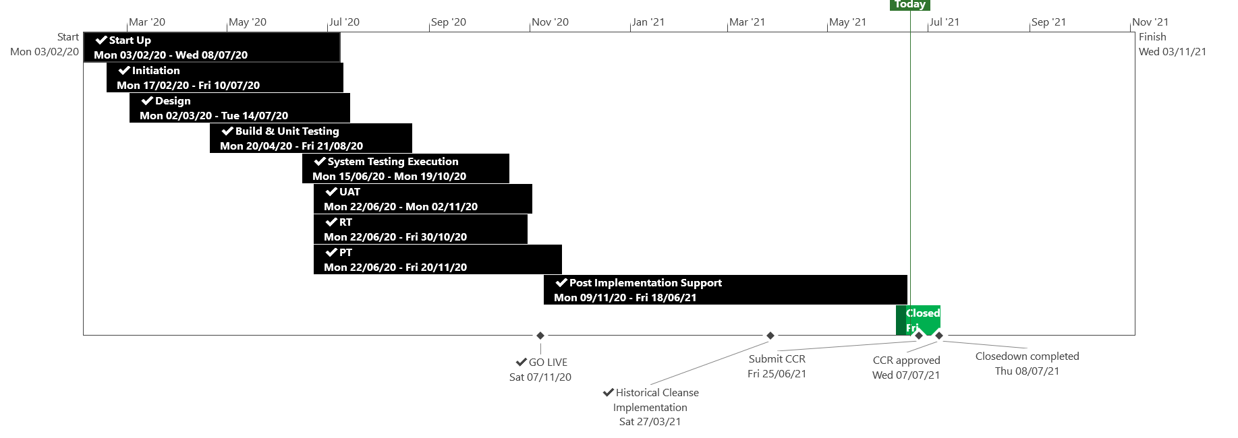
XRN5110 – Nov 20 Release - Status Update
 | Overall Project RAG Status
 | Schedule | Risks and Issues | Cost
RAG Status
Status Justification
Schedule | November 20 Release completed Historical Cleanse completed successfully on the 4th June 2021 Final Shipper reports issued on the 8th June 2021 All Shipper reports will be saved for 3 months until 24th September 2021 in each shippers unique SharePoint folder CCR submitted to July ChMC for approval Decision in July ChMC: Approval required of CCR
Risks and Issues | No open risks or issues to report
Cost | Forecast to complete delivery against approved BER
Scope | In Scope - XRN4897 - Resolution of deleted Contact Details (contained within the S66 records) at a Change of Shipper event In Scope - XRN4899 - Treatment of Priority Service Register Data and Contact Details on Change of Supplier Event In Scope - XRN4801 - Additional Information in DES In Scope - XRN4871b - Rachet Regime Changes In Scope - XRN5014 - Facilitating HyDeploy2 Live Pilot Descoped - XRN4931 Submission of a Space in Mandatory Data on Multiple SPA Files Descoped - XRN4941 MOD 692 – Auto Updates to Read Frequency Descoped - XRN4992 Supplier of Last Resort Charge Types Moved to CSSC - XRN4870c MAP ID
Complete
On Track
At Risk
Overdue
Not Baselined
Complete
On Track
At Risk
Overdue
Not Baselined
Slide updated on 22st June 2021

Slide 45
CCR for XRN5110 November 2020
Voting Shipper & DNO

Slide 46
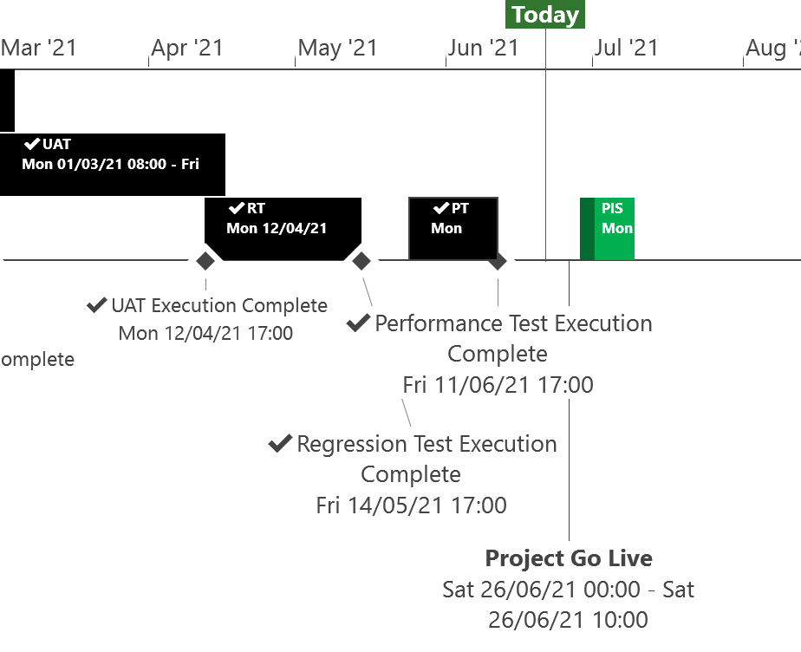
XRN5253 June 21 Major Release - Status Update
 | Overall Project RAG Status
 | Schedule | Risks and Issues | Cost
RAG Status
Status Justification
Schedule | XRN5253 June 21 Project is on track All Testing phases successfully completed Implementation Dress Rehearsal has successfully completed ahead of Go live Go Live is scheduled for Saturday 26th June First Post Implementation Support (PIS) period to commence from 28th June and run until 9th July Further PIS periods scheduled between September and December to cover all 1st Usage. Decision In July ChMC None
Risks and Issues | None Applicable
Cost | Forecast costs on track to complete within approved BER
Scope | In Scope (XRN5093) - MOD0711 – Update of AUG Table to reflect new EUC bands Descoped (XRN4992) - MOD0687 – Creation of new charge to recover last resort supply payments – Descoped at Extraordinary ChMC on 26th October 2020 Descoped (XRN4941) - MOD0692 - Auto updates to meter read frequency Descoped at ChMC on 11th November 2020
Complete
On Track
At Risk
Overdue
Not Baselined
Slide updated on 21st June 2021

Slide 47
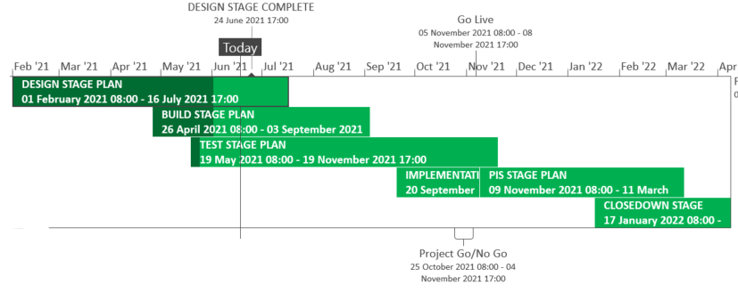
XRN5289 – November 21 Major Release - Status Update
 | Overall Project RAG Status
 | Schedule | Risks and Issues |  | Cost
RAG Status
Status Justification
Schedule | Detailed delivery plan has been baselined Build in progress for XRN4941 and XRN5007 Build is completed and System Test has commenced for XRN5142, XRN5180 and XRN5072 XRN4780C MAP ID is in the process of being scoped into the November 21 release for delivery Implementation Approach provided for information shared with July ChMC Decision In July ChMC Approval of scope change in BER to include XRN4780C MAP ID
Risks and Issues | ​None applicable
Cost | Forecast to complete delivery against approved BER
Scope | In Scope – XRN4941 - MOD0692 - Auto updates to meter read frequency In Scope - XRN5007 - Enhancement to reconciliation process where prevailing volume is zero​ In Scope - XRN5072 - Application and derivation of TTZ indicator and calculation of volume and energy – all classes​ In Scope - XRN5142 - New allowable values for DCC Service Flag in DXI File from DCC​ In Scope - XRN5180 - Inner tolerance validation for replacement reads and read insertions​ Descoped - XRN5091 - Deferral of creation of Class change reads at transfer of ownership​ Descoped - XRN5186 MOD0701 – Aligning capacity booking under the UNC and arrangements set out in relevant NExAs​ Descoped - XRN5187 MOD0696 – Addressing inequalities between capacity booking under the UNC and arrangements set out in the relevant NExAs
Complete
On Track
At Risk
Overdue
Not Baselined
Slide updated on 22nd June 2021

Slide 48
XRN5289 – November 21 Implementation Approach v1

Slide 49
High Level Implementation Timeline
The implementation for the 5 changes consists of code transports for BW, and ISU, Control M, AMT systems, UK Link Oracle web centre (DN Portal)
Go Live 5/11/21 XRN5142
XRN5142 need to align to DCC implementation date, if not aligned DXI files that are sent from the DCC on the 5th November will be rejected in the UKLink systems due to the mismatch in file formats being used across both systems
Go Live 6/11/21 Remaining Changes

Slide 50
File Transition
To incorporate the changes to files and associated processing the EFT channels will need to be closed
We will follow the standard processing times and ensure that there are none of the below files waiting for processing before we close the channels
Monitoring of all inbound files and confirmation of all response outbound files will be completed between 23:00:01 and 23:59:59 prior to any transports taking place
Channels will be re-opened for 09:00:00 for the next standard job processing time

Slide 51
File Format Transition plan - Inbound
File Type | Last inbound (Time = File Processing) | First Inbound (Time = File Processing) | Related Change
DXI | 04/11/21 23:00:00 | 05/11/2021 BAU | XRN5142
UMR | 23:00:00 | BAU | XRN5007 XRN5072 XRN5180
UBR | 23:00:00 | BAU
UDR | 23:00:00 | BAU
SFN | 23:00:00 | BAU
DLC | 23:00:00 | BAU
SPC | 23:00:00 | BAU | XRN4941
JOB | 23:00:00 | BAU | XRN4941 XRN5072
UPD | 23:00:00 | BAU
AQI | 23:00:00 | BAU | XRN5072
All timelines with the exception of DXI will be 5th – 6th November

Slide 52
File Format Transition plan - Outbound
File Type | Last outbound | First outbound | Related Change
DXR* | 04/11/21 23:59:59 | 05/11/2021 BAU | XRN5142
CFR | 23:59:59 | BAU | XRN4941
URS | 23:59:59 | BAU | XRN5007 XRN5072 XRN5180
SFR | 23:59:59 | BAU
SCR | 23:59:59 | BAU | XRN4941
JRS | 23:59:59 | BAU | XRN4941 XRN5072
URS | 23:59:59 | BAU
TRF* | 23:59:59 | BAU | XRN5142
MRI* | 23:59:59 | BAU | XRN5142
File Type | Last outbound | First outbound | Related Change
TRS* | 23:59:59 | BAU | XRN5142
IDL | 23:59:59 | BAU | XRN5142 XRN4941
CRS* | 23:59:59 | BAU | XRN5142
SNR* | 23:59:59 | BAU | XRN5142
NRF* | 23:59:59 | BAU | XRN5142
NMR* | 23:59:59 | BAU | XRN5142
PAC* | 23:59:59 | BAU | XRN5142
AQR | 23:59:59 | BAU | XRN5072
* The last outbound for these will be on the 4th and the first outbound following the changes will be on the 5th
All timelines with the exception of those against XRN5142 will be 5th – 6th November

Slide 53
Deployment timeline
Deployment window to be followed according to the below table
Sl No | System | Available window | Code deployment Date / time | Changes
01 | Control-M (configuration only) | 12pm - 2pm | 05-Nov-2021 / 12pm - 2pm | XRN4941
02 | IS-U | 5am - 7am | 05-Nov-2021 / 5am - 7am 06-Nov-2021 / 5am - 7am | XRN5142 Remaining changes
03 | AMT | 5am - 7am | 05-Nov-2021 / 5am - 7am | XRN5142
04 | BW | 5am - 7am | 05-Nov-2021 / 5am - 7am | XRN5142
05 | UK Link Oracle Web Centre (DN Portal) | 5am - 7am | 06-Nov-2021 / 5am - 7am | XRN5180

Slide 54
Contingency Date
Should we need to use a contingency date the following weekend will be utilised 12th and 13th November 2021
BER – Updated with XRN4780C

Slide 55
XRN5371 - Minor Release Drop 10 - Status Update
 | Overall Project RAG Status
 | Schedule |  | Risks and Issues | Cost
RAG Status
Status Justification
Schedule | All change packs have been issued Design sessions completed by 11th June for all changes Build has completed for XRN5309 & XRN5188 and testing due to commence Testing has started for XRN5309 and XRN5188 Remining build for XRN5246 is on track to compete Decision in July ChMC: None
Risks and Issues | None applicable
Cost | On track to complete within approved spend
Scope | XRN5309 - FSG Automation of FSR Process XRN5188 - MAP ID Data Upload to UK Link XRN5246 - Confirmation File Performance improvements
Complete
On Track
At Risk
Overdue
Not Baselined
Slide Updated on 21st June 2021

Slide 56
Gemini Horizon Plan

Slide 57
XRN5122 Gemini System Enhancements (GSE)

Slide 58
Gemini System Enhancements
Background
The Gemini IT system underpins the commercial gas transmission regime and accounts for all capacity and energy transactions.
GSE is a project to adapt and improve Gemini delivering over 65 enhancements based on the needs of a changing industry.
Full details have been communicated in Change Packs and communications via the .Box.UKLINK.Manual <uklink@xoserve.com>

Slide 59
Gemini System Enhancements update
The following changes will be delivered on 25th July 2021
Changes to existing screens
Changes to the Meter Look up facility
Introduction of 2 new report screens
Introduction of a Dashboard facility
Introduction of 13 new APIs
Enhancement to one existing API – View Re-nomination detail
User Trials took place between 1st June 2021 and 25th June 2021
During User Trials changes to the schemas of the 13 new APIs were identified. The API Specification document has been updated to reflect these changes. The updated document showing the changes has been published on the GSE web page. A Change Pack will be issued on 12th July 2021 containing the updated document.
The difficult decision has been taken to delay the launch of APIs over the Internet until Q3 2021 in order to enable more robust security Protecting the data security monitoring and control of APIs. of our customers is of upmost importance and to enable more robust security monitoring and control for the APIs to be in place. Further updates will be provided once the timeline is confirmed.

Slide 60
Gemini System Enhancements (GSE)
Implementation date
The changes will be implemented during the Sunday maintenance window between 03:00am and 05:00am on Sunday 25th July 2021 with a contingency date of Sunday 1st August 2021.
An extended outage of 1 hour until 06:00 am will only be required in the event of a rollback, this will be notified by ANS message.
Should the implementation move to the contingency date of Sunday 1st August 2021 it would be completed during the Sunday maintenance window between 03:00am and 05:00am.
As with the planned date of 25th July, if the contingency date of 1st August is used, an extended outage of 1 hour until 06:00 am will only be required in the event of a rollback, this will be notified by ANS message.

Slide 61
Further details
Further details relating to the changes are available on the GSE web page available at the link below.
https://www.xoserve.com/systems/gemini/gemini-system-enhancements-gse/
On this webpage you will find
Video – explaining GSE
Useful Documents relating to GSE
Any queries please email
https://www.xoserve.com/systems/gemini/gemini-system-enhancements-gse/

Slide 62
CSSC Programme Dashboard

Slide 63
Programme Update
Programme Health – RAG |  |  | Return to Green Plan
Overall Programme Status | Previous | Current | The programme remains at a Green status. As per last month’s update, wider Switching Programme is reporting an Amber-Green status with the Amber portion being related to the planning activities around Transition. We expect this position to remain for at least another couple of months whilst the programme align and agree wider Transition approaches. Ofgem are working through considerations of the Go-live date. This consideration is now moving outside of the initial thought of a Monday Go-live with other days in the week being assessed by Ofgem initially. UEPT continues with no major impacts or defects. Preparation continues for E2E Testing, Transition, Business Change and Service Management activities.
Programme Plan | Previous | Current
Risk Profile | Previous | Current
Resources | Previous | Current
Executive Summary |  |  |  | Upcoming Activities & Milestones (Next Month)
Key Programme Updates To date, all Xoserve key internal and external milestones have been met Transition: Live Rehearsal Cycle 1 continues to plan along with preparations for LR Cycle 2, which is more reflective of Transition. Artefact reviews continue with the Switching Programme, alongside internal workshops. Additionally, discussions are also ongoing with held switch processing approach and Go-live considerations (detailed above) Internal & External Testing: All testing activities are on track. UEPT continues with all the Parties Under Integration. There are no defects against the CSSC programme, at the point of creation of this pack. We have sent confirmation that we are ready to commence “UEPT Tranche 2” for the milestone TE770. Data Migration: Work continues to gather required data to complete the analysis reports for Cycle 5 (non-rel). Business Change: Internal knowledge transfer sessions continue. Target Operating Model activities are on track Service Management: The Xoserve raised a CR to align Service Management Response SLAs has been put on hold until the Service Management requirements clarifications are clarified due to a request from other parties under integration. If this CR is rejected, this will have Operate cost implications which will be included as part of BP22. SoLR: Discussions continue with Ofgem |  |  |  | Live Rehearsal: Continue Cycle 1 Internal Test: Progress CR testing and any relevant regression tests DES:& Secondary APIs Continue development and system test activities. Transition: Continue Live Rehearsal & Transition planning MAP C: Delivery continues to plan, build updates will be provided via Nov 21 updates. REC: Continue REC schedule review as per Ofgem timelines Business Change: Continue awareness and knowledge transfer session

Slide 64
Cloud Programme Update
July 2021

Slide 65
Cloud Programme Update
The Go Live date for the Cloud Programme is January 2022. I will come back to this Committee and confirm the exact date in January next month.
Detailed design workshops have not identified any further changes other than those I have hi-lighted via DSG. These changes plus updates to the UK Link manual have been included in the change pack for this Programme which is currently out for Industry Consultation.
As previously confirmed as we move towards this implementation date I will bring back the detail of the outage and password re-set requirements to all appropriate forums (including this one) as well as issuing communications as per the UK Link manual notifications and timelines.

Slide 66
CMS Rebuild Update
June Updates for July’s ChMC
Jo Williams

Slide 67
CMS Rebuild - Progress to date
Summary of progress to date
Of the five options provided, we have now shortlisted two options to take forward into further analysis A follow up Must Reads Workshop has been held which generated some great conversations on possible improvements in the process, an additional session will be scheduled in the near future to continue these discussions Internal teams are revisiting the GSR process to see if additional improvements can be identified and built into the Ideal “To Be” process The requirements log has been refined and republished for review, with instructions to advise before COP 22nd June 2021. There have been no objections so these will be taken through to the next stage, where they can be explored in more detail. We will continue to work with customers throughout these stages and will be establishing dedicated a Design Sub Group (DSG) meetings. SDEP tool is still being investigated to ascertain the duplication or replication of requirements. The CMS Rebuild Team continue to work with the CSSC and REC team to input to the schedule reviews and identify any consequential impacts on the CMS processes Additional conversations regarding the TOG Mod have continued to ensure we are aligned with the latest updates Work has commenced on identifying the mandatory and optional data fields for all processes Preparation for the next stage of the project has now commenced

Slide 68
CMS Rebuild Start Up and Initiation
Start Up and Initiation Details
The CMS Rebuild Team have mobilised in June with the two vendors. However, we are not yet able to determine the right solution due to: The fluidity of CSSC/Rec Code and consequence on CMS contacts Impacts to customers of an incremental or single implementation The need to finalise the high level requirements for the Must Read and GSR contacts On-going discussion on SDEP and potential duplication of functionality/process We want to ensure customers can make a fully informed decision without these current levels of risk and uncertainty. So we will be continuing into the next stage of the project undertaking detailed analysis work on the external influences and the requirements. We will continue with the high levels of collaboration with customers, through the introduction of a dedicated Design Sub Group (DSG) to ensure that detailed requirements and “to be” processes are fully understood and agreed. However, as promised, we will also use the Change Pack process to consult formally on design proposals to ensure all customer views are represented and considered.

Slide 69
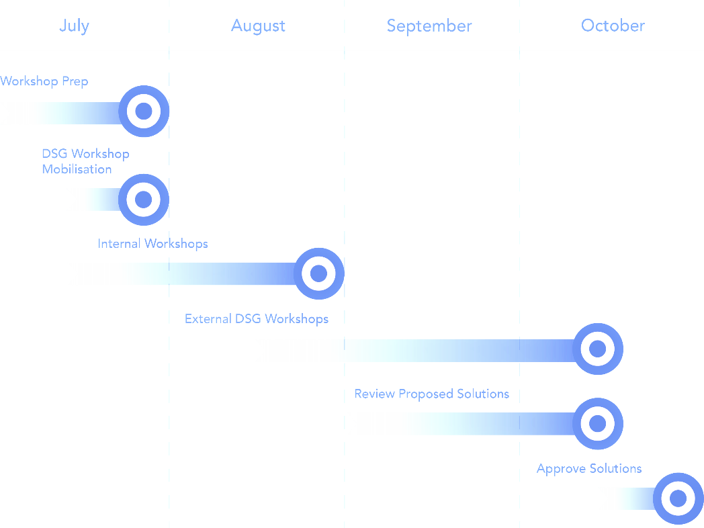
CMS Rebuild Timeline
Timeline and Summary
Further workshops will be required to:
Understand level and complexity of impact to customers
Identification of any consequential impacts
Firm up requirements
The outputs of these workshops will then be used as inputs to the DSG and once the solutions have been chosen these can then feed the Change Pack process
We will be targeting September / October with a preferred solution

Slide 70
Section 6: Any Other Business

Slide 71
APPENDIX

Slide 72
Outages
Outages
Change Request Number | Impacted System | Outage Duration |  |  |  |  | Committee Notified Date
 |  | Start Date | Start Time | End Date | End Time | Brief Description
CHG0031138 | CMS | 17/07/2021 | 00:00 | 17/07/2021 | 07:00 | CMS Disaster Recovery Test 2021 This is an annual activity to confirm CMS (Contact Management Service) services can be migrated to a secondary data centre location should there be a catastrophic failure within the primary data centre. During this phase of the test CMS services will failover from the primary site to the secondary site. NOTE: This activity will run during the normal CMS maintenance window so no extended outage is expected however if we experience issues when the system is released there may be an extended outage until 11:00 as we revert the system back | 09/06/2021
CHG0031138 | CMS | 18/07/2021 | 00:00 | 18/07/2021 | 07:00 | CMS Disaster Recovery Test 2021 During this phase of the test CMS services will failback from the secondary site to the primary site. NOTE: This activity will run during the normal CMS maintenance window so no extended outage is expected however if we experience issues when the system is released there may be an extended outage until 11:00 as we revert the system back | 09/06/2021
CHG0031149 | UKLink | 27/08/2021 | 23:00 | 28/08/2021 | 10:00 | UKLINK Disaster Recovery Test 2021 This is an annual activity to confirm UKLink services can be migrated to a secondary data centre location should there be a catastrophic failure within the primary data centre. During this phase of the test UKLink services will failover from the primary site to the secondary site. | New Outage 07/07/2022
CHG0031149 | UKLink | 28/08/2021 | 23:00 | 29/08/2021 | 07:00 | UKLINK Disaster Recovery Test 2021 During this phase of the test UKLink services will failback from the secondary site to the primary site. | New Outage 07/07/2022

Slide 73
Portfolio POAP

Slide 74
CSSC Programme Dashboard
July 2021

Slide 75
Programme Update
Programme Health – RAG |  |  | Return to Green Plan
Overall Programme Status | Previous | Current | The programme remains at a Green status. As per last month’s update, wider Switching Programme is reporting an Amber-Green status with the Amber portion being related to the planning activities around Transition. We expect this position to remain for at least another couple of months whilst the programme align and agree wider Transition approaches. Ofgem are working through considerations of the Go-live date. This consideration is now moving outside of the initial thought of a Monday Go-live with other days in the week being assessed by Ofgem initially. UEPT continues with no major impacts or defects. Preparation continues for E2E Testing, Transition, Business Change and Service Management activities.
Programme Plan | Previous | Current
Risk Profile | Previous | Current
Resources | Previous | Current
Executive Summary |  |  |  | Upcoming Activities & Milestones (Next Month)
Key Programme Updates To date, all Xoserve key internal and external milestones have been met Transition: Live Rehearsal Cycle 1 continues to plan along with preparations for LR Cycle 2, which is more reflective of Transition. Artefact reviews continue with the Switching Programme, alongside internal workshops. Additionally, discussions are also ongoing with held switch processing approach and Go-live considerations (detailed above) Internal & External Testing: All testing activities are on track. UEPT continues with all the Parties Under Integration. There are no defects against the CSSC programme, at the point of creation of this pack. We have sent confirmation that we are ready to commence “UEPT Tranche 2” for the milestone TE770. Data Migration: Work continues to gather required data to complete the analysis reports for Cycle 5 (non-rel). Business Change: Internal knowledge transfer sessions continue. Target Operating Model activities are on track Service Management: The Xoserve raised a CR to align Service Management Response SLAs has been put on hold until the Service Management requirements clarifications are clarified due to a request from other parties under integration. If this CR is rejected, this will have Operate cost implications which will be included as part of BP22. SoLR: Discussions continue with Ofgem |  |  |  | Live Rehearsal: Continue Cycle 1 Internal Test: Progress CR testing and any relevant regression tests DES:& Secondary APIs Continue development and system test activities. Transition: Continue Live Rehearsal & Transition planning MAP C: Delivery continues to plan, build updates will be provided via Nov 21 updates. REC: Continue REC schedule review as per Ofgem timelines Business Change: Continue awareness and knowledge transfer session

Slide 76
Green Workstream Updates
RAG Previous MONTH | RAG Current MONTH | WORK STREAM | SUMMARY
 |  | DES & Secondary API | Overall Green: Delivery on track for E2E
 |  | Testing | The overall status remains Green. UEPT continues well, at the point of writing this, no significant defects have been seen. Operational Testing with DCC has also commenced and is progressing well, with no defects raised against Xoserve. Preparation continues towards E2E
 |  | Service Management | The Xoserve raised a CR to align Service Management Response SLAs has been put on hold until the Service Management requirements clarifications are clarified due to a request from other parties under integration. If this CR is rejected, this will have Operate cost implications which will be included as part of BP22.
 |  | Batch | The overall status is green, with testing support underway for UEPT/E2E activities
 |  | Gemini | The overall status is green
 |  | Reporting | An internal CR will be raised to incorporate the impact of one newly identified report that will need changes.
 |  | UK Link | Status continues to be Green with work underway to impact assess, deliver and test Switching Programme changes raised through the last few months

Slide 77
Green Workstream Updates
RAG Previous MONTH | RAG Current MONTH | WORK STREAM | SUMMARY
 |  | REC | REC consultation continues with Xoserve actively engaged in relevant RDUG meetings as well as reviewing REC schedules
 |  | Data Migration | Work continues to gather required data to complete the analysis reports for Cycle 5 (non-rel)
 |  | Environments | Workstream continues to be Green with all activities continuing to track to plan for all upcoming activities. Awaiting confirmation from DCC and REC around the need for enduring environments post Go-live
 |  | MAP C (XRN-4780C) | Delivery continues to plan, build updates will be provided via Nov 21 updates. Solution is now agreed for SFTP with internal governance in progress.
 |  | SoLR (XRN-5144) | Discussions continue with Ofgem

Slide 78
Key Programme Risks (1/3)
RTC | RAG | Workstream | Description | Mitigation Strategy | Latest Update | Resolution Date
65352 |  | Transition & Cutover | There is a risk that some transition processes will not be fully tested during transition testing because the SI are undertaking the Transition Test phase as a pure testing phase as opposed to a execution rehearsal where all transition processes are also fully tested leading to the possibility that some processes would be completely new for all parties during transition and subsequently pose a greater risk to Go-live. | Discuss with SI and Ofgem to ensure Transition Testing is undertaken to be as closely reflective of Transition as possible. Where there are differences, the risk needs to be accepted by all parties | This was discussed at SI Transition Group on 15/06. The SI are drafting a CR to remove Test Scenarios, scripts and steps from scope. Discussions are also in progress between SI/DCC to agree evidence gathering mechanisms that will be utilised. We have stressed that these need to be aligned to the Transition framework for the testing to be fully reflective of transition | 16/07/21
65426 |  | Transition & Cutover | There is a risk that the Go Live assumption day of Monday may get changed because various variables (factors) are being looked at by OFGEM leading to rework on Transition plan and related activities. | Internal assessment planned to assess impact of this ask by Ofgem to provide an assessment that covers everything that could impact Xoserve | Internal assessment planned to assess impact of this ask by Ofgem to provide an assessment that covers everything that could impact Xoserve | 18/07/21
55513 |  | Programme | There is a risk that in the Programme participants might interpret business rules differently because business rules underpinning the CSS Interfaces have not been published alongside the interface document as well as discrepancies between business rules defined within REC and captured in ABACUS. Leading to significant process mismatches at a later stage (i.e. SIT, UEPT) and potential rework and timeline slippages. | Xoserve to publish design assumptions as part of the RAID reporting to the SI to ensure visibility of Xoserve design assumptions around business rules and processes. | Continues to be monitored until Tranche 1 of E2E is complete | 01/08/21

Slide 79
Key Programme Risks (2/3)
RTC | RAG | Workstream | Description | Mitigation Strategy | Latest Update | Resolution Date
61894 |  | Service Management | There is a risk that the CSS proposed SLA's do not align to current service model/SLA's because DCC/Ofgem are proposing a new set of SLA's for all parties regardless of existing arrangements, leading to target operating model changes and potential contractual changes with 3rd party suppliers (considerable increase in operational cost) | Our working assumption is that existing SLAs will prevail however, there are ongoing discussions taking place with DCC to understand their expectation. REC review - no such SLA's imposed on us currently. | CRD072 still under discussion. SI/DCC intention is to discuss and close out as part of finalising SM requirements over next two weeks | 30/07/21
65156 |  | Transition & Cutover | There is risk that the change freeze scope could impact Transition because the scope of Programme Change Freeze from 03/01/22 is not clearly defined leading to impacts during actual Transition | Work with the SI to collectively define the scope of Change Freeze | Internal discussions are ongoing within Ofgem to define the scope of this Change Freeze | 26/07/21
64002 |  | Programme | There is a risk that ongoing pipeline of customer driven and regulatory change within the industry could impact the CSSC and wider Switching Programme delivery because of technical conflict with the design of other changes and demand on resources across Xoserve and the customer teams involved in Switching Programme delivery leading to additional regression testing activity, CRs raised to modify solutions already developed and tested by the programme, delays to the overall Switching Programme, and therefore unplanned costs for Xoserve. | 1. Discuss the potential for change moratoria with Ofgem that could restrict the volume of change being made and in particular mitigate some of this risk in relation to coding impacts 2. Investigate the availability of and if necessary invest in tooling to support more enhanced branching and merging in terms of development to mitigate the technical impact of any non-CSSC changes. 3. Work with the SI to monitor for any potential impact on programme resources, including customer resources, that may result from change initiatives running in parallel with critical path Switching Programme phases. | Continues to be monitored, remains a low exposure at this point | 30/06/22
65244 |  | Transition & Cutover | There is a risk that the Xoserve DMLR Cycle 2 schedule will have to be changed at very short notice As the SI as not following the transition runbook for LR testing, and are planning to review / revise the plan as LR Cycle 1 progresses leading to very short notice changes, with potential resource conflicts and additional work to bring transition runbook into line | Request DMLR Cycle 2 stage 1 plan at the end of cycle 1 stage 1 | SI have advised that the cycle 2 Stage 1 schedule will be issued on 18/06. Risk remains as cycle 1 schedule amended with 1 days notice | 25/06/21
55549 |  | Programme | There is a risk that that the approval of the CSS Physical Design does not take into consideration the complete E2E impacts of the Switching Programme because the CSS design is solely focused on the core CSS and primary interactions with CSS. Leading to an inaccurate critical path being followed for the Programme and subsequent downstream delays to the delivery timeline. | 1. Raise with Ofgem to identify owner/RACI 2. E2E CSS design needs to be in place involving all components/systems/interactions which needs to be form the architectural baseline that the Programme is governed against. | Continues to be monitored until Tranche 1 of E2E is complete | 01/08/21

Slide 80
Key Programme Risks (3/3)
RTC | RAG | Workstream | Description | Mitigation Strategy | Latest Update | Resolution Date
64171 |  | Transition and Cutover | There is a risk that the SoLR process might kick off during the transition period because of a supplier going out of business at that time leading to Landmark needing to cater to additional volumes and also the potential for additional requirements for PUIs to undertake to ensure Transition timelines are maintained | Raise the risk with Ofgem and SI to understand what non-functional considerations have been applied to enable Landmark to manage the increased volumes Raise with the SI to include a transition test scenario if relevant to mitigate this possibility | Still awaiting confirmation from the SI that Ofgem have accepted this risk. This risk will be accepted once this is formally confirmed | 30/07/21
65122 |  | Transition and Cutover | There is risk that additional Transitional changes could change scope of Transition because more changes are identified as Transition planning continues at the Central programme level leading to changes to the Transition plan and Xoserve planned activities. | Xoserve are actively involved in all programme work groups to monitor and mitigate this risk. | The probability of this risk has been reduced. Recon CR is being IA'ed, the CR itself is not impacting Transition activites, however testing considerations need to be understood and assessed | 26/07/21
64513 |  | Data | There is a risk that data cleansing requirements may not be met because Xoserve are not responsible for the data in UK Link, and can't compel shippers / GTs / iGTs to correct their data leading to incorrect data at the point of go live. | Communicate requirements through DSG and track progress | No update on the data cleansing. However have this week challenged CR-D083 - new assumption NCA476 that data providers will be responsible for cleansing any data issues found during transition - as this responsibility is with data owners not data providers | 30/12/22
65176 |  | Transition and Cutover | There is a risk that the Runbook may not be properly tested because schedules to be used across test phases (DM LR / Transition testing) are being developed seperately leading to potential for discrepancies and for insights from one activity being missed by the other | Liaise with the SI to ensure that all plans are aligned. Request early sight of plans to ensure adequate review in advance | Awaiting DM LR plans to compare against the latest issued Transition Test schedule | 01/03/22
65157 |  | Transition & Cutover | There is risk that the catch up processing could impact transition timelines because the catch up processing is not being exercised/rehearsed during Central Programme Transition Testing leading to impacts during actual Transition. | Work with the SI to assess if this activity can be tested in advance of Transition | This was discussed at the SI Transition Group on 16/06. The current expectation is that the approach will be landed in August, which still carries the risk that the held switch processing will not be tested during Transition and was raised by Xoserve at the call | 26/07/21

Slide 81
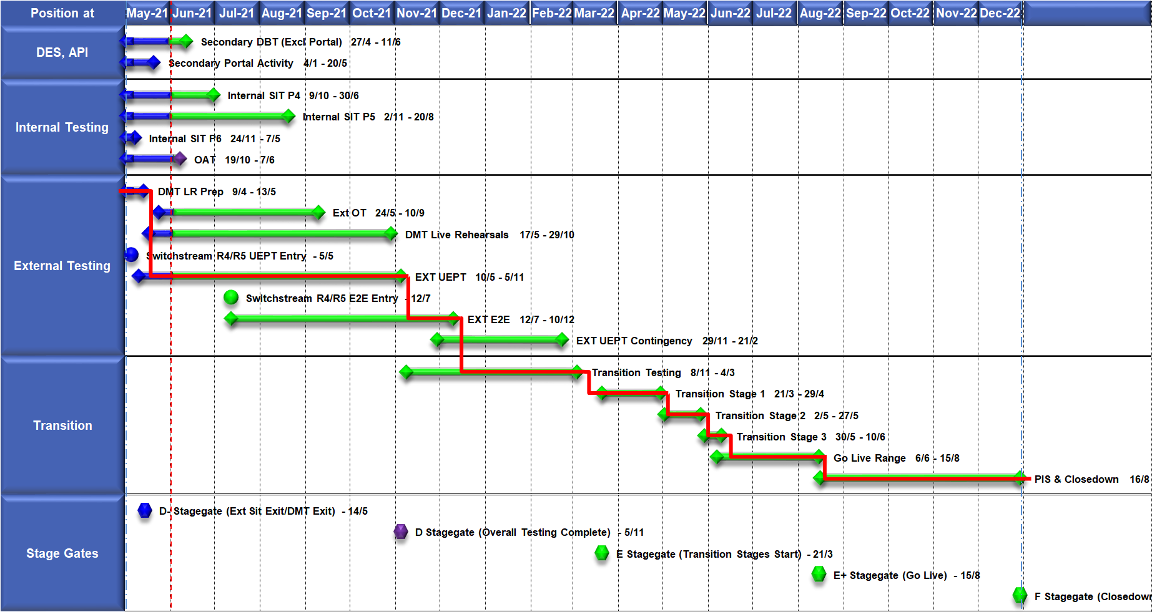
High Level Plan

Slide 82
Switching Programme CR Position – CRs impacting Xoserve
CR Name | CR Ref | High Level Cost IA Cost | Date Raised | Status
Programme Plan Re-Baseline | CR-D002 | £0.00 | 07/11/2019 | Approved - Complete
Updates to the CSS Physical Interface Design (PhID). | CR-D008 | £17,250.00 | 22/01/2020 | Approved - Internal CR Created
CSS_Exception_Handling_Strategy_v0.2 | CR-D014 | £0.00 | 26/02/2020 | Approved - Internal CR Created
Provide_CSS_RegistrationID_to_PUI_and_LPs | CR-D016 | £12,643.00 | 07/08/2020 | Approved - Internal CR Created
Licence Exempt Network Customer Identifier – ABACUS Data Model update | CR-E51 | £0.00 | 29/10/2019 | Approved - Complete
Amendments to the DMS artefact suite | CR-D019 | £6,500.00 | 16/03/2020 | Approved - Internal CR Created
Migration of Terminated Gas RMPS | CR-D022 | £0.00 | 10/06/2020 | Approved - Internal CR Created
Amendments to the NC-0079 for REL (Retail Energy Location) Data Migration and Reconciliation | CR-D024 | £20,000.00 | 06/07/2020 | Approved - Internal CR Created
DMS - PHID Alignment Parties | CR-D026 | £0.00 | 06/07/2020 | Approved - Internal CR Created
Request For a New or Upgraded DMT Environment | CR-D027 | £256,009.00 | 07/08/2020 | Approved - Internal CR Created
Enable TLS connection pooling for all directly connected parties to CSS] | CR-D028 | £2,500.00 | 13/07/2020 | Approved - Internal CR Created
Message Header Format for PKI Certificate Identification] | CR-D029 | £2,500.00 | 13/07/2020 | Approved - Internal CR Created
SIT Functional Test Re Plan Enabling Parallel Testing | CR-D030 | £56,000.00 | 20/07/2020 | Approved - Internal CR Created
DM_Validation Catalogue_Shipper_Effective_Date_Change_ | CR-D032 | £0.00 | 03/08/2020 | Approved - Internal CR Created
Compression During Data Migration | CR-D034 | £500.00 | 09/09/2020 | Approved - Internal CR Created
Uplift to the CSS Interface Specifications | CR-D038 | £70,000.00 | 07/10/2020 | Approved - Internal CR Created
Uplift to Business Data Validation Rules | CR-D039 | £20,000.00 | 25/09/2020 | Approved - Internal CR Created
Programme Plan Re-Baseline | CR-D042 | £14,913,000.00 | 28/09/2020 | Approved - Internal CR Created
Operational Choreography Detection 0.5 | CR-D060 | £308,205.00 | 25/01/2021 | Awaiting Decision
Operational Choreography Rectification 0.3 | CR-D061 | £0.00 | 25/01/2021 | Awaiting Decision
Amendment of Data Migration Solution to Protect Programme Timescales - Removal of Transition Stage 1 Delta files | CR-D062 | £83,490.00 | 25/02/2021 | Approved - Internal CR Created
Change to Management of In-Flight Switches Approach | CR-D071 | £0.00 | 15/03/2021 | Approved - Internal CR Created
Amend the Transition Testing Milestones TR210 & TR220 for PUI Production Data Cuts v0.4 | CR-D078 | £0.00 | 14/05/2021 | Awaiting Decision
Increase Cadence of Data cuts | CR-D080 | £24,600.00 | 10/05/2021 | Awaiting Decision
Amendment to Assumptions as a result of analysis undertaken during CP1 v0.4] | CR-D083 | £0.00 | 24/05/2021 | Awaiting Decision
Request for an additional Data Reconciliation Activity at the end of DMT Live Rehearsal Cycle 2 v0.2 | CR-D086 | £76,000.00 | 01/06/2021 | Awaiting Decision
Update to UIT E2E Plan and Artefacts to incorporate the additional scope identified on the outcome of REL Gap Analysis v0.7 | CR-D087 | £0.00 | 17/06/2021 | Pending PIA

Slide 83
Switching Programme CR Position – CRs not impacting Xoserve
CR Name | CR Ref | Date Raised | Status
Non_Mandatory_MPAS_Metered_Indicator_v0.4 | CR-D001 | 27/01/2020 | Complete - No Xoserve Impact
REC Manager Procurement Timelines | CR-D003 | 02/12/2019 | Complete - No Xoserve Impact
MPAS Related MPAN Disconnection | CR-D004 |  | Withdrawn
Introduction of Validation Message to Logical Mode | CR-D005 | 25/11/2019 | Withdrawn
Modification of Related MPAN Cleanse Checkpoint Milestones | CR-D006 | 27/11/2019 | Complete - No Xoserve Impact
ABACUS Corrections and Re-alignments | CR-D007 | 04/12/2019 | Complete - No Xoserve Impact
ECOES REL API Webmethod | CR-D009 | 17/12/2019 | Complete - No Xoserve Impact
CSSIA Uplift to Implement IG Recommendations | CR-D010 | 17/12/2019 | Complete - No Xoserve Impact
Update 3 E2Es to align to CSSIA | CR-D011 | 10/06/2020 | Complete - No Xoserve Impact
CSS_Physical_Interface_Design_Updates_mpxn_v0.2 | CR-D012 | 30/01/2020 | Complete - No Xoserve Impact
Messaging_Requirements_Revisions_REC_Code_Manager_and_CSS_v0.1 Clean | CR-D013 | 28/01/2020 | Complete - No Xoserve Impact
Amendment_of_Xoserve_Consequential_Change_Milestone_Delivery_Dates_v0.2[DRAFT] | CR-D015 | 26/02/2020 | Withdrawn
CSS_Handling_of_MPAS_Business_Dates_v0.2[DRAFT] | CR-D017 | 20/07/2020 | Complete - No Xoserve Impact
Confirmation_Responses_to_Outbound_Synchronisations_v0.2[DRAFT] | CR-D018 | 02/03/2020 | Withdrawn
Regulatory Workstream – Programme Milestones Refresh | CR-D020 | 16/03/2020 | Withdrawn
Remove MPAS Interface | CR-D021 | 29/04/2020 | Withdrawn
DSP_Specific_ SIT_ Functional_Exit_Criteria | CR-D023 | 29/05/2020 | Complete - No Xoserve Impact
Changes to support enhanced Solar arrangements | CR-D025 |  | Withdrawn
CSS Role-based access control (RBAC) | CR-D031 | 24/07/2020 | Withdrawn
A Quality Analysis Activity of the Data being used for the DMT Non-Functional Test Phase​​ | CR-D033 |  | Withdrawn
CSS Change from UTC to Local Time | CR-D035 | 22/09/2020 | Complete - No Xoserve Impact
Xoserve CR for DES AI Removal | CR-D036 | 24/09/2020 | Complete - No Xoserve Impact
Provide_CSS_RegistrationID_to_LPs | CR-D037 | 06/10/2020 | Complete - No Xoserve Impact
UEPT Tranche Regulatory Change | CR-D040 | N/A | Complete - No Xoserve Impact
NCT-0073 Functional Script Master Changes | CR-D041 | 25/09/2020 | Complete - No Xoserve Impact
Update to the End to End Testing Plan | CR-D043 | 05/10/2020 | Complete - No Xoserve Impact
Request For a New DMT Environment for DMT Live Rehearsal | CR-D044 | 23/10/2020 | Complete - No Xoserve Impact
NC-0079 Adding Post Load Integrity Check Document | CR-D045 | 09/11/2020 | Complete - No Xoserve Impact
Uplift to the Code of Connection | CR-0046 | 09/11/2020 | Complete - No Xoserve Impact
Correctional Changes to MAD Log v2.0 & POAP v2.0 | CR-D047 | 13/11/2020 | Complete - No Xoserve Impact
Changes to Data Milestones in MAD Log v2.0 & POAP v2.0 | CR-D048 | 09/11/2020 | Complete - No Xoserve Impact
Consequential Changes to Testing Milestones in MAD Log | CR-D049 | 13/11/2020 | Withdrawn
CSS Environments for Faster Switching Enduring Service | CR-D050 |  | Withdrawn
Changes to Data Validation Rules | CR-D051 | 30/11/2020 | Complete - No Xoserve Impact

Slide 84
Switching Programme CR Position – CRs not impacting Xoserve
CR Name | CR Ref | Date Raised | Status
Non_Mandatory_MPAS_Metered_Indicator_v0.4 | CR-D001 | 27/01/2020 | Complete - No Xoserve Impact
REC Manager Procurement Timelines | CR-D003 | 02/12/2019 | Complete - No Xoserve Impact
MPAS Related MPAN Disconnection | CR-D004 |  | Withdrawn
Introduction of Validation Message to Logical Mode | CR-D005 | 25/11/2019 | Withdrawn
Modification of Related MPAN Cleanse Checkpoint Milestones | CR-D006 | 27/11/2019 | Complete - No Xoserve Impact
ABACUS Corrections and Re-alignments | CR-D007 | 04/12/2019 | Complete - No Xoserve Impact
ECOES REL API Webmethod | CR-D009 | 17/12/2019 | Complete - No Xoserve Impact
CSSIA Uplift to Implement IG Recommendations | CR-D010 | 17/12/2019 | Complete - No Xoserve Impact
Update 3 E2Es to align to CSSIA | CR-D011 | 10/06/2020 | Complete - No Xoserve Impact
CSS_Physical_Interface_Design_Updates_mpxn_v0.2 | CR-D012 | 30/01/2020 | Complete - No Xoserve Impact
Messaging_Requirements_Revisions_REC_Code_Manager_and_CSS_v0.1 Clean | CR-D013 | 28/01/2020 | Complete - No Xoserve Impact
Amendment_of_Xoserve_Consequential_Change_Milestone_Delivery_Dates_v0.2[DRAFT] | CR-D015 | 26/02/2020 | Withdrawn
CSS_Handling_of_MPAS_Business_Dates_v0.2[DRAFT] | CR-D017 | 20/07/2020 | Complete - No Xoserve Impact
Confirmation_Responses_to_Outbound_Synchronisations_v0.2[DRAFT] | CR-D018 | 02/03/2020 | Withdrawn
Regulatory Workstream – Programme Milestones Refresh | CR-D020 | 16/03/2020 | Withdrawn
Remove MPAS Interface | CR-D021 | 29/04/2020 | Withdrawn
DSP_Specific_ SIT_ Functional_Exit_Criteria | CR-D023 | 29/05/2020 | Complete - No Xoserve Impact
Changes to support enhanced Solar arrangements | CR-D025 |  | Withdrawn
CSS Role-based access control (RBAC) | CR-D031 | 24/07/2020 | Withdrawn
A Quality Analysis Activity of the Data being used for the DMT Non-Functional Test Phase​​ | CR-D033 |  | Withdrawn
CSS Change from UTC to Local Time | CR-D035 | 22/09/2020 | Complete - No Xoserve Impact
Xoserve CR for DES AI Removal | CR-D036 | 24/09/2020 | Complete - No Xoserve Impact
Provide_CSS_RegistrationID_to_LPs | CR-D037 | 06/10/2020 | Complete - No Xoserve Impact
UEPT Tranche Regulatory Change | CR-D040 | N/A | Complete - No Xoserve Impact
NCT-0073 Functional Script Master Changes | CR-D041 | 25/09/2020 | Complete - No Xoserve Impact
Update to the End to End Testing Plan | CR-D043 | 05/10/2020 | Complete - No Xoserve Impact
Request For a New DMT Environment for DMT Live Rehearsal | CR-D044 | 23/10/2020 | Complete - No Xoserve Impact
NC-0079 Adding Post Load Integrity Check Document | CR-D045 | 09/11/2020 | Complete - No Xoserve Impact
Uplift to the Code of Connection | CR-0046 | 09/11/2020 | Complete - No Xoserve Impact
Correctional Changes to MAD Log v2.0 & POAP v2.0 | CR-D047 | 13/11/2020 | Complete - No Xoserve Impact
Changes to Data Milestones in MAD Log v2.0 & POAP v2.0 | CR-D048 | 09/11/2020 | Complete - No Xoserve Impact
Consequential Changes to Testing Milestones in MAD Log | CR-D049 | 13/11/2020 | Withdrawn
CSS Environments for Faster Switching Enduring Service | CR-D050 |  | Withdrawn
Changes to Data Validation Rules | CR-D051 | 30/11/2020 | Complete - No Xoserve Impact

